Slide 1


DAYANANDA SAGAR UNIVERSITY
SCHOOL OF ENGINEERING
Department of Computer Science and Engineering
Minor project Review 1
RIDERLINK: OFFLINE MESH NETWORKING & TELEMETRY SYSTEM FOR MOTORCYCLES
Under the Supervision
Dr./Prof. <Guide Name>
<Designation of Guide>
1
Presented By:
Ashwin & Team
Minor project Review 1
Notes:
Title of the project
CSE Dept., SET-Jain University
1

Slide 2
Overview
Abstract
Problem Statement
Introduction
Social/Environmental Impact (If applicable)
State of the Art work (Literature survey)
Functional Requirements
Non-Functional Requirements
System/Software Requirements
Design
Methodology
References
*
Dept of CSE., SOE-Dayananda Sagar University
2 of 12

Slide 3
Abstract
RiderLink is an advanced motorcycle telemetry and safety system leveraging ESP32-based LoRa mesh networking and Flutter. It addresses the critical issue of cellular black-spots during group rides by providing off-grid GPS tracking, automatic crash detection via IMU sensors, and peer-to-peer hazard broadcasting. The system includes an Android app for navigation and a digital garage for maintenance tracking.
*
Dept of CSE., SOE-Dayananda Sagar University
3 of 12

Slide 4
Problem Statement
- Motorcycle riders frequently travel through remote areas lacking cellular coverage, making group coordination and emergency responses difficult.
- Existing navigation apps rely heavily on constant active internet connections.
- Current SOS systems are expensive, subscription-based, or lack automated vehicle-telemetry crash detection.
*
Dept of CSE., SOE-Dayananda Sagar University
4 of 12

Slide 5
Introduction
Current Status: Base Flutter UI, SQLite Database, and off-grid LoRa mesh logic implemented.
Plan: Finalize hardware integration with ESP32 sensors.
Scope: Real-time lean angle telemetry, Waze-style hazard reporting over LoRa, offline map routing, and group proximity alerts.
Assumptions: Riders will equip their bikes with the RiderLink ESP32 hardware module.
*
Dept of CSE., SOE-Dayananda Sagar University
5 of 12

Slide 6
Social/Environmental Impact
- Significantly reduces emergency response times for motorcycle accidents in remote areas via mesh-routed SOS beacons.
- Encourages safer riding habits through live lean-angle and G-force telemetry feedback.
- Promotes environmental awareness by integrating weather alerts and efficient curvy-route generation.
*
Dept of CSE., SOE-Dayananda Sagar University
6 of 12

Slide 7
State of the Art-work
1. Traditional cellular GPS trackers (cannot operate fully off-grid).
2. Garmin inReach (expensive satellite subscription required).
3. Standard mesh intercoms (Cardo/Sena) lack map-visualized GPS coordinates.
RiderLink bridges this gap by unifying free LoRa hardware with a rich smartphone UI.
Author’s Name/ Paper Title | Conference/Journal Name and year | Technology/ Design | Results shared by author | What you infer
Jiang Hongyu et al. "Genre-based Emoji Usage Analysis and Prediction in Video Comments." [2] | IEEE International Symposium on Dependable, Autonomic and Secure Computing 2020 | Gated Recurrent Unit(GRU) Neural Networks. | To predict an emojis category and position in the video comments. | Categorize the emojis to achieve the high accuracy and recommend the suitable emoji for the context.
*
Dept of CSE., SOE-Dayananda Sagar University
7 of 12

Slide 8
Design
- Frontend: Flutter (Dart) for Android/iOS.
- Backend/Hardware: ESP32 microcontroller with standard LoRa SX1278 transceiver.
- Mapping: 'flutter_map' with offline Tile Layer support.
- Database: SQLite (sqflite) for localized GPX route logging and maintenance tracking.
- Protocol: Custom binary lightweight BLE mesh protocol.
*
Dept of CSE., SOE-Dayananda Sagar University
8 of 12

Slide 9
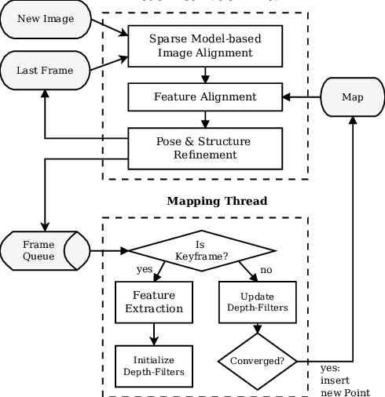
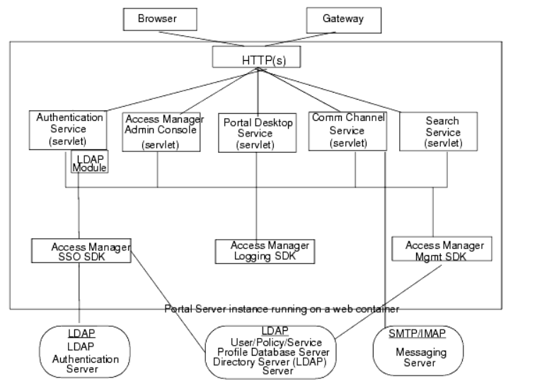
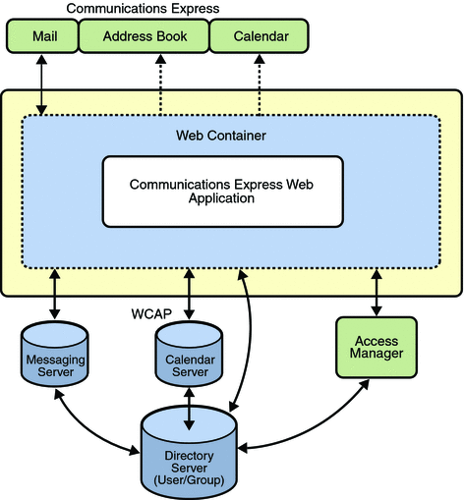
Design- few examples
*
Dept of CSE., SOE-Dayananda Sagar University
9 of 12

Slide 10
Methodology
1. Hardware Assembly: ESP32 + LoRa + GPS + MPU6050 IMU.
2. Firmware: C++ FreeRTOS tasks to handle high-frequency sensor fusion and LoRa interrupts.
3. BLE Bridge: Flutter app acts as a central Bluetooth client, parsing custom characteristic payloads.
4. UI Mapping: Layered state management (GetX) to render moving map markers and pop emergency Modals instantly.
*
10 of 12
Dept of CSE., SOE-Dayananda Sagar University

Slide 11
References
[1] Augustin, A., et al., "A study of LoRa: Long Range & Low Power Networks for the IoT," Sensors, 2016.
[2] Flutter API Documentation, flutter.dev
[3] Espressif ESP32 Datasheet and Hardware Reference Manual.
*
Dept of CSE., SOE-Dayananda Sagar University
11 of 12

Slide 12
THANK YOU
*
Dept of CSE., SOE-Dayananda Sagar University
(#) of 12

