Slide 1
eCos kernel seminar
Konkuk University, Seoul, Korea
Nodir Kodirov
nodir.qodirov@gmail.com
November 18, 2011

Slide 2
Content
eCos general
eCos kernel
  Detailed HAL execution
  HAL to kernel transition
  Kernel to application transition
How to make changes in eCos kernel
  Case study
    eCos TCB (Task Control Block)
    adding new scheduler
eCos highlights
  Main advantage of the eCos

Slide 3
eCos general

Slide 4
Components
Hardware Abstraction Layer (HAL) – providing a software layer that gives general access to the hardware;
Kernel – including interrupt and exception handling, thread and synchronization support, a choice of scheduler implementations, timers, counters, and alarms;
ISO C and math libraries – standard compatibility with function calls;
Device drivers – including standard serial, Ethernet, Flash ROM, and others;
GNU debugger (GDB) support – provides target software for communicating with a GDB host enabling application debugging;
  Note: both eCos and the application run in supervisor mode, there is no division between user and kernel mode;

Slide 5
Architecture overview
eCos Layered Software Architecture
Application
eCos repository
Libraries
Compatibility
Web
Server
Math
C
POSIX
μITRON
Kernel
Networking Stack
File System
Target independent
Target specific
RedBoot
ROM
Monitor
HAL
Device Drivers
Interrupts
Exceptions
Vectors
Flash
Serial
Ethernet
Target Hardware

Slide 6
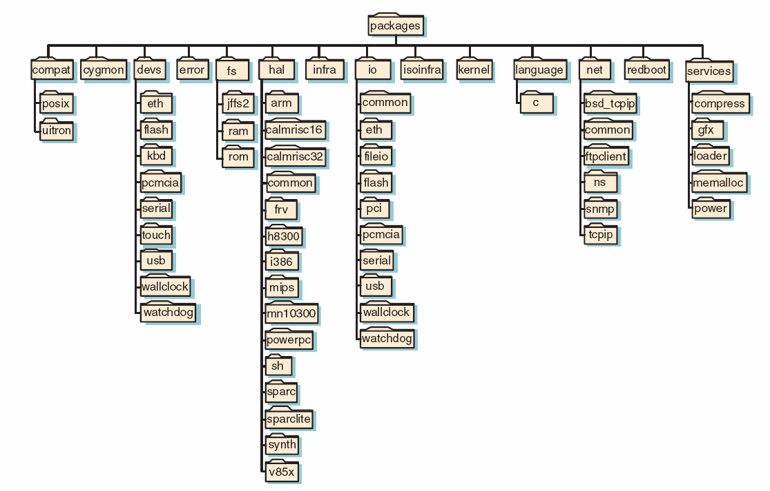
Packages
Package is a type of components that is ready for distribution;
source code files, header files, configuration description files, documentation,
and other relevant files;

Slide 7
The Kernel

Slide 8
The Kernel
The kernel – being core of the eCos system, provides the standard functionality expected in an RTOS:
  Interrupt and exception handling;
  Scheduling;
  Threads;
  Synchronization;
These standard functional components are fully configurable under the eCos system to meet specific needs;
The eCos kernel is implemented in C++ allowing applications implemented in C++ to interface directly to the kernel;
There is no official C++ API provided, but there is C kernel API configuration option which can be enabled;
The eCos kernel also supports interfacing to standard µITRON and POSIX compatibility layers;

Slide 9
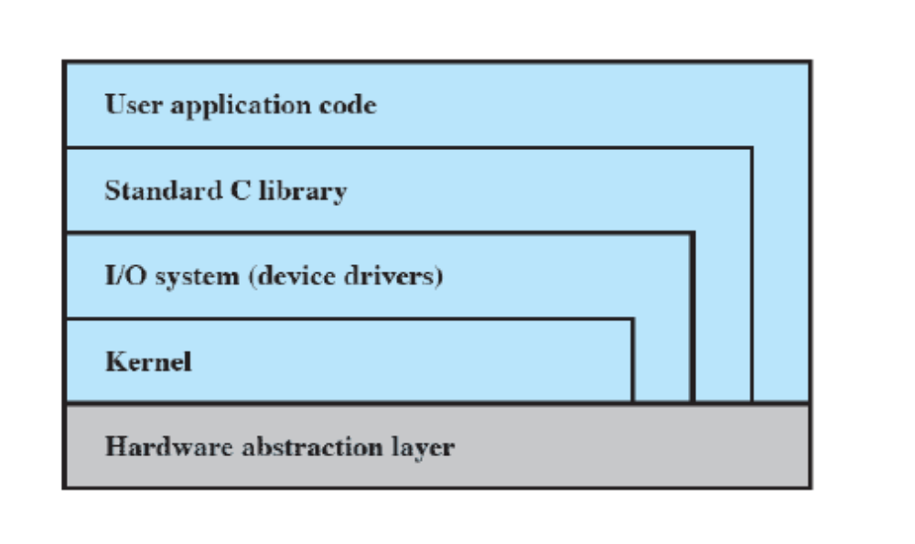
Kernel layered structure
Low interrupt latency – short time for ISR;
Low task switching latency – in DSR intrts are enabled;
Small memory footprint – packages are configurable;
Deterministic behavior – kernel operations are predictable;
eCos layered structure
Not in eCos Kernel:
  Memory allocation – mainly done in configuration tool;
  Device driver – at I/O subsystem;

Slide 10




eCos execution steps
Power up/reset
HAL
Kernel
Application

Slide 11
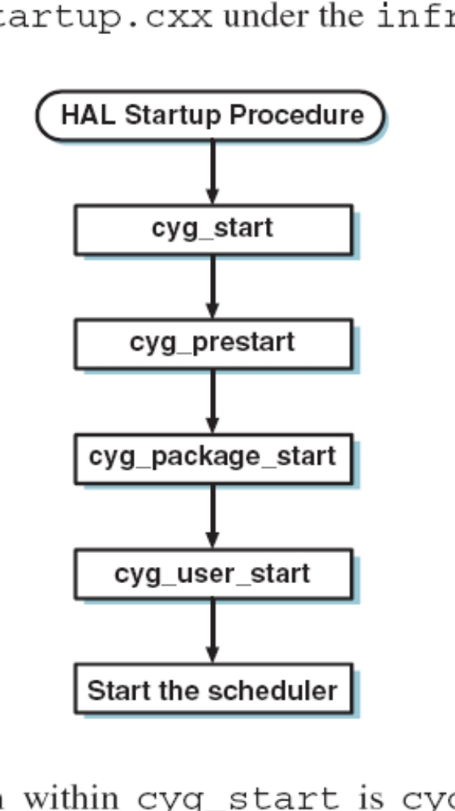
Kernel startup

Slide 12
HAL – startup procedure
Hardware powerup
All routines are implemented in either assembly language or C
reset_vector
Performs the minimum processor register configuration;
Main starting point for all HAL initialization;
Setting processor specific registers – disabling instructions, data caches…
Performing h/w init – conf. chip select regs, setting real time clock…
Reserve memory to save processor state information in an interrupt occur;
Ensure that default exception handlers are installed for every exception;
Clear BSS section to store noninitialized variables;
Prepare stack so that C functions can be called;
Initialize virtual vector table, based on configuration;
Init memory mngt unit – translation of logical address to physical address;
Enable data and instruction caches;
Set up Communications Processor Unit – accepts internal & external intpts;
Handle the generation of the list of global constructors;
In debug environment – prepare hardware to debug;
_start
hal_cpu_init
hal_hardware_init
Setup interrupt stack
hal_mon_init
Clear bss section
Setup C function call stack
hal_platform_init
hal_MMU_init
hal_enable_caches
hal_IRQ_init
cyg_hal_invoke_constructors
initialize_stub
cyg_start On to kernel startup...

Slide 13
_start
Zero the BSS
cyg_start
hal_cpu_init
Copy the data section out to the RAM
cyg_prestart
hal_smp_init
hal_variant_init
cyg_package_start
hal_diag_init
hal_platform_init
cyg_user_start
KERNEL
hal_mmu_init
hal_pcmb_init
H
A
L
Cyg_Scheduler::start()
hal_memc_init
ISR & VSR table setup
CYG_KERNEL_CPU_START
hal_intc_init
HAL_CLOCK_INITIALIZE
start_cpu
hal_cache_init
hal_if_init
intr->set_cpu
hal_timer_init
cyg_hal_smp_init
scheduler.schedule()
hal_idt_init
initialize_stub
clear_need_reschedule
hal_mon_init
cyg_hal_smp_cpu_start_all
set_current_thread
hal_fpu_init
breakpoint
HAL_THREAD_LOAD_CONTEXT

Slide 14
Detailed illustration of
HAL-to-Kernel init process flow
As whole code does not fit to our slides,
we use this form
Where this instruction is
Functionality
Called from - File path
Implemented in - File path
comment

Slide 15
_start
packages\hal\i386\arch\current\src\vectors.S
packages\hal\i386\arch\current\src\vectors.S
First startup point after reset
hal_cpu_init
packages\hal\i386\arch\current\src\vectors.S
packages\hal\i386\arch\current\include\platform.inc
Set up our own GDT and IDT, reload the segment
registers and proceed
hal_smp_init
packages\hal\i386\arch\current\src\vectors.S
packages\hal\i386\arch\current\include\arch.inc
Initialize SMP specific processor registers
(if support for SMP exists)
hal_diag_init
packages\hal\i386\arch\current\src\vectors.S
packages\hal\i386\arch\current\include\arch.inc
Diagnostics macros.
Macros is only defined, no implementation

Slide 16
hal_mmu_init
packages\hal\i386\arch\current\src\vectors.S
packages\hal\i386\arch\current\include\arch.inc
MMU (Memory Management Unit) macros.
Macros is only defined, no implementation
hal_memc_init
packages\hal\i386\arch\current\src\vectors.S
packages\hal\i386\arch\current\include\arch.inc
Simply enables the A20 gate.
hal_intc_init
packages\hal\i386\arch\current\src\vectors.S
packages\hal\i386\pcmb\current\include\pcmb.inc
Interrupt controller support
hal_cache_init
packages\hal\i386\arch\current\src\vectors.S
packages\hal\i386\arch\current\include\arch.inc
Cache macros
Macros is only defined, no implementation

Slide 17
hal_timer_init
packages\hal\i386\arch\current\src\vectors.S
packages\hal\i386\arch\current\include\arch.inc
Timer initialization.
Macros is only defined, no implementation.
Usually to implement it in later steps.
hal_idt_init
packages\hal\i386\arch\current\src\vectors.S
packages\hal\i386\arch\current\include\platform.inc
IDT (Interrupt Description Table) initialization.
hal_mon_init
packages\hal\i386\arch\current\src\vectors.S
packages\hal\i386\arch\current\include\arch.inc
Monitor initialization.
Macros is only defined, no implementation.
Usually to implement it in later steps.
hal_fpu_init
packages\hal\i386\arch\current\src\vectors.S
packages\hal\i386\arch\current\include\arch.inc
FPU (Floating Point Unit) macros.
Tell the CPU to use the math hardware, in any.

Slide 18
Zero the BSS
packages\hal\i386\arch\current\src\vectors.S
packages\hal\i386\arch\current\src\vectors.S
Zero the BSS (Block Started by Symbol).
Where local static variables initialized zero value.
Copy the data section
out to the RAM
packages\hal\i386\arch\current\src\vectors.S
packages\hal\i386\arch\current\src\vectors.S
In a ROM booted system, we also need to
copy the data section out to the RAM
hal_variant_init
packages\hal\i386\arch\current\src\vectors.S
packages\hal\i386\generic\current\src\var_misc.c
Function is implemented with an empty body.
Means most works will be done in platform init.
eCos HAL: Architecture->Variant->Platform
hal_platform_init
packages\hal\i386\arch\current\src\vectors.S
packages\hal\i386\pc\current\src\plf_misc.c
Re-enable CACHE and DCACHE.

Slide 19
hal_pcmb_init
packages\hal\i386\pc\current\src\plf_misc.c
packages\hal\i386\pcmb\current\src\pcmb_misc.c
Motherboard init function.
Currently does not do anything.
ISR & VSR table setup
packages\hal\i386\pc\current\src\plf_misc.c
packages\hal\i386\pc\current\src\plf_misc.c
Plant the default ISR in all interrupt handlers
and the default interrupt VSR
in the equivalent VSR table slots.
HAL_CLOCK_INITIALIZE
packages\hal\i386\pc\current\src\plf_misc.c
…\hal\i386\pcmb\current\include\pcmb_intr.h
Start the timer device running if we are
in a RedBoot configuration.
hal_pc_clock_initialize
hal\i386\pcmb\current\include\pcmb_intr.h
packages\hal\i386\pcmb\current\src\pcmb_misc.c
Start the timer device running if we are
in a RedBoot configuration.

Slide 20
hal_if_init
packages\hal\i386\pc\current\src\plf_misc.c
packages\hal\common\current\src\hal_if.c
ROM/RAM interfacing functions (if).
Setup debug channels, NOP functions
to all hal_virtual_vector_tables.
cyg_hal_smp_init
packages\hal\i386\pc\current\src\plf_misc.c
packages\hal\i386\pcmb\current\src\pcmb_smp.c
Check SMP features to be exists.
Initialize SMP if it is there.
initialize_stub
packages\hal\i386\arch\current\src\vectors.S
packages\hal\common\current\src\generic-stub.c
Initializes GDB stub support.
Used to debug application in source code level.
cyg_hal_invoke_constructors
packages\hal\i386\arch\current\src\vectors.S
hal\i386\arch\current\src\hal_misc.c
Invokes/initializes all
C/C++ class constructors stored in the list.

Slide 21
cyg_hal_smp_cpu_start_all
packages\hal\i386\arch\current\src\vectors.S
packages\hal\i386\pcmb\current\src\pcmb_smp.c
If system is SMP, start all CPUs.
breakpoint
packages\hal\i386\arch\current\src\vectors.S
packages\hal\common\current\src\hal_stub.c
Red line means last call from current block/routine
Used at the start of a program
to sync with debugger.
So debugger is able to track our system/application.
cyg_start
packages\hal\i386\arch\current\src\vectors.S
packages\infra\current\src\startup.cxx
HAL to kernel transition function.
cyg_prestart
packages\infra\current\src\startup.cxx
packages\infra\current\src\prestart.cxx
The 1st thing called after the HAL init and before
package init. User overrides it to make own
pre-package init. Currently empty function.

Slide 22
cyg_package_start
packages\infra\current\src\startup.cxx
packages\infra\current\src\pkgstart.cxx
Inits compability packages (e.g. mITRON)
before application initialization.
cyg_user_start
packages\infra\current\src\startup.cxx
packages\infra\current\src\userstart.cxx
main() function for application.
Scheduler will be called next by itself.
Currently method does not do anything.
Cyg_Scheduler::start()
packages\infra\current\src\startup.cxx
packages\kernel\current\src\sched\sched.cxx
Start function of eCos scheduler
CYG_KERNEL_CPU_START
packages\kernel\current\src\sched\sched.cxx
packages\kernel\current\include\smp.hxx
Start all CPUs if there is support for SMP.

Slide 23
start_cpu
packages\kernel\current\src\sched\sched.cxx
packages\kernel\current\src\sched\sched.cxx
Start scheduling on this CPU. Called on each CPU
in the system when it is started.
intr->set_cpu
packages\kernel\current\src\sched\sched.cxx
packages\kernel\current\src\sched\sched.cxx
If there is support for SMP then
set up the inter-CPU interrupt for this CPU
scheduler.schedule()
packages\kernel\current\src\sched\sched.cxx
packages\kernel\current\src\sched\bitmap.cxx
In bitmap scheduling threads put the array
and highest index is high priority thread to run.
clear_need_reschedule
packages\kernel\current\src\sched\sched.cxx
packages\kernel\current\include\sched.hxx
As we have just got our thread from scheduler
we should clear this variable, for others to set later

Slide 24
set_current_thread
packages\kernel\current\src\sched\sched.cxx
packages\kernel\current\include\sched.hxx
Set thread returned from scheduler in the
current_thread global variable.
HAL_THREAD_LOAD_CONTEXT
packages\kernel\current\src\sched\sched.cxx
packages\hal\i386\arch\current\include\hal_arch.h
Load current thread context to the CPU
and run it!!!
Further world run by defined configuration
at scheduler/timer/interrupt …

Slide 25
eCos scheduler
Case study:
eCos TCB
adding new scheduler to eCos kernel

Slide 26
Linked list of threads
Thread Control Block
Cyg_Thread
.
.
.
.
.
.
.
.
.
.
Cyg_Thread
.
.
.
.
.
.
.
.
.
.
Cyg_Thread
.
.
.
.
.
.
.
.
.
.
Static member of Cyg_Thread class.
We can always get last created thread referring to this.
original_priority
original_priority
original_priority
list_next
list_next
list_next
unique_id
unique_id
unique_id
thread_list

Slide 27
Structure of eCos thread as control block
Cyg_Thread
Cyg_HardwareThread
Cyg_SchedThread
Cyg_HardwareThread
Cyg_Thread
cyg_uint32 stack_base
Pointer to base of stack area, user defined
cyg_uint32 stack_size
Size of stack area in bytes
Thread states:
RUNNING=0,
SLEEPING=1,
COUNTSLEEP=2,
SUSPENDED=4,
CREATING=8,
EXITED = 16,
cyg_uint32 stack_ptr
Pointer to saved state on stack
void *entry_point
Main entry point (code pointer!)
cyg_uint32 entry_data
Entry point argument
Cyg_SchedThread
Cyg_ThreadQueue *queue
Queue of threads
cyg_count32 original_priority
Our original priority before priority inversion protocol
cyg_bool priority_inherited
Boolean indication of do we inherited priority

Slide 28
Structure of eCos thread as control block (2)
cyg_uint32 state
Current thread state, a logical OR of the above values.
Only if this word is zero can the thread execute.
cyg_ucount32 suspend_count
Suspension counter, if > 0, the thread is suspended
cyg_ucount32 wakeup_count
Wakeup counter, if > 0, sleep will not sleep, just decrement
A word of data used in synchronization object to communicate information between sleepers and wakers
cyg_uint32 wait_info
cyg_uint16 unique_id
Unique thread id assigned on creation
enum {
NONE,
WAIT,
DELAY,
TIMEOUT,
BREAK,
DESTRUCT,
EXIT,
DONE
}
cyg_reason sleep_reason
Reason for sleeping of this thread
Reason for waking
cyg_reason wake_reason
An optional thread name string, for humans to read
char *name
Pointer to the next extant thread in the system
Cyg_Thread *list_next
Static member of the Cyg_Thread class,
always points to the last created thread
Cyg_Thread *thread_list
All threads assigned unique id automatically.
This value is incremented in every new thread creation time.
cyg_uint16 next_unique_id

Slide 29
Kernel scheduler
The core of the eCos kernel is the scheduler;
Scheduler’s job:
  select the appropriate thread for execution;
  provide mechanisms for executing threads to synchronize;
  control the effect of interrupts on thread execution;
During the execution of the scheduler code, interrupts are not disabled – interrupt latency is kept low;
eCos supports three different schedulers that implement distinct policies:
  Multilevel queue;
  Bitmap;
  Lottery (not fully yet)
The eCos kernel is built using only a single scheduler at any one time;

Slide 30
An EDF implementation approach
In order to keep most of the kernel parts the same, we will modify eCos scheduler only;
Here is kernel comparison between existing Multi-Level scheduler and our EDF scheduler;
eCos kernel
eCos kernel
EDF Scheduler
Multi-Level Scheduler
…
…
Timing Features
Timing Features
Mutex
Mutex
Counter
Semaphore
Semaphore
Alarm
…
…
Mutex
Mutex
Counter
Semaphore
Semaphore
Alarm
…
…
Inter-thread communication
Inter-thread communication
Inter-thread communication
Inter-thread communication
Mutex
Mutex
Mutex
Semaphore
Semaphore
Semaphore
…
…
Mutex
Mutex
Mutex
Semaphore
Semaphore
Semaphore
…
…

Slide 31

Added and edited EDF specific files
/my_dev
infra
v3_0
src
prestart.cxx
ecos_dev
scheduler.cdl
cdl
kernel.cdl
ecos_edf
_rep
kapidata.h
ecos-3.0
edf.hxx
include
packages
kapi.h
ktypes.h
kernel
v3_0
clock.cxx
common
thread.cxx
Note: newly added files are indicated in a red
Modified files are in blue color
src
kapi.cxx
sched
edf.cxx

Slide 32
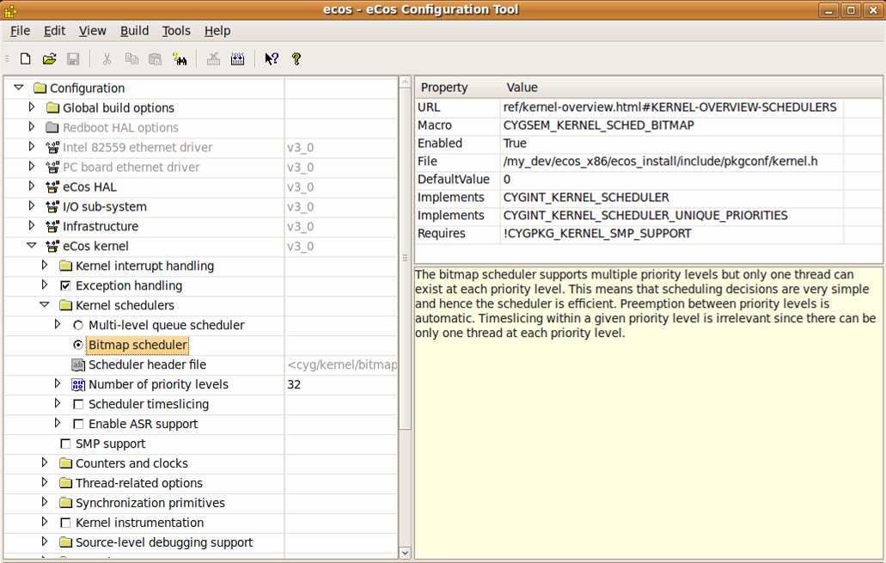
Adding EDF to eCosConfigTool
We should modify CDL (Component Description Language) file at
/my_dev/ecos_edf/ecos_edf_rep/ecos-3.0/packages/kernel/v3_0/cdl
Originally there are two scheduling (Multi-level, Bitmap) we should modify CDL file to add EDF

Slide 33
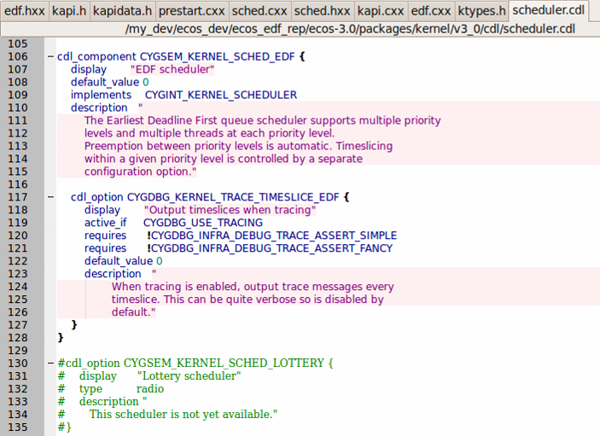
Adding EDF to eCosConfigTool
eCos already has CDLs for Bitmap and Multi-level, we can copy/past and modify it according EDF scheduling
This description will appear in Configuration tool, when user selects EDF scheduling

Slide 34
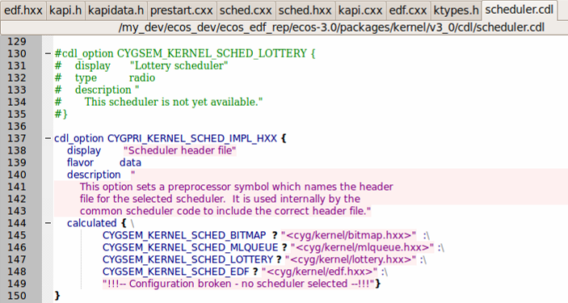
Adding EDF to eCosConfigTool
Comment in this CDL indicates eCos v3.0 not to support Lottery scheduling
When user selects scheduler’s header file will be used by kernel accordingly

Slide 35
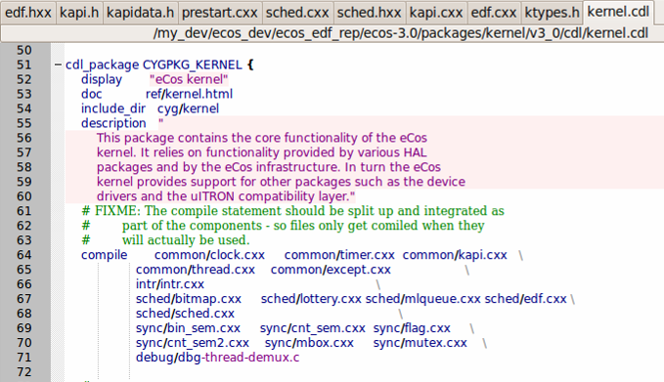
Adding EDF to eCosConfigTool
New scheduler should be added to the compile list of eCos kernel

Slide 36
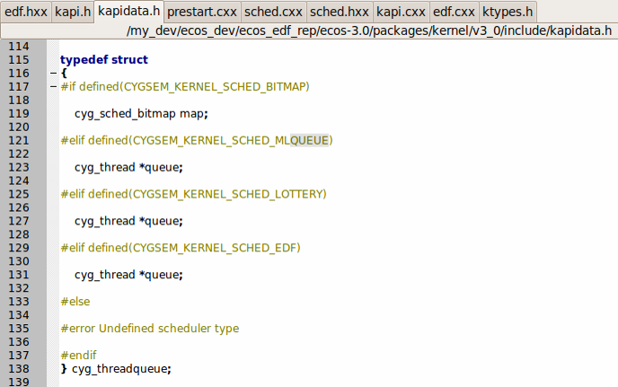
Create EDF support structures
Each scheduler has queue to keep threads in the queue, as we add EDF scheduler we should make for it as well

Slide 37
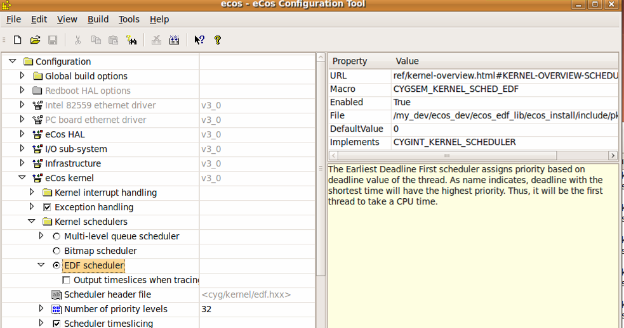
Adding EDF to eCosConfigTool
As we finish all modifications, we will have EDF scheduling in our
eCos Config Tool. Next we have to create EDF supporting source files.
Originally there were two scheduling (Multi-level, Bitmap) options, now we have EDF also
Explanation of this option, which we wrote at our CDL file

Slide 38
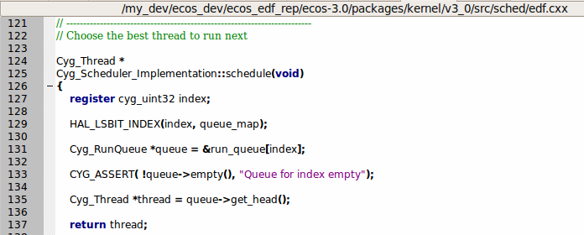
Visual representation of scheduler threads
HAL_LSBIT_INDEX macro selects “last significant” bit from queue_map (highest priority READY thread queue) and assign value to index variable
We take highest priority READY thread queue and return head of the queue (same priority queue is ordered as FIFO and new READY thread is added to the tail of the queue)
We return highest priority which is the first thread became on READY state
index=2
return thread
queue_map
Th_{index}^{priority}
0
0
1
1
0
…
1
0
0
Cyg_RunQueue[0]
Th₀⁰
Th₁⁰
…
Th₃₁⁰
Th
Th
Th
Th
Th
Th
Th
Th
Th
Th
Th
Th
Th
Th
index
…
Cyg_RunQueue[1]
Th₀¹
Th₁¹
…
Th₃₁¹
…
…
…
…
…
…
…
0
Cyg_RunQueue[…]
…
Th
Th
Th
Th
Th
Th
Th
0
Cyg_RunQueue[31]
Th₀³¹
Th₁³¹
…
Th₃₁³¹
Th
Th
Th
Th
Th
Th
Th

Slide 39
EDF implementation
In EDF scheduling we don’t use priorities as a main factor, instead we use deadline value to be primary;
In order not to overwrite add, remove, resume and other management codes in EDF we will keep *queue_map* and thus *Cyg_RunQueue* related code;
In our current design we will keep all threads at the same priority as a linked list;
In each *schedule()* method call, we will return READY thread (from Cyg_RunQueue) with a shortest deadline, thus we will have EDF scheduling concept;

Slide 40
Multi-Level scheduling
Th_{index}^{priority}
index=2
return thread
queue_map
0
0
1
1
0
…
1
0
0
Cyg_RunQueue[0]
Th₀⁰
Th₁⁰
…
Th₃₁⁰
Th
Th
Th
Th
Th
Th
Th
index
Cyg_RunQueue[1]
Th₀¹
Th₁¹
…
Th₃₁¹
Th
Th
Th
Th
Th
Th
Th
…
0
Cyg_RunQueue[…]
…
…
…
…
…
…
…
…
0
Cyg_RunQueue[31]
Th₀³¹
Th₁³¹
…
Th₃₁³¹
Th
Th
Th
Th
Th
Th
Th
Th
Th
Th
Th
Th
Th
Th
Earliest Deadline First scheduling
index=2
return thread
0
queue_map
0
0
0
1
0
1
…
0
1
index
1
Cyg_RunQueue[1]
Th₀¹
Th₁¹
…
Th₃₁¹
Th
Th_{main}¹⁵
Th
Th_{idle}³¹
…
1
Cyg_RunQueue[15]
Th_{main}³¹
…
…
Th
1
Cyg_RunQueue[31]
Th_{idle}³¹
Th

Slide 41
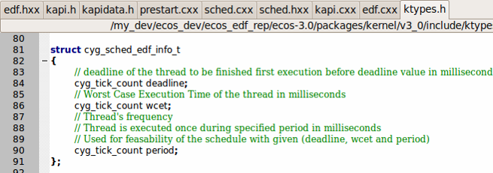
EDF specific data structure
We add this data structure to the eCos kernel;
These three values are given by application programmer

Slide 42
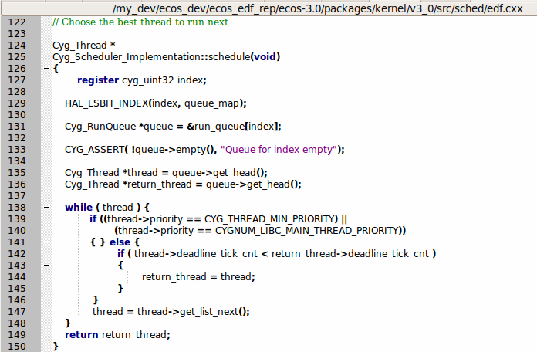
EDF implementation
In EDF all application threads have the same priority, we just keep it for interoperability with underlying ML scheduling code
Queue of READY threads, can be run
*thread* is to run through and *return_thread* to compare deadlines and return shortest deadline thread
No need to check Idle or Main thread
Keep earliest deadline thread in return_thread
Run until the last READY thread
Return the shortest deadline thread as *highest priority*

Slide 43
EDF application code (1)
#include <cyg/kernel/kapi.h> #include <cyg/kernel/ktypes.h> #include <stdio.h>
#include <math.h> #include <stdlib.h>
/* now declare (and allocate space for) some kernel objects, like the edf threads we will use */
cyg_thread thread_s[3]; /* space for EDF thread objects */
char stack[3][4096]; /* space for EDF 4K stacks */
cyg_handle_t simple_threadA, simple_threadB, simple_threadC; /* now the handles for the threads */
cyg_thread_entry_t simple_program; /* and now variables for the procedure which is the thread */
cyg_mutex_t cliblock; /* and now a mutex to protect calls to the C library */
void cyg_user_start(void) /*EDF specific type we install our own startup routine which sets up threads */
{
printf("Running with EDF scheduler v1.7.6\n");
struct cyg_sched_edf_info_t my_edf_info_A = {100, 150, 250}; // {ddln,wcet,period} of thread in MilSec
struct cyg_sched_edf_info_t my_edf_info_B = {250, 100, 200};
struct cyg_sched_edf_info_t my_edf_info_C = {350, 30, 300};
cyg_mutex_init(&cliblock);
cyg_thread_create((cyg_addrword_t) &my_edf_info_A, simple_program, (cyg_addrword_t) 0,
"Thread A", (void *) stack[0], 4096, &simple_threadA, &thread_s[0]);
cyg_thread_create((cyg_addrword_t) &my_edf_info_B, simple_program, (cyg_addrword_t) 0,
"Thread B", (void *) stack[1], 4096, &simple_threadB, &thread_s[1]);
cyg_thread_create((cyg_addrword_t) &my_edf_info_C, simple_program, (cyg_addrword_t) 0,
"Thread C", (void *) stack[2], 4096, &simple_threadC, &thread_s[2]);
cyg_sched_edf_prep();
cyg_thread_resume(simple_threadA); cyg_thread_resume(simple_threadB); cyg_thread_resume(simple_threadC);
}

Slide 44
EDF application code (2)
/* this is a simple program which runs in a thread */
void simple_program(cyg_addrword_t data)
{
int message = (int) data;
int delay;
printf("Beginning execution; thread data is %d\n", message);
cyg_thread_delay(200);
cyg_thread_info info;
cyg_handle_t cur_thread;
for (;;) {
delay = 400 + (rand() % 50);
cur_thread = cyg_thread_self();
/* note: printf() must be protected by a call to cyg_mutex_lock() */
cyg_mutex_lock(&cliblock); {
printf("Thread %d: and now a delay of %d clock ticks\n", message, delay);
cyg_thread_get_info(cur_thread, cyg_thread_get_id( cyg_thread_self() ), &info);
printf("ID: %d, name: %10s, ser pri: %d cur pri: %d stack use: %d\n\n",
info.id, info.name, info.set_pri, info.cur_pri, info.stack_used);
}
cyg_mutex_unlock(&cliblock);
cyg_thread_delay(delay);
}
}

Slide 45
eCos highlights
- main advantages of eCos

Slide 46
Main advantages of eCos
Open Source
  eCos (embedded Configurable operating system) is an open-source, configurable, portable real-time operating system, developed by RedHat;
For deeply embedded systems
  eCos is targeted at high-volume applications in consumer electronics, telecommunications, automotive, and other deeply embedded applications;
Focus on the applications, rather than the real-time OS
Small memory footprint
  e.g. eCos is 1.3.1 is quite small in size, occupies 3K of ROM and 1K of RAM for a kernel that includes a scheduler, memory management, RTC support, several threads and interrupt handlers;

Slide 47
Main advantages of eCos (2)
Configurability:
  It can be configured in great detail at compile time, which avoids the need to add unwanted code to the library to be linked with the application code;
  Configuration is also fine-grained, so that very small details of eCos’ behavior can be tuned;
  Developers are given the ability to create their own application-specific operating system;
Portability:
  eCos is designed to be portable to a wide range of target architectures and platforms, including 16, 32 and 64 bit architectures, microcontrollers and DSPs;
  The reason that enables eCos to be highly portable is the implemented Hardware Abstraction Layer (HAL)

Slide 48
Questions?
Thank you!

