Slide 1
Navigating Housing and Transit
Welcome to UBC!
Nodir Kodirov
PhD-track, Computer Science, UBC
August 27, 2014

Slide 2
I will briefly talk about
Housing
Transit
Driving license
Car sharing

Slide 3
Housing
Types: on-campus, off-campus
On-campus
SHHS: student, family - kids, family + kids
Private residences
Off-campus: all combinations
General tips
read a contract carefully, particularly about start and end dates!
roommate: just be good

Slide 4
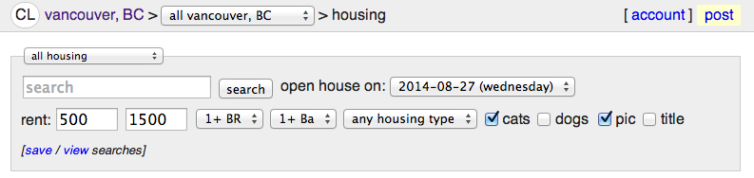
Off campus house hunt
Craigslist – includes furniture, bikes and etc.
Alternative resources
AMSRentsline, Padlister, Kijiji, AirBnB and others …
http://www.padmapper.com/ --- aggregates
Tip: be aware of “bad guys”

Slide 5

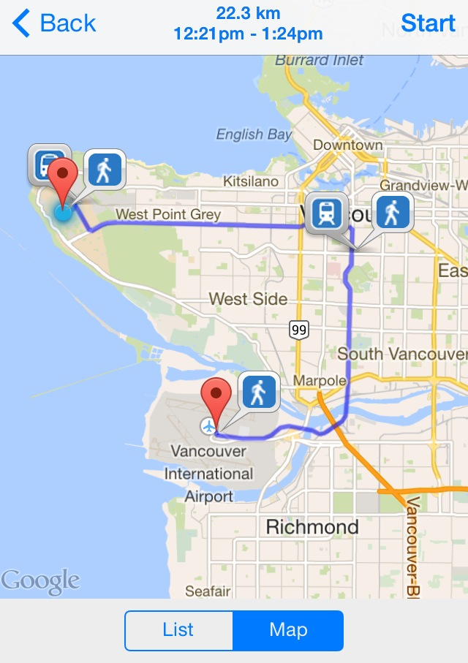

Transit
UPass: bus, trolleybus, sea bus, sky train
Vancouver is very bike friendly too, check out UBC bike kitchen

Slide 6

Driving license
Insurance Company of British Columbia
New BC residents can drive up to 90 days with a foreign license (visitors up to 6 months)
Then, everyone (exceptions below) should convert to a Canadian driving license
Exceptions (source WelcomeBC and personal experience)
License holders from United States, Austria, Germany, Switzerland, Japan, South Korea or another province of Canada can apply directly (without knowledge test and etc.)
Full time students from above locations can drive with their foreign license as long as in a full time student status

Slide 7




Car sharing
Very affordable way of “owning” a car (source: personal experience)
Example (insurance, fuel, parking* included):
7.50 CAD (+ tax) per hour (up to 200 Km)
60 CAD (+ tax) for 24 hours booking

Slide 8
Questions & Answers
Housing
Transit
Driving license
Car sharing
Enjoy UBC!

