Slide 1


JavaScript build & package management
By-
A confused & perplexed developer

Slide 2
THE FLASHBACK
JavaScript born
1995
1997
ECMA standard
AJAX gains popularity
2004-05
2006
jQuery launch (Also our own GWT ☺ )
LESS & SASS usage grows
2009-10
2012 -13
Angular & React enter the stage
HTML 5 is out
2014

Slide 3

VILLIAN’S ENTRY

Slide 4






SUPERHEROES TO THE RESCUE

Slide 5


NODE V/S NPM

Slide 6
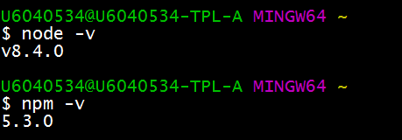
Install Node JS
Open a command prompt/ GIT Bash terminal(better)
Type the commands node –v & then npm –v :
That’s it. NPM is ready to use

Slide 7
Decrypting package.json

