Slide 1
NEOvi
Near-Earth Object visualization

Slide 2
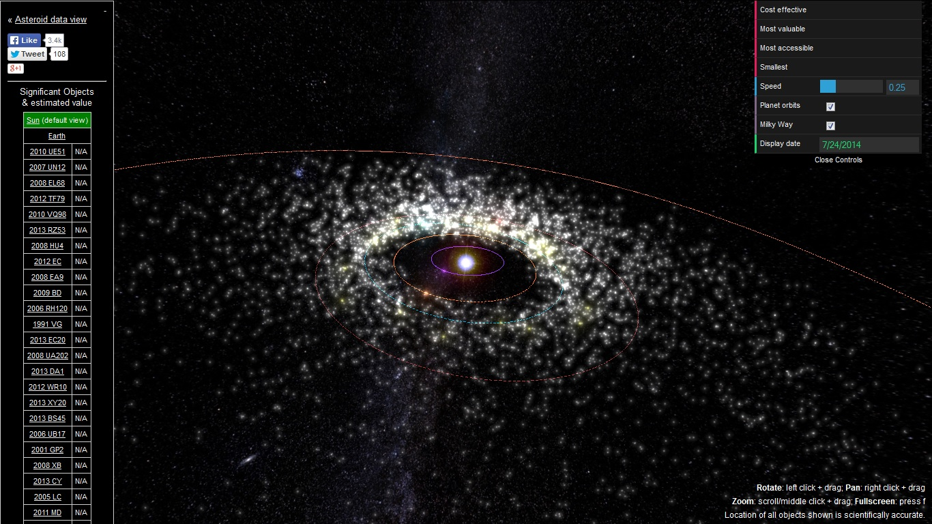
Many existing physical visualizations
asterank.com

Slide 3
Distill data for the public
What data is meaningful to the public and can help contextualize asteroid discovery?
What is the best format to convey this information?

Slide 4
Technology Used
Asterank API (http://www.asterank.com/api)
D3 data visualization (http://d3js.org/)
Python + django + Heroku

Slide 5
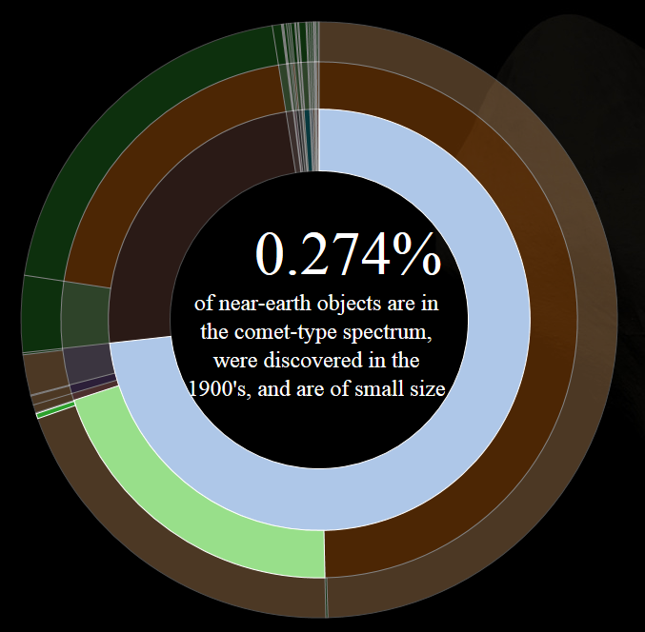
Data Visualized

Slide 6
Application URLs
Application (https://neovi.herokuapp.com/)
Source (https://github.com/knoopr/NASA_app)

