Slide 1
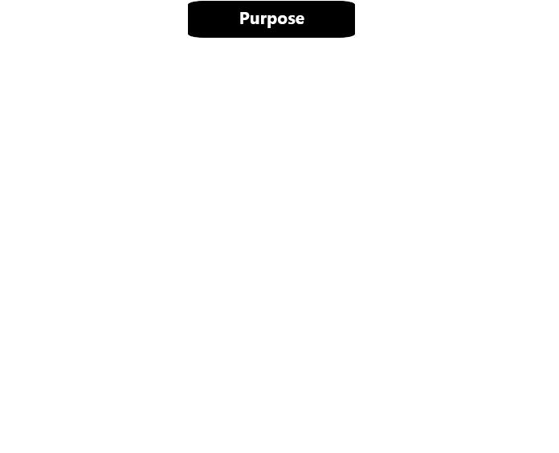
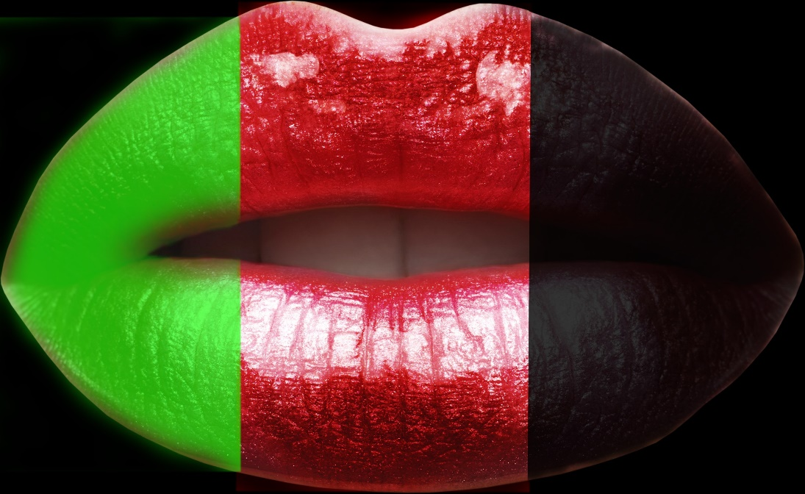

Your mood is your color.

Slide 2

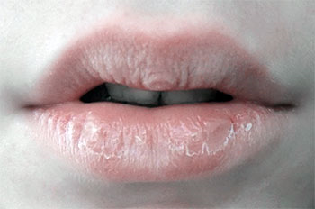
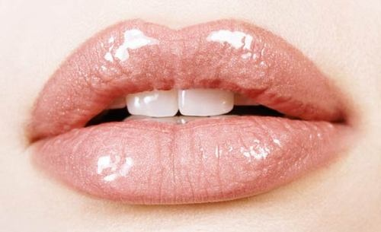
Oh! No.
My lips are beatiful, soft and moist.

Slide 3

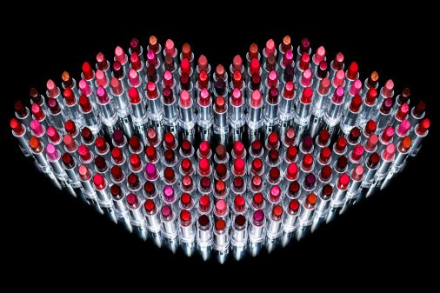
Our natural lipstick is the solution, all the problems associated with the lips..

Slide 4
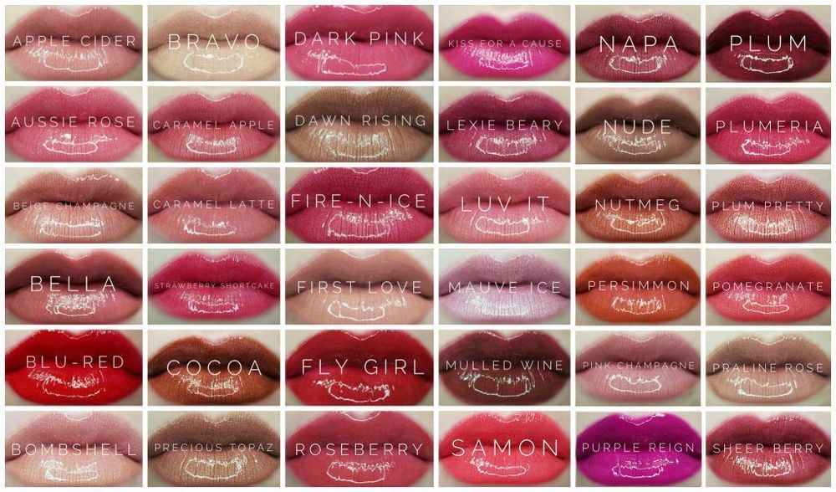
At us in the country a small choice of natural cosmetics, and the order from foreign shops is a long delivery and the huge prices. In our store you can find a large selection of inexpensive lipsticks.

Slide 5

Фото каталогу

Slide 6


Slide 7

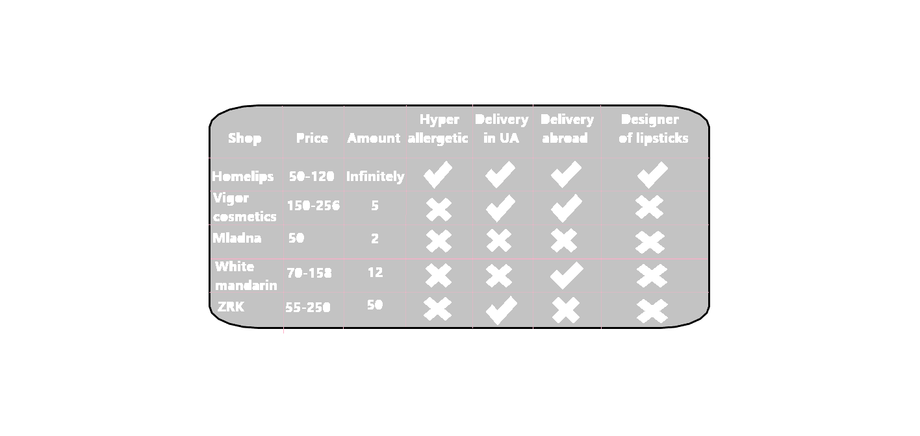
Competition in our area

