Slide 1

Objects in JS
Objects in JavaScript hold key-value pairs:
let obj = { name : "SoftUni", age : 3 }; console.log(obj); // Object {name: "SoftUni", age: 3} obj['site'] = "https://softuni.bg"; console.log(obj); // Object {name: "SoftUni", age: 3, site: " https://softuni.bg" } delete obj.name; // Delete a property obj.site = undefined; // Delete a property value console.log(obj); // Object {age: 3, site: undefined}

Slide 2
Object Keys and Values
let course = { name: 'JS Core', hall: 'Open Source' }; let keys = Object.keys(course); console.log(keys); // [ 'name', 'hall' ] if (course.hasOwnProperty('name')) console.log(course.name); // JS Core
let values = Object.values(course); console.log(values); // [ 'JS Core', 'Open Source' ] if (values.includes('JS Core')) console.log("Found 'JS Core' value");

Slide 3
Object Freeze and Seal
let cat = { name: 'Tom', age: 5 }; Object.freeze(cat); cat.age = 10; // Error in strict mode cat.gender = 'male'; // Error in strict mode console.log(cat); // { name: 'Tom', age: 5 }
cat = { name: 'Tom', age: 5 }; Object.seal(cat); cat.age = 10; // OK delete cat.age; // Error in strict mode console.log(cat); // { name: 'Tom', age: 10 }

Slide 4


Objects and JSON
JavaScript objects can be stored as text in JSON format
JSON == JavaScript Object Notation == text object format
let obj = { name : "SoftUni", age : 3 };
let str = JSON.stringify(obj);
console.log(str); // {"name":"SoftUni","age":3}
let str = "{\"name\":\"Nakov\",\"age\":24}";
let obj = JSON.parse(str);
console.log(obj); // Object {name: "Nakov", age: 24}

Slide 5
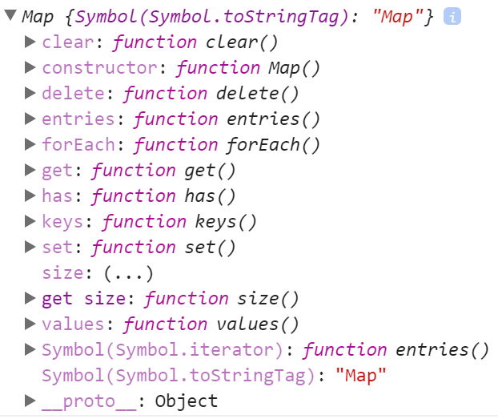
The Map Class in JS
The Map class holds { key -> value } map
Better functionality than plain JS object
let score = new Map(); score.set("Peter", 130); score.set("Maria", 85); for (let [k, v] of score){ console.log(k + ' -> ' + v); }

Slide 6
Phonebook - Map Example
let phonebook = new Map(); phonebook.set("John Smith", "+1-555-8976"); // Add phonebook.set("Lisa Smith","+1-555-1234"); phonebook.set("Sam Doe", "+1-555-5030"); phonebook.set("Nakov", "+359-899-555-592"); phonebook.set("Nakov", "+359-2-981-9819"); // Replace
phonebook.delete("John Smith"); // Delete console.log(phonebook.size); // 3
for (let [key, value] of phonebook){ // Print console.log(`${key} -> ${value}`); }

Slide 7
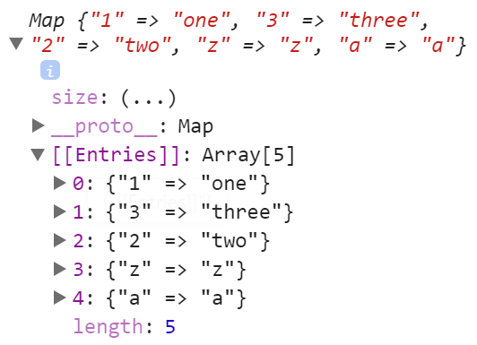
Maps Preserve the Insertion Order of Keys
let map = new Map([ ["1", 'one'], ["3", 'three'], ["2", 'two'], ["z", 'z'], ["a", 'a'] ]);
console.log(map); // Map {"1" => "one", "3" => "three", "2" => "two", "z" => "z", "a" => "a"} console.log(Array.from(map.keys())); // ["1", "3", "2", "z", "a"]

Slide 8

The Set Class in JS
Sets in JS are collections of unique objects
The insertion order is preserved, with no duplicates
let names = new Set(); names.add("Peter"); names.add(20); names.add("Maria"); names.add(5);
console.log(names.has('Peter')); // true
names.add("Maria"); // Duplicates are skipped
names.delete(20); // Delete element if exists
for (let name of names) console.log(name);

Slide 9

Summary
Objects in JS hold key-value pairs
Maps map key to values, preserve key order
Sets hold unique collection of values
…
…
…
let obj = { name : "SoftUni", age : 3 };
obj.age++;
obj[town] = 'Sofia';
delete obj.name;
let map = new Map();
map.set('score', 20);
let map = new Set(); set.add(5);

