Slide 1



Green code – Developer perspective
Harri Mehtälä (Software Developer – Knowit Solutions Finland Oy)

Slide 2
Thesis: Green in software engineering
A literature review of tools, methods and practices for reducing the environmental impacts of software use
(Mehtälä, 2023) University of Helsinki

Slide 3
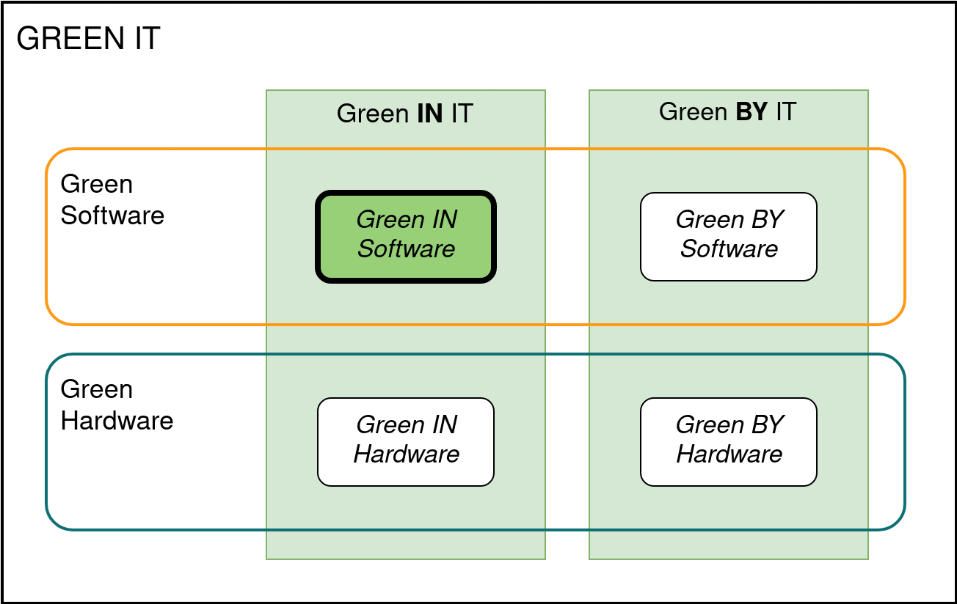

Today’s topic
Green Code
Green Code
→ Footprint
→ Handprint

Slide 4
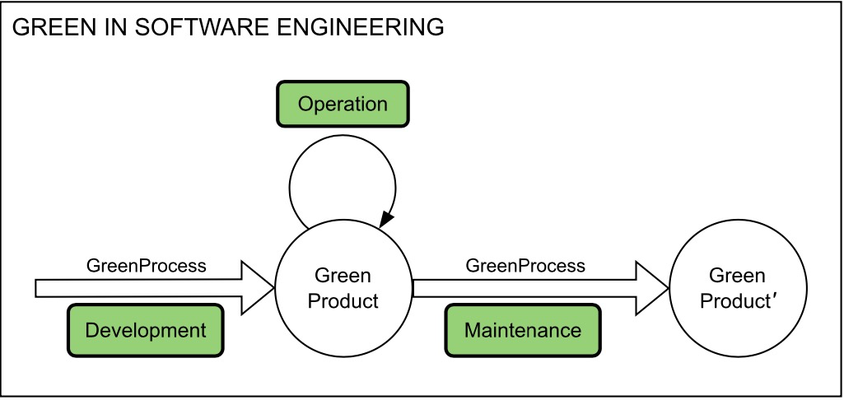
Today’s topic
GREEN CODE
Actions that we can take in the Development, Operation and Maintenance phases in order to affect the environmental footprint of the product.

Slide 5
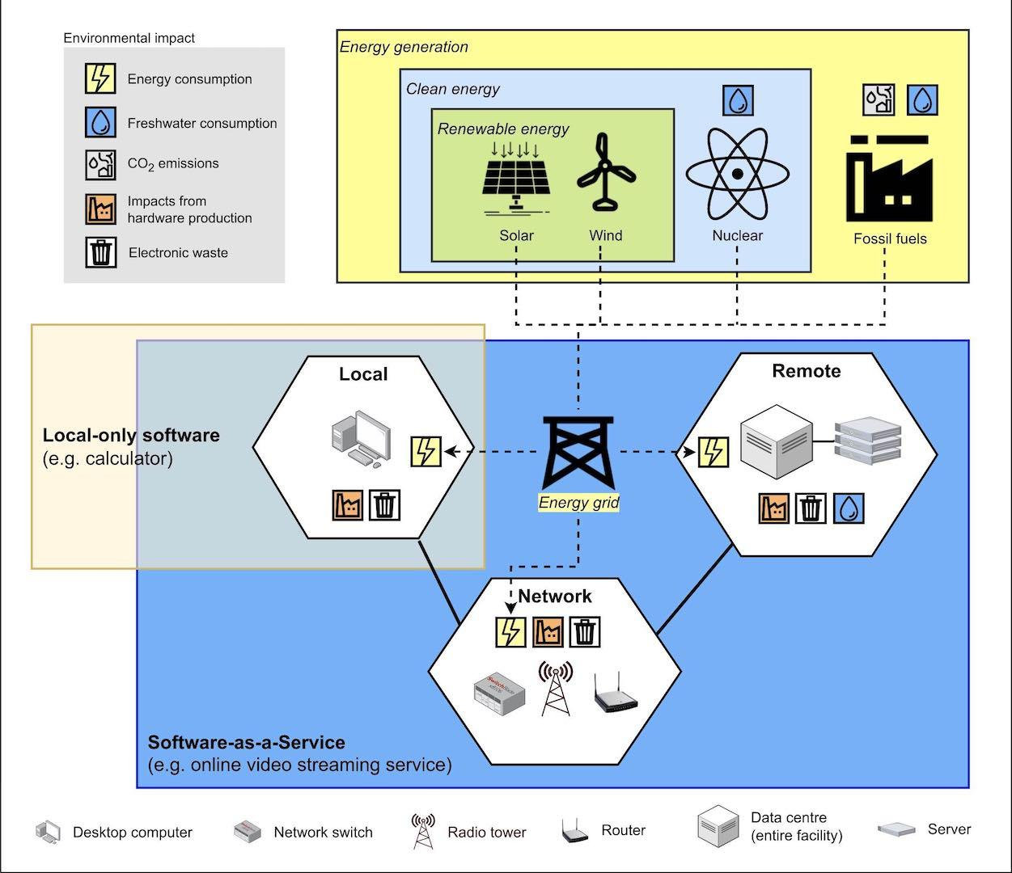

Slide 6
What is our current impact?
IT sector: 1.8—3.9% of global GHG emissions
Aviation industry: 2% of global energy-related CO2 emissions
Data centres + data transmission networks: 2–3% of global electricity use
Data centres & networks—Fuels & Technologies. IEA. Retrieved September 12, 2023, from https://www.iea.org/energy-system/buildings/data-centres-and-data-transmission-networks
IEA. (2023). Aviation. https://www.iea.org/energy-system/transport/aviation
Freitag, C., Berners-Lee, M., Widdicks, K., Knowles, B., Blair, G. S., & Friday, A. (2021). The real climate and transformative impact of ICT: A critique of estimates, trends, and regulations. Patterns, 2(9). https://doi.org/10.1016/j.patter.2021.100340

Slide 7
Today’s focus topics
Hardware / OS requirements
Carbon-Aware Computing
On-demand video

Slide 8
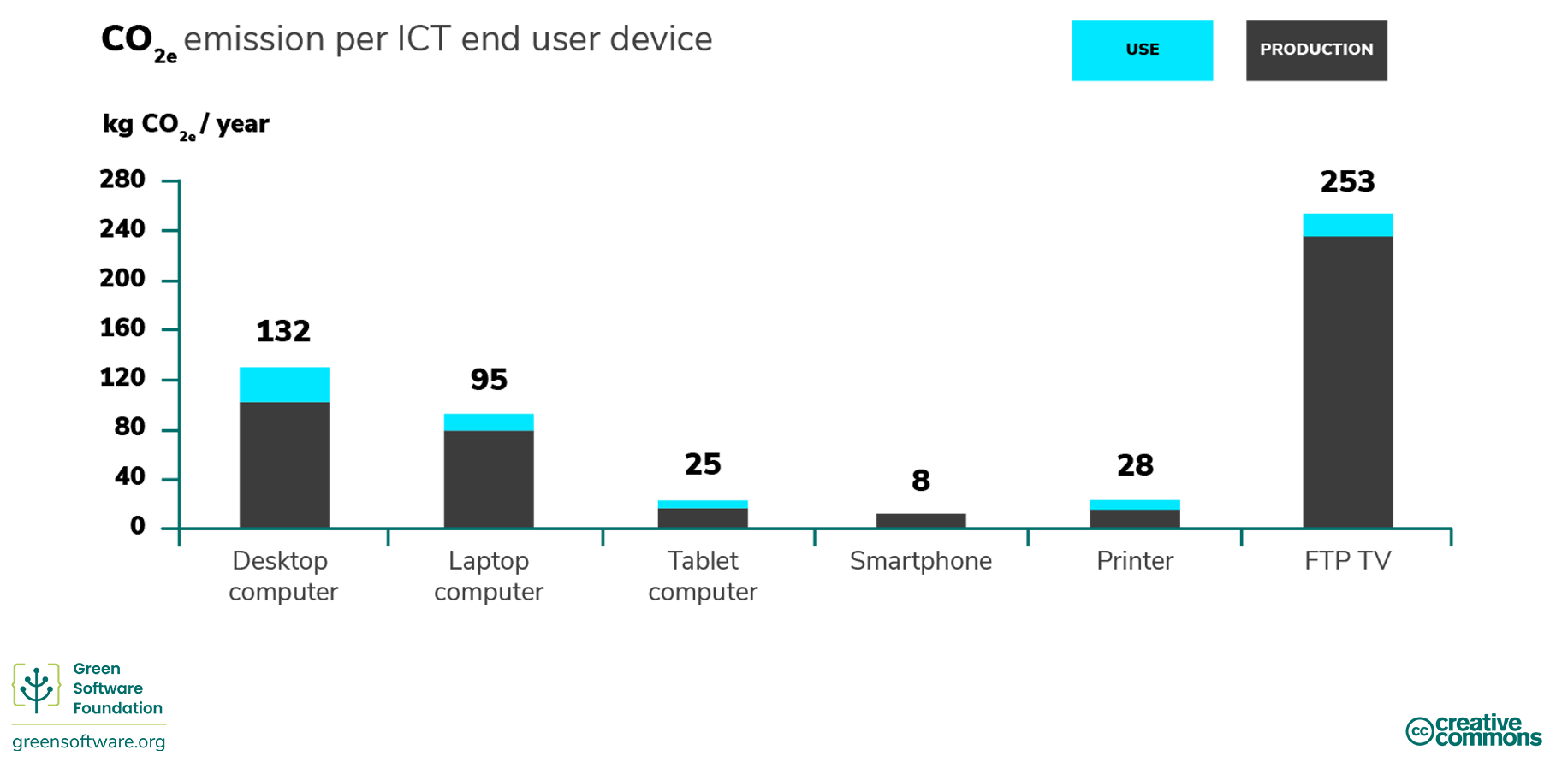
Hardware and Operating System Requirements

Slide 9
Example: Android Messaging Apps
 | Required Android version (checked 12.12.2023) | Works on device
Slack | 10 | Samsung Galaxy S9 (2018) OnePlus 5 (2017)
MS Teams | 8 | Samsung Galaxy S7 (2016)
Discord | 7 | Samsung Galaxy Note5 (2015)
WhatsApp | 5 | Nexus 5 (2013)

Slide 10
Hardware and Operating System Requirements
Test your app with older hardware
Keep core functionalities compatible with older HW
Design with these in mind
Right to Repair (EU)
Used and refurbished devices

Slide 11
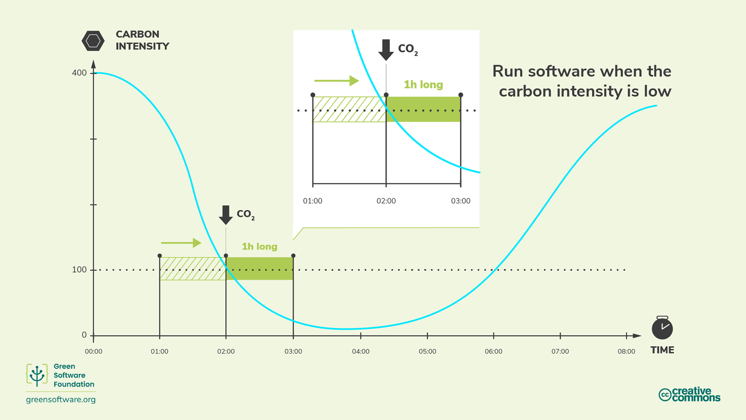
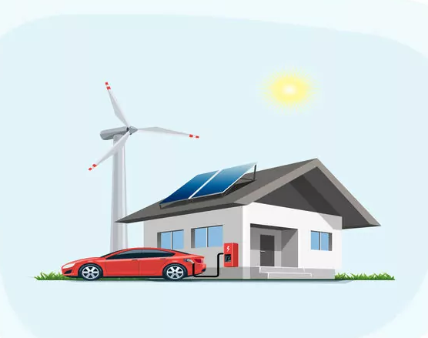
Carbon awareness
Do more when the electricity is cleaner
Do less when the electricity is dirtier

Slide 12
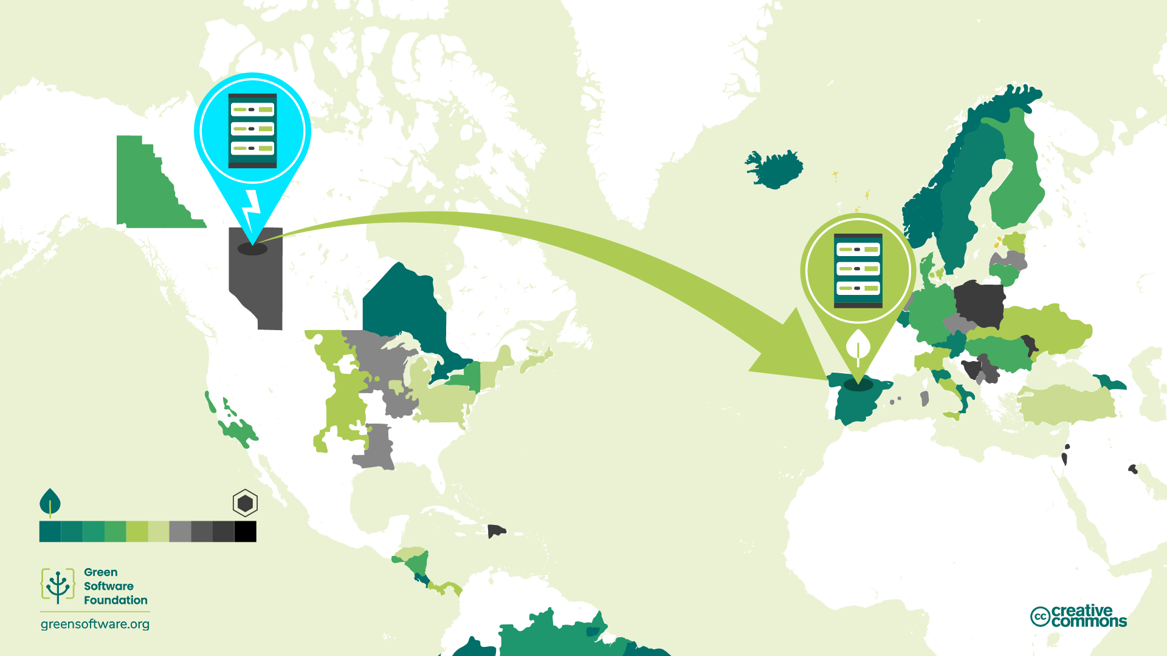
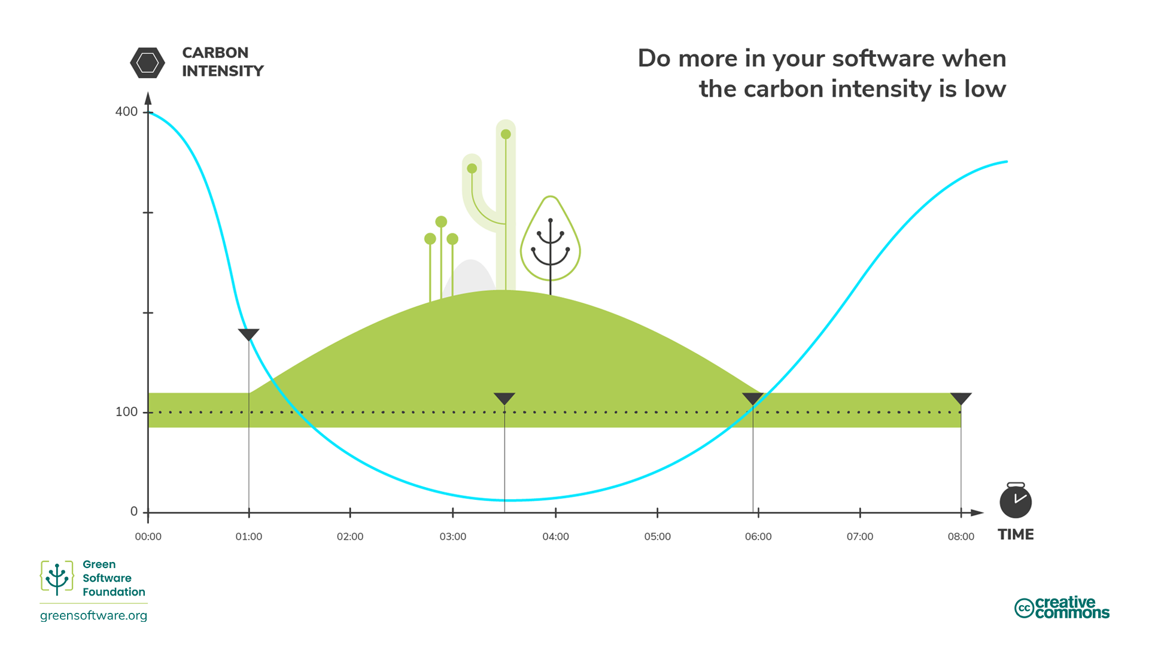
Carbon Awareness
Time shifting
Location shifting
Demand shifting
Job types:
Batch job, DB indexing
ML trainings
Video encoding
Demand shaping
Demand shaping
”Eco mode” for software
Ask user consent?

Slide 13
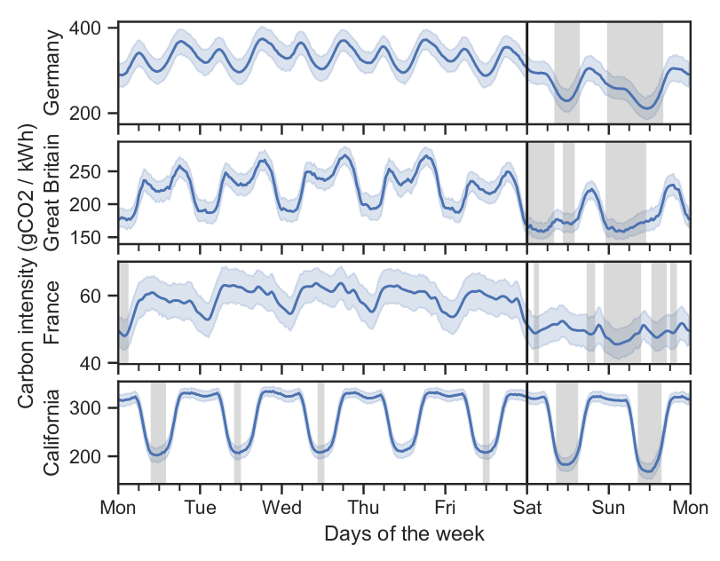
Carbon Awareness
Wiesner, P. et al. (2021). Let’s wait awhile: How temporal workload shifting can reduce carbon emissions in the cloud. Proceedings of the 22nd International Middleware Conference, 260–272. https://doi.org/10.1145/3464298.3493399
Where to get electricity grid carbon data?
ElectricityMaps & WattTime (paid)
Real-time electricity grid CO2 emissions
FinnGrid API
Wind electricity generation forecasts
https://data.fingrid.fi/en/pages/apis
Green Web Foundation
CO2.js
Grid Intensity CLI
When you can’t use real-time data:
Weekends are typically a less carbon-intensive choice.
Check historical data for patterns:
ElectricityMaps OpenData Portal
You will consume less carbon on average

Slide 14
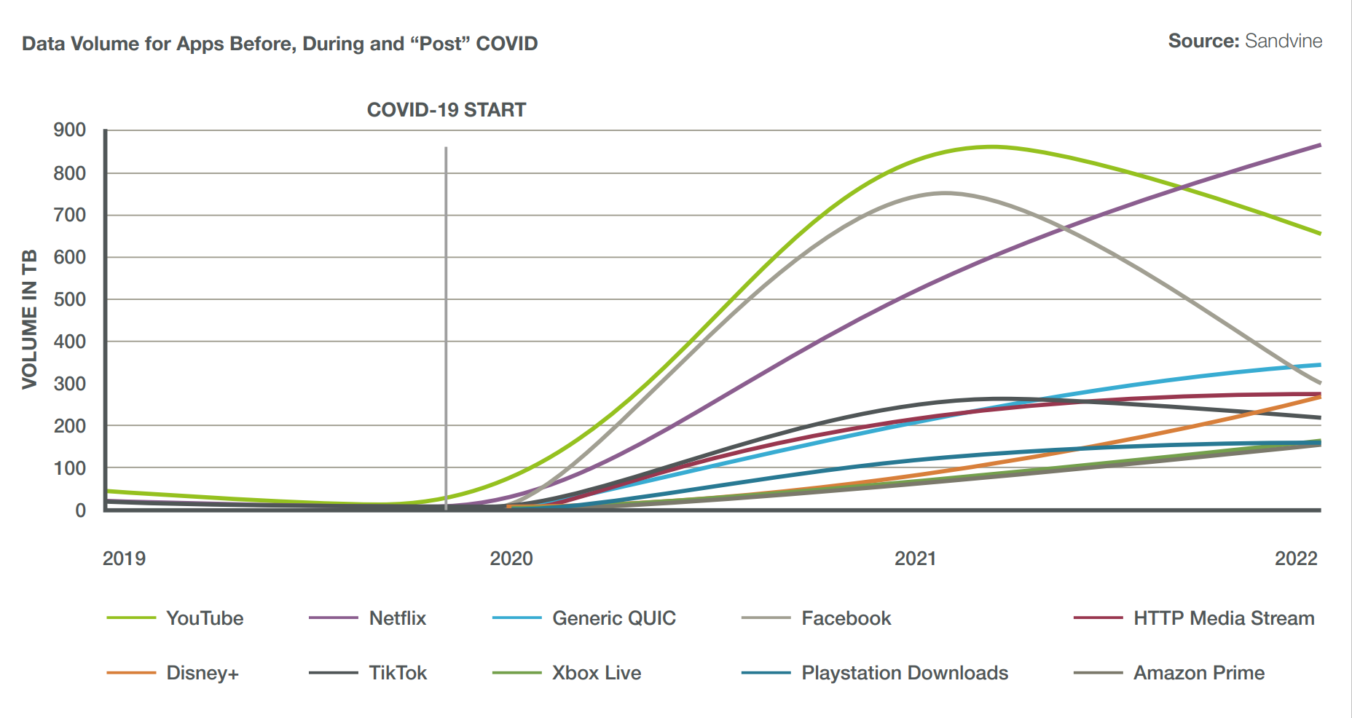
On-demand video
Estimates: between 65—80% of all internet traffic is video
4K streaming is on the increase
Avoid using video content, if possible
Optimise video file size
Compression
Use lower definitions
https://theshiftproject.org/en/article/unsustainable-use-online-video/
https://www.digitalinformationworld.com/2023/01/video-accounts-for-65-of-all-internet.html
https://www.cisco.com/c/en/us/solutions/collateral/executive-perspectives/annual-internet-report/white-paper-c11-741490.html#Trends

Slide 15
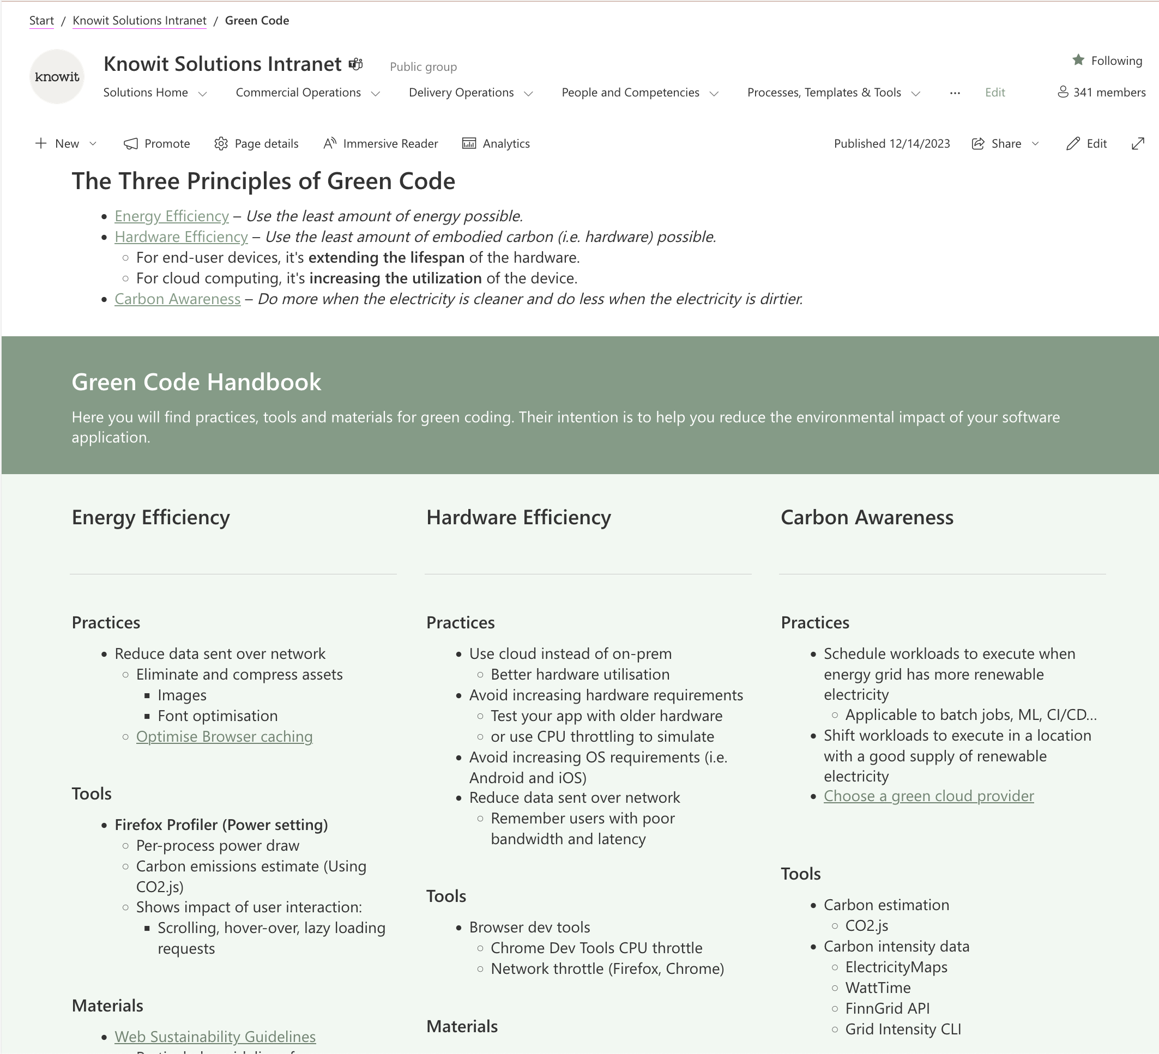
Green Code (Shareit)
Green Code Handbook
Materials (Internal & external)
Practices
Tools
knowit.sharepoint.com/sites/Org-510-internal/SitePages/GreenCode.aspx

Slide 16
Tools and practices
Web development
Web Sustainability Guidelines 1.0 (draft)
W3C community group
Katsaus käytännön koodioptimoinnin tekniikoihin (Recording in Finnish)
Tommi Sinivuo & Tommi Jalkanen, (Koodihuoneilmiö podcast)
Tieke Green ICT –hanke
Optimising DevOps pipeline (GH Actions)
Minimizing docker image size
JS frontend profiling

Slide 17
Green code resources
Keynote: Janne Kalliola (Exove) - Green Coding (slides)
Code Forward 30.8.2023, Technopolis Tampere
Environmental impact of software
Practices for reducing energy and resource consumption
Green Software Practitioner Course training.linuxfoundation.org/training/green-software-for-practitioners-lfc131
Learn the basics of green code
Get certified
Course and exam take between 2 – 4 hours to complete
Free, unlimited exam retakes

Slide 18
Environmental impact of software
Green Coding - a sustainable web in the making (Recording)
Peter Solow (Knowit Experience Danmark A/S)
Impact of web: data storage, video, images, fonts, etc.
Climate Impact of Software Testing (Recording in Finnish)
Kari Kakkonen (Knowit Solutions Finland Oy)
Topics:
Climate impact of ICT, Green ICT
Green Testing Techniques and Processes
Test environment right-sizing
On-demand deployments of test environments
Learnster
Digital Sustainability for environmental impact
Digital Sustainability Developer Perspective

Slide 19
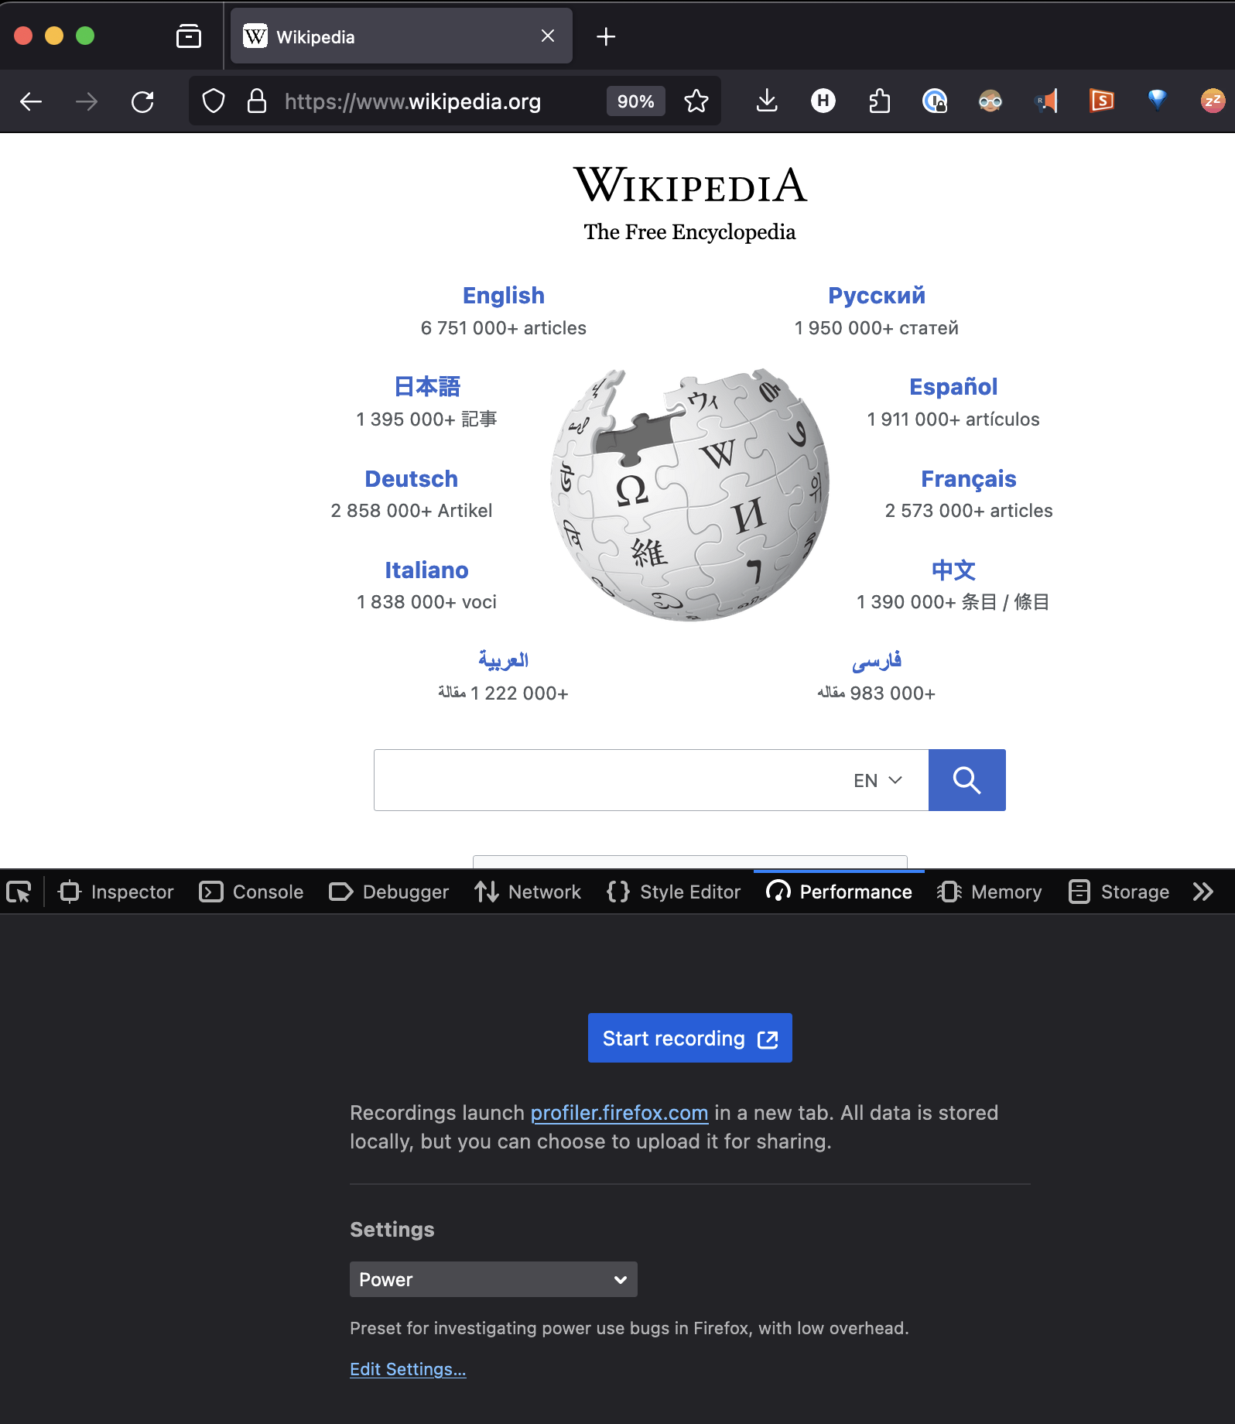
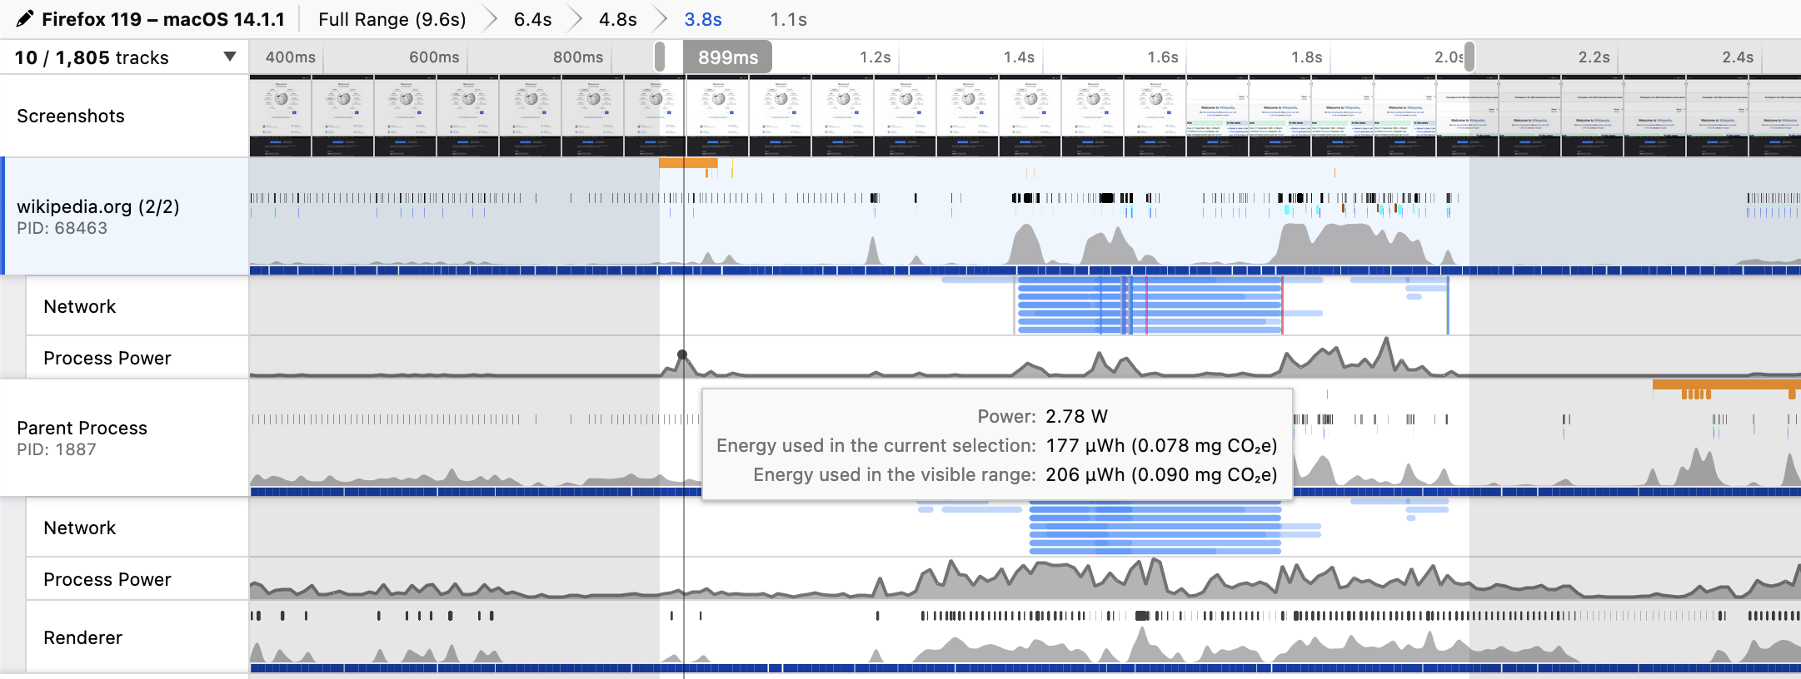
Firefox Profiler: “Power” setting
Per-process power draw
CO2 emissions estimate
Using CO2.js
Shows impact of user interaction:
Scrolling, hover, etc.
Lazy loading requests

