Slide 1
Creating lightweight desktop applications with Tauri
https://tauri.app/

Slide 2
Contents of this workshop
Create desktop application for reading system information with Rust, which is rendered in a GUI
Compare Tauri to its alternatives
Discuss about possible use-cases

Slide 3
About Tauri
Secure by default, allowing APIs must be done purposefully
https://v2.tauri.app/security/
Runs using WRY rendering library
Cross-platform
Uses native WebView of the OS
https://github.com/tauri-apps/wry
Frontend options
HTML/CSS/JavaScript
Rust
.NET
Built application can be run as portable or be installed

Slide 4
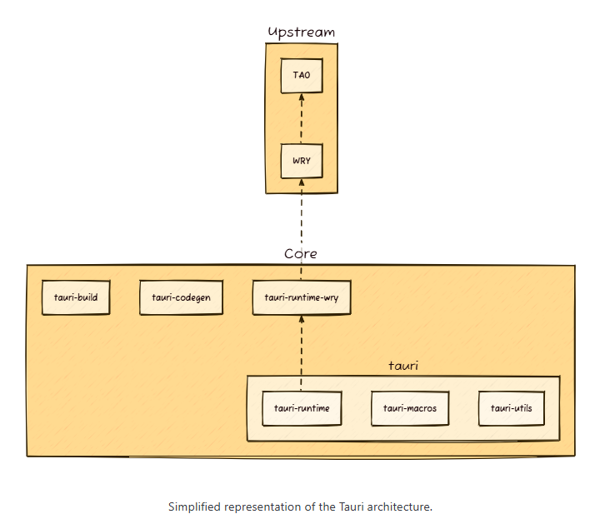
Architecture
Communication between frontend and backend done via IPC
By default frontend has no direct access to system resources
https://v2.tauri.app/concept/architecture/

Slide 5
Creating a new Tauri application
Prerequisites: https://v2.tauri.app/start/prerequisites/
Run npm create tauri-app@latest in terminal
Note: on Windows, must be run on PowerShell, VS Code integrated terminal or command line, Git Bash does not work for this
Select your preferred front-end framework
Recommended VS Code extensions
Rust, contains Rust lang server and rust-analyzer
Rust Prettier, autoformatting code
For other than VS Code users, installing Rust lang server and rust-analyzer should be sufficient

Slide 6
Initialize!
Notes:
Create the initial app with npm create tauri-app@latest and run it

Slide 7
About app structure
/
Contains front-end configurations
/src
Contains front-end application code
/src-tauri
Contains the Rust back-end code
Contains application configurations in tauri.conf.json
These include allowed operations and app window settings
Installing Rust dependencies or running tests must be done in this directory

Slide 8
Front-end development
Developing the front-end with Tauri is similar to regular front-end development
There are some caveats, most of the time native WebViews support the most modern web features, these might differ a bit on different operating systems
Some functionalities might be restricted due to incompatibilities with native APIs
Though most frameworks are supported out-of-the-box, some might require more configurations https://v2.tauri.app/start/frontend/
Next, we will do some coding and see how the application looks when running: run npm run tauri dev in the project root to start.

Slide 9
Time to code!
Notes:
Create example to frontend side by using simple mock data

Slide 10
Calling Rust from the frontend
https://v2.tauri.app/develop/calling-rust/
There are few ways to communicate with the Rust backend, we will be looking at using commands first

Slide 11

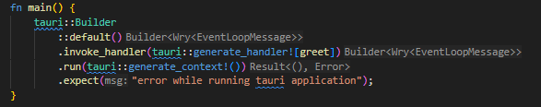

Back-end functions can be marked as commands with tauri::command macro
After they are added the build context, when they are called the input parameters get parsed as call arguments automatically
Calling the command from front-end is done via invoke command
There are two ways of using this function:
Imported from @tauri-apps npm package
Found in window global object if configured in tauri.conf.json
Command in the backend
Adding command to the context
Invoking command from the front-end

Slide 12
Time to code!
Notes:
Modify existing greet command to take snakecase value in

Slide 13
Let’s get a little Rusty…
Rust is language that is memory-safe by default, utilizing ownership model and variable lifetimes
Lifetimes prevent memory leakage by dropping values after their scope is finished
This is not unique to Rust, in most languages local variables are also dropped at the end of scope
Ownership is used to decide variable lifetime
When variable is declared, its lifetime is declared to last to the end of the scope
When variable is returned from different scope, its ownership is passed the caller
When variable is borrowed as a mutable, its lifetime can be considered as ended, since reference to the original variable would be considered unsafe operation, which causes a compiler error

Slide 14
This function does not work for two reasons:
When returning reference to a pointer (borrowed value), function must declare lifetime for the return type
Return value is a reference to a variable that is local for the function scope, which is prohibited due to the value being dropped after scope is finished, causing null pointer
Returning local variables from a function without reference is okay as usual, since ownership of the variable is passed to the caller

Slide 15

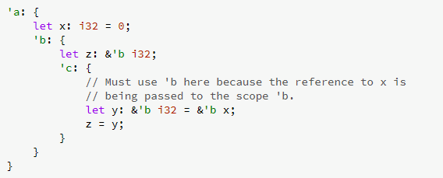
Lifetimes are notated by using variables prefixed with an apostrophe
Rust does this automatically in most cases, more complicated function calls might require it to be declared manually
https://doc.rust-lang.org/nomicon/lifetimes.html

Slide 16
Even though we declare a lifetime to the return type, same rules apply so that even if it seems okay to declare that the return value should have lifetime of the caller, it still returns a reference to a local variable
Returning references from functions is okay if following rules apply
Return value has a declared lifetime
Returned value is already borrowed from outside functions scope

Slide 17
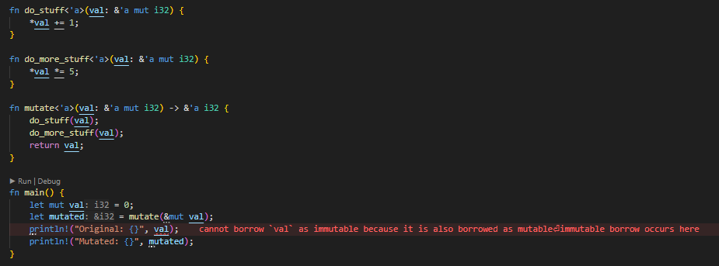
More reasonable example on why and how borrowing mutable references might be used:
If we need some performance optimization to avoid cloning values, we might want to mutate references directly
Mutating references is not considered memory safe, for which Rust has it by design that these operations should be rather explicit and complex to declare
As seen from above, since original variable was borrowed as mutable, Rust considers its value to be possibly changed elsewhere, so even though its value is the same as the returned reference, it cannot be used anymore since its value has possibly changed

Slide 18
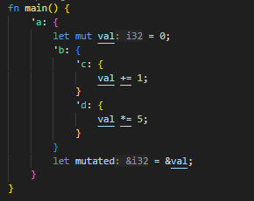
Though not perfectly explained here, previous example can be destructured to look something like this:
main() has its lifetime declared as ‘a
mutate() has its lifetime declared as ‘b
The two mutating functions has their lifetimes declared as ‘c and ‘d
Variable mutated is set to be a reference to the original value
These lifetimes do not usually have to be manually declared, Rust infers them automatically based on the variable’s lifetimes.

Slide 19
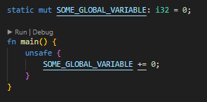
Using global variables is considered unsafe, since it might cause race conditions if variable is mutated in multiple places at the same time
By default, this causes compiler error if not handled properly
Using global variables is not incorrect by default, but Rust enforces these rules to make sure that developers do not make mistakes by accident. Because of this, operations that are considered to not be memory safe must be wrapped inside unsafe block:
Note that this does not prevent race conditions or memory leakage, all it does is that it makes sure that this operation was intentional
https://doc.rust-lang.org/beta/reference/items/static-items.html

Slide 20
Calling system-level operations
Even though Tauri would already be a good alternative to other options, since running expensive tasks multithreaded with Rust is more performant than using JavaScript, what it also allows us to do is to call operations normally outside of web applications scopes
Next, we will be installing a package for reading system resources on the backend and create a command for returning them to the frontend
Run cargo add sysinfo in /src-tauri directory to add it to the dependencies

Slide 21
Time to code!
Notes:
Install sysinfo package and return basic system info from back end

Slide 22
Using events
https://v2.tauri.app/develop/calling-rust/#event-system
Even though commands are neat and handy for running certain tasks by actions, information can also be transferred using events
This includes adding event listener to the front-end and emitting that event from the back-end
Next, we will be adding an event omitter to the back-end, which is run asynchronously, updating the system information on the front-end

Slide 23
Time to code!
Notes:
Run event on timer to emit system info to frontend instead of using commands

Slide 24
Tauri Plugins
https://v2.tauri.app/develop/plugins/
What you essentially just did, was to create your own plugin!
Under the hood, plugins are essentially just collections of event handlers and commands created by someone to ease implementation of certain complicated tasks
You could move this code into a separate plugin and use it in the application
Next, we will be installing a plugin for creating persistent key-value store to save application configurations across run-times

Slide 25
Tauri plugin store
https://github.com/tauri-apps/tauri-plugin-store

Slide 26
Time to code!
Notes:
Run event on timer to emit system info to frontend instead of using commands

Slide 27
Bonus step (if we have time)
Add currently running processes to the object sent from back-end and list them as a table
Notes:
Install tauri-plugin-store and use it for storing persistent styles of the app

Slide 28
Time to build!
Building the application is done via npm run tauri build
This creates a portable executable and installer
Build directory: /src-tauri/target/release

Slide 29
Summary
Easiest comparison is to Electron, which uses Chromium for rendering the front-end
Built Electron apps start somewhere around 50MB
Tauri apps can be as small as 600KB
With Electron, multithreading is not enabled by default but is possible
Electron uses Node.js for backend, which is not as performant as Rust due to garbage collection

Slide 30
Use cases?
Lightweight applications for running low-level tasks
Reading data from device ports
Running system- or even kernel-level operations
Running expensive data-processing
Running some performance-heavy tasks that should usually not be run in the front-end
Simply whatever you would do with Electron

Slide 31
Downsides?
Integrating existing projects might not work 100% out of the box
Certain actions that work in web might be restricted
Still quite new framework
Comparatively few users when comparing to Electron for example (70k vs 700k)
400 contributors vs. 1200 contributors

