Slide 1
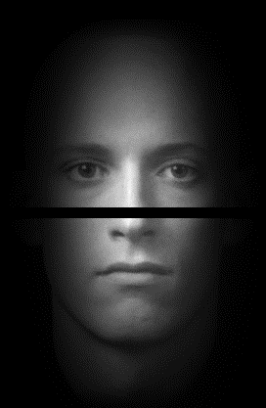

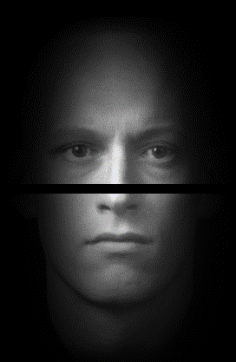
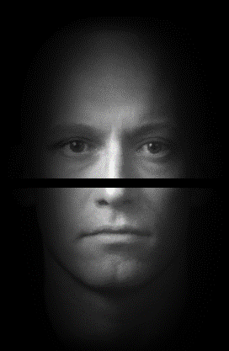
In the present task, a stimulus will be presented on the monitor on each trial. Each stimulus consists of two face halves – the top and the bottom. The different face stimuli are illustrated below.
Your task is to learn to identify these four faces (the horizontal shift between the two halves will vary). Their identities are based on a combination of the top face half and the bottom face half.
On each trial, press the button that corresponds to the stimulus (A, B, C, or D) on the box.
You can use the diagram below to familiarize yourself with the stimuli. Though at the beginning you may make mistakes, over time you should be able to categorize the stimuli accurately. We would like you to come up with a strategy to classify the objects. Once you have that strategy in mind, we would like you to continue to use that strategy for the remainder of the experiment.
Your task is to classify the objects as quickly as possible WITHOUT ANY ERRORS. Please remember that it is important to respond correctly. If you start to make errors, it’s likely because you’re going too fast so slow down and try to respond more accurately. Once you’ve made your decision about the category, however, please respond. (That is, take your time to make an accurate decision but don’t dilly-dally after you’ve made that decision).
Please press a button to continue.
Stimulus A
Stimulus B
Stimulus C
Stimulus D

Slide 2
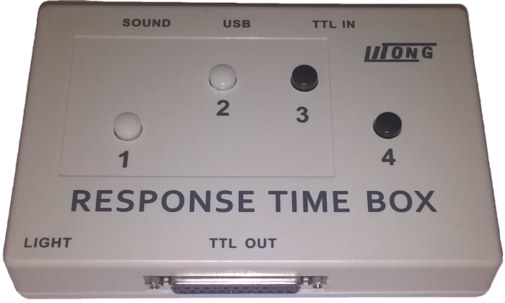
In this experiment, you will be asked to make responses using the Response Box, which looks like the one pictured below.
You will respond with Stimulus A, B, C, or D by pressing one of the buttons as shown below.
It is important that you keep one finger on EACH of the buttons, rather than using only one or two fingers and switching between buttons.
Press any button for further instructions.
Stimulus B
Stimulus C
Stimulus A
Stimulus D

Slide 3
Please take a short break. Press a button to continue.

Slide 4
Thank you for your participation! Please call the experimenter.

Slide 5



In the present task, you will be shown faces with a range of different similarities. For instance, an example such as the one which follows would be very similar
Consequently, this pair should receive a high rating (i.e., a 7 or an 8). On the other hand, this pair is highly dissimilar and should receive a low rating (i.e., a 1 or 2):
Finally, this pair has a similarity somewhere in the middle of the other two and should receive a middle rating (e.g., 4 or 5)
During the course of the experiment, please try to use all of the similarity scores. That is, don't just use scores of 1 and 8, try to make your scores using the entire range of responses.
Your goal is to respond as honestly as possible but bear in mind that the full range of similarities will be shown. If you have any questions, ask the experimenter now. Press SPACE to continue

