Slide 1
Title: Earthquake Shakes Twitter Users: Real-time Event Detection by Social Sensors
Conference/Journal: WWW’10
Author: Takeshi Sakaki (The University of Tokyo , major in earthquake and twitter)
Time: 2010

Slide 2
Outline
Motivation
Major Contribution
Solution
Major Results
Lessons

Slide 3
Outline
Motivation
Major Contribution
Solution
Major Results
Lessons

Slide 4
Motivation
Detect earthquake occurrence promptly, simply by observing the tweets

Slide 5
Outline
Motivation
Major Contribution
Solution
Major Results
Lessons

Slide 6
Major Contribution
Propose an algorithm to detect target event according to keyword, number of words and context
Produce a probabilistic spatiotemporal model for the tar-get event that can find the center and the trajectory of the event location

Slide 7
Outline
Motivation
Major Contribution
Solution
Major Results
Lessons

Slide 8
What is event?
Large scale, particularly influence people’s daily life, spatial and temporal regions
Social events: large parties, sports events, exhibitions, accidents, and political campaigns
Natural events: storms, heavy rainfall, tornadoes, typhoons/hurricanes/cyclones, and earthquakes.

Slide 9
Classify Tweets
Many tweets are unrelated to event, we should classify tweets into two categories: positive and negative
SVM
Three features:
Statistical features: words number, the position of the query words
Keyword features
Context: the words before and after the query words

Slide 10
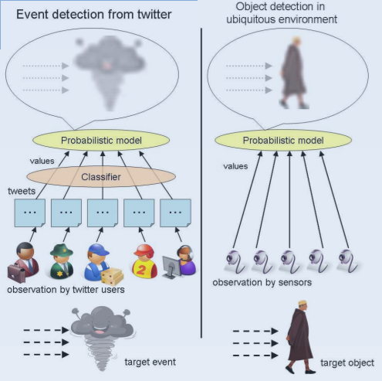
User = Sensor
Assumption:
A sensor detects a target event and makes a report probabilistically
Each tweet is associated with a time and location

Slide 11
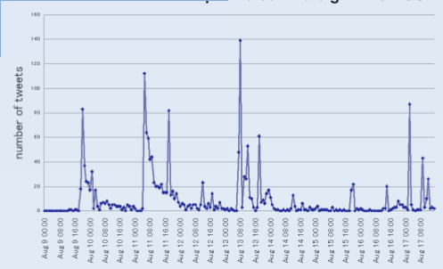
Temporal Model: When a Target Event Occurs
An exponential distribution

Slide 12

Temporal Model: When a Target Event Occurs

Slide 13
Spatial Model: Where a Target Event Occurs or Trajectory
Particle filter algorithm
Kalman filter

Slide 14
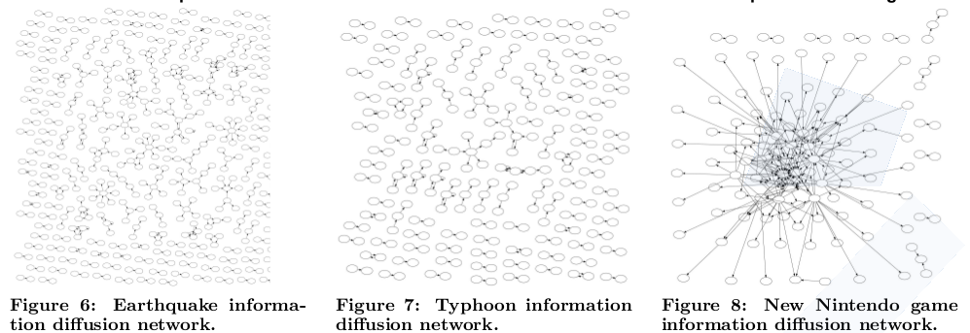
Information Difussion
sensors might not be mutually independent

Slide 15
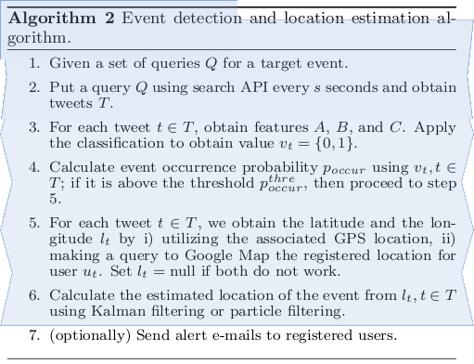

Slide 16
Outline
Motivation
Major Contribution
Solution
Major Results
Lessons

Slide 17
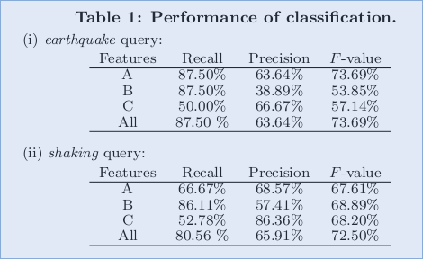
Results: Classification

Slide 18
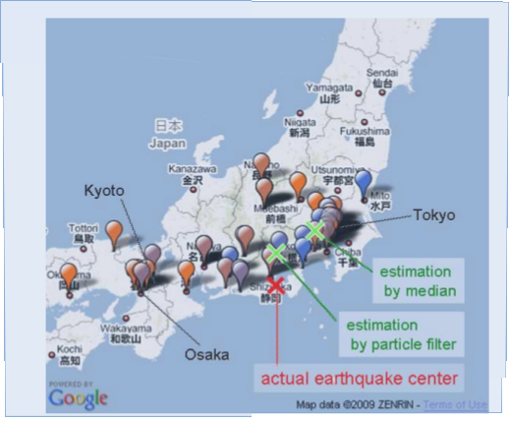
Result

Slide 19
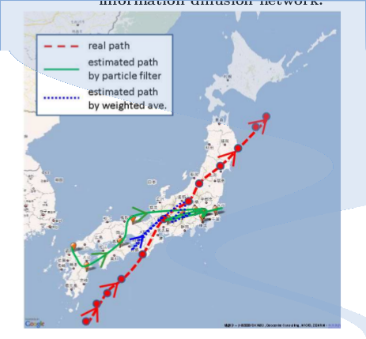
Result

Slide 20

Result

Slide 21
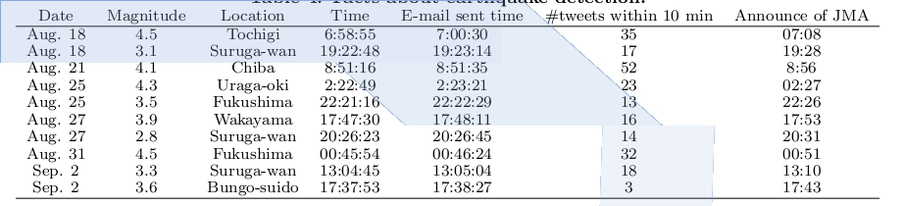
Result

Slide 22
Outline
Motivation
Major Contribution
Solution
Major Results
Lessons

Slide 23
Lessons
Some inspiration about social sensor

