Slide 1
Title: Towards building a disease-phenotype knowledge base:
Extracting disease-manifestation relationship from literature.
Conference/Journal: Bioinformatics
Author: Rong Xu, Li Li and QuanQiu Wang
Time: 2013

Slide 2
Outline
Motivation
Data and Methods
Solutions
Major Results
Lessons

Slide 3
Motivation
Systems approaches to studying phenotypic relationships among diseases are emerging as an active area of research for both novel disease gene discovery and drug repurposing.
Currently, systematic study of disease phenotypic relationships on a phenome-wide scale is limited because large-scale machine-understandable disease–phenotype relationship knowledge bases are often unavailable.
Based on above reasons, this paper presents an automatic approach to extract disease–manifestation (D-M) pairs (one specific type of disease–phenotype relationship) from the wide body of published biomedical literature.

Slide 4
Outline
Motivation
Data and Methods
Solutions
Major Results
Lessons

Slide 5
Data and Methods
Data: Medline sentences+UMLS+Disease lexicon
Methods:
First, it uses D-M pairs from existing biomedical ontologies as prior knowledge to automatically discover D-M–specific syntactic patterns.
Then, automatically extract additional pairs from the MEDILINE literature based on the learned patterns.
Finally, the paper analysed correlations between disease- manifestations and disease-associated genes and drugs

Slide 6
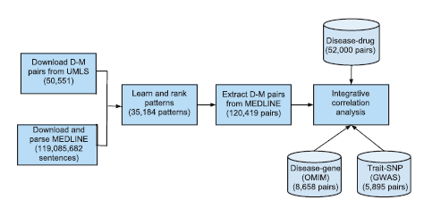
Methods Details 1

Slide 7
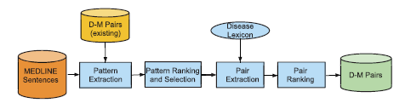
Methods Details 2
Obtain and parse MEDLINE corpus;
Extract existing D-M pairs from UMLS (prior knowledge);
Extract D-M pairs from MEDLINE in following steps: pattern ranking and selection, pair extraction and pair ranking;
Analyse the correlation between extractedD-M pairs and disease-associated genes and drugs (integrative correlation analysis).

Slide 8
Outline
Motivation
Related Work
Solutions
Major Results
Lessons

Slide 9
Solution(1)
Build a local MEDLINE search engine to get the potential sentences of MEDLINE based on the search conditions : D-M pair from the UMLS
Ways:
Stanford Parser: parse every sentence syntactically
Lucene: create indeces on both sentences and corresponding parse trees

Slide 10
Solution(2)
Extract additional D-M pairs from MEDLINE
Create a clean disease lexicon to filter unnecessary contents (Disease Ontology + UMLS)
Pattern extraction: used the expanded known D-M pairs as search queries to the local search engine. For example
search query: Coffin–Lowry Syndrome–mental retardation
Returned sentence: ‘Coffin–Lowry Syndrome is characterized by mental retardation, . . .’ (PMID 17249444).
Learned pattern: D is characterized by M

Slide 11



Solution(3)
Analyse the correlation between extracted D-M pairs and disease-associated drugs and genes
with disease-associated drugs
With disease-associated genes

Slide 12
Outline
Motivation
Data and Methods
Solutions
Major Results
Lessons

Slide 13
Major Results
1. It extracted 121,359 D-M pairs with a high precision of 0.924. And most of the pairs (120,419) have not been captured in existing structured knowledge sources.
2. Extracted disease manifestations correlate positively with both disease-associated genes and drug treatments, which will have profound implication in our deeper understanding of disease etiology and in rapid drug repurposing.

Slide 14
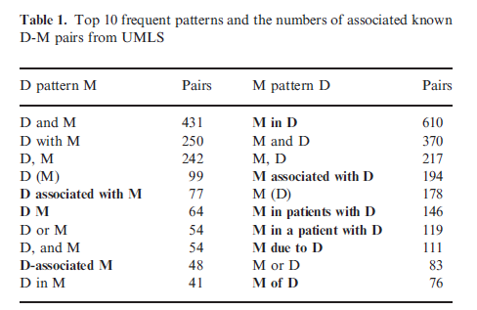
Major Results(1)
Learning D-M–specific patterns

Slide 15
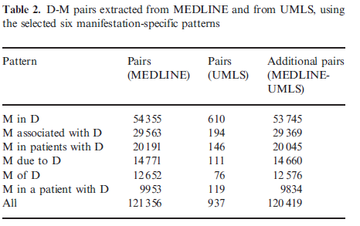
Major Results(2)
Extract additional D-M pairs from MEDLINE using specific patterns

Slide 16
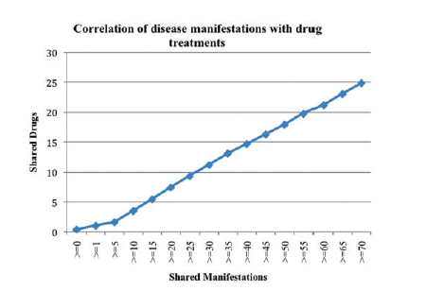
Major Results(3)
D-M pairs positively correlate with disease drug treatments

Slide 17
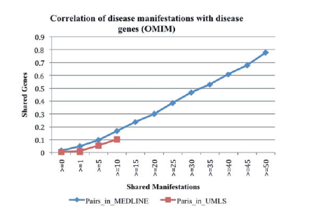
Major Results(4)
D-M pairs positively correlate with disease-associated genes

Slide 18
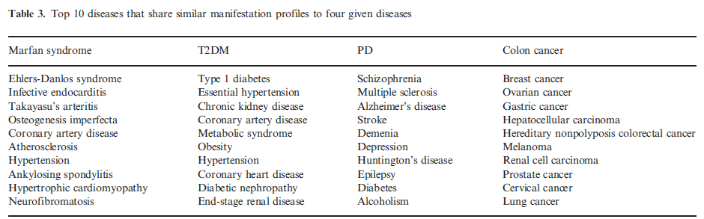
Major Results(5)
Examples of disease–disease relationships based on manifestation similarity

Slide 19
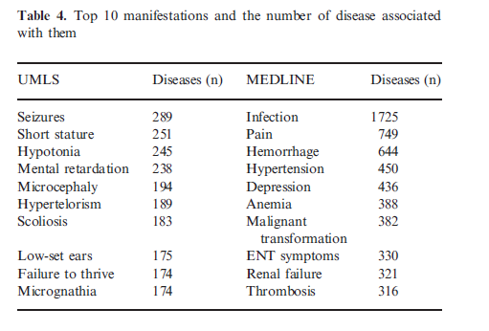
Major Results(6)
Top-ranked manifestations from MEDLINE and from UMLS

Slide 20
Outline
Motivation
Data and Methods
Solution
Major Results
Lessons

Slide 21
Lessons
1. Several concrete and useful examples about the relationship among disease-manifestation-gene-drug-protein are introduced by this paper. These associations and corresponding biological mechanisms can be cited in later research.
2. Similar methods (or a different pattern learning method) can be used to extract the relationships among disease-syndrome-synptom from the TCM literature.
3. A large-scale automatic extraction framework can be conbined with standard ontologies to complement existing biomedical databases and construct a more comprehensive linked knowledge graph. Thus, reasoning or other analysis methods can be used to explore the undiscovered biomedical relationships.

