Slide 1
AMIE: Association rule mining under incomplete evidence in ontological knowledge bases
Peiqin Gu, Nov 25

Slide 2
Paper Info
AMIE: Association Rule Mining Under Incomplete Evidence in Ontological Knowledge Bases.
Luis Galarraga, Christina Teflioudi, etc.
WWW 2013

Slide 3
Motivation
Existing KBs, Cyc, YAGO, Dbpedia, Freebase, etc. today’s KBs contain millions of entities and hundreds of millions of facts.
Yet, even these large KBs are not complete. However, they usually contain enough information to derive and add new facts.
E.g., a KB contains the fact that a child has a mother, then the mother’s husband is most likely the father:
motherOf(m, c) ∧marriedTo(m, f) => fatherOf(f, c)

Slide 4
Motivation
Finding such rules can serve four purposes
New facts can be derived that make the KB more complete.
Identify potential errors in the KB.
Used for reasoning.
Understand the data better.
Goal of the paper
Mine such rules from KBs.

Slide 5
Background
Mining rules have been studied in the context of association rule mining and inductive logic programming (ILP).
Association rule mining is well known in the context of sales databases.
If a client brought beer and wine, then he also bought aspirin.
Current ILP systems cannot be applied to semantic KBs for two reasons
They usually require negative statements as counter-examples.
They are slow and cannot handle the huge amount of data that KBs provide.

Slide 6
Contributions
A method to simulate negative examples for positive KBs (the partial completeness assumption)
An algorithm for the efficient mining of rules
A system, AMIE, that mines rules on millions of facts in a few minutes without the need for parameter tuning or expert input.

Slide 7
Related Work
Association rule mining
Logical rule mining
Expert rule mining
Generating schemas
Learning rules from hybrid sources
Further applications of rule mining

Slide 8
Preliminaries
Focus on horn rules
Horn rules on binary predicates, denoted as r(x,y)
motherOf(m, c) ∧marriedTo(m, f) => fatherOf(f, c)
Mainly concerned with ABox rule mining.
Definitions
A given KB K as input;
R=π_{relation}(K): the set of relations contained in K;
ε=π_{subject}(K) ∨π_{object}(K): the set of entities;

Slide 9
Preliminaries
Definitions
Functions: a function is a relation r that has at most one object for every subject, i.e., for every x, |y: r(x,y)|≤1.
KBs can be noisy, so the functionality of a relation r is a value between 0 and 1, that is 1 if r is a function;
Rules: an atom is a fact that can have variables at the subject and/or object position. A (Horn) rule consists of a head and a body, where the head is a single atom and the body is a set of atoms.
B₁∧B₂∧…∧B_{n}=>r(x,y)

Slide 10
Preliminaries
Definitions
Language Bias: to restrict the search space.
We say that two atoms in a rule are connected if they share a variable or an entity. A rule is connected if every atom is connected transitively to every other atom of the rule.
We say that a rule is closed if every variable in the rule appears at least twice.

Slide 11
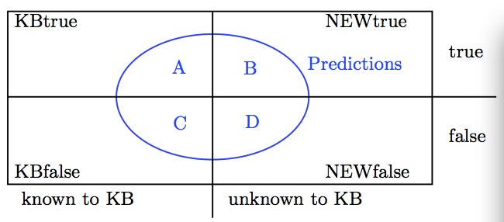
Mining Model
Goal: to find rules that make true predictions that go beyond the current KB.

Slide 12
Mining Model
Goal: Maximize the area B, and minimize the are D.
Obvious challenges
The area Newtrue and Newfalse are unknown;
Semantic KBs do not contain negative evidence.
Solutions
Support: the support of a rule quantifies the number of correct predictions, i.e., the size of A.
The number of distinct pairs of subjects and objects in the head of all instantiations that appear in the KB

Slide 13

Mining Model
Solutions
Head Coverage: the proportions of pairs from the head relation that are covered by the predictions of the rule.
Partial Completeness Assumption (PCA): the assumption that if r(x,y) in KBtrue for some x, y, then:
If the database knows some r-attribute of x, then it knows all r-attributes of x.

Slide 14

Mining Model
Solutions
PCA Confidence: not only by the entire set of facts, but by the set of facts of which we know that they are true, together with the facts of which we assume that they are false.

Slide 15
AMIE system
Explore the search space by iteratively extending rules by mining operators.
Mining Operators: a rule is a sequence of atoms, the first atom is the head atom, and the others are the body atoms.
Add Dangling Atom (O_{D}): add a new atom to a rule.
Add Instantiated Atom (O_{I}): add a new atom to a rule that uses an entity for one argument and shares the other argument (variable or entity) with the rule.
Add Closing Atom (O_{C}): add a new atom to a rule so that both of its arguments are shared with the rule.

Slide 16
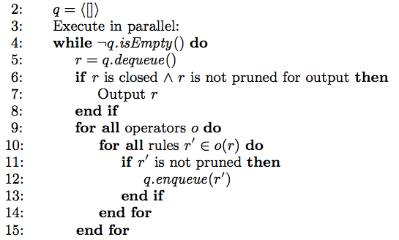
Rule mining algorithm

Slide 17
AMIE system
Pruning
Rules that cover, for example, less than 1% of the facts of the head relation can safely assumed to be marginal. Therefore, they set θ=0.01 as a lower bound for the head coverage.
If a rule B₁∧B₂∧…∧B_{n+1}=>H does not have larger confidence than the rule B₁∧B₂∧…∧B_{n}=>H, then we do not output the longer rule.
Never enqueue a rule that is already in the queue, just by comparing the measures such as head coverage, confidence, and PCA confidence.

Slide 18
AMIE system
Project Queries
No matter what operator is applied in particular, the algorithm needs to choose a relation for the new atom that is added to the rule.

