Slide 1
Title: Stream Reasoning (A series of paper)
Conference/Journal: WWW, IEEE Intelligent System, ISWC, CIKM, AAAI, IJCAI
Author: Barbieri , Calbimonte , Anicic, Jeff, etc.
Time: 2009-2013

Slide 2
Outline
Motivation
Related Work
Major Contribution
Solution
Major Results
Lessons

Slide 3
Outline
Motivation
Related Work
Major Contribution
Solution
Major Results
Lessons

Slide 4
Motivation
Reasoning upon rapidly changing information (Barbieri): focus on continuous query, C-SPARQL [3-10][14][23]
Which content on the news Web portal is attracting the most attention?
Ontology –based access to stream data (Calbimonte): data integration [11][12][15]
Event processing and Stream reasoning (Anicic): similar to the work of Barbieri, etc. [1][2][13]
Ontology stream reasoning with description logic (Jeff): ontinuously and incrementally updating and materialising ontological knowledge bases [17-20]

Slide 5
Outline
Motivation
Related Work
Major Contribution
Solution
Major Results
Lessons

Slide 6
Related Work
Stream data base management system (DSMS)
Process query upon stream-based data sources
The execution environment of C-SPARQL is built upon DSMS engine and SPARQL
Event processing system (EP)
on-the-fly analysis of data streams enabling real-time decisions and actions
No higher-level knowledge representation and reasoning necessary for handling background knowledge

Slide 7
Related Work
Truth maintenance system (TMS):
not only reasoning results, but also intermediate results and the deduction relations among them
excessive memory consumption
Jeff, et. al build ontology stream reasoning system based on TMS with novel DL algorithm

Slide 8
Outline
Motivation
Related Work
Major Contribution
Solution
Major Results
Lessons

Slide 9
Contributions
C-SPARQL: continuous query grammar, execution environment, applications with social media/hurricane sensors
Ontology-based access: ontology-based stream data integration
Event processing: a language, a logic-based account and an prototype, for complex events and stream reasoning

Slide 10
Contributions
Ontology stream reasoning: scalable reasoning via syntactic approximation, optimizing ontology stream reasoning with TMS, knowledge prediction based on ontology stream, change diagnosis

Slide 11
Outline
Motivation
Related Work
Major Contribution
Solution
Major Results
Lessons

Slide 12
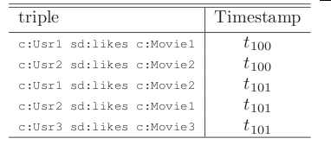
C-SPARQL
Add timestamps to all the RDF triples

Slide 13
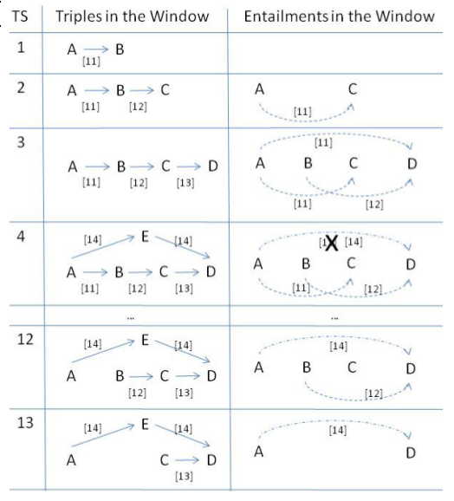
C-SPARQL

Slide 14
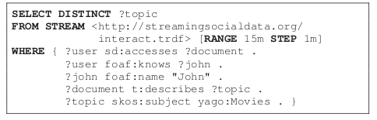
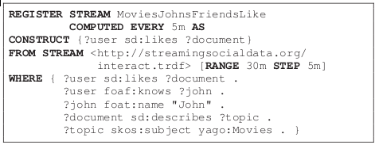
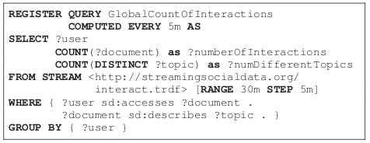
C-SPARQL

Slide 15
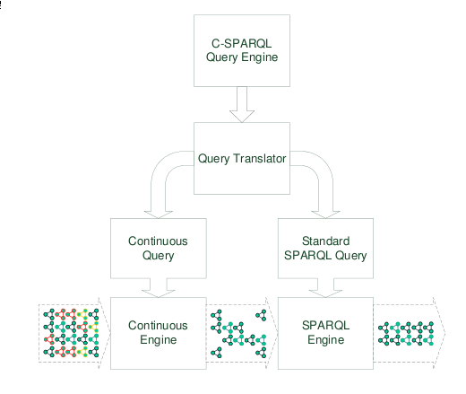
C-SPARQL

Slide 16
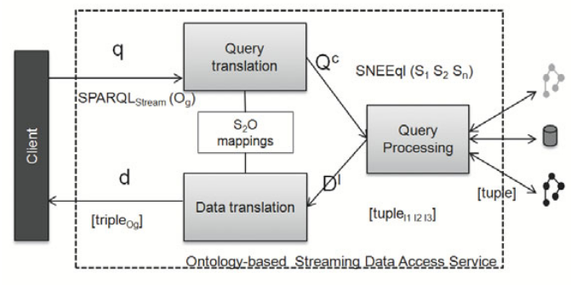
Ontology-based Access
Propose S2O: link stream data (stored relational data) to ontology
Design SPARQL-Stream: query stream data

Slide 17
Event Processing
Similar to C-SPARQL, but for event processing application, e.g. the most popular topic on twitter

Slide 18
Ontology Stream Reasoning
Take the example of knowledge prediction (paper in IJCAI):
Implement ontology stream based on TMS
Describe autocorrelation by DL in ontology stream
Describe association rule by DL in ontology stream
Adopt autocorrelation to select association rules
Prediction with association rules

Slide 19
Outline
Motivation
Related Work
Major Contribution
Solution
Major Results
Lessons

Slide 20
Result
C-SPARQL: very mature, with demos, code of engine, and tens of paper (09-10)
Ontology-based access and event processing: with several paper
Ontology stream: mainly the DL algorithms with several paper (AAAI, IJCAI, CIKM), has experiments but no prototype and code

Slide 21
Reference
[1] Anicic, D., Fodor, P., Rudolph, S. & Stojanovic, N. EP-SPARQL: a unified language for event processing and stream reasoning Proceedings of the 20th international conference on World wide web ACM, 2011, pp. 635-644
[2] Anicic, D., Rudolph, S., Fodor, P. & Stojanovic, N. Stream reasoning and complex event processing in etalis Semantic Web, IOS Press, 2012, Vol. 3(4), pp. 397-407
[3] Barbieri, D., Braga, D., Ceri, S., Della Valle, E. & Grossniklaus, M. Stream reasoning: Where we got so far Proceedings of the 4th workshop on new forms of reasoning for the Semantic Web: Scalable & dynamic 2010, pp. 1-7

Slide 22
Reference
[4] Barbieri, D., Braga, D., Ceri, S., Valle, E. & Grossniklaus, M. Incremental Reasoning on Streams and Rich Background Knowledge Aroyo, L., Antoniou, G., Hyvönen, E., Teije, A., Stuckenschmidt, H., Cabral, L. & Tudorache, T. (ed.) The Semantic Web: Research and Applications Springer Berlin Heidelberg, 2010, Vol. 6088, pp. 1-15
[5] Barbieri, D., Braga, D., Ceri, S., Valle, E., Huang, Y., Tresp, V., Rettinger, A. & Wermser, H. Deductive and Inductive Stream Reasoning for Semantic Social Media Analytics Intelligent Systems, IEEE, 2010, Vol. 25(6), pp. 32-41
[6] Barbieri, D.F., Braga, D., Ceri, S., Della Valle, E. & Grossniklaus, M. C-SPARQL: SPARQL for continuous querying Proceedings of the 18th international conference on World wide web ACM, 2009, pp. 1061-1062

Slide 23
Reference
[7] Barbieri, D.F., Braga, D., Ceri, S., Della Valle, E. & Grossniklaus, M. Continuous Queries and Real-time Analysis of Social Semantic Data with C-SPARQL SDoW2009 CEUR-WS.org, 2009, Vol. 520
[8] Barbieri, D.F., Braga, D., Ceri, S. & Grossniklaus, M. An execution environment for C-SPARQL queries Proceedings of the 13th International Conference on Extending Database Technology ACM, 2010, pp. 441-452
[9] Barbieri, D.F., Braga, D., Ceri, S., Valle, E.D. & Grossniklaus, M. Querying RDF streams with C-SPARQL SIGMOD Rec., ACM, 2010, Vol. 39(1), pp. 20-26

Slide 24
Reference
[10] Bolles, A., Grawunder, M. & Jacobi, J. Streaming SPARQL extending SPARQL to process data streams Proceedings of the 5th European semantic web conference on The semantic web: research and applications Springer-Verlag, 2008, pp. 448-462
[11] Calbimonte, J.-P., Corcho, O. & Gray, A. Enabling Ontology-Based Access to Streaming Data Sources Patel-Schneider, P., Pan, Y., Hitzler, P., Mika, P., Zhang, L., Pan, J., Horrocks, I. & Glimm, B. (ed.) The Semantic Web – ISWC 2010 Springer Berlin Heidelberg, 2010, Vol. 6496, pp. 96-111
[12] Calbimonte, J.-P., Corcho, O. & Gray, A.J. Ontology-based Access to Streaming Data Poster at the 7th Extended Semantic Web Conference (ESWC2010). Hersonissos, Greece 2010

Slide 25
Reference
[13] Cugola, G. & Margara, A. Processing flows of information: From data stream to complex event processing ACM Comput. Surv., ACM, 2012, Vol. 44(3), pp. 15:1-15:62
[14] Della Valle, E., Ceri, S., Braga, D., Celino, I., Frensel, D., van Harmelen, F. & Unel, G. Research chapters in the area of stream reasoning SR2009, 2009, Vol. 466
[15] Heintz, F. & Dragisic, Z. Semantic information integration for stream reasoning Information Fusion (FUSION), 2012 15th International Conference on 2012, pp. 1454-1461

Slide 26
Reference
[16] Lanzanasto, N., Komazec, S. & Toma, I. Reasoning over real time data streams 2012
[17] Lecue, F. & Pan., J.Z. Predicting Knowledge in An Ontology Stream Proc. of the 23rd International Joint Conference on Artificial Intelligence (IJCAI 2013). 2013
[18] Lécué, F. Diagnosing Changes in An Ontology Stream: A DL Reasoning Approach. AAAI 2012

Slide 27
Reference
[19] Ren, Y. & Pan, J.Z. Optimising ontology stream reasoning with truth maintenance system Proceedings of the 20th ACM international conference on Information and knowledge management ACM, 2011, pp. 831-836
[20] Ren, Y., Pan, J.Z. & Zhao, Y. Towards Scalable Reasoning on Ontology Streams via Syntactic Approximation Proc. of IWOD, 2010
[21] Stuckenschmidt, H., Ceri, S., Della Valle, E., van Harmelen, F. & di Milano, P. Towards expressive stream reasoning Proceedings of the Dagstuhl Seminar on Semantic Aspects of Sensor Networks 2010

Slide 28
Reference
[22] Valle, E., Ceri, S., Barbieri, D., Braga, D. & Campi, A. A First Step Towards Stream Reasoning Domingue, J., Fensel, D. & Traverso, P. (ed.) Future Internet – FIS 2008 Springer Berlin Heidelberg, 2009, Vol. 5468, pp. 72-81
[23] Valle, E.D., Ceri, S., van Harmelen, F. & Fensel, D. It's a Streaming World! Reasoning upon Rapidly Changing Information IEEE Intelligent Systems, IEEE Computer Society, 2009, Vol. 24(6), pp. 83-89
[24] Walavalkar, O.B. Streaming knowledge bases ProQuest, 2007

Slide 29
Outline
Motivation
Related Work
Major Contribution
Solution
Major Results
Lessons

Slide 30
Lessons
Title: Predictive Reasoning in Multiple Spatial Data Streams

Slide 31
Problem Motivation: Air Quality Forecasting
1. The streams are spatially correlated: each air quality station is correlated with some others
2. Predict multiple spatial time-series: air quality prediction for each station
3. Generate new knowledge stream: Continuous reasoning, semantic query, enrich air quality records, etc.
4. Other Scenarios: waterlogging, traffic jam, forest temperature, water contamination, etc

Slide 32
Problem Statement
Prediction for multiple spatial data, in fact, is real-time pattern matching
Use ontology for structured spatial data and knowledge
Enable stream reasoning
Simpler integration of heterogeneous data and Web interpretation on the Web
Use stream reasoning:
Combine static knowledge, and perform reasoning task
Providing and evaluating domain knowledge

Slide 33
Related Work
Spatial Data Streams: pattern discovery, classification, summarization
Few for prediction of data streams
Less consideration of spatial correlation
Stream Reasoning: C-SPARQL, ontology reasoning, ...
We need numeral predictive inference

Slide 34
Contributions
Predictive reasoning for spatial data streams:
Accurate Prediction with multiple spatially correlated data streams
Continuous predictive knowledge stream with C-SPARQL
Scalability of the method

Slide 35
Method
1. Find correlations among spatial data streams and hidden variables with PCA or spatial analysis, ...
2. Predict with domain rules (trained ANNs)
3. Ontology-based access to stream data for structured RDF stream
4. Stream reasoning for RDF stream and static knowledge base

Slide 36
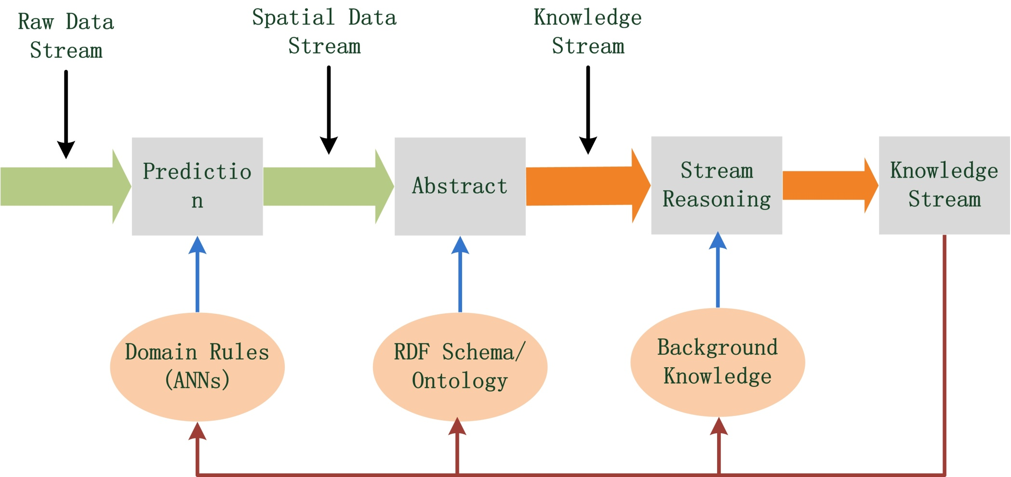
Method

Slide 37
Performance
Apply to the application of air quality:
Evaluation of prediction: compare to prediction without consideration of spatial correlation
Stream reasoning capabilities
Scalability:
increment of throughput
number of streams

