Slide 1
Title:GeoScope: Online Detection of Geo-Correlated Information Trends in Social Networks
Conference/Journal::VLDB2013
Author:Ceren Budak
Time:2013

Slide 2
Outline
Motivation
Related Work
Major Contribution
Solution
Major Results
Lessons

Slide 3
Outline
Motivation
Related Work
Major Contribution
Solution
Major Results
Lessons

Slide 4
Motivation
Geography plays an important role in various aspects of our lives.
Geographical signals can also be used to extract relevant information from the public for crisis management
Thereis need for algorithmic solutions that capture geo-intent and detect informational trends in a scalable fashion

Slide 5
Outline
Motivation
Related Work
Major Contribution
Solution
Major Results
Lessons

Slide 6
Related Work
Social Networks Analysis
Trend detection in social networks has been an important research area in the recent years
Geo-tagging social content is an important sub-task in our study

Slide 7
Related Work
Data Streams and Detecting Significant Co-occurences
Algorithms for answering frequent elements queries (heavy-hitters) are broadly divided into two categories: sketch-based and counterbased.
There has been some effort in multi-dimensional data streams
Identifying significant co-occurrences is also an important problem
for the data mining and information retrieval communities

Slide 8
Outline
Motivation
Related Work
Major Contribution
Solution
Major Results
Lessons

Slide 9
Major Contribution
An algorithmic tool for detecting geotrends in online social networks by reporting trending and correlated location - topic pairs.
GeoScope also captures the temporality of trends by detecting geo-trends along a sliding window.
GeoScope detects significant events ranging from emergency events to political demonstrations to concerts and sports events.

Slide 10
Outline
Motivation
Related Work
Major Contribution
Solution
Major Results
Lessons

Slide 11
Solution
We denote the set of all topics as T={t1,t2…}and the set of all locations as L={l1,l2 …}
Problem Definition
Given a stream S of location-topic pairs of the form (li,tj) and three user defined frequency thresholdsφψθand in the interval[0, 1];

Slide 12
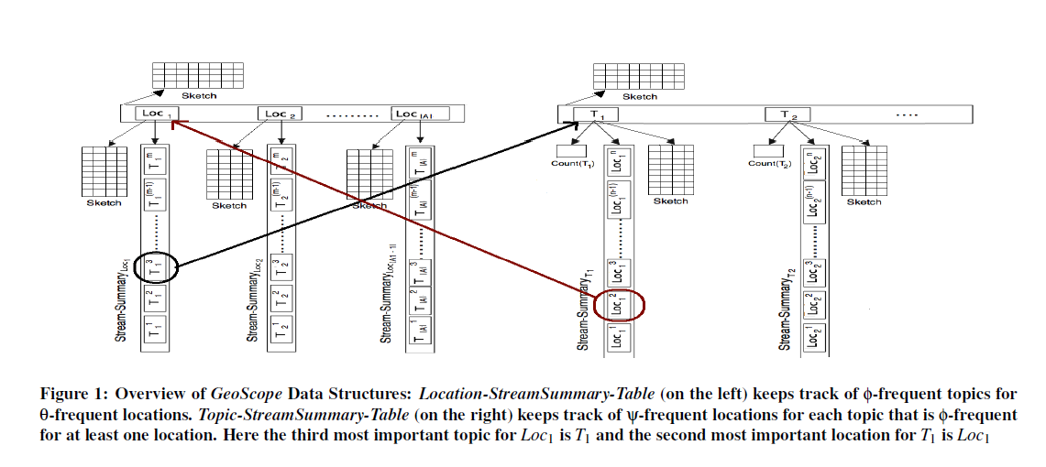
Solution

Slide 13
Solution
GeoScope Case Study: Twitter
three baselines:
Traditional Heavy-Hitters Approach (THHA)
Geographical Heavy-Hitters Approach (GHHA)
Statistically Significant Topic-Location Detection (SSTLD)

Slide 14
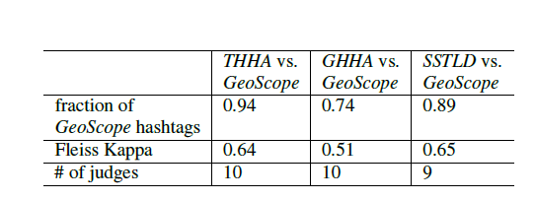
Solution

Slide 15
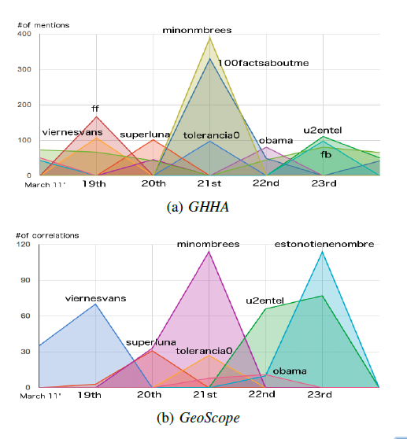
Solution

Slide 16
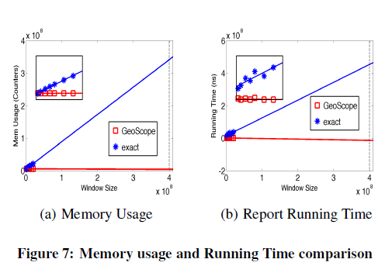
Solution

Slide 17
Outline
Motivation
Related Work
Major Contribution
Solution
Major Results
Lessons

Slide 18
Lessons
The premise and problem definition is worth learning.
Data Streams and Detecting Significant Co-occurences.

