Slide 1
Title: Bio2RDF: Towards a mashup to build bioinformatics knowledge systems
Conference/Journal: Biomedical informatics
Author: Francois Belleau
Time: 2008

Slide 2
Outline
Motivation
Related Work
Major Contribution
Solution
Major Results
Lessons

Slide 3
Outline
Motivation
Related Work
Major Contribution
Solution
Major Results
Lessons

Slide 4
Motivation
It is hard to make full use of numerous available biomedical databases because each has its own formats, terminology….
There is a pressing need to build a mashup system to help the integration of biomedical data

Slide 5
Outline
Motivation
Related Work
Major Contribution
Solution
Major Results
Lessons

Slide 6
Related Work
Existing integration methods in bioinformatics
Integration using a semantic approach.

Slide 7
Outline
Motivation
Related Work
Major Contribution
Solution
Major Results
Lessons

Slide 8
Major Contribution
1. Create a biomedical ontology based on html analysis.
2. Present basic steps to build mashups of bioinformatics data

Slide 9
Outline
Motivation
Related Work
Major Contribution
Solution
Major Results
Lessons

Slide 10
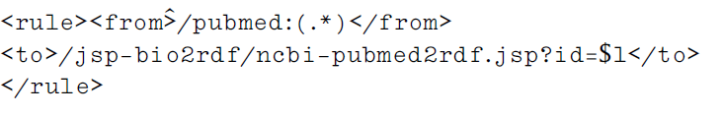
Step1 : URI Normalization
build a list of namespaces for different data providers to provide a mapping from source url to destination url
Eg.
source url :http://bio2rdf.org/jsp-bio2rdf/ncbi- pubmed2rdf.jsp?id=12728276

Slide 11
Step2 :Ontology Design
1. analyze the existing HTML page to identify the predicates and relations describing the entities to produce an OWL description for every html document.
2. repeated for each namespace recognized by the current version of Bio2RDF: GO, OMIM, PDB, etc.For BioPAX and UniProt, this step was unnecessary because their OWL schema was already available.
3. Merge the ontology of each namespace to form final ontology description

Slide 12
Step3 :RDFizer
JSP tools were used to create rdfizers, which are programs transforming existing data into an RDF representation,(relational databases, text files, XML documents, and HTML pages)
Eg. ncbi-omim2rdf.jsp
Fetch the XML result by web service provided by nebi efetch service
the information for the document is extracted according to the ontology previously created

Slide 13
Outline
Motivation
Related Work
Major Contribution
Solution
Major Results
Lessons

Slide 14
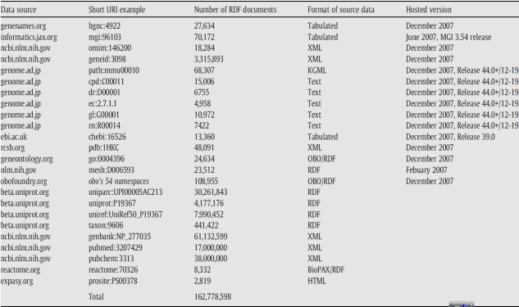
Major Results
Integration datasets:

Slide 15
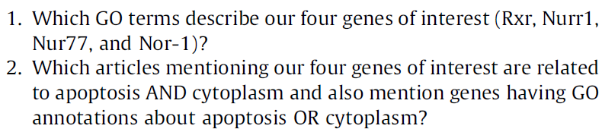
Major Results
Parkinson use case: by answering two questions

Slide 16
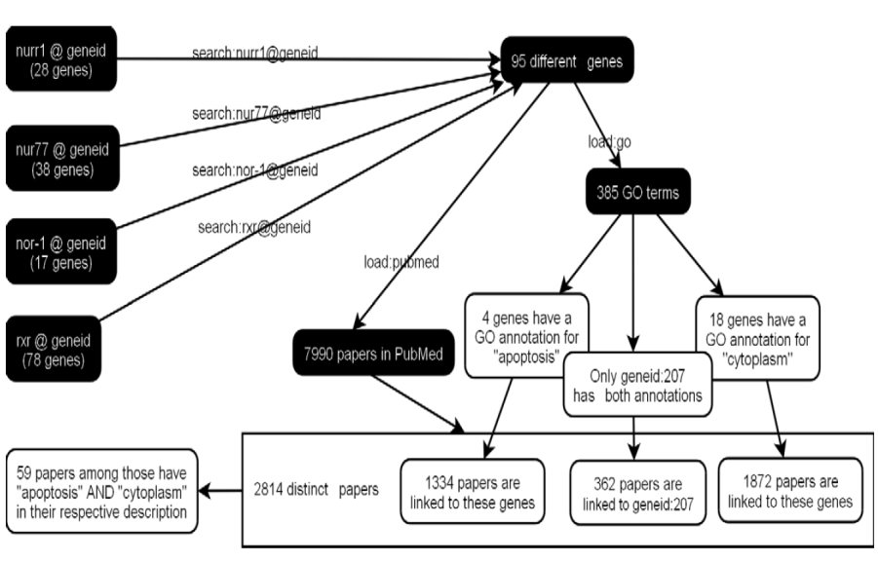
Major Results

Slide 17
Outline
Motivation
Related Work
Major Contribution
Solution
Major Results
Lessons

Slide 18
Lessons
1. Ontology desiging method
2. Biomedical mashup system may be used in TCM document

