Slide 1

Title: Ontology-based information extraction(OBIE) :an introduction and survey of current approaches
Conference/Journal: Journal of Information Science
Author: Daya C. Wimalasuriya, Dejing Dou
Time: 2010

Slide 2
Outline
Introduction
Major Contribution
Details
Lessons
Notes:
<number>

Slide 3
Introduction
1. It briefly discusses the general idea of IE (information extraction) : automatically retrieve certain types of information from natural language text.
2. Then , it explains why ontologies and IE (information extraction) can be combined to enable the development of OBIE (Both are specified for particular domains)

Slide 4
Outline
Motivation
Major Contribution
Solution
Major Results
Lessons

Slide 5
Major Contribution
Provide the characteristics and definition for an OBIE system:
Present the common architectures and general functionality.
Classification for OBIE
Describe common implementation tools and performance and evaluation

Slide 6
Outline
Introduction
Major Contribution
Detail
Major Results
Lessons

Slide 7
OBIE Definition
Some factors that make OBIE different from IE
Input: unstructured or semi-structured natural language text
Present the output using ontologies
Use an IE process guided by an ontology

Slide 8
Why OBIE is valuable
Automatically processing the information contained in natural language text, since most of the information in web is text.
Create semantic contents for the Semantic Web
Improve the quality of ontologies.

Slide 9
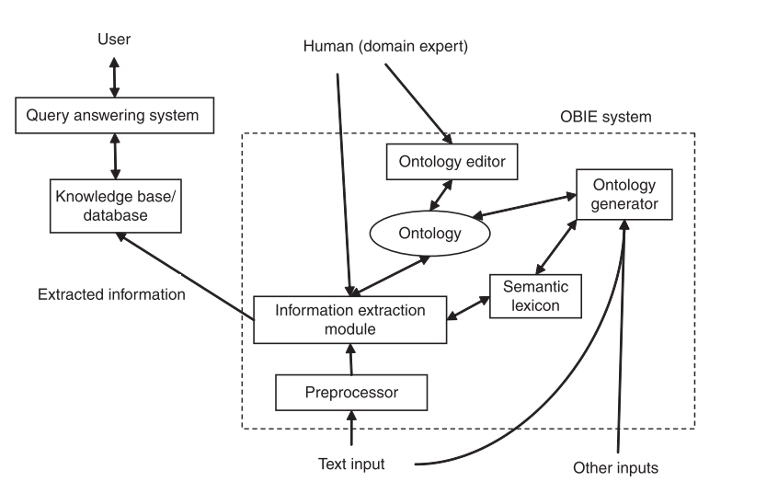
OBIE architecture

Slide 10
Classification of current OBIE
Information extraction method.(important)
If it acquires the ontology or not in the information extraction
Types of different sources

Slide 11
1.Different information extraction method
1) Automatically processing the information contained in natural language text, since most of the information in web is text.
2) Create semantic contents for the Semantic Web
3) Improve the quality of ontologies.

Slide 12
1.1Linguistic rules represented by regular expressions
General idea: specify regular expressions to capture certain types of information.
Example: the expression (watched|seen) <NP> might capture the names of movies (represented by the noun phrase) in a set of documents

Slide 13
1.2.Gazetteer lists
General idea: recognize individual words or phases instead of patterns based on a gazetteer list.
Example: gazetteer lists can be used to recognize states of the US or countries of the world. (widely used in named-entity recognition task)

Slide 14
1.3.Classification techniques
1. General idea: classifiers are trained to identify different components of an ontology such as instances and property values.

Slide 15
1.4.other IE methods
1.4. Construction of partial parse trees
1.5. Analyzing HTML/XML tags
1.6.Types of input text sources

Slide 16
2.common tools
1. Shallow NLP tools:
GATE、sProUT、Stanford NLP、CIIR...
2. semantic lexicons: WordNet、GermaNet..
3. Standard Text corpora (gold standard).

Slide 17
3.Evaluation parameter
1.precision
2.recall
3.f-measure

Slide 18
Outline
Introduction
Major Contribution
Details
Lessons
Notes:
<number>

