Slide 1
Linked Data A Global Distributed Dataspace
Jiaoyan Chen
Aug 17, 2012

Slide 2
Content
From a Web of Document to a Web of Data
What is Linked Data
How to Consume Linked Data
Applications
What we can contribute and utilize

Slide 3
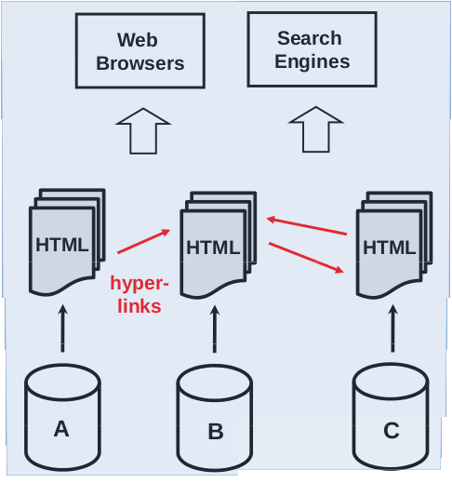
The classic web
Single Global Informaction Space
URLs as
Globally unique IDs
Retrieval mechanism
HTML as shared content format
Hyperlinks

Slide 4
Problem and solution
Problem
As Web content is only loosely structured it is
difficult for applications to do smart things with it
Solution
Increase the structure of Web content

Slide 5
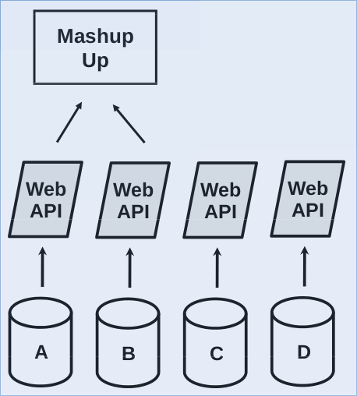
Web APIs and Mashups
Shortcomings
APIs provide proprietary interfaces
Mashups are based on a fixed set of data sources
You can not set hyperlinks between data objects

Slide 6
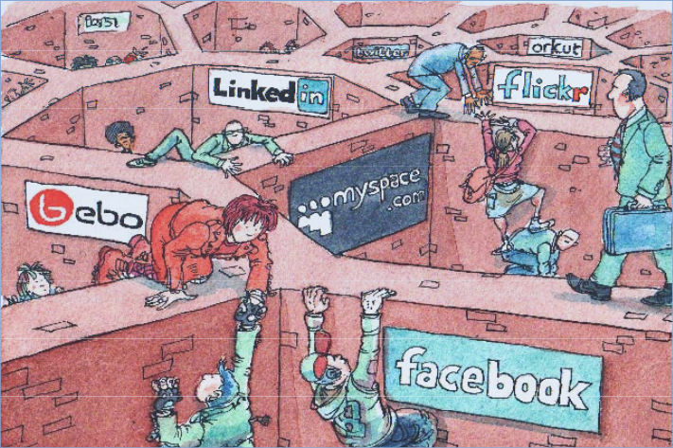
Web APIs slice the Web into Walled Gardens

Slide 7
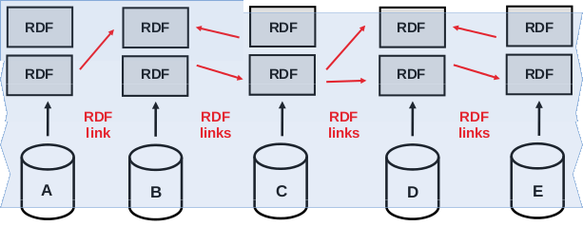
What is Linked Data
Use Semantic Web technologies to
publish structured data on the Web,
set links between data from one data source to data within other data sources.

Slide 8
Linked Data Principles
Use URIs as names for things
Use HTTP URIs so that people can look up those names
When someone looks up a URI, provide useful RDF URI information
Include RDF statements that link to other URIs so that they can discover related things

Slide 9
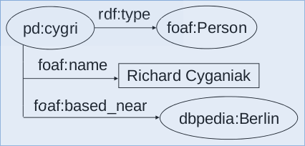
The Rdf data model

Slide 10
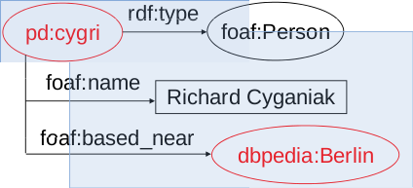
Data items are identified with HTTP URIs
pd:cygri = http://richard.cyganiak.de/foaf.rdf#cygri
dbpedia:Berlin = http://dbpedia.org/resource/Berlin

Slide 11
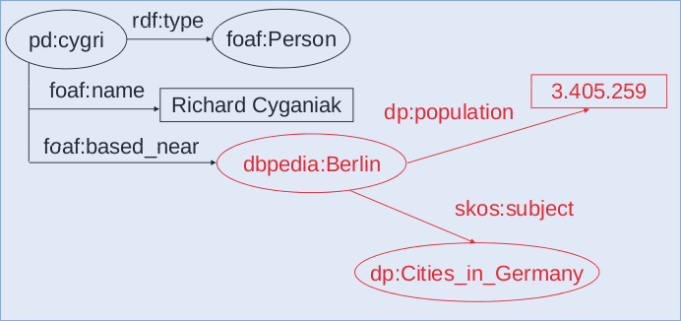
Resolving URIs over the Web

Slide 12
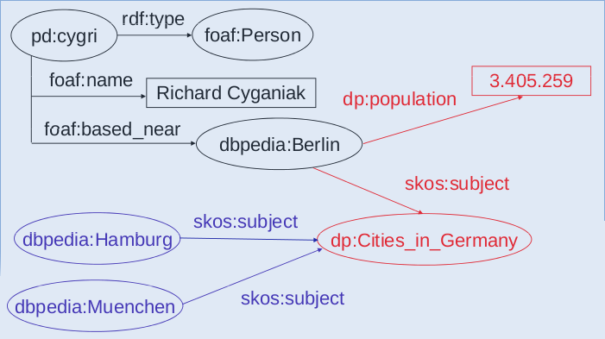
Dereferencing URIs over the Web

Slide 13
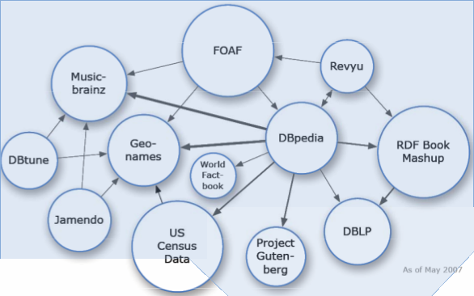
LOD Datasets Scale: May 2007

Slide 14
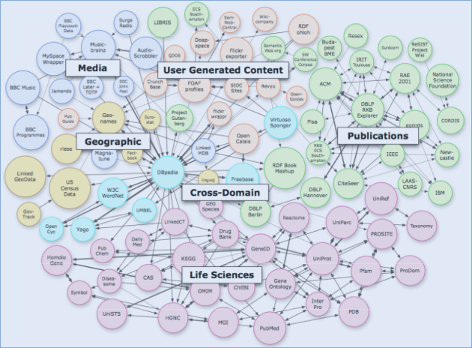
LOD Datasets Scale: july 2009

Slide 15
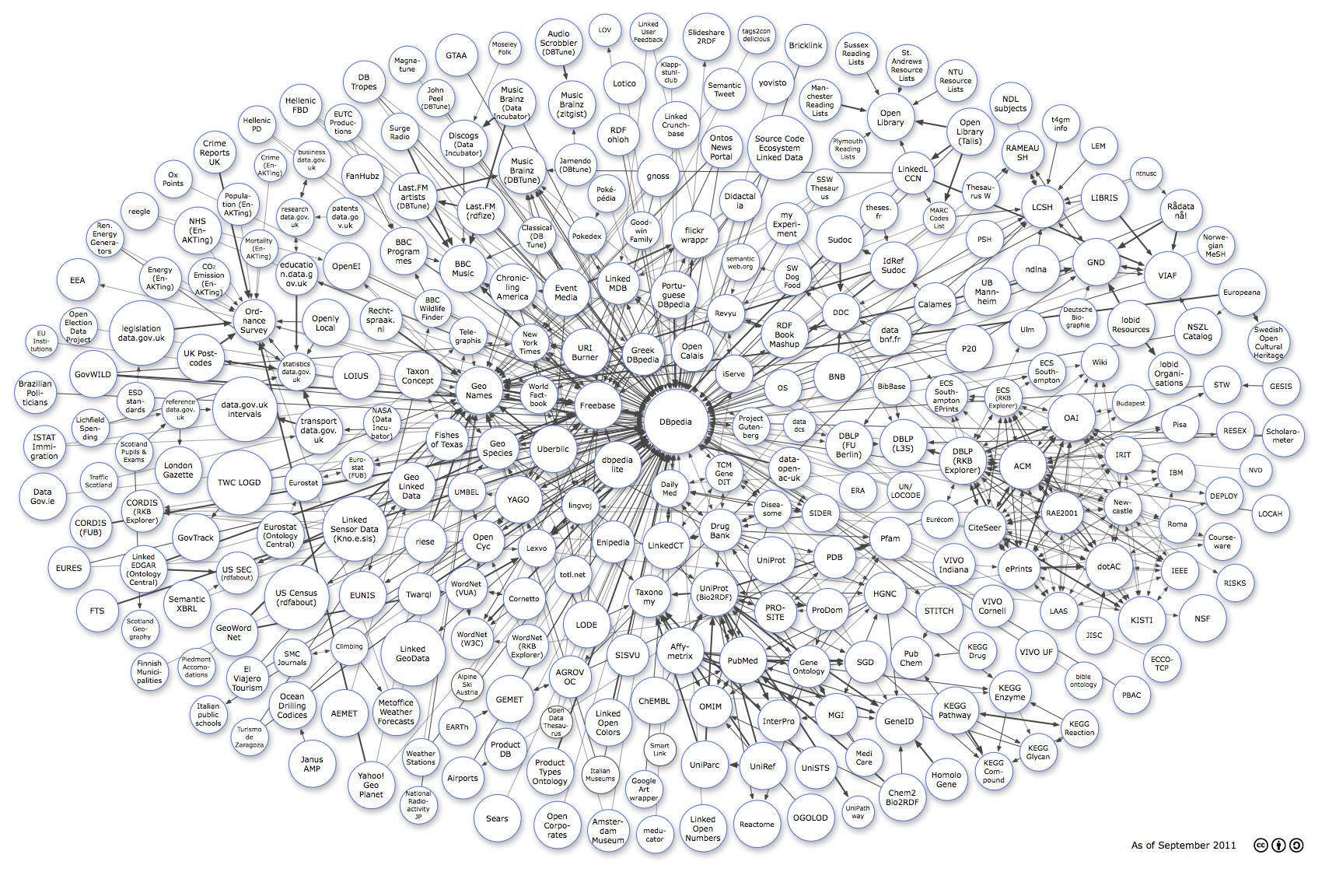
LOD Datasets Scale: sep 2011
Billions of Triples!!

Slide 16
How to consume linked data
Consuming Linked Data by Humans
Linked Data Browsers(Marbles, Fenfire, et.)
Semantic Search Engine(Swoogle, Falcons, et.)
Consuming Linked Data by Machines and Applications
Accessing and retrieving Linked Data
Querying Linked Data with SPARQL
Automated Linked Traversal

Slide 17
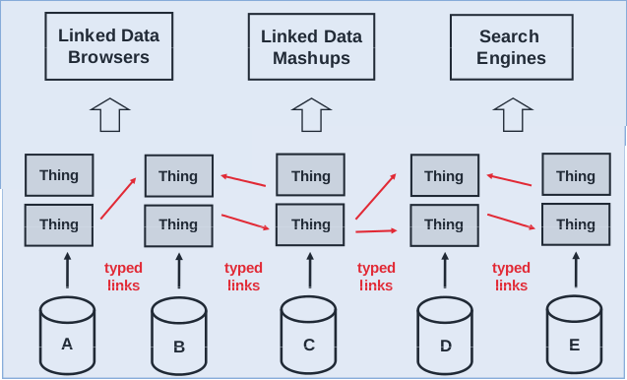
What can I do with linked data

Slide 18
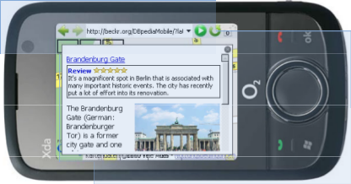
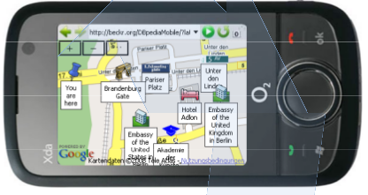
DBPedia mobile
Based on the GPS signal of a mobile, it is able to render a map indicating nearby locations from the Dbpedia, Revyu and Filckr data.

Slide 19
BBC’s new music beta site
Music metadata such as related artists are pulled from Musicbrainz, for those links pointing to Wikipedia, the introductory text for each artist’s biography is fetched from there

Slide 20
Extracting Enterprise Vocabularies Using Linked Open Data
A paper contributes a process to automatically extract a domain specific vocabulary (terms and types) from unstructured data in the en-terprise guided by term definitions in Linked Open Data
Dbpedia and Freebase are used

Slide 21
What we can contribute
We can link our Social-Groupbuy Dataset to LOD

Slide 22
What we can utilize
Automatically annotate text from text
Extract key words from groupbuy title, thus enhancing our background mashup engine

Slide 23
Thanks!

