Slide 1
Title: Ontology-based information extraction(OBIE) :an introduction and survey of current approaches
Conference/Journal: Information Science
Author: Daya C. Wimalasuriya, Dejing Dou
Time: 2010

Slide 2
Outline
Introduction
Major Contributions
Details
Lessons

Slide 3
Outline
Introduction
Major Contributions
Details
Lessons

Slide 4
Introduction
It briefly discusses the general idea of IE (information extraction) : automatically retrieve certain types of information from natural language text.
Then , it explains why ontologies and IE (information extraction) can be combined to enable the development of OBIE (Both are specified for particular domains)

Slide 5
Outline
Introduction
Major Contributions
Details
Lessons

Slide 6
Major Contributions
Provide the characteristics and definition for an OBIE system:
Present the common architectures and general functionality.
Classification for OBIE
Describe common implementation tools and performance evaluation parameters

Slide 7
Outline
Introduction
Major Contributions
Details
Lessons

Slide 8
OBIE Definition
Several requirements:
Input: unstructured or semi-structured natural language text
Present the output using ontologies
Use an IE process guided by an ontology
Formal definition: a system that processes unstructured or semi-unstructured natural language text through a mechanism guided by ontologies to extract certain types of information and presents the output using ontologies

Slide 9

Why OBIE is valuable
Automatically processing the information contained in natural language text, since most of the information in web is text.
Create semantic contents for the Semantic Web
Improve the quality of ontologies.

Slide 10
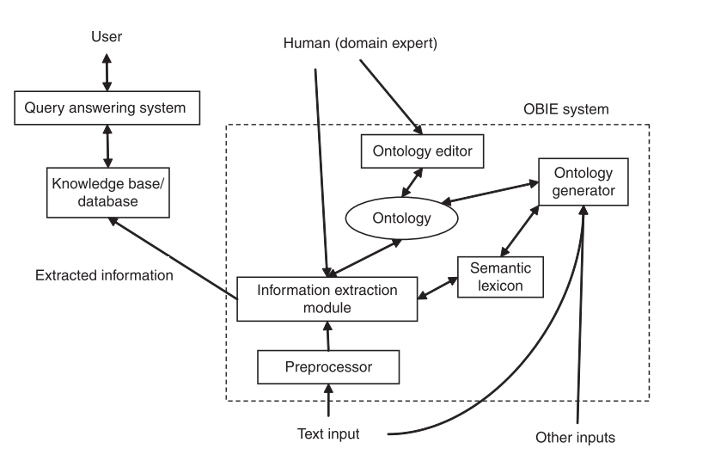
OBIE architecture

Slide 11
Classification of current OBIE
Information extraction method.(important)
If it acquires the ontology as input or not in the information extraction
Types of different sources (html, plain text, xml…)

Slide 12
1.1Linguistic rules represented by regular expressions
General idea: specify regular expressions to capture certain types of information.
Example: the expression (watched|seen) <NP> might capture the names of movies (represented by the noun phrase) in a set of documents
Systems: GATE,ontoX,Textpresso,KIM and so on.

Slide 13
1.2.Gazetteer lists
General idea: recognize individual words or phases instead of patterns based on a gazetteer list containing all instances of some classes of the ontology.
Example: gazetteer lists can be used to recognize states of the US or countries of the world. (widely used in named-entity recognition task)
Systems: SOBA…

Slide 14
1.3.Classification techniques
1. General idea: classifiers are trained to identify different components of an ontology such as instances and property values.

Slide 15
1.4.other IE methods
1.4. Construction of partial parse trees
1.5. Analyzing HTML/XML tags
1.6. Types of input text sources

Slide 16
2.Common IE tools
1. Shallow NLP tools:
GATE、sProUT、Stanford NLP、CIIR...
2. semantic lexicons: WordNet、GermaNet..
3. Standard Text corpora (gold standard).

Slide 17
3.Evaluation parameter
1.precision
2.recall
3.f-measure

Slide 18
Outline
Introduction
Major Contributions
Details
Lessons

Slide 19
Lessons
It is useful to have a basic understanding of IE and OBIE.
It enables me to be familiar with some common text parsers.

