Slide 1
Semantic Collaboration Compass
Milestone Report
January, 2012

Slide 2
1
Milestone-1 Task Descriptions
Topic | Fast Prototype
Objective | Finish a proof of concept of a prototype of the system with major UI interfaces implementation targeting at group-buying application.
Deliverables | SNS components for typical SNS services integrated to Semantic Wiki. Web UI for wiki widgets configuration tool. Web UI for portal configuration tool. Data importing tool based on sMash. Typical mashup-based wiki widgets for group buys are finished: SNS widgets, group buys widgets, micro-blog widgets, comments widgets, news widgets, etc.
Start | October1, 2011
End | December 30, 2011

Slide 3
2
Status Reports
1. Design 2 CC wiki Skins for choice
3. Finish 5 widgets with all data importing through sMash
4. Finish 7 special pages for portal/widget configuration
5. Integrate 3 most popular SNS services into CC by sMash
6. Integrate 2 popular group buying websites into CC by sMash
7. Integrate 2 popular microblog services
8. Design and develop a lightweight CC ontology
9. Support semantic data merging and integration with CC wiki
2. Finish 3 Templates for creating CC pages

Slide 4
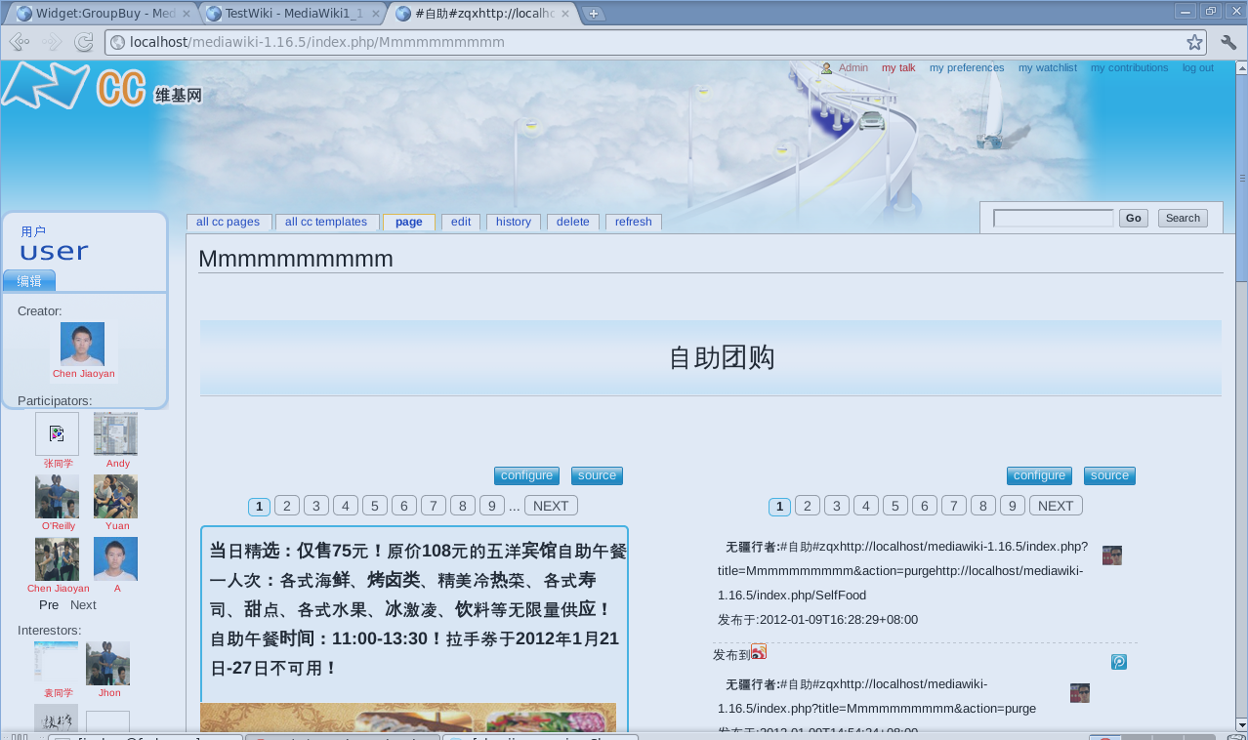
3
2 Skins for Choices

Slide 5
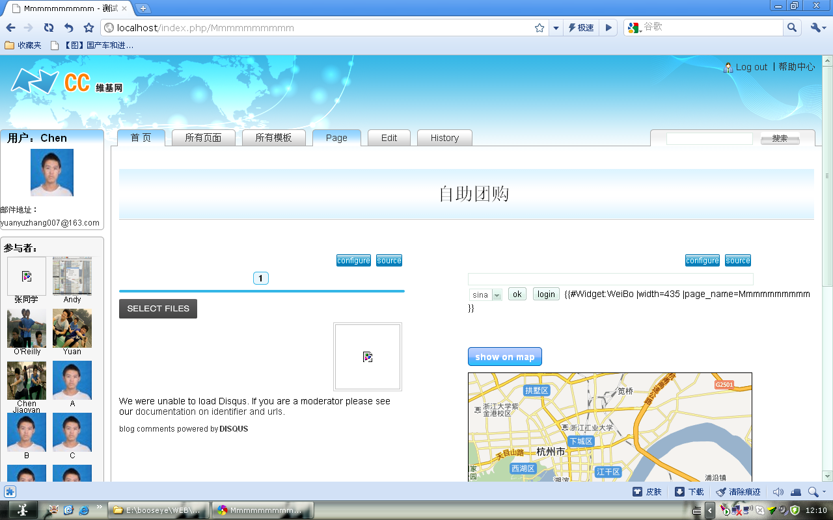
3
2 Skins for Choices

Slide 6
4
3 Templates
Restaurant Template
Traveling Template
E-Product Template

Slide 7






5
5 Widgets with real-time data importing
Group Buying Widgets
Micro Blog Widget
SNS Widget
Bus Info Widget
Comment Widget

Slide 8
6
7 Special Pages
Special Page for: SNS Invitation
Special Page for: Group Buying Widget Configuration
Special Page for: Microblog Widget Configuration
Special Page for: Participate
Special Page for: Show Interest
Special Page for: All CC Pages
Special Page for: All CC Templates

Slide 9
7
Semantic Data Importing Tools
We design a lightweight CC ontology
We develop a semantic mapping engine for group-buying and SNS, all data from different data APIs with different format and data models have been semantically merged before importing to CC.
Imported semantic data is queryable through SMW’s SPARQL query tools.
This means we can develop stronger semantic search functionality against those integrated semantic data stemming from different rest-ful data APIs. (This is important as most mashup data are structured)

Slide 10
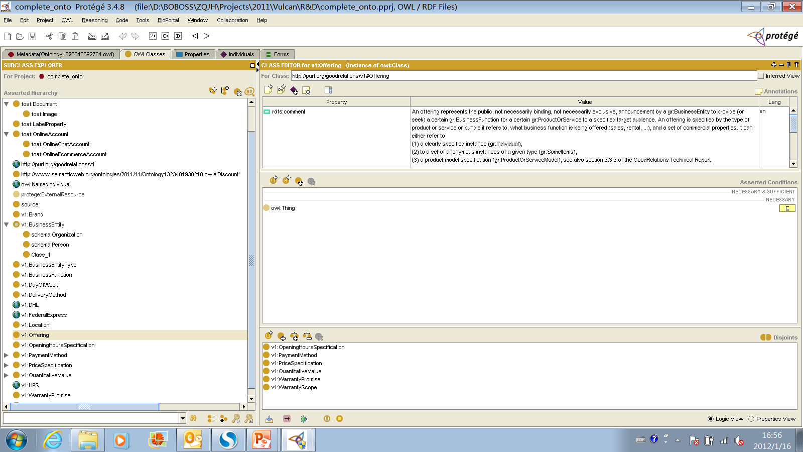
8
The CC ontology v1

Slide 11
9
Live Demo by Jiaoyan Chen

Slide 12
10
Next Steps- Milestone 2
Topic | Major components development
Objective | Finish major components development with a number of underlying support technologies.
Deliverables | A portal template repository with a number of easy-to-use portal templates. A wiki widgets repository with a number of easy-to-use widgets templates. Semantic filters with a number filtering approaches and algorithms. Content recommenders and data ranking algorithms integrated with certain wiki widgets. Semantic annotators integrated with wiki widgets. Semantic data exporter integrated with wiki widgets.
Start | January 1, 2011
End | April 30, 2011

Slide 13
11
Next Steps- Tasks
Invite 3-5 students to perform a mini evaluation on the prototype system and collect the report. Based on this report, we are going to
Optimize the workflows and user stories.
Improve the user experience.
Improve the stability of the whole system.
Redesign all templates, special pages and widgets.
More Templates, More Widgets and More APIs.
Develop at least 10 ready-to-use templates with necessary widgets.
Integrate > 10 most popular group buying data APIs in China.
Integrate > 8 most popular SNS services in China.
Integrate > 4 most popular micro-blog services in China.
Advanced Semantic Search and Filtering.
A new CC ontology with wider concept coverage and integrated into CC.
Semantic search to CC page discovery and contend recommendation.
Semantic filtering search for group buying configuration.
Shift to the Wiki-based project management tool.
Make a demo at SWMCon2012

Slide 14

Thanks for your attentions!

