Slide 1

Semantic Collaboration Compass: A Social Shopping Application
Team Work On-the-Fly
Huajun Chen (Zhejiang University), Jesse Wang (Vulcan)
2012/4/26

Slide 2
Outline
Motivation (4 mins)
Design and Implementation (8 mins)
Live Demo (10 mins)
Look Into Future (3 mins)
Q&A (5 mins)

Slide 3
Motivation
1

Slide 4








What is Social Shopping
Social Shopping is a method of e-commerce where shoppers' friends become involved in the shopping experience.
Social Shopping is very popular in China, a lot of social shopping websites publishing social shopping information instantly.
Almost all of such types of websites offer restful-based web service.

Slide 5
What is Collaboration Compass?
Collaboration Compass (CC) is a micro-wiki system and dynamic wiki system that uses a combination of short posts, charts, tweets, online mash-ups, etc., which are delivered as mini-wiki-widgets, to support on-the-fly social collaboration.
It is based on Semantic MediaWiki Plus (SMW+) and a semantic mash-up engine called sMash by Zhejiang University.
Collaboration Compass
Semantic MediaWiki +
Wiki Widgets
Social Network Service
sMash
Data Mashups

Slide 6
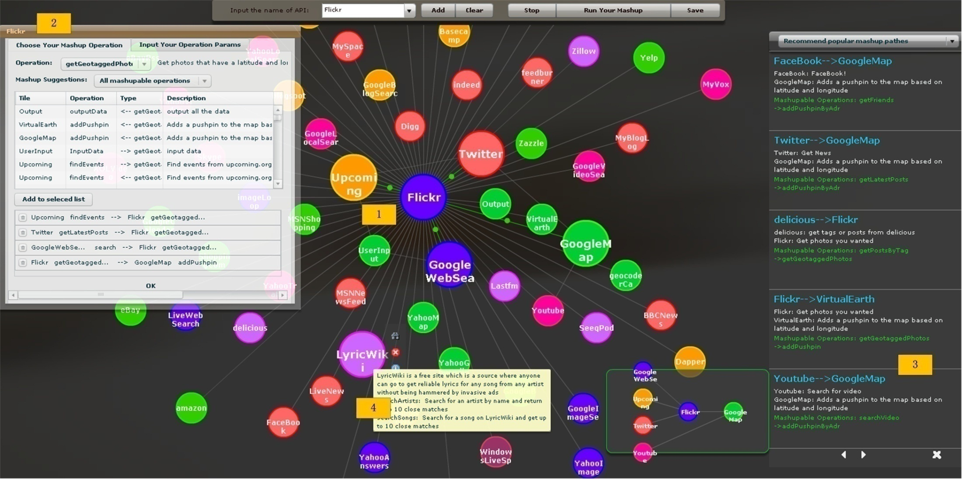
What is sMash
Search and Navigation with Semantics
Integration with Semantics
Mapping data to an Ontology
Synchronization With Online APIs

Slide 7
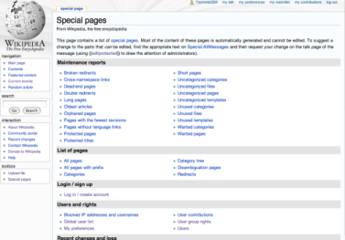








What we want to do for social shopping?
Social Participation
Semantic Wiki
Create wiki page
“G14 mobile Group-buying”
Manage Information
topic creator
Information Aggregation
Everything is based on Semantics
Invite friends
Semantic Mashup engine
G14 mobile
Filter
Detail information
Comments
@this plan
Purchase
SNS
APIs
Microblog APIs
Social Shopping
APIs
Comment APIs
Production Information
APIs

Slide 8
Typical Features
It serves smaller social circle for more focused, transient, recurring topics such as a “Hawaii vacation plan” instead of bigger domains such as a biological encyclopedia.
It offers mini-wiki-widgets to let users create editable, annotatable micro-contents such as tweets, mashups, charts, streams etc. instead of a whole page or just links.
Wiki widgets can be built upon online mash-ups, so the wiki content can be automatically synchronized.
Mashups are annotated and composited semantically, which have mappings to wiki ontologies so data can be easily imported into semantic wiki.
Popular Social Networks Services networks such as Facebook, Twitter, LinkedIn, Sina, Tencent, etc. will be natively supported.
Users will be able to collaborate through the web interface, email, SNS and mobile applications.

Slide 9
Design and Implementation
1

Slide 10
Design Principles
Everything is an (open) wiki page.
Everything is on clouds.
SNS, Deals, Comments, Blogs…… CC is just like a cloud bus
Keep things simple.
Simple UI, simple workflow, simple ontology…
Both data and UI are stored as wiki pages

Slide 11
Basic Implementation Ideas (1/2)
Integrate and import all kinds of SNS services such as facebook, twitter, renren, msn, sina-weibo, QQ, etc. on the fly by sMash to SMW.
No need to create and maintain a new SNS service.
Integrate different types of online data APIs by sMash and import mashuped data directly to SMW.
Data are delivered at real-time, no need to maintain a huge data center.
Each mashup corresponds to a wiki widget that is responsible for data visualization for mashuped data.

Slide 12
Basic Implementation Ideas (2/2)
Fine filters and content recommender are developed
Only relevant data will be delivered instantly.
Offer a number of mashup-based wiki widgets templates.
Can be configured and used all together by members of the group.
Mobile wiki widgets will also be supported in the future.

Slide 13
Data Page vs UI Page
A data page is generated by the sMash engine.
A UI page is created by user based on certain templates.
SNS Data Pages
ASK Queries
Web
API
Deal Data Pages
UI Pages
ASK Queries
Blog Data Pages
……
ASK Queries
Page Templates
Other Data Pages

Slide 14
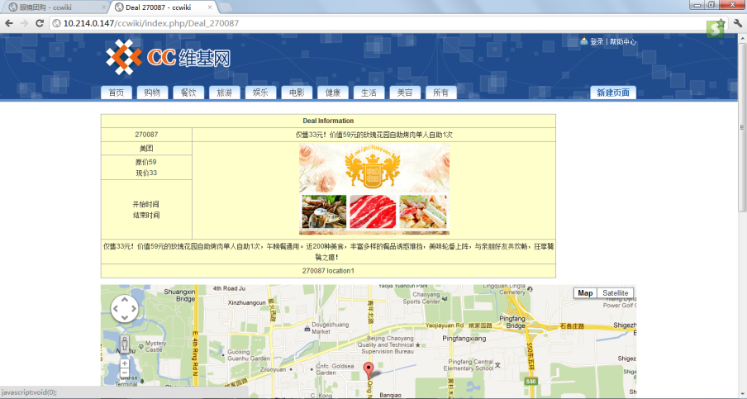
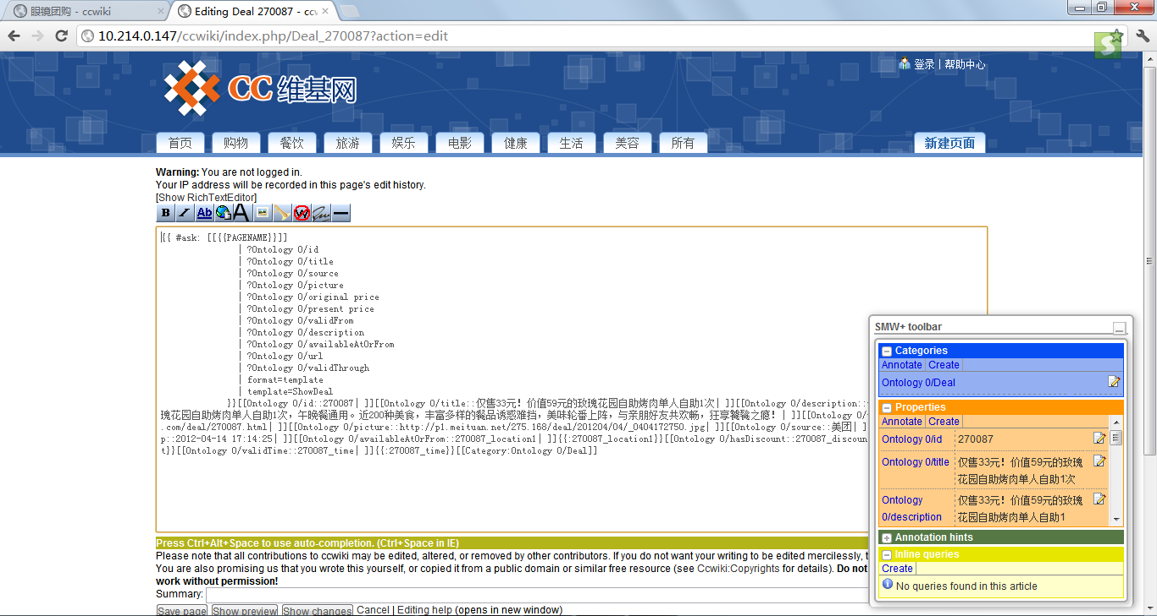
A Sample Data Page

Slide 15
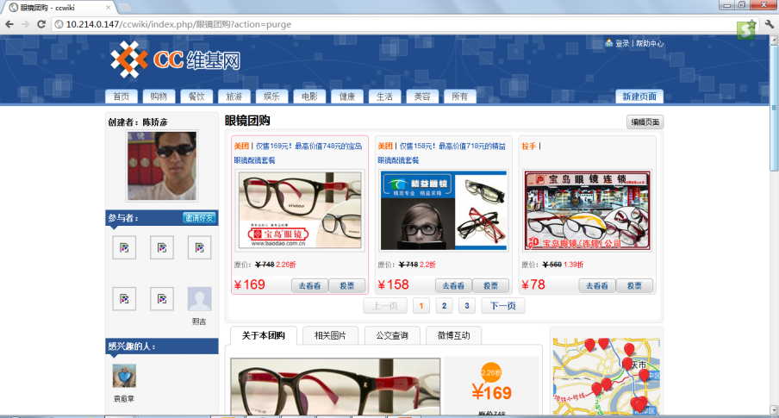
A Sample UI Page

Slide 16
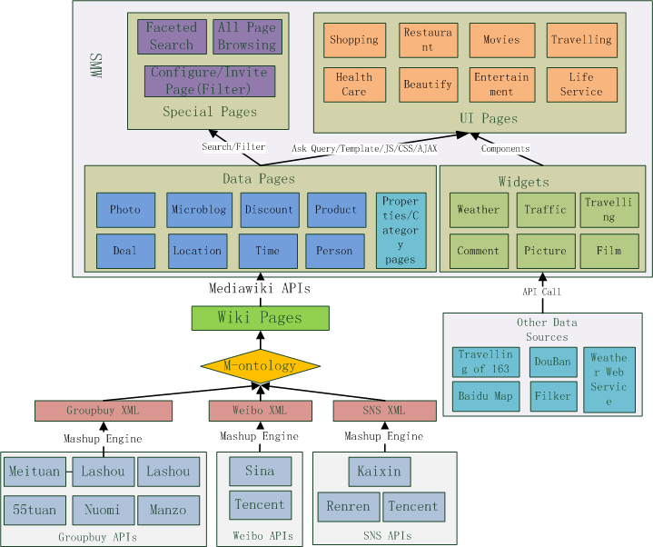
Technical Architecture
All data pages and UI pages can be searched by a customized facet search engine.
UI pages retrieve data from data pages through “ASK Query”.
A UI page is typically comprised of several wiki widgets that control the display of the semantic data.
All data are imported to SMW as semantic data pages.
Each wiki widget is a kind of semantic result format that can control the display of semantic data.
All data are mapped to the ontology so that heterogeneous data can be merged.
Data are mashuped from online APIs.

Slide 17
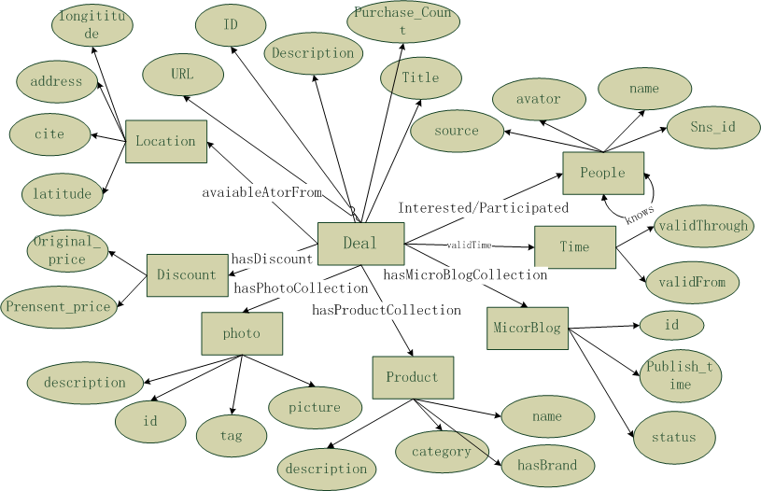
The CC Ontology
One category page is created for each class of the ontology

Slide 18
Facet Search Implementation
Two places where we use facet searches
Search all UI pages based Semantic Content in that Pages.
Filtering deal data pages while configuring social-shopping.

Slide 19
The problem of current facet search
Does not support the search of content that is generated through ASK Queries.
CC needs to search the content of UI pages that are typically generated by a number of ASK queries.

Slide 20
Solution
For each UI page, we generate a corresponding data page (called UI-data-page) by executing those ASK queries of that UI page.
The facet search engine simply indexes these UI-data-pages. While users search a UI-data-page, they will be re-directed to the corresponding UI pages.
We then write a spider(like a search engine spider) to periodically execute those UI pages to update corresponding data pages.

Slide 21
Data Sources Integrated
Social Shopping
Data Sources:
Micro Blog
Data Sources:
SNS
Data Sources:
Others:
Travelling
Data Sources:
Film
Data Source:
Meituan, Lashou, 55tuan, Nuomi, Ftuan, Manzo
Sina, Tencent
Kaixin, Renren, Tencent
Travelling of 163, dili360
Douban
Weather, Map and Traffic Information, Pictures from Filker , et

Slide 22
Live Demo

Slide 23
Look into the Future
1

Slide 24
Who may like the system? It is not only for Social Shopping…
Any user who wants a more structured discussion or collaboration on a topic
Sport team organization: roster, schedules, reminders, scores, fields, photos
Wedding, baby shower or other complicated process management
Project leaders who want collaborative information collecting beyond Microsoft Excel and Email
Any user who wants to build a more structured Content Management System
A local food guide or places of interest in a small town
A knowledge-base of architecture firm
Department and Office location, contact info and so on in a large corporation
Users who need a collaborative project portal
Distributed software project management system
School district donation management
Users who want to integrate online data sources and internal databases
Medical scientists need clinical trial data together with some Linked Open Data and/or their local databases
Financial engineers analyze their model results with some historical market data.

Slide 25
Other Applications Will be Developed
Agile project management in a small group.
Human-fresh search (人肉搜索：Social Search).
Party organization and family meet up.
Small-scale workshop/conferences organization.
Other social applications……
Small interesting groups or working groups.

Slide 26






Thanks for your attention and time! Welcome to visit Hangzhou and Zhejiang University

