Slide 1
Our Recent Work on RS Imagery Processing
Jul 25, 2012
Jiaoyan Chen

Slide 2
Title: Time-series Processing of Large Scale Remote
Sensing Data with Extreme Learning Machine

Slide 3
Key words: Extreme Learning Machine, Remote Sensing, Classification, Change
Detection, Time-series

Slide 4
Contributions:
1)a novel (ELM) based land-cover change detection method
2)high accuracy, high efficiency and little human intervention
3)analyis of rapid land use change in Taihu Lake region

Slide 5
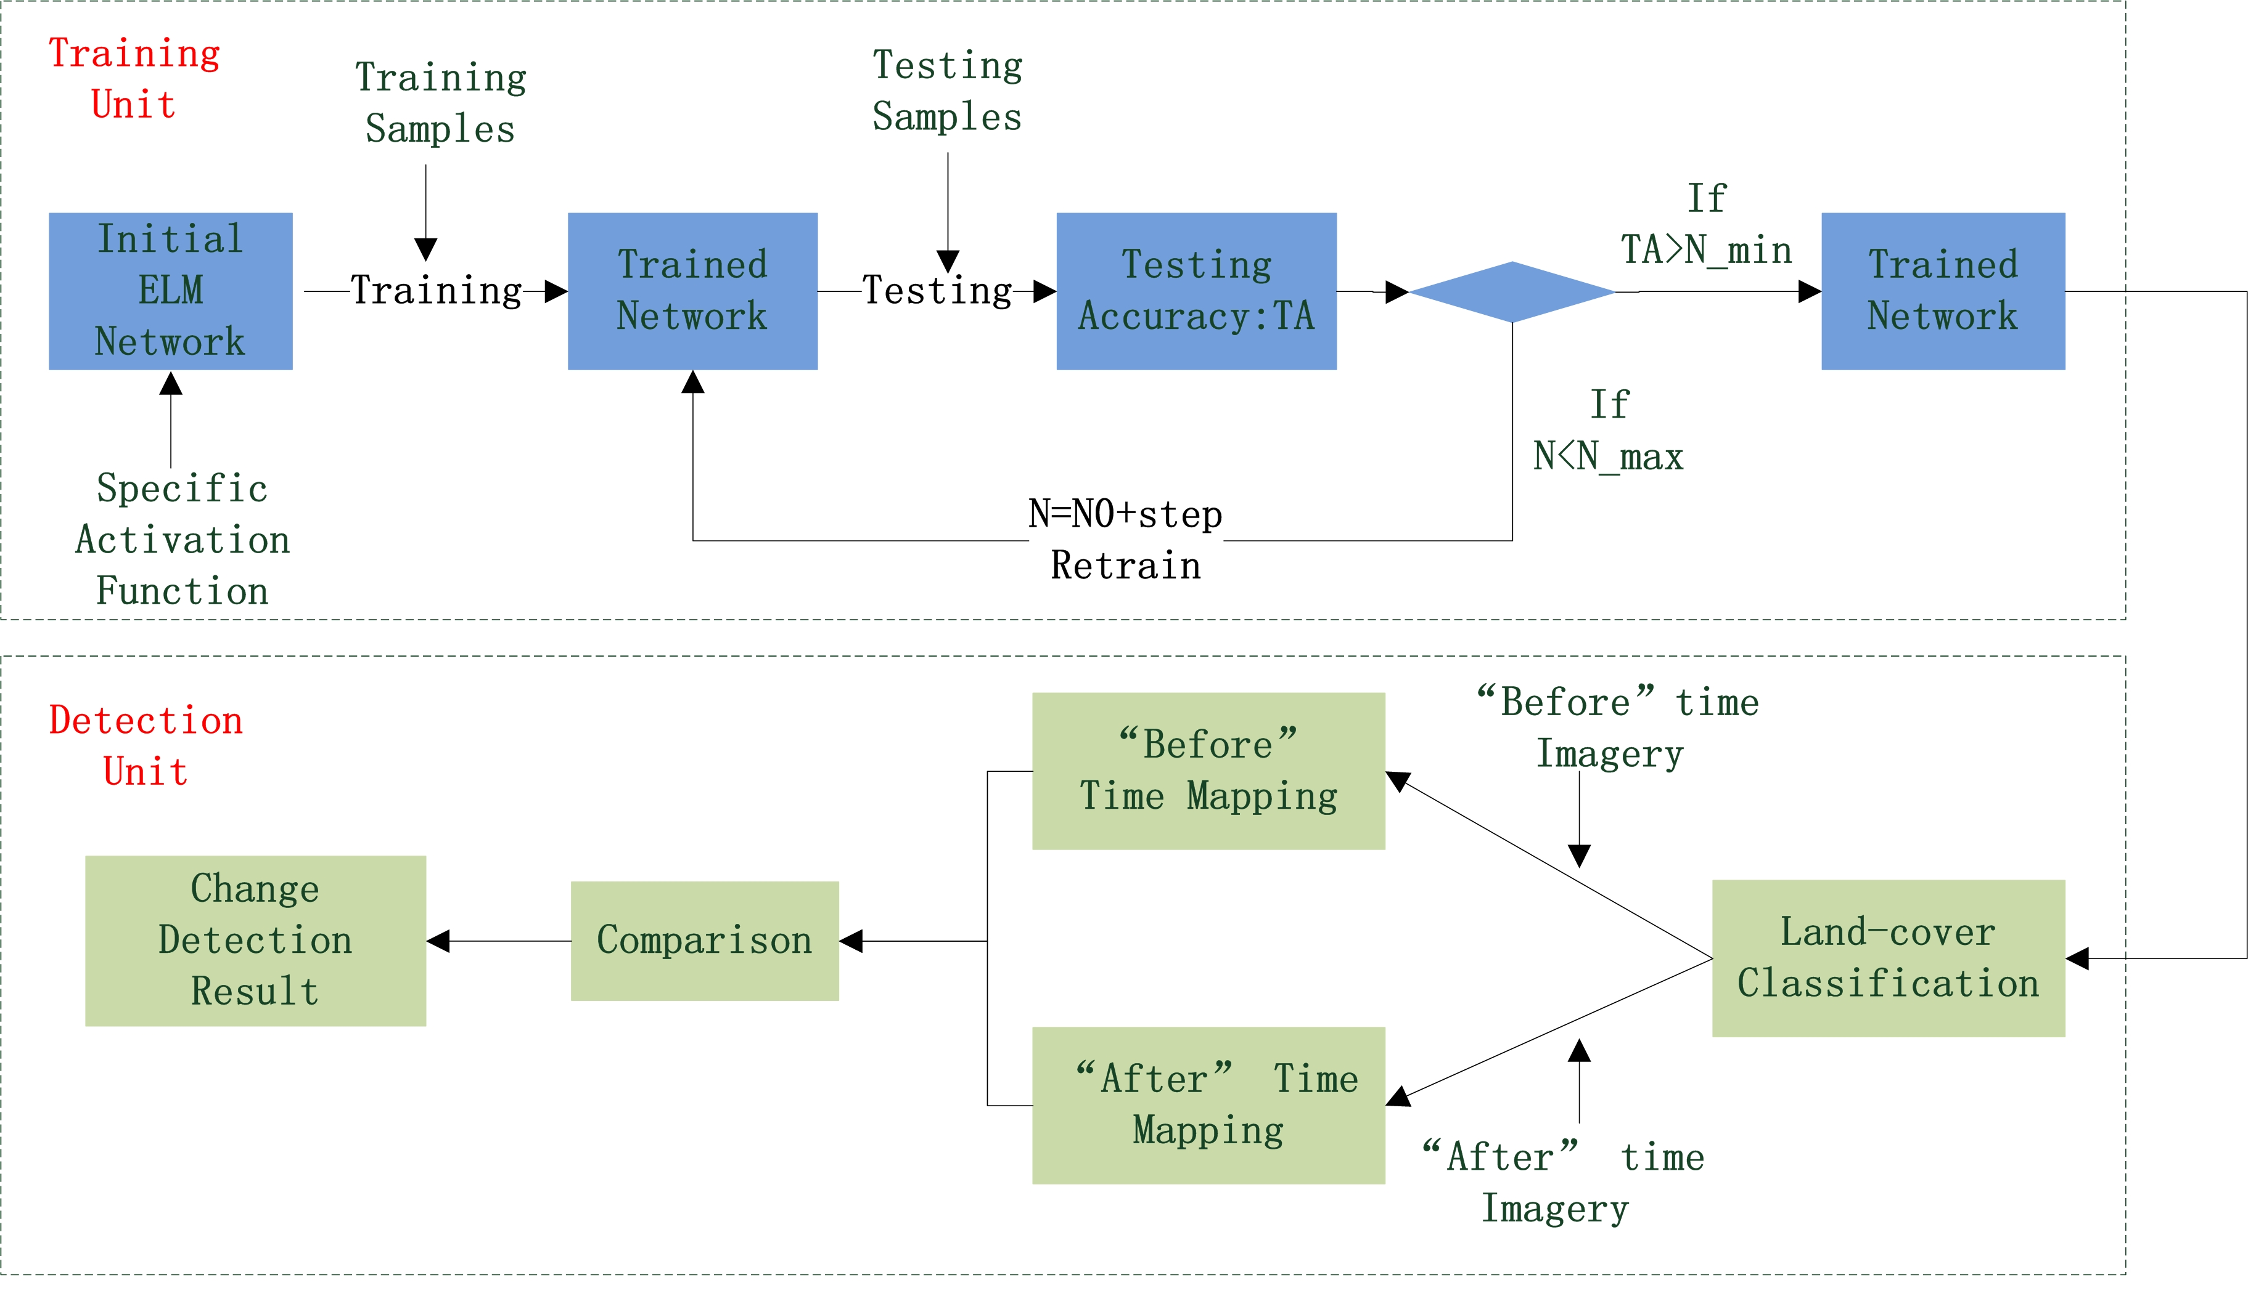
Construction of the Method

Slide 6
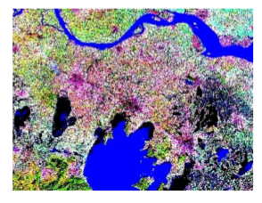
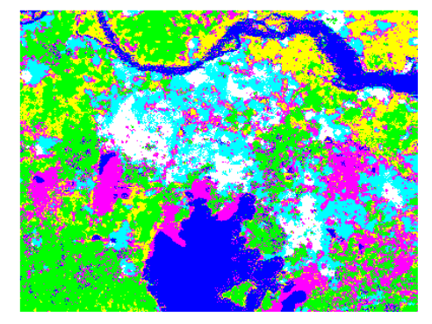
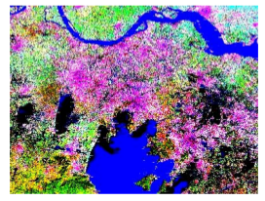
Result

Slide 7
Other Tips
1)The experiment is based on Matlab, you can find the code from https://github.com/spatio-temporal-cloud/LandCoverDetection
2) We hope to expand the method to cloud infrastructure.

Slide 8
Thanks!

