Slide 1
sMash: 基于语义的Mashup系统
计算机07硕: 卢 宾

Slide 2
Outline
Mashup Introduction
Related Work/System
sMash
Demo Show
2

Slide 3
Introduction to Mashup
3

Slide 4

Definition
API X
API Y
mashup Z
Mash-up 模式指的是网站采用混合技术搭建，不同的功能模块与不同的外界API接口对接实现。
4

Slide 5
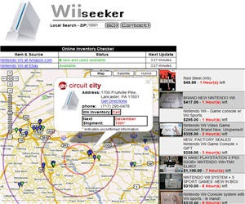

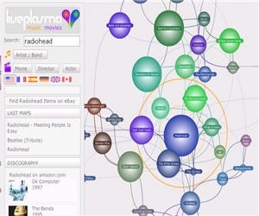
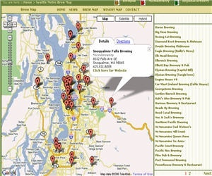
Mashup Applications
Mapping (Google Map, Microsoft Virtual Earth, Yahoo Maps, AOL MapQuest)
Video, Photo(YouTube, Flickr)
Search and Shopping(Amazon, Ebay)
News, Events(Upcoming, liveNews, Twitter )
5

Slide 6
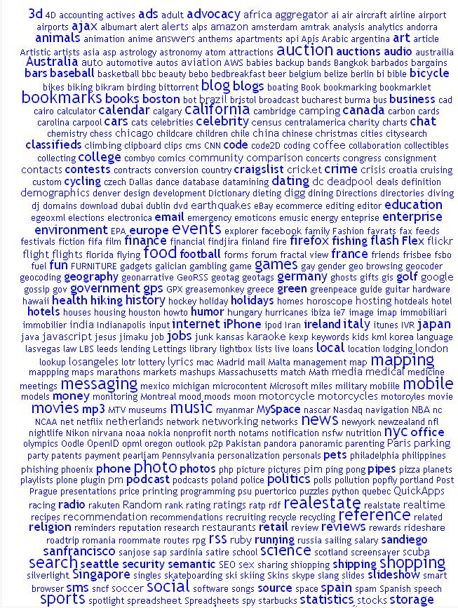
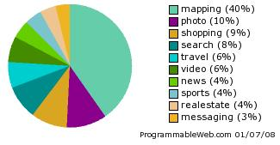
Tag
clouds
7

Slide 7
Related Work/System
3

Slide 8
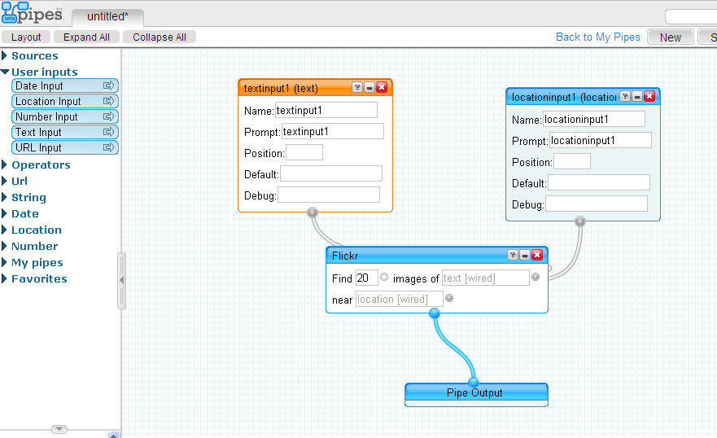
Yahoo! Pipes
9

Slide 9
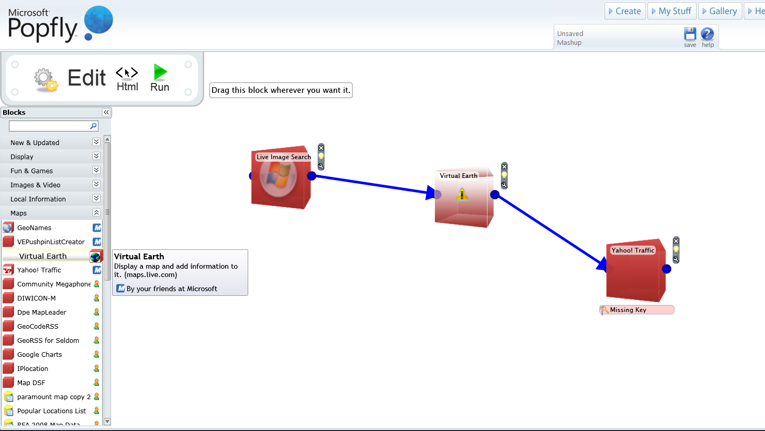
Microsoft Popfly
10

Slide 10
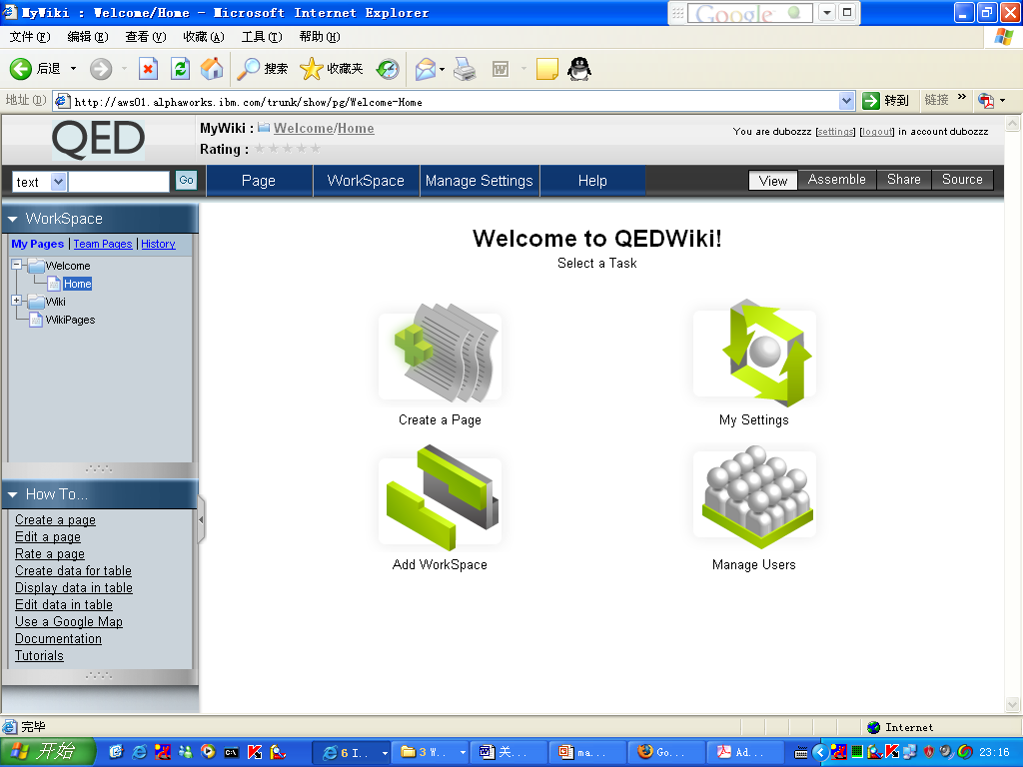
IBM QED
11

Slide 11
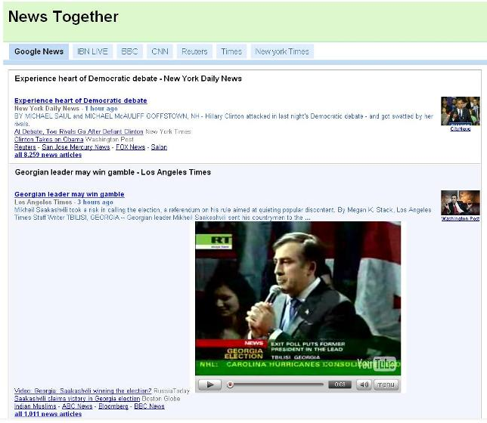
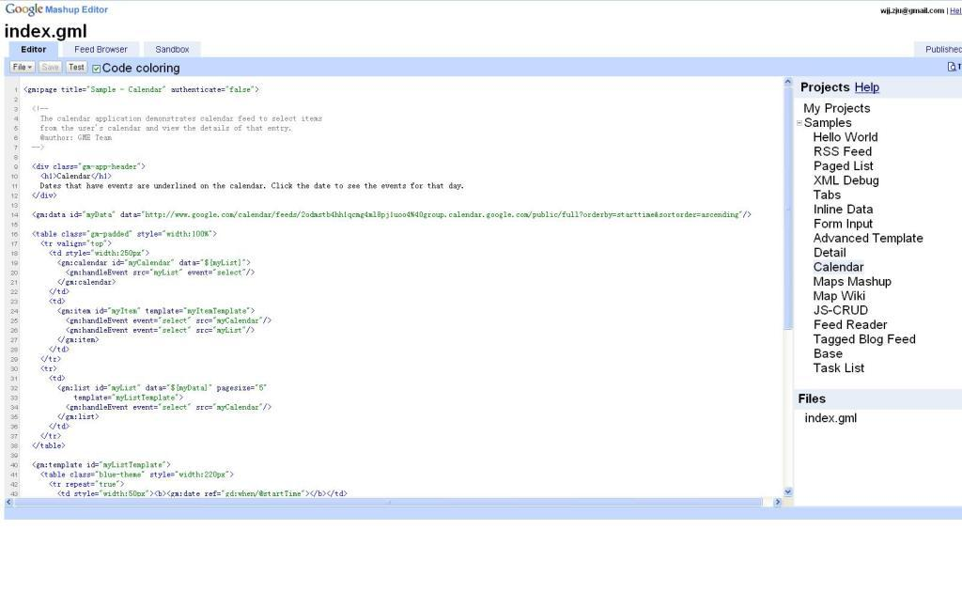
Google Mashup Editor
12

Slide 12
sMash: Semantic-based Mashup System
13

Slide 13
Challenges and Motivation
The difficulties to locate and combine the right data APIs because of lack of knowledge about these APIs and relationships amongst them;
Inconvenient and unpleasant steps to be performed whenever they want to mashup a new API, such as finding and reading its specification, deciphering the appropriate functions to be used, checking its mashupability with other APIs, etc;
Limited ability to discover more mashupable APIs which may make their mashups more abundant.
how to help novice users master data APIs and relationships amongst them easily;
how to inspire various users to build more amazing Web data mashups
14

Slide 14
Our Solutions
Mine the relationships to construct and visualize a real-life data API network to enable mashup building;
Provide Navigation.
15

Slide 15
Unique Features of sMash
1. Automatic Generation of Mashup Graph;
users who have clear ideas about which data APIs to use
fuzzy-match-keyword-search
2. Surf and Mashup;
users who have no clear purpose of mashup results.
leave a trace
3. Trace-based Recommendation;
4. Inference-based Recommendation.
Power users
4/5 data APIs are rarely used
only 30% links of the network are covered.
16

Slide 16
Architecture of sMash
17

Slide 17
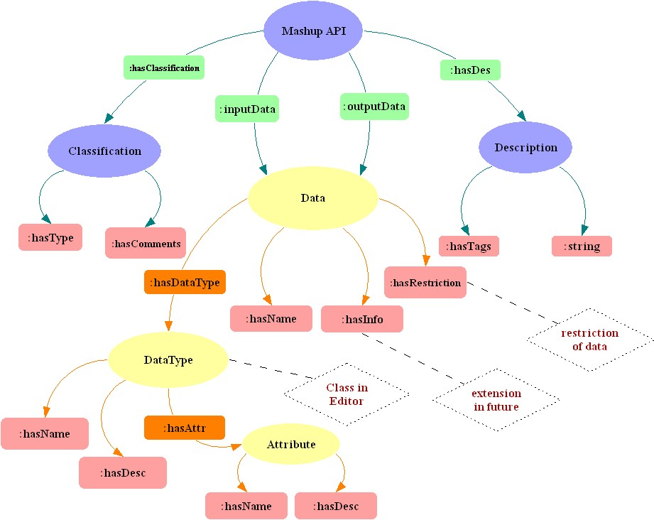
Key Technologies – Network Construction
Precise Representation of Data API Metadata;
incorporate rich semantics, rdf model
microformats-like semantic data types
Integrity of Links;
provide a better platform for users to exert their imagination
data content based matching
Scalability of Network.
take advantage of social community
two auxiliary user friendly tools, API schema editor and data type editor
18

Slide 18
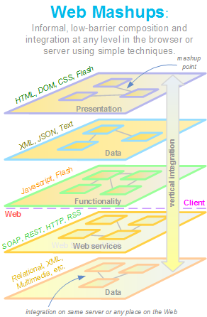
Key Technologies – Data Handler
19

Slide 19
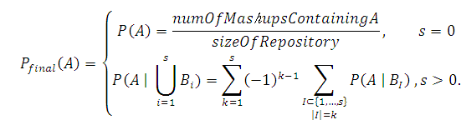
Key Technologies – Link Recommendation
repository of mashups
Data API Network
user’s current traces
20

Slide 20
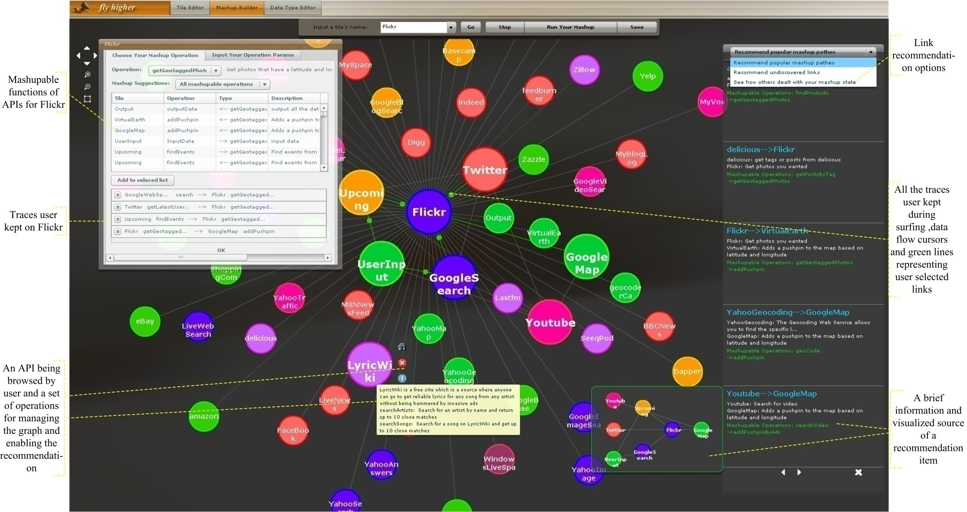
A Screenshot of sMash
21

Slide 21
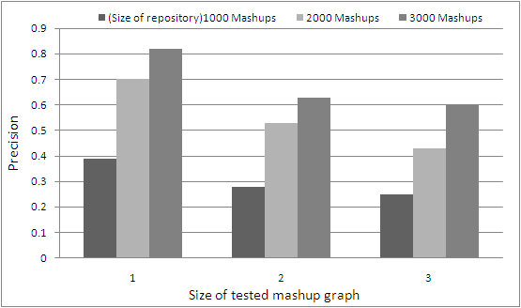
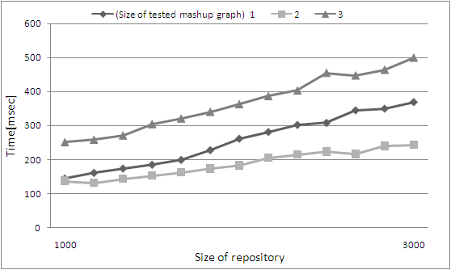
Evaluation – Trace-based Recommendation
Quality of Trace-based
Recommendation
Recommender Performance
22

Slide 22
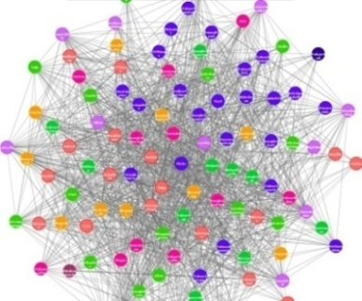
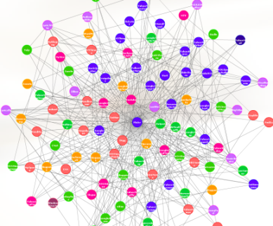
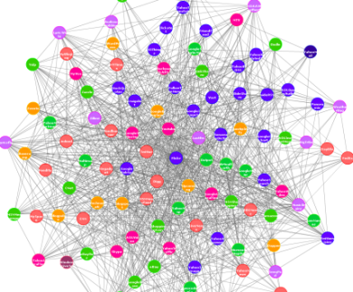
Evaluation – Inference-based Recommendation
(a) (b) (c)
Quality Evaluation of Inference-based Recommendation. (a) shows the sample data API network composed of 112 APIs and 3814 links; (b) is composed of the 112 APIs and all the links that have been used by users to build mashups so far, only 1123 links in all; (c) is a combination of (b) and the recommended links which are obtained by taking part of each mashup in repository as input to simulate users’ traces, 2288 links in all.
23

Slide 23
Conclusion
1. A Mashup System: sMash V2.0
2. Publication:
Bin Lu, Zhaohui Wu, Yuan Ni, Guotong Xie, Chunying Zhou, Huajun Chen. sMash: Semantic-based Mashup Navigation System for Data API network. In Proceedings of the 18th World Wide Web Conference (WWW2009), Madrid, Spain, April 2009.
Huajun Chen, Bin Lu, Yuan Ni, Guotong Xie, Chunying Zhou, Zhaohui Wu. Mashup by Surfing a Web of Data APIs. (VLDB 2009)
24

Slide 24
Ongoing Work
1. sMash V3.0 :
a semantic search engine based on data API network to help people find more useful information, such as
Find a restaurant near Zhejiang University -- googlewebsearch → googlemap;
Locate indian food in NewYork– yahoo.com → local.yahoo.com
Google and Yahoo news – news.google.com Union news.search.yahoo.com
2. A paper for SIGMOD 2010.
24

Slide 25
Demo Show
25

Slide 26
谢谢！
26

