Slide 1
Integrating Web Data in Mashups' Way

Slide 2
Outline
Introduction to Mashup
Related Work/System
The Problems
Current Research
sMash: Our Approach
sMashV3.0: Our Work
2

Slide 3
Definition
Mashup是来自多个源的数据组合成的集成 Web 应用程序，从而提供集成的体验，帮助人们更好的获取信息。
4

Slide 4
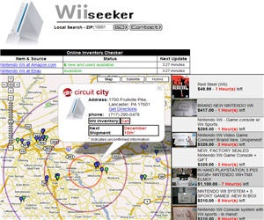

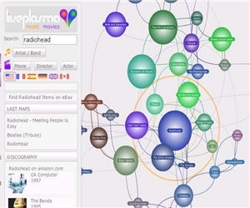
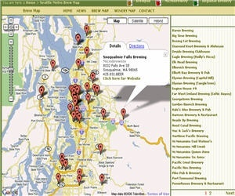
Mashup Applications
Mapping (Google Map, Microsoft Virtual Earth, Yahoo Maps, AOL MapQuest)
Video, Photo(YouTube, Flickr)
Search and Shopping(Amazon, Ebay)
News, Events(Upcoming, liveNews, Twitter )
5

Slide 5
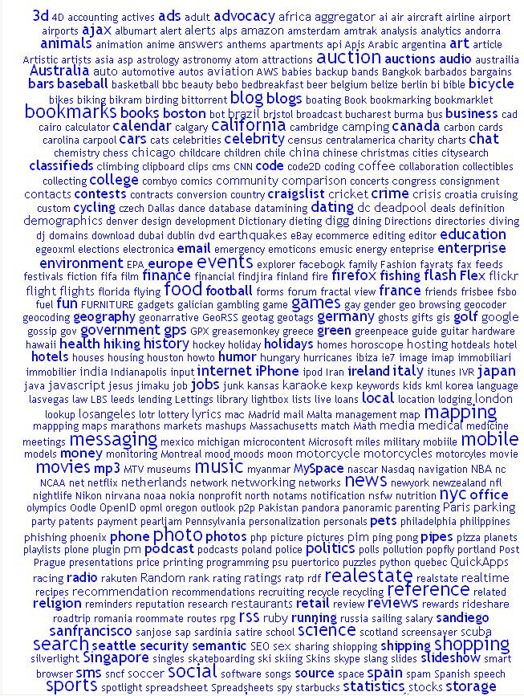
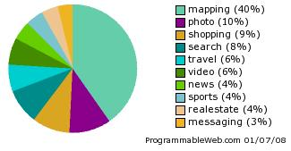
Tag
clouds
7

Slide 6
Related Work/System
3

Slide 7
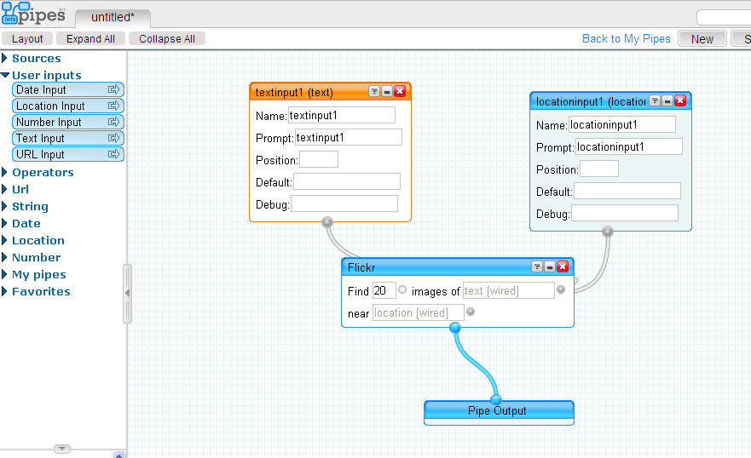
Yahoo! Pipes
9

Slide 8
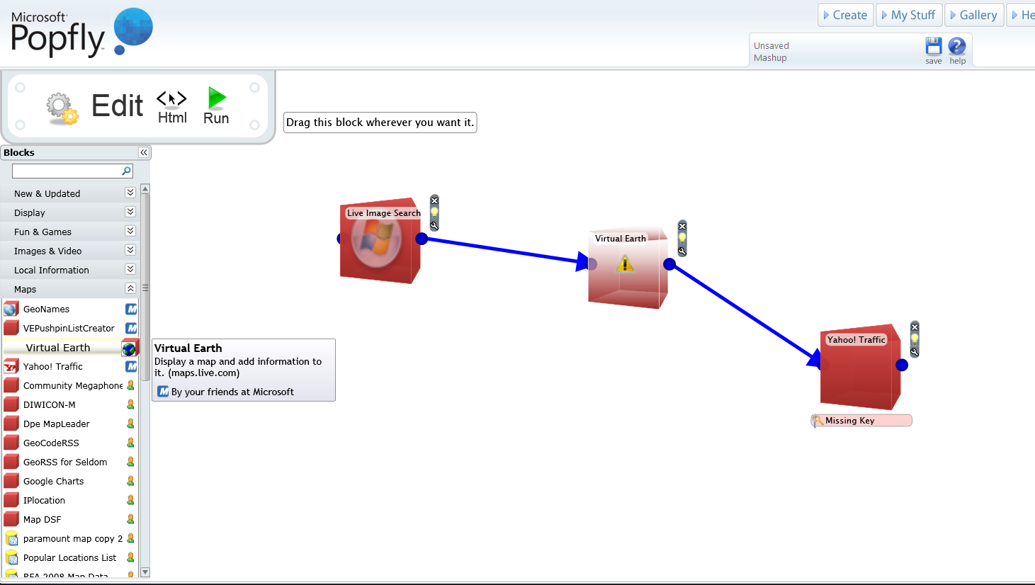
Microsoft Popfly
10

Slide 9
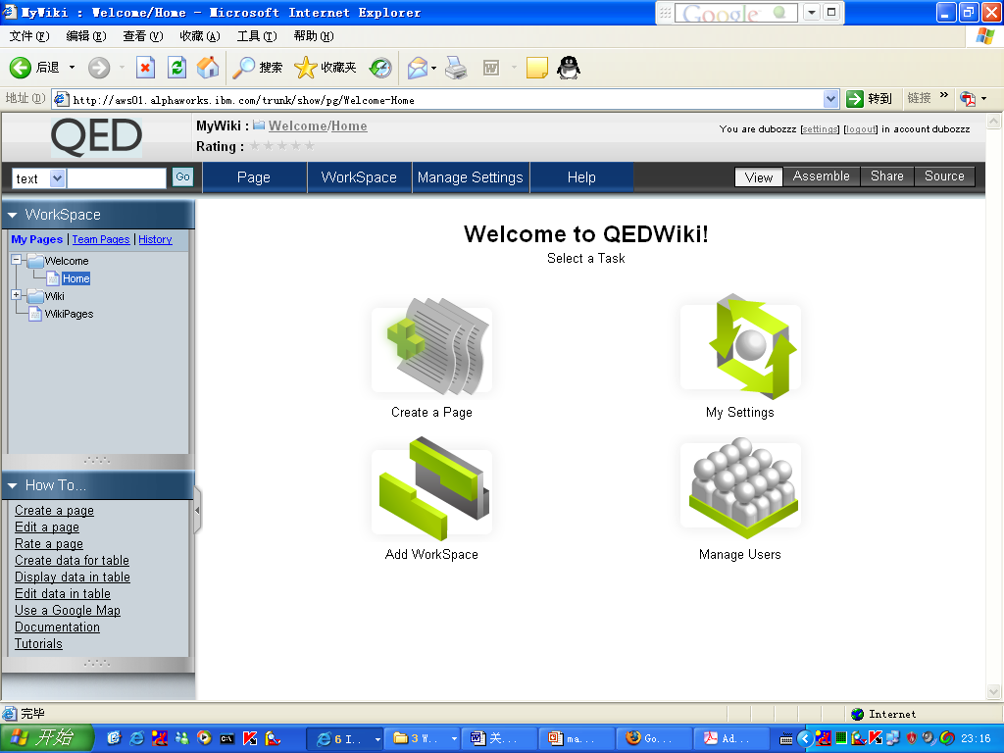
IBM QED
11

Slide 10
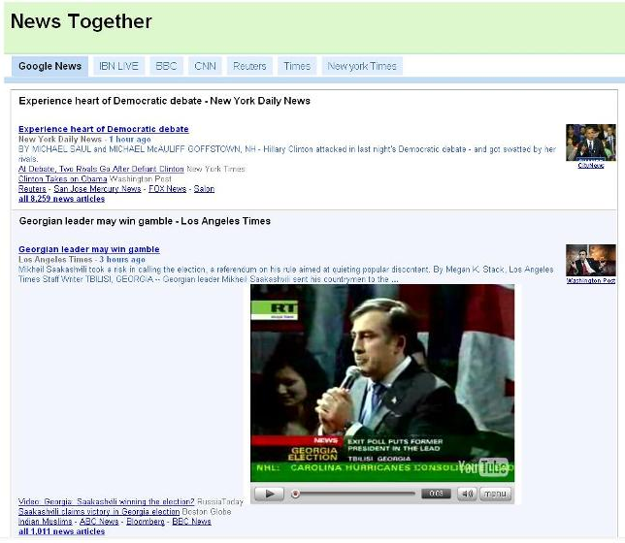
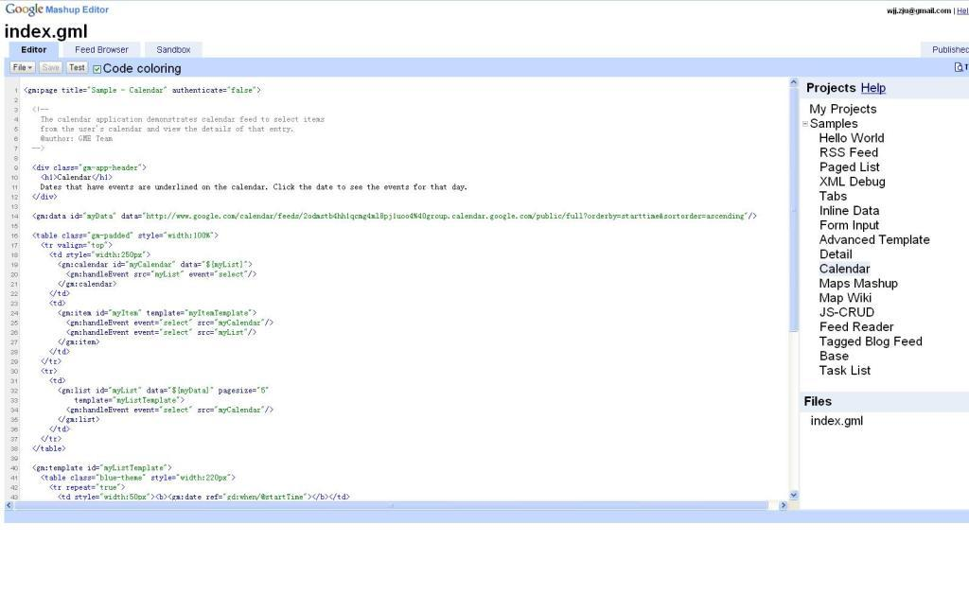
Google Mashup Editor
12

Slide 11
The Problems
13

Slide 12
The Problems
The difficulties to locate and combine the right data APIs because of lack of knowledge about these APIs and relationships amongst them;
Inconvenient and unpleasant steps to be performed whenever they want to mashup a new API, such as finding and reading its specification, deciphering the appropriate functions to be used, checking its mashupability with other APIs, etc;
Limited ability to discover more mashupable APIs which may make their mashups more abundant.
how to help novice users master data APIs and relationships amongst them easily;
how to inspire various users to build more amazing Web data mashups
14

Slide 13
Current Research
3

Slide 14
Related Papers
Autocompletion for Mashups (ICDE09(demo); VLDB09)
Wishful Search: Interactive Composition of Data Mashups (WWW08)
Mashmaker: mashups for the masses (SIGMOD07 poster)
Damia: data mashups for intranet applications (VLDB07(demo);SIGMOD08)

Slide 15
Autocompletion for Mashups
The work:
Given a user’s partial mashup specification(i.e. user select some mashlets (APIs)), recommend top-k GPs (completed mashups) that are potentially most relevant to the user’s current needs. (A GP is a mashup developed by some user.)
How to instantly retrieve the most relevant GPs from thousands of GPs (repository).

Slide 16
Autocompletion for Mashups
User Input: Recommendation List:
Flickr
GoogleMap
Flickr
Flickr
VirtualEarth
GoogleMap
Flickr
GoogleMap
Facebook
Facebook
Youtube
GoogleMap

Slide 17
The Approach
Key Observation:
mashups developed by different users, in similar contexts, typically share common characteristics, i.e., they use similar classes of mashup components and glue them together in a similar manner.

Slide 18
Inheritance.
Definition: a mashlet m2 inherits from mashlet m1 if the interface of m2 (its input/output relations) is a superset of the interface of m1, and for each input (resp. output) relation of m1, the attribute-set in the corresponding relation in m2 is a superset of that in m1.
mashlet m2 can substitute m1 in any composition that uses an instance of m1.

Slide 19
M: denote the collection of mashlets and GPs in the database; m: denote a mashlet; g: a GP; Components(g):A set of mashlets linked by g; Imp(m): the importance of m in the mashlet Web; Imp(g)…
m1,m2,…mn denote a user-specified partial mashup M; g is a candidate completion for M if it can link a non-empty subset of m1, . . . ,mn. S(g) is the score of g.
g(mi) ∈ Components(g) that is a generalization of mi and is closest to it
Compl (M):denote the set of completions for the partial mashup M.

Slide 20
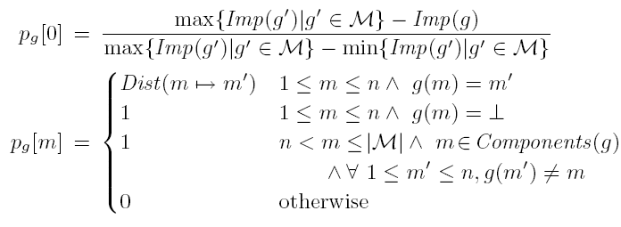
A D-dimensional Space
D = |M| + 1;
A candidate g is mapped to a point p_{g} in this
space with the following coordinates:

Slide 21
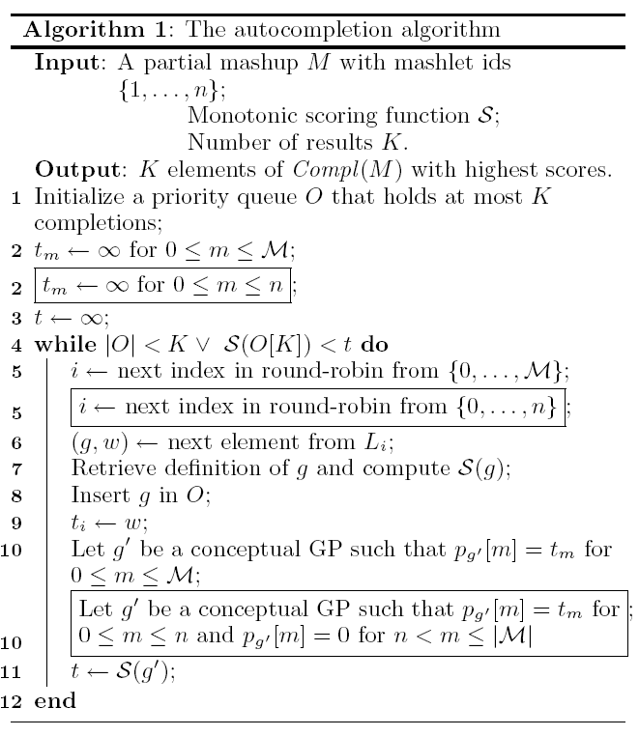
The Algorithm
1.

Slide 22
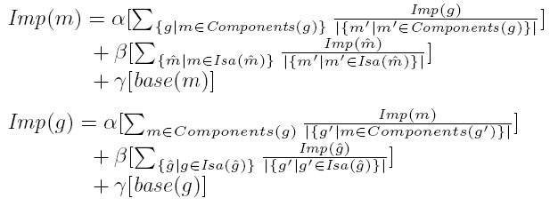
Computing Importance
The style of PageRank algorithm

Slide 23
2.Wishful Search : Interactive Composition of Data Mashups
allows users to explore the space of potentially composable data mashups and preview composition results as they iteratively refine their “wishes”.
the users express their composition requirements as tag queries describing the desired flow output.

Slide 24
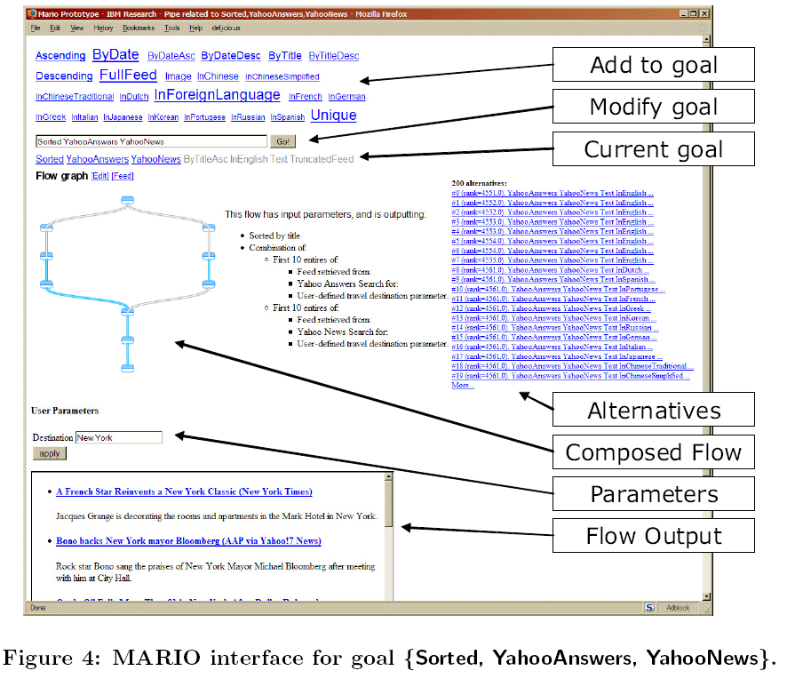

Slide 25
Introduction to sMash
3

Slide 26
Unique Features of sMash
1. Automatic Generation of Mashup Graph;
users who have clear ideas about which data APIs to use
fuzzy-match-keyword-search
2. Surf and Mashup;
users who have no clear purpose of mashup results.
leave a trace
3. Trace-based Recommendation;
4. Inference-based Recommendation.
Power users
4/5 data APIs are rarely used
only 30% links of the network are covered.
16

Slide 27
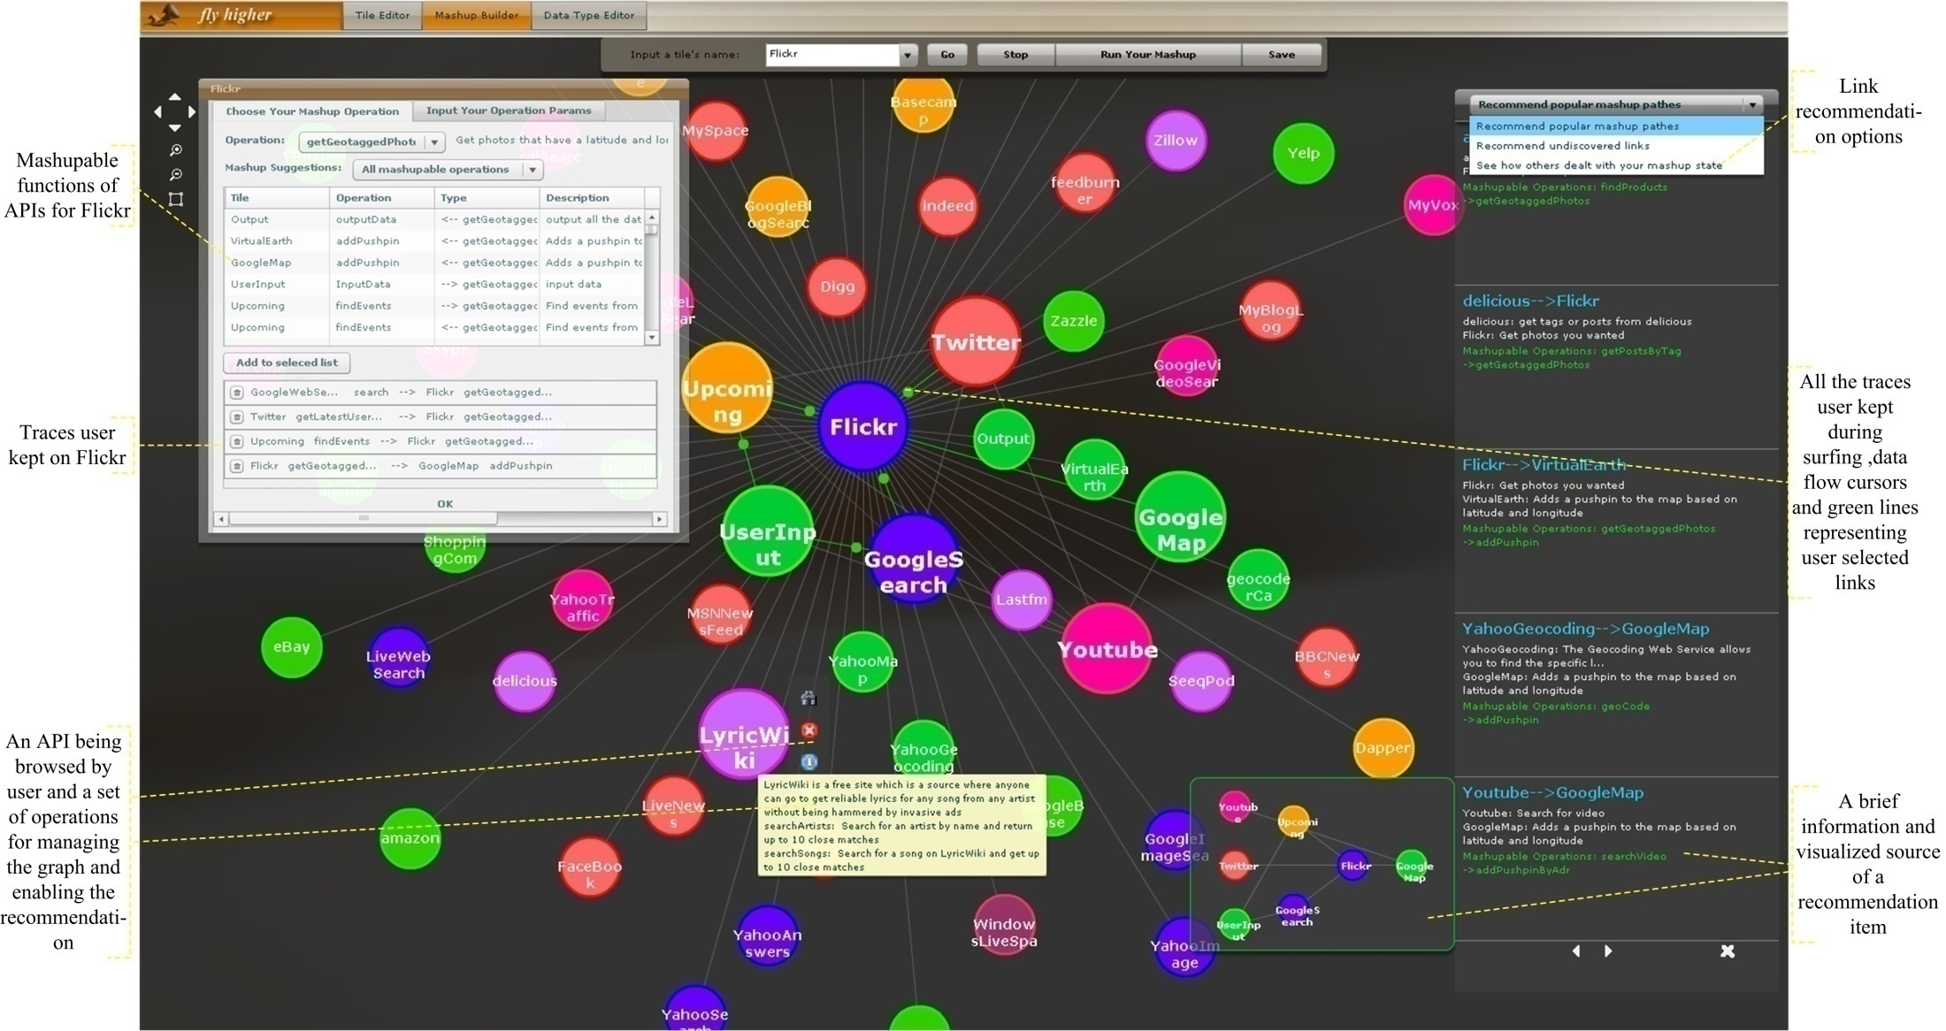
A Screenshot of sMash
21

Slide 28
Architecture of sMash
17

Slide 29
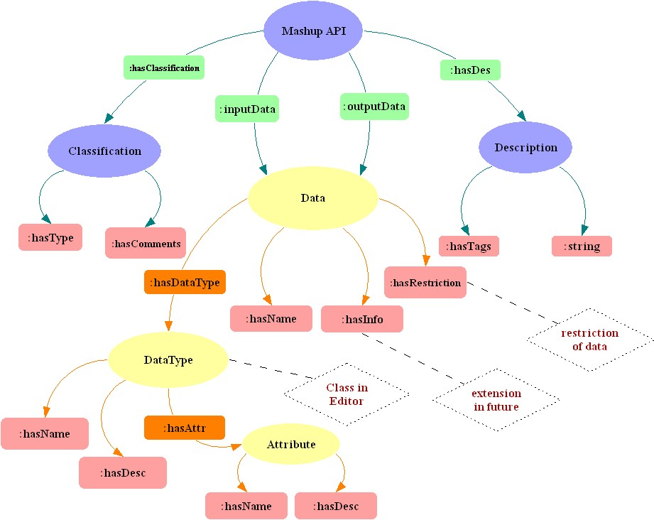
Key Technologies – Network Construction
Precise Representation of Data API Metadata;
incorporate rich semantics, rdf model
microformats-like semantic data types
Integrity of Links;
provide a better platform for users to exert their imagination
data content based matching
Scalability of Network.
take advantage of social community
two auxiliary user friendly tools, API schema editor and data type editor
18

Slide 30
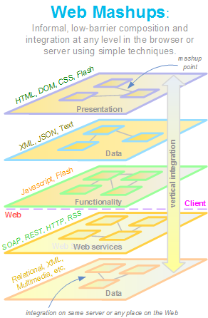
Key Technologies – Data Handler
19

Slide 31
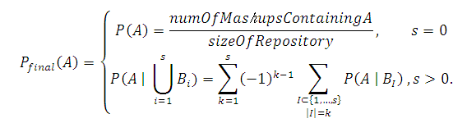
Key Technologies – Link Recommendation
repository of mashups
Data API Network
user’s current traces
20

Slide 32
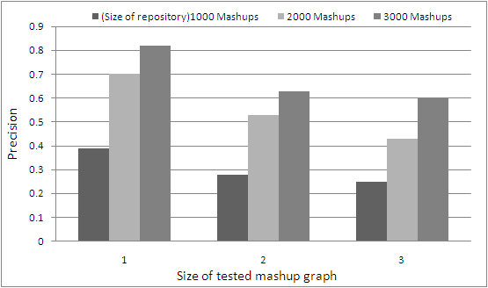
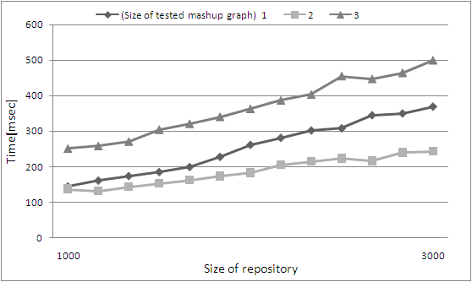
Evaluation – Trace-based Recommendation
Quality of Trace-based
Recommendation
Recommender Performance
22

Slide 33
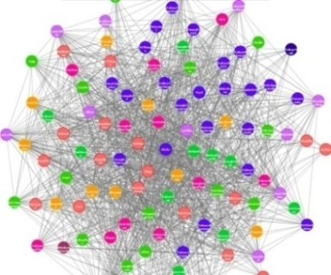
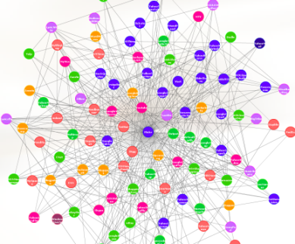
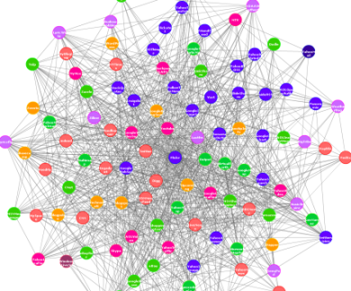
Evaluation – Inference-based Recommendation
(a) (b) (c)
Quality Evaluation of Inference-based Recommendation. (a) shows the sample data API network composed of 112 APIs and 3814 links; (b) is composed of the 112 APIs and all the links that have been used by users to build mashups so far, only 1123 links in all; (c) is a combination of (b) and the recommended links which are obtained by taking part of each mashup in repository as input to simulate users’ traces, 2288 links in all.
23

Slide 34
The Results
1. A Mashup System: sMash V2.0
2. Publication:
Bin Lu, Zhaohui Wu, Yuan Ni, Guotong Xie, Chunying Zhou, Huajun Chen. sMash: Semantic-based Mashup Navigation System for Data API network. In Proceedings of the 18th World Wide Web Conference (WWW2009), Madrid, Spain, April 2009.
Huajun Chen, Bin Lu, Yuan Ni, Guotong Xie, Chunying Zhou, Zhaohui Wu. Mashup by Surfing a Web of Data APIs. (VLDB 2009)
24

Slide 35
Our Work
3

Slide 36
Our Work
一个系统的完善的数学模型来理论化的概述我们已取得的进展。
Web of Data API (Definition, Proof, )
Recommendation
Evaluation
改进推荐算法
一个灵活的服务执行引擎
对Web Data API的精确封装
Web API调度、执行、组合和展示引擎

Slide 37
服务的语义描述
<name>Flickr</name>
<providerUrl>http://www.flickr.com/services/api/, http://api.flickr.com</providerUrl>
<description>
<tags>photos</tags>
<text>Get photos you wanted</text>
</description>
<category>photos</category>
<services>
<service name="getGeotaggedPhotos">
<description>Get photos that have a latitude and longitude and have been tagged as "geotagged"</description>
<invokeUrl>http://www.flickr.com/services/rest/?method=</invokeUrl>
<input>
<param className="object.allType" name="search_text" required="true">
<description>text in title, description, or tags</description>
<defaultValue>beach</defaultValue>
</param>
<param className="object.decimal" name="number" required="false">
<description>maximum number of photos to return</description>
<defaultValue>15</defaultValue>
</param>
</input>
<output>
<param className="photo.title" name="title"/>
<param className="photo.imageUrl" name="url"/>
<param className="photo.thumbnailImageUrl" name="thumbnailUrl"/>
<param className="photo.userName" name="owner"/>
<param className="photo.url" name="linkUrl"/>
<param className="photo.imageUrl" name="originalUrl"/>
<param className="geo.latitude" name="latitude"/>
<param className="geo.longitude" name="longitude"/>
<param className="photo.id" name="id"/>
</output>
</service>

Slide 38
FlickrClass.prototype.getGeotaggedPhotos = function(text, number) {
// Retrieves geotagged photos marked with the specified text in the title, description, or tags.
// text (required): The desired text
// number (optional): The maximum number of photos to return (default=30)
var apikey = "ca4b0ae508ecf7e47f19adc2f2e9dbb3";
// debugger;
var params = "&sort=" + "interestingness-desc" + "&text=geotagged+" + escape(text);
var photos = this._getFlickrPhotos("flickr.photos.search", number, params, apikey);
return photos;
};
FlickrClass.prototype._getFlickrPhotos = function(method, number, extraParams, apikey){
if(!number || isNaN(number)) number = this.DEFAULT_MAX_PHOTOS;
var params = "&extras=owner_name,geo,date_taken,original_format&per_page="+ number;
var root = this._getFlickrXml(method, params + extraParams, apikey);
var photos = this._getPhotoArrayFromXml(root);
return photos;};
FlickrClass.prototype._getFlickrXml = function(method, params, apikey){
var root = environment.getXml("http://www.flickr.com/services/rest/?method="+ method + params +"&api_key="+ apikey, "flickr");
var rsp = root.getElementsByTagName("rsp")[0];
… …
return root;};
Environment.getXml()→getRequest(){xmlHttp.send();}
Server
ajaxHandler {call Flickr service; return result to client}

Slide 39
目前存在的问题：必须为每一个Data API写一段对应的处理代码；
解决方案：
1、精确语义描述
2、按照语义描述的内容，自动的去调用服务（一个灵活的执行引擎）。

