Slide 1



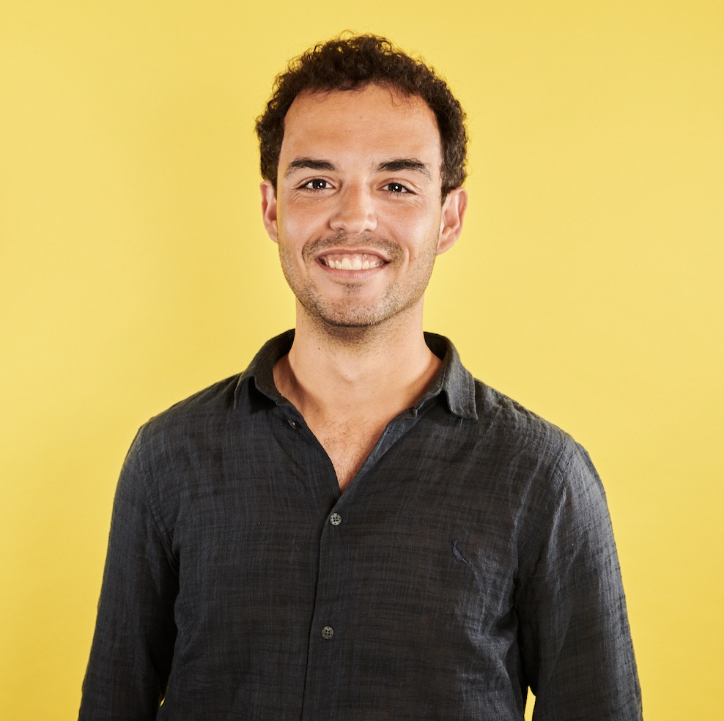


Call For Papers: KnowledgeNLP-KDD’23
Introduction Language models are being developed and deployed in many applications, “small”-scale and large-scale, generic and specialized, text-only and multimodal, etc. Meanwhile, the missingness of important knowledge causes limitations and safety challenges. The knowledge includes common sense, world facts, domain expertise, and especially the unique patterns that need to be discovered from big data applications.
Paper Submission Topics include but are not limited to the following:
Knowledge-augmented language model pre-training / fine-tuning
Retrieval augmentation with unstructured / structured data
Language models augmented with commonsense / knowledge graphs
Scalable machine learning architectures in KnowledgeNLP products/platforms
Knowledge-augmented NLP for user modeling and query understanding
Knowledge-augmented NLP for e-commerce, RecSys, social media analysis, affective computing, education, healthcare, and other applications
Human-centric NLP for social good and intelligent assistance
Important Dates
Paper Submission Deadline: May 23rd, 2023
Notification of Acceptance: June 23rd, 2023
Camera-ready deadline: June 30th, 2023
Workshop Date: August 7th or 8th, 2023
All deadlines are 11:59pm UTC-12 ("anywhere on Earth")
Keynote Speakers
Organizers
Wenhao Yu, Lingbo Tong, Meng Jiang (ND); Weijia Shi (UW); Nanyun Peng (UCLA)
Dong, Xin Luna
Meta Reality Lab
Han, Jiawei
UIUC
Neves, Leonardo
Grammarly
Yin, Bing
Amazon
Website https://knowledge-nlp.github.io/kdd2023 Twitter @knowledgenlp

