Slide 1
Internet of things Security gaps
Eric Edwards
Paul Polsinelli
Cameron George

Slide 2
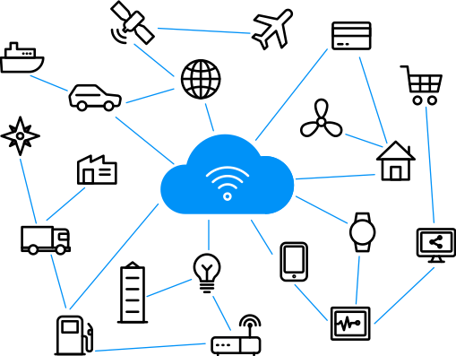
IOT DEVICES AND THEIR GROWTH
IoT devices are a network of internet-connected objects that can exchange and collect data
127 IoT devices are connected to the internet every second
31 billion IoT devices will be activated in 2020
An estimated 35 billion will be activated in 2021
By 2025 there will be more than 75 billion devices connected

Slide 3
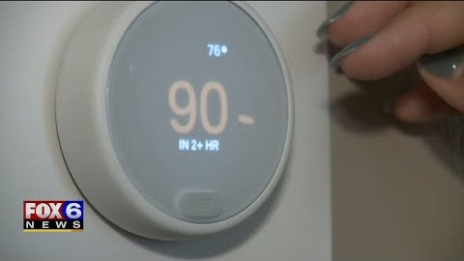
Cyberattacks on iot devices
Cyberattacks on IoT devices increased 300% in 2019
Most attacks originated in China, Russia, the United States, and Germany
One attack was on a Milwaukee family that had their home system taken over
Issue was not solved until the couple changed their network ID
Mirai botnet in 2016
Due to lack of extra memory in the devices. The devices could not hold recent updates to prevent attacks

Slide 4
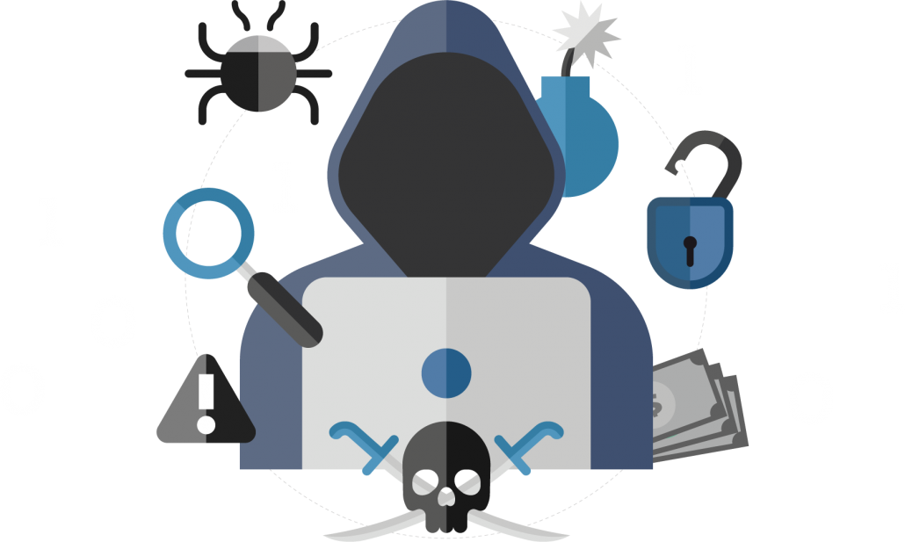
What happens if Iot security doesn’t get solved?
Increase in backlash
Decrease in consumer confidence
Less devices purchased
Ultimately will have a negative impact on the economy
We must put the focus of development into security

Slide 5
Why isn’t there a standard security feature?
Unfortunately not currently the biggest concern for most businesses and companies
There must be a security protocol added in the architecture of devices to make them more secure
If only some of these devices have embedded protocols, can other devices communicate with them?

Slide 6
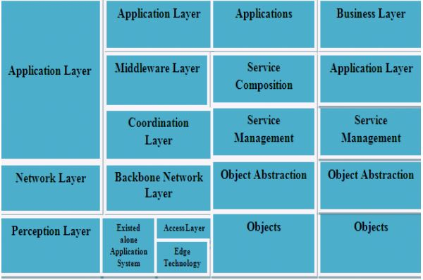
Iot device architecture
To begin designing a secure device, properly designing the architecture is necessary
The basic model of IoT architecture includes: 3-layer, middle-ware based layer, SOA based layer, and Five-layer models
Must consider resource constraints: power consumption and device life cycles
Companies are producing devices with currently used protocols that many cybercriminals are familiar with
These devices are cheaper and faster for companies to produce, which means a faster payout

Slide 7

Closing the security gap in iot devices
User awareness must be increased
Lack of action by employees and human error
Encourage peer reviews
Better and more frequent training methods should be in place
Lack of a security standard across countries
European Union’s General Data Protection Regulation covers 27 countries
The United States has the NIST Cybersecurity Framework
Move away from profit and functionality and put the focus on privacy and protection

Slide 8
References
Maayan, G. (2020). The IoT Rundown For 2020: Stats, Risks, and Solutions, Security Today. Retrieved from https://securitytoday.com/Articles/2020/01/13/The-IoT-Rundown-for-2020.aspx?Page=2,
Doffman, Z. (2019). Cyberattacks on IOT Devices Surge 300% In 2019,’Measured in Billions’, Report Claims. Forbes. Retrieved from https://www.forbes.com/sites/zakdoffman/2019/09/14/dangerous-cyberattacks-on-iot-devices-up-300-in-2019-now-rampant-report-claims/#9f38eda58926
Anonymous, (2020). 10 IoT Security Incidents That Make You Feel Less Secure, Cisomag. Retrieved from https://www.cisomag.com/10-iot-security-incidents-that-make-you-feel-less-secure/
Wallen, J. (2017). Five Nightmarish Attacks That Show the Risks of IoT Security, ZDNet. Retrieved from https://www.zdnet.com/article/5-nightmarish-attacks-that-show-the-risks-of-iot-security/
Paul, F. (2018). What Happens if IoT Security Doesn’t Get Solved? Network World. Retrieved from https://www.networkworld.com/article/3278023/what-happens-if-iot-security-doesnt-get-solved.html
Bilal, H., Faraz, I. K., Sufian, H. (2019). Understanding Security Requirements and Challenges in Internet of Things (IoT): A Review. Hindawi. Retrieved from https://www.hindawi.com/journals/jcnc/2019/9629381/
Toomey, M. (2018). IoT Device Security is being seriously neglected. Aberdeen. Retrieved from https://www.aberdeen.com/techpro-essentials/iot-device-security-seriously-neglected/
Garcia-Morchon, O., Gomez, D., Gutierrez, J., Tolhuizen, L. (n.d). (2012) Towards fully collusion-resistant ID-based establishment of pairwise keys. Retrieved from http://citeseerx.ist.psu.edu/viewdoc/download?doi=10.1.1.258.2669&rep=rep1&type=pdf
Anonymous, (2019). Top 10 Biggest IoT Security Issues. Intellect Soft. Retrieved from https://www.intellectsoft.net/blog/biggest-iot-security-issues/#:~:text=One%20of%20the%20biggest%20IoT,gain%20access%20to%20a%20network.&text=Instead%20of%20targeting%20devices%2C%20a,a%20human%2C%20using%20the%20IoT.
Anonymous, (2018). The Human Factor in IT Security: How Employees are Making Businesses Vulnerable from Within. Kaspersky Daily. Retrieved from https://www.kaspersky.com/blog/the-human-factor-in-it-security/
Armerding, T. (2019). Awash in Regulations, Companies Struggle with Compliance. Forbes. Retrieved from https://www.forbes.com/sites/taylorarmerding/2019/08/30/awash-in-regulations-companies-struggle-with-compliance/#1ef8315e150e
FOX6 News Milwaukee. [FOX6 News Milwaukee]. (2019, September 22). Milwaukee couple warns hackers are outsmarting smart homes. [Video]. YouTube. https://www.youtube.com/watch?v=-bHcp5mC9Lg

