Slide 1
Recent Breaches and Their Effect on Social Expectations
Eric Edwards
Paul Polsinelli
Cameron George

Slide 2

With the Correct Key Any Lock Can Be Picked

Slide 3
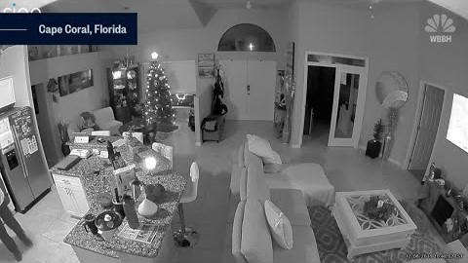
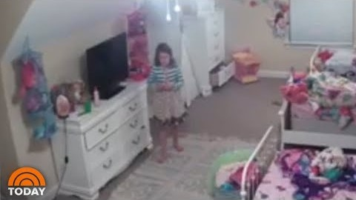
Ring Camera Hacking Incidents

Slide 4

What is an Acceptable Level of Security and Privacy in this Technological Age?

Slide 5
Social Expectations
Can I live with the fact that some things I do may be monitored, listened to, or watched?
Am I comfortable enough with the occasional cyber-intrusion and/or prank?
Do I care if information gathered through these devices are exploited without my knowledge by criminals and corporations alike?
Do the things I’m getting out of this tech outweigh the negatives as a whole?

Slide 6
References
Cristina Mendez. (2019). Stranger Spews Racial Slurs Over Family’s Hacked Ring Camera. NBC. Retrieved from https://www.nbc-2.com/story/41428183/stranger-spews-racial-slurs-over-familys-hacked-ring-camera
KGET News. [KGET News]. (2019, December 11). Hateful Hacking: Family Berated With Racial Slurs Via Ring Camera. [Video]. YouTube. https://www.youtube.com/watch?v=-bHcp5mC9Lg
Minyvonne Burke. (2019). Man Hacks Ring Camera in 8-year old girl’s bedroom, taunts her: ‘I’m Santa Claus’. NBC. Retrieved from https://www.nbcnews.com/news/us-news/man-hacks-ring-camera-8-year-old-girl-s-bedroom-n1100586
Today. [TODAY]. (2019, December 12). Hacker Accessed ‘Ring’ Camera Inside Little Girl’s Room, Her Family Says | TODAY. [Video]. YouTube. https://www.youtube.com/watch?v=ZsJSDX0DfSA

