Slide 1
Binary Search Trees
CS 302 – Data Structures
Chapter 8

Slide 2
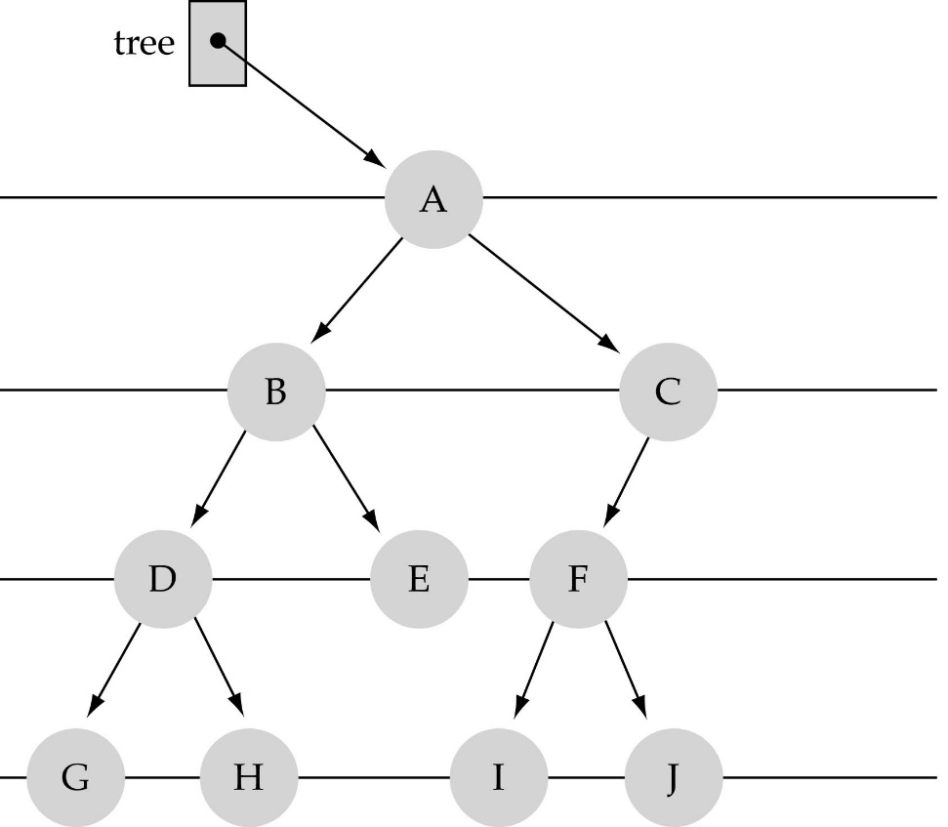
What is a binary tree?
Property 1: each node can have up to two successor nodes.

Slide 3
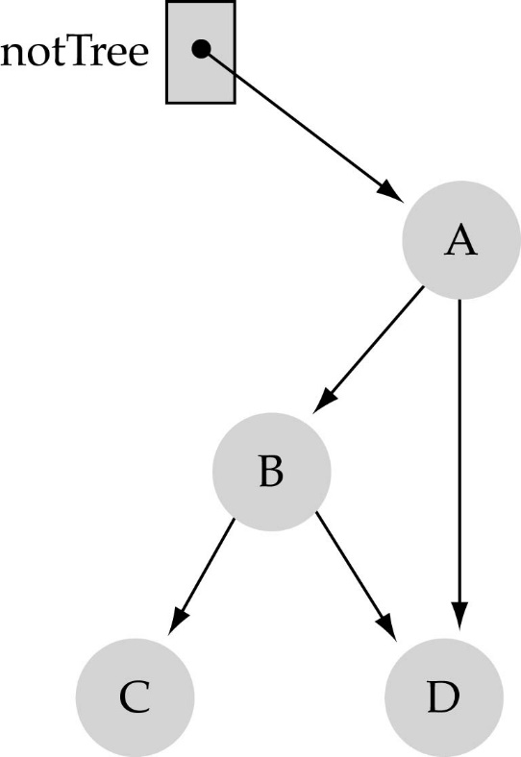
What is a binary tree? (cont.)
Property 2: a unique path exists from the root to every other node
Not a valid binary tree!

Slide 4
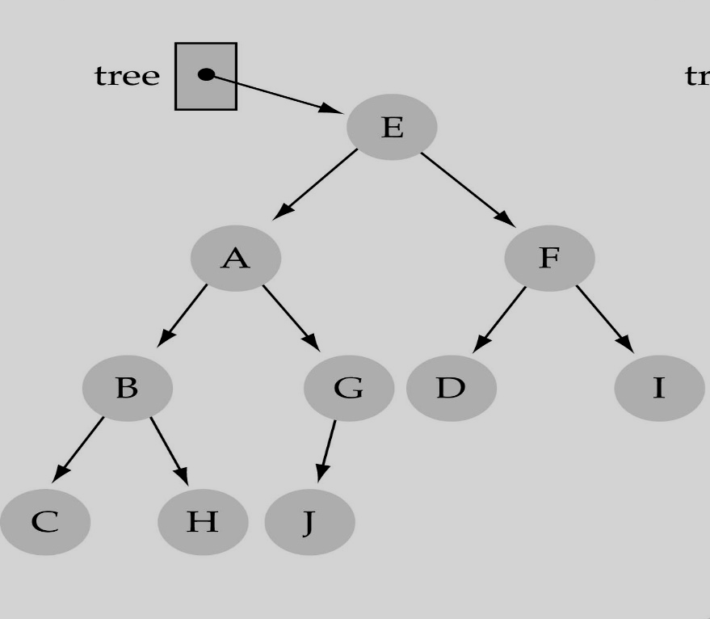
Some terminology
The successor nodes of a node are called its children
The predecessor node of a node is called its parent
The "beginning" node is called the root (has no parent)
A node without children is called a leaf

Slide 5
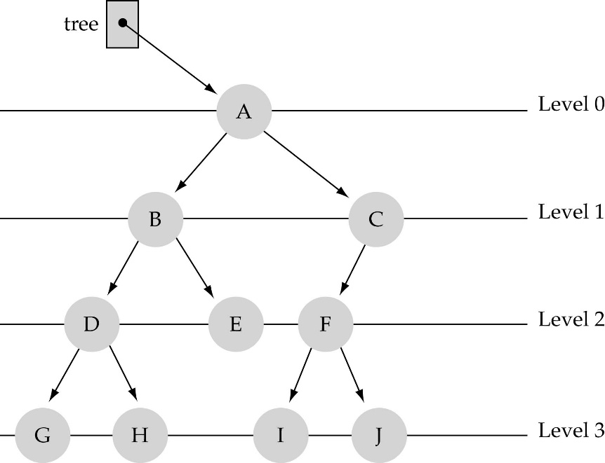
Some terminology (cont’d)
Nodes are organize in levels (indexed from 0).
Level (or depth) of a node: number of edges in the path from the root to that node.
Height of a tree h: #levels = L
(Warning: some books define h
as #levels-1).
Full tree: every node has exactly
two children and all the
leaves are on the same level.
not full!

Slide 6

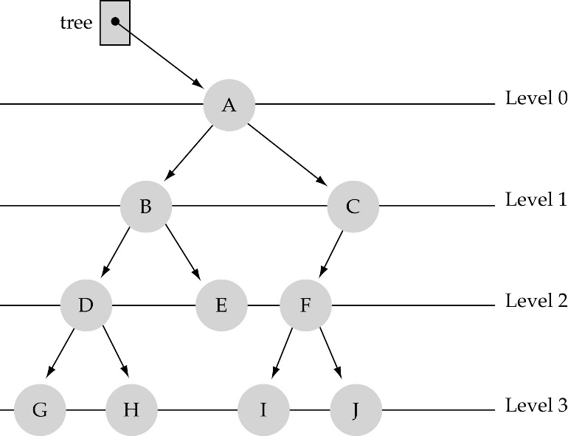




What is the max #nodes at some level l?
The max #nodes at level is
where l=0,1,2, ...,L-1

Slide 7
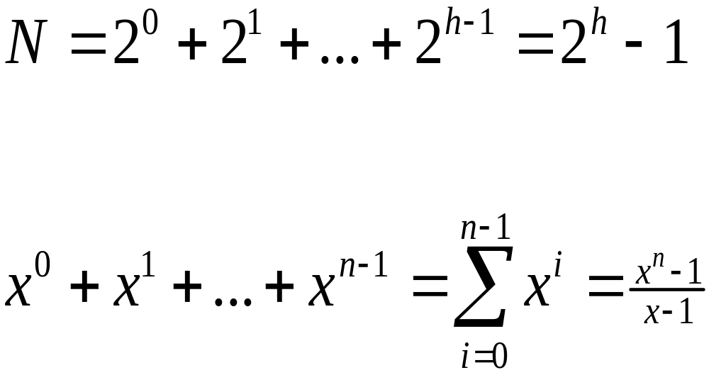
What is the total #nodes N of a full tree with height h?
l=0
l=1
l=h-1
using the geometric series:

Slide 8
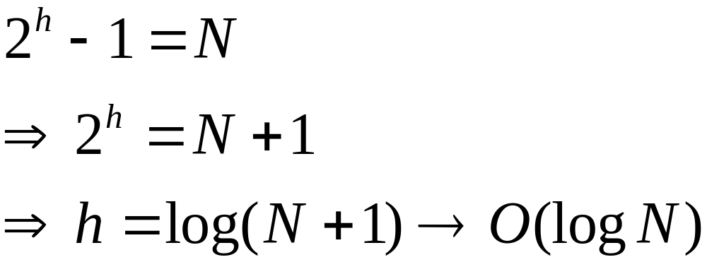
What is the height h of a full tree with N nodes?

Slide 9
Why is h important?
Tree operations (e.g., insert, delete, retrieve etc.) are typically expressed in terms of h.
So, h determines running time!

Slide 10

What is the max height of a tree with N nodes?
N (same as a linked list)
What is the min height of a tree with N nodes?
log(N+1)

Slide 11

How to search a binary tree?
(1) Start at the root
(2) Search the tree level
by level, until you find
the element you are
searching for or you reach
a leaf.
Is this better than searching a linked list?
No → O(N)

Slide 12
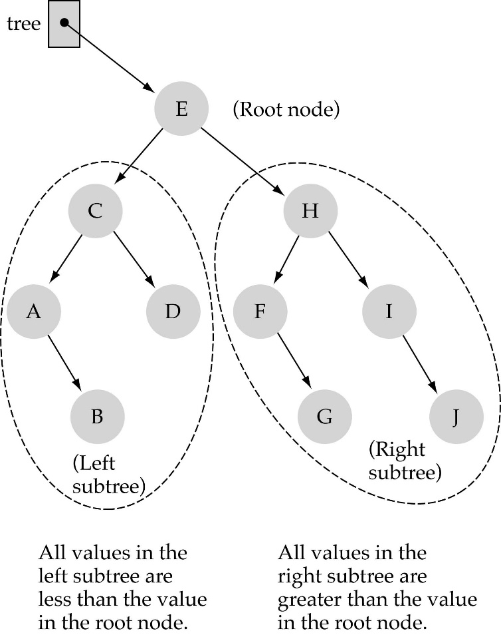
Binary Search Trees (BSTs)
Binary Search Tree Property:
The value stored at
a node is greater than
the value stored at its
left child and less than
the value stored at its
right child

Slide 13

Binary Search Trees (BSTs)
In a BST, the value stored at the root of a subtree is greater than any value in its left subtree and less than any value in its right subtree!

Slide 14
Binary Search Trees (BSTs)
Where is the smallest element?
Ans: leftmost element
Where is the largest element?
Ans: rightmost element

Slide 15

How to search a binary search tree?
(1) Start at the root
(2) Compare the value of the item you are searching for with the value stored at the root
(3) If the values are equal, then item found; otherwise, if it is a leaf node, then not found

Slide 16
How to search a binary search tree?
(4) If it is less than the value stored at the root, then search the left subtree
(5) If it is greater than the value stored at the root, then search the right subtree
(6) Repeat steps 2-6 for the root of the subtree chosen in the previous step 4 or 5

Slide 17
How to search a binary search tree?
Is this better than searching
a linked list?
Yes !! ---> O(logN)

Slide 18
Function NumberOf Nodes
Recursive implementation
  #nodes in a tree =
  #nodes in left subtree + #nodes in right subtree + 1
What is the size factor?
  Number of nodes in the tree we are examining
What is the base case?
  The tree is empty
What is the general case?
  CountNodes(Left(tree)) + CountNodes(Right(tree)) + 1

Slide 19
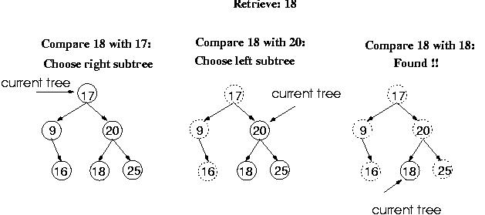
Function Retrieve Item

Slide 20
Function RetrieveItem
What is the size of the problem?
  Number of nodes in the tree we are examining
What is the base case(s)?
    When the key is found
    The tree is empty (key was not found)
What is the general case?
  Search in the left or right subtrees

Slide 21
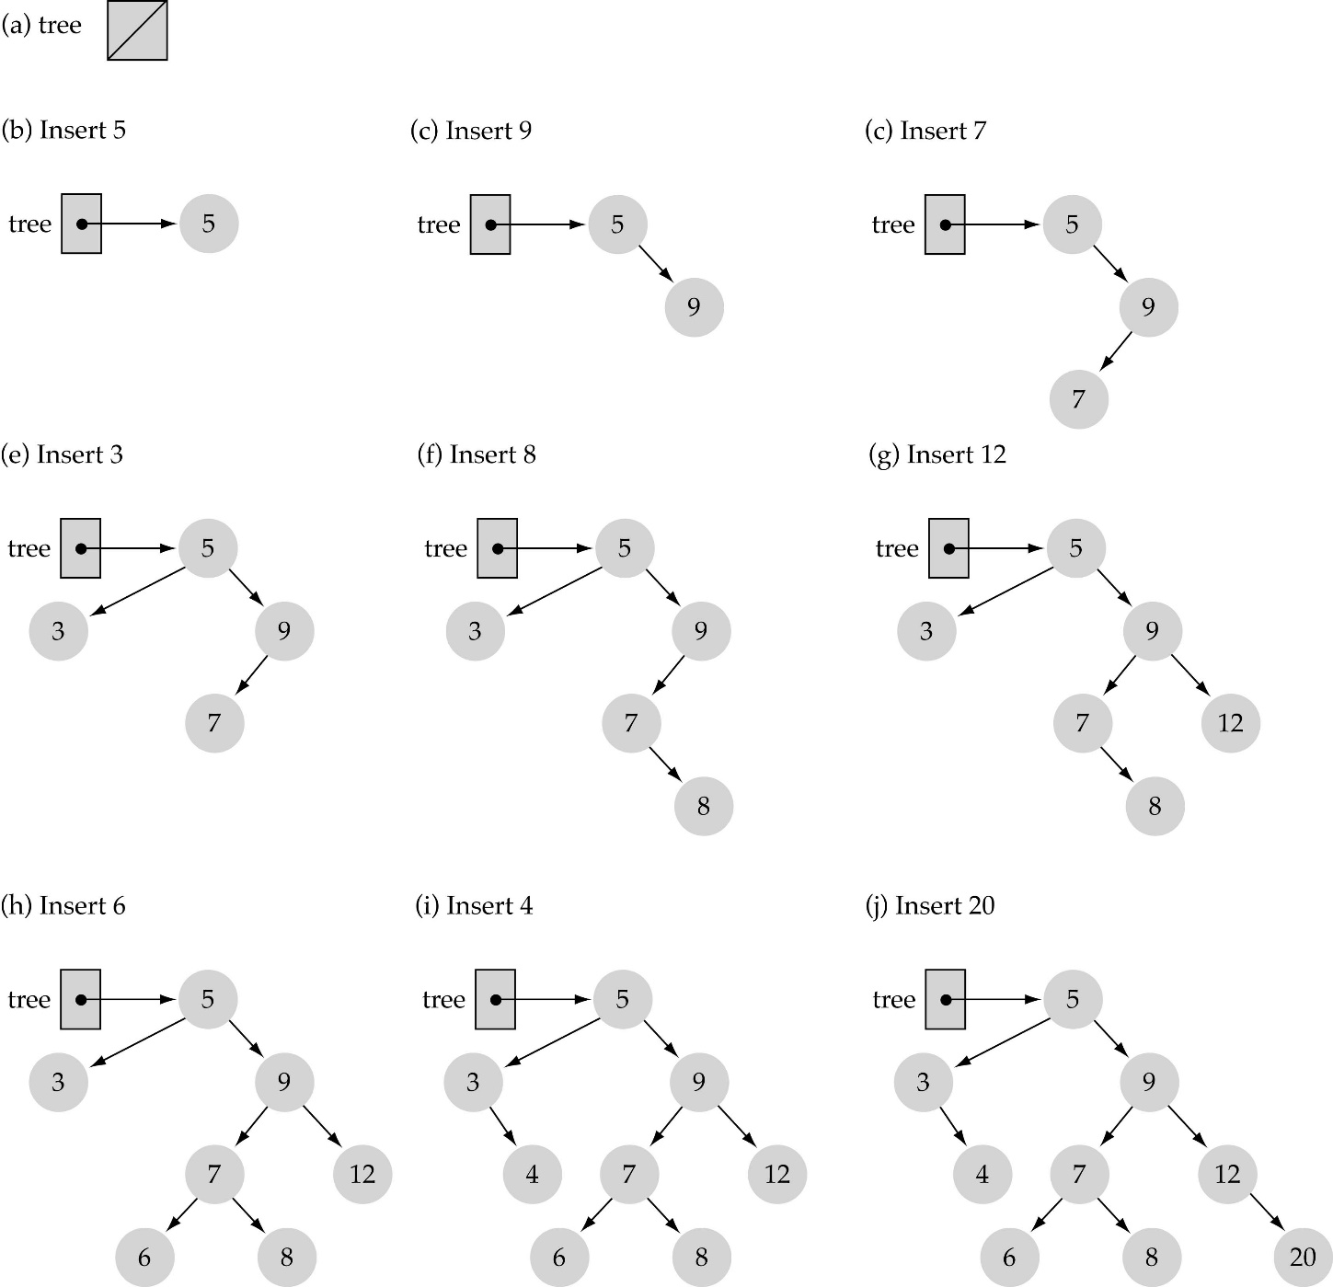
Function InsertItem
Use the binary search tree property to insert the new item at the correct place

Slide 22
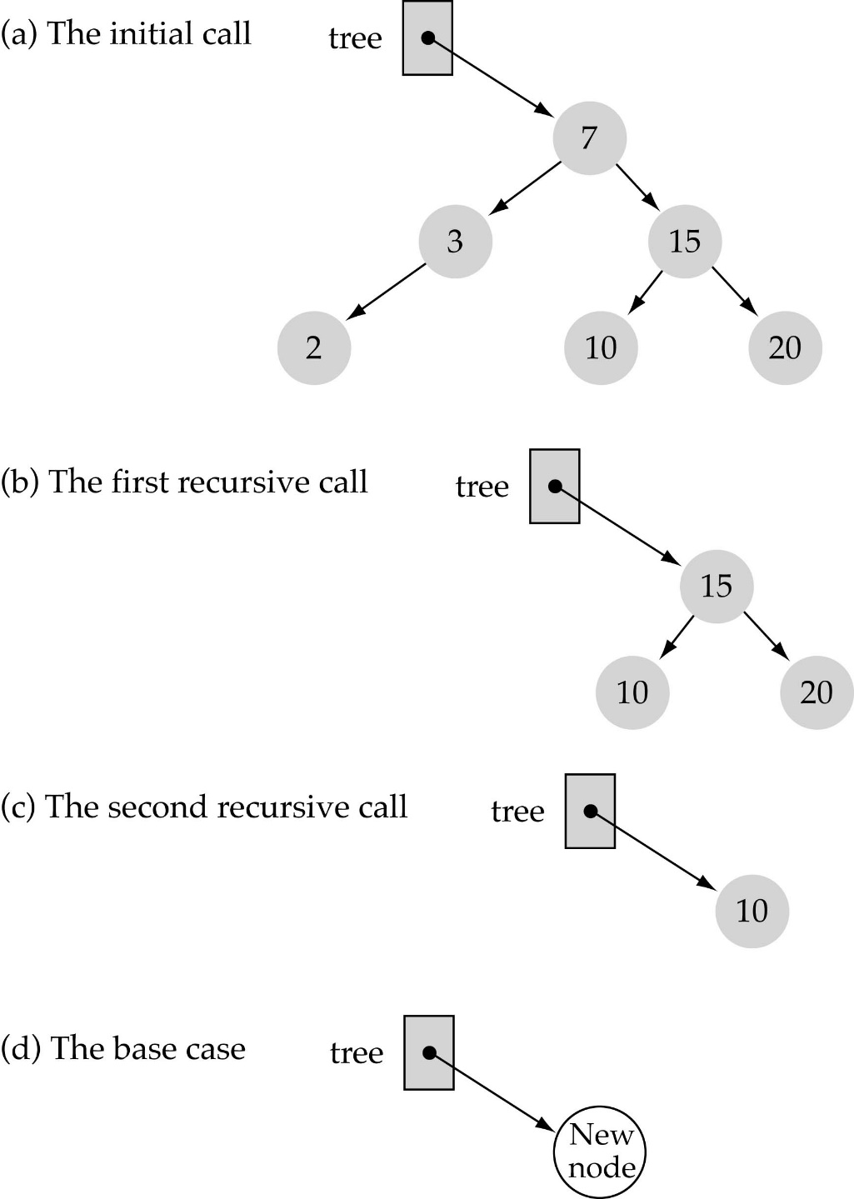
Function InsertItem
(cont.)
Implementing insertion resursively
e.g., insert 11

Slide 23
Function InsertItem (cont.)
What is the size of the problem?
  Number of nodes in the tree we are examining
What is the base case(s)?
  The tree is empty
What is the general case?
  Choose the left or right subtree

