Slide 1
G2M CASE STUDY
Sirui Zhang

Slide 2
Background
XYZ is a private firm in US. Due to remarkable growth in the Cab Industry in last few years and multiple key players in the market, it is planning for an investment in Cab industry and they want to understand the market before taking final decision.
This presentation will be judged based on the visuals provided, the quality of my analysis and the value of my recommendations and insights.

Slide 3
Data Exploration
Information files:
Cab_Data.csv information of two companies’ transaction
City.csv information about each city
Transaction_ID.csv transactions’ related customers
Customer_ID.csv information about each customer
Final results:
result.ppt

Slide 4
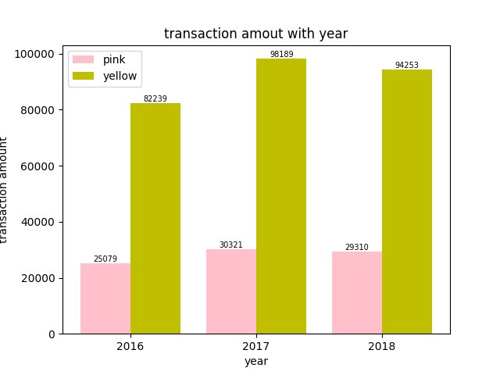
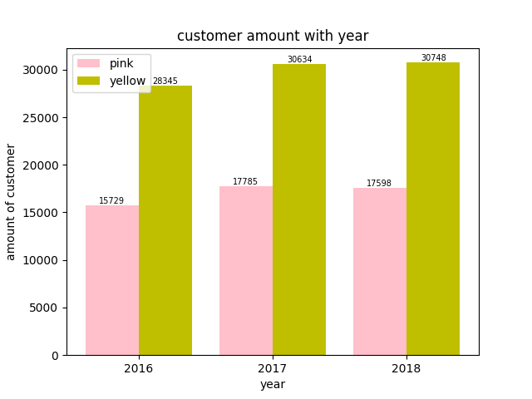
Transaction and Customer
Both company had the least transactions and customers in 2016, reach peak in 2017 and their transactions both decreased a bit in 2018. Their customers in 2018 is almost the same as 2017 . But, yellow company has higher amount of both transactions and customers compared with pink company

Slide 5
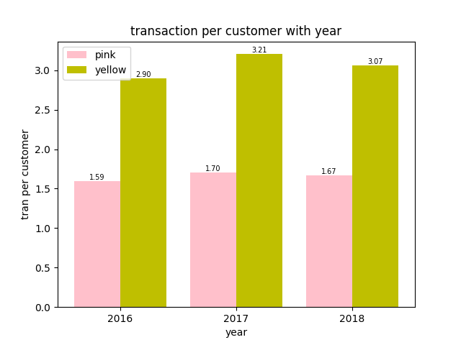
Transaction and Customer
Yellow company’s customers have stronger willingness to use the services. These three pictures significantly show that yellow company occupy more market needs and customers than pink company.

Slide 6
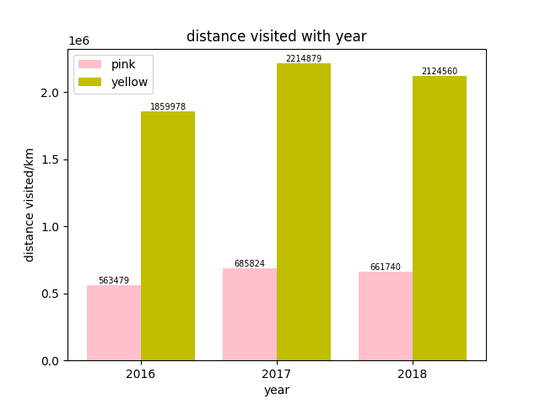
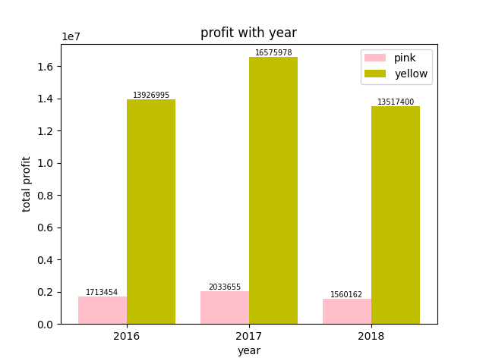
Distance and Profit

Slide 7
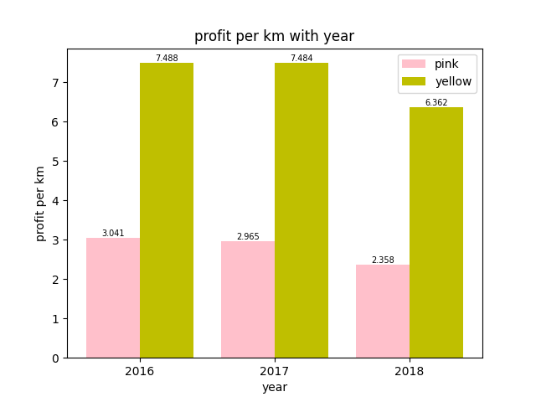
Distance and Profit
Yellow company undoubtable has a bigger size than pink company. And, from the profit per km, we can see that the transaction of yellow company is under higher price.

Slide 8
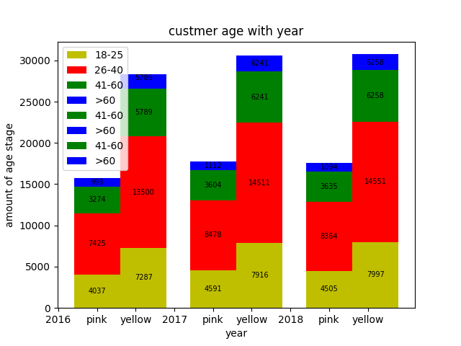
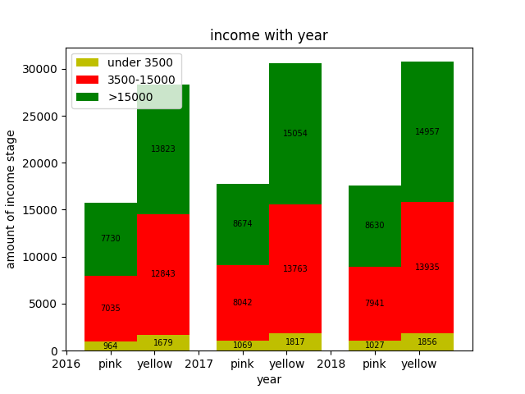
Customer Analysis
Both companies’ customer structure are similar.
Age group mainly 26-40, income group 3500-15000 and >15000 have similar amount.

Slide 9
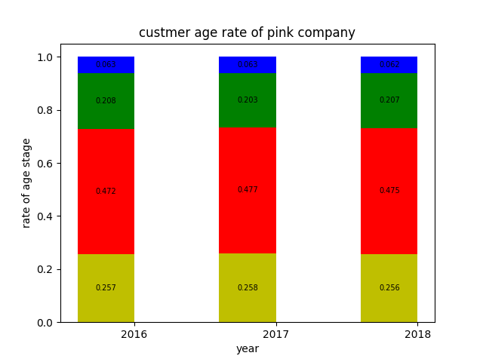

Customer Analysis
There two picture shows the similar age structure. Customer who are 26-40 is the main consumer of both companies.

Slide 10
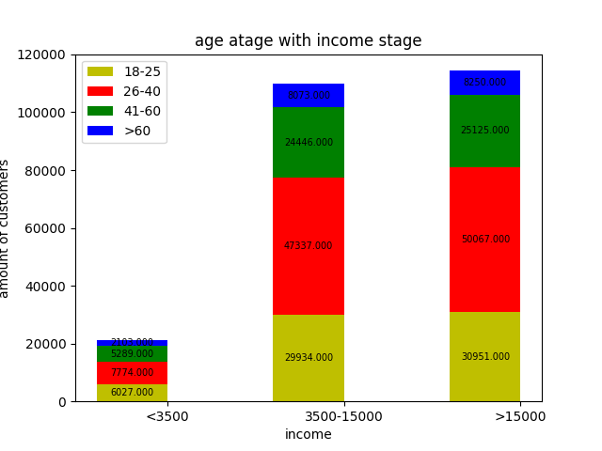
Customer Analysis
This picture shows each age groups’ income stage. We can see that age group 18-25 and 41-60 are more likely to earn less than 3500, and age group 26-40 is more likely to earn more than 15000. The income stage 3500-15000 ‘s age structure is normal.

Slide 11
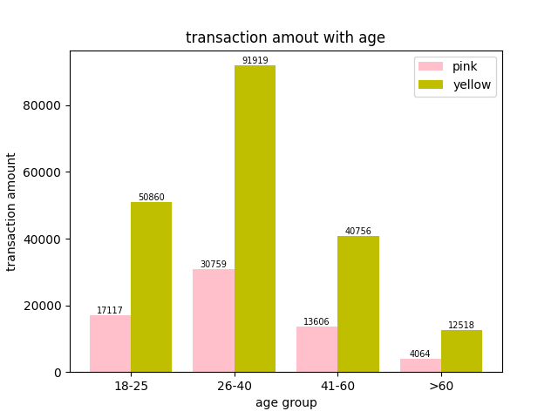
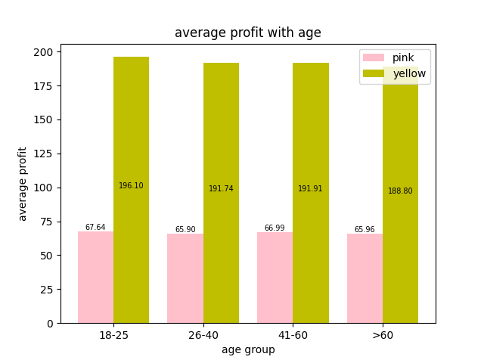
Customer Analysis
For both companies, each age groups provide similar average profit. But, it is significant that age group 26-40 provide more transactions. Then is 18-25, then 41-60. Age group 60+ provide the least transactions.

Slide 12
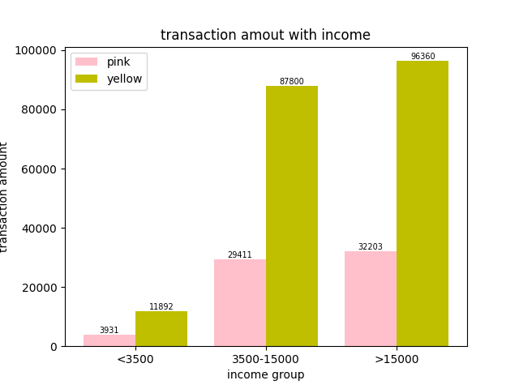
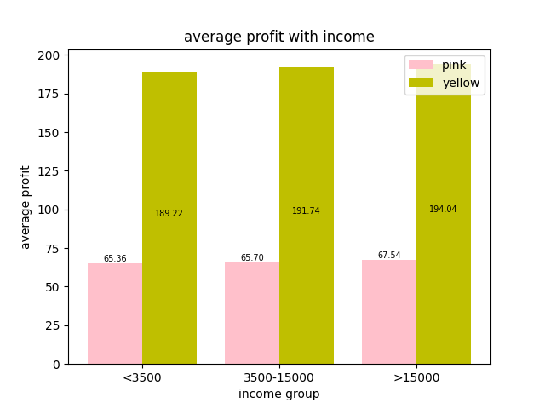
Customer Analysis
Similar as age stage, the mean profit of each income stage are similar. But, for transaction amounts, those who have >15000 income provide the most transactions.

Slide 13
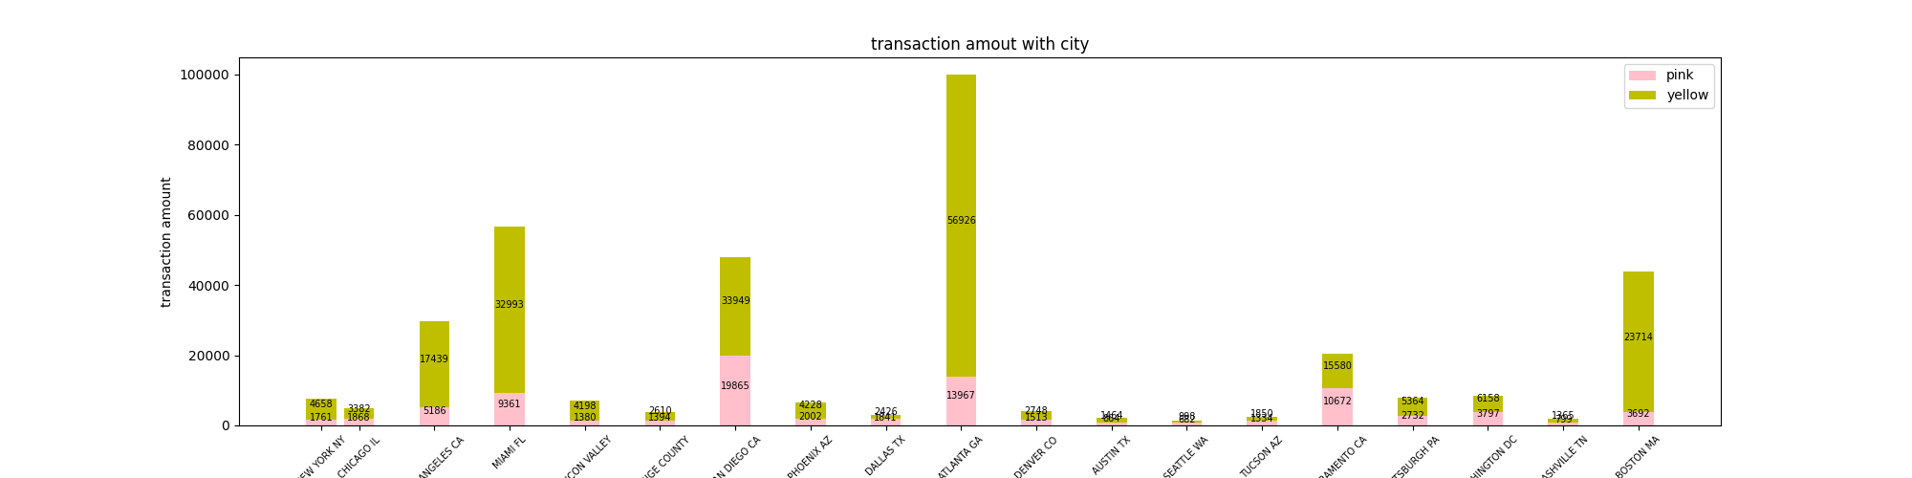
City analysis
It is significant that yellow company occupy more in each city.

Slide 14
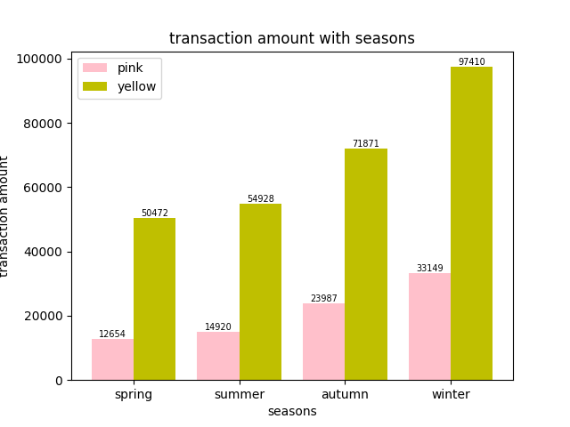
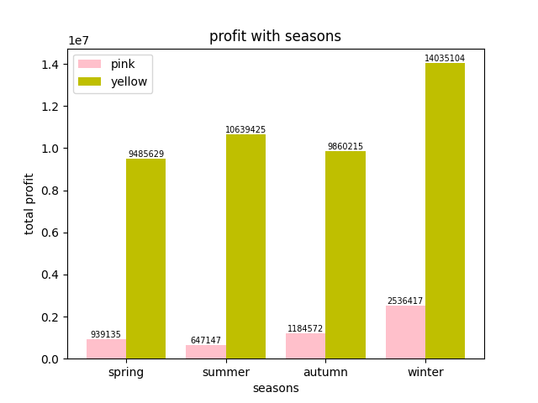
Transaction and Profit
In winter, people’s willingness to use the services is the most. But in summer, each transaction provides more profit.

Slide 15
Recommendations
For market occupation, yellow company has absolutely advantage. Yellow company has three times of transactions and 2 times of customers as pink company.
Yellow company’s customer has higher willingness to consume. Each customer of yellow company provide two times of amount of transactions as customers of pink company.
Yellow company have more high-income customers which provide more profit.
As profit rate:
yellow company also win.
yellow | 54.3%
pink | 25.56%

Slide 16
Recommendations
During three years, both companies’ transaction and customer increased by about 1.15 . But the rate of 24-40 age group and >15000 income group of pink company, increased less compared with yellow company.
Base on these points, we will recommend yellow company for investment

