Slide 1
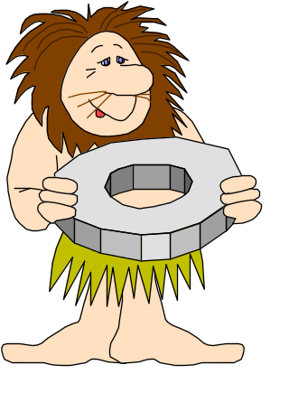
What Is a DBMS?
A very large, integrated collection of data.
Models real-world enterprise.
  Entities (e.g., students, courses)
  Relationships (e.g., Madonna is taking CS564)
A Database Management System (DBMS) is a software package designed to store and manage databases.

Slide 2

Why Use a DBMS?
Data independence and efficient access.
Reduced application development time.
Data integrity and security.
Uniform data administration.
Concurrent access, recovery from crashes.
Notes:
3

Slide 3
Data Models
A data model is a collection of concepts for describing data.
A schema is a description of a particular collection of data, using the a given data model.
The relational model of data is the most widely used model today.
  Main concept: relation, basically a table with rows and columns.
  Every relation has a schema, which describes the columns, or fields.
Notes:
5

Slide 4
Levels of Abstraction
Many views, single conceptual (logical) schema and physical schema.
  Views describe how users see the data.
  Conceptual schema defines logical structure
  Physical schema describes the files and indexes used.
View 1
View 2
View 3
Conceptual Schema
Physical Schema
Schemas are defined using DDL; data is modified/queried using DML.
Notes:
6

Slide 5
Example: University Database
Conceptual schema:
  Students(sid: string, name: string, login: string,
  age: integer, gpa:real)
  Courses(cid: string, cname:string, credits:integer)
  Enrolled(sid:string, cid:string, grade:string)
Physical schema:
  Relations stored as unordered files.
  Index on first column of Students.
External Schema (View):
  Course_info(cid:string,enrollment:integer)
Notes:
7

Slide 6
Data Independence *
Applications insulated from how data is structured and stored.
Logical data independence: Protection from changes in logical structure of data.
Physical data independence: Protection from changes in physical structure of data.
One of the most important benefits of using a DBMS!

Slide 7

Databases make these folks happy ...
End users and DBMS vendors
DB application programmers
  E.g. smart webmasters
Database administrator (DBA)
  Designs logical /physical schemas
  Handles security and authorization
  Data availability, crash recovery
  Database tuning as needs evolve
Must understand how a DBMS works!
Notes:
21

Slide 8
Structure of a DBMS
These layers
must consider
concurrency
control and
recovery
A typical DBMS has a layered architecture.
The figure does not show the concurrency control and recovery components.
This is one of several possible architectures; each system has its own variations.
Query Optimization
and Execution
Relational Operators
Files and Access Methods
Buffer Management
Disk Space Management
DB
Notes:
22

Slide 9

Summary
DBMS used to maintain, query large datasets.
Benefits include recovery from system crashes, concurrent access, quick application development, data integrity and security.
Levels of abstraction give data independence.
A DBMS typically has a layered architecture.
DBAs hold responsible jobs and are well-paid!
DBMS R&D is one of the broadest, most exciting areas in CS.

