Slide 1
The Relational Model
Chapter 3
Notes:
1
The slides for this text are organized into chapters. This lecture covers Chapter 3.
Chapter 1: Introduction to Database Systems
Chapter 2: The Entity-Relationship Model
Chapter 3: The Relational Model
Chapter 4 (Part A): Relational Algebra
Chapter 4 (Part B): Relational Calculus
Chapter 5: SQL: Queries, Programming, Triggers
Chapter 6: Query-by-Example (QBE)
Chapter 7: Storing Data: Disks and Files
Chapter 8: File Organizations and Indexing
Chapter 9: Tree-Structured Indexing
Chapter 10: Hash-Based Indexing
Chapter 11: External Sorting
Chapter 12 (Part A): Evaluation of Relational Operators
Chapter 12 (Part B): Evaluation of Relational Operators: Other Techniques
Chapter 13: Introduction to Query Optimization
Chapter 14: A Typical Relational Optimizer
Chapter 15: Schema Refinement and Normal Forms
Chapter 16 (Part A): Physical Database Design
Chapter 16 (Part B): Database Tuning
Chapter 17: Security
Chapter 18: Transaction Management Overview
Chapter 19: Concurrency Control
Chapter 20: Crash Recovery
Chapter 21: Parallel and Distributed Databases
Chapter 22: Internet Databases
Chapter 23: Decision Support
Chapter 24: Data Mining
Chapter 25: Object-Database Systems
Chapter 26: Spatial Data Management
Chapter 27: Deductive Databases
Chapter 28: Additional Topics

Slide 2
Relational Database: Definitions
Relational database: a set of relations
Relation: made up of 2 parts:
  Instance : a table, with rows and columns.
  #Rows = cardinality, #fields = degree / arity.
  Schema : specifies name of relation, plus name and type of each column.
    E.G. Students(sid: string, name: string, login: string, age: integer, gpa: real).
Can think of a relation as a set of rows or tuples (i.e., all rows are distinct).
Notes:
3

Slide 3
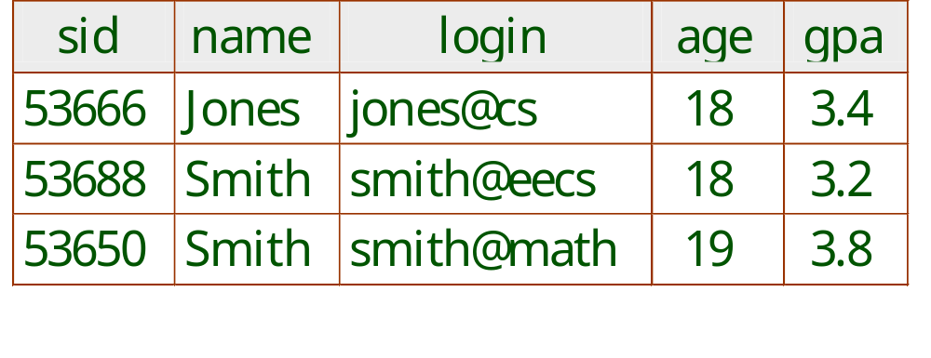
Example Instance of Students Relation
Cardinality = 3, degree = 5, all rows distinct
Do all columns in a relation instance have to
be distinct?
Notes:
4

Slide 4
The SQL Query Language
Developed by IBM (System-R, SEQUEL) in the 1970s
Need for a standard since it is used by many vendors
Standards:
  SQL-86
  SQL-89 (minor revision)
  SQL-92 or SQL-2(major revision)
  SQL-99 or SQL-3 (major extensions, current standard)

Slide 5
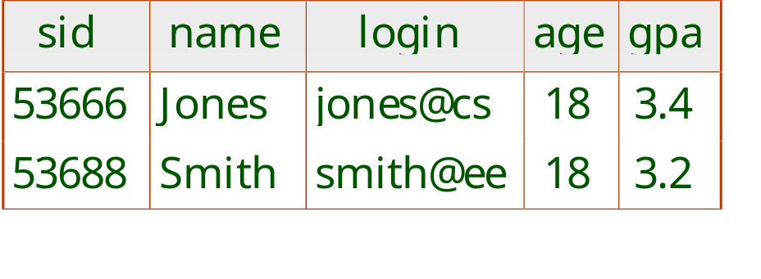
The SQL Query Language
To find all 18 year old students, we can write:
SELECT *
FROM Students S
WHERE S.age=18
To find just names and logins, replace the first line:
SELECT S.name, S.login

Slide 6
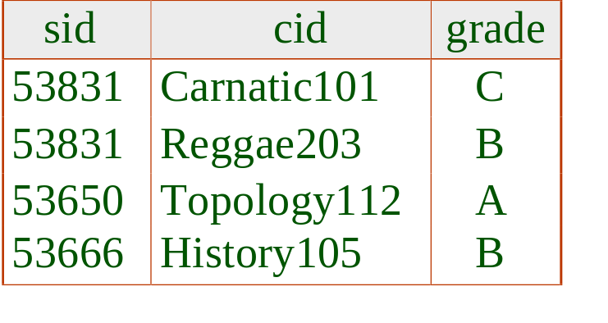
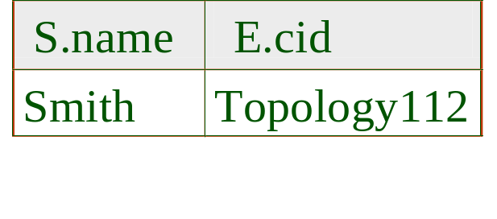
Querying Multiple Relations
What does the following query compute?
SELECT S.name, E.cid
FROM Students S, Enrolled E
WHERE S.sid=E.sid AND E.grade=“A”
Given the following instance of Enrolled (is this possible if the DBMS ensures referential integrity?):
we get:

Slide 7
Creating Relations in SQL
Creates the Students relation. Observe that the type (domain) of each field is specified, and enforced by the DBMS whenever tuples are added or modified.
As another example, the Enrolled table holds information about courses that students take.
CREATE TABLE Students
(sid: CHAR(20),
name: CHAR(20),
login: CHAR(10),
age: INTEGER,
gpa: REAL)
CREATE TABLE Enrolled
(sid: CHAR(20),
cid: CHAR(20),
grade: CHAR(2))
Notes:
15

Slide 8
Destroying and Altering Relations
DROP TABLE Students
Destroys the relation Students. The schema information and the tuples are deleted.
ALTER TABLE Students
ADD COLUMN firstYear: integer
The schema of Students is altered by adding a new field; every tuple in the current instance is extended with a null value in the new field.
Notes:
16

Slide 9
Adding and Deleting Tuples
Can insert a single tuple using:
INSERT INTO Students (sid, name, login, age, gpa)
VALUES (53688, ‘Smith’, ‘smith@ee’, 18, 3.2)
Can delete all tuples satisfying some condition (e.g., name = Smith):
DELETE
FROM Students S
WHERE S.name = ‘Smith’
Powerful variants of these commands are available; more later!
Notes:
10

Slide 10
Integrity Constraints (ICs)
IC: condition that must be true for any instance of the database; e.g., domain constraints.
  ICs are specified when schema is defined.
  ICs are checked when relations are modified.
A legal instance of a relation is one that satisfies all specified ICs.
  DBMS should not allow illegal instances.
If the DBMS checks ICs, stored data is more faithful to real-world meaning.
  Avoids data entry errors, too!
Notes:
5

Slide 11
Primary Key Constraints
A set of fields is a key for a relation if :
  1. No two distinct tuples can have same values in all key fields, and
  2. This is not true for any subset of the key.
  Part 2 false? A superkey.
  If there’s >1 key for a relation, one of the keys is chosen (by DBA) to be the primary key.
E.g., sid is a key for Students. (What about name?) The set {sid, gpa} is a superkey.
Notes:
6

Slide 12
Primary and Candidate Keys in SQL
Possibly many candidate keys (specified using UNIQUE), one of which is chosen as the primary key.
“For a given student and course, there is a single grade.” vs. “Students can take only one course, and receive a single grade for that course; further, no two students in a course receive the same grade.”
Used carelessly, an IC can prevent the storage of database instances that arise in practice!
CREATE TABLE Enrolled
(sid CHAR(20)
cid CHAR(20),
grade CHAR(2),
PRIMARY KEY (sid,cid) )
CREATE TABLE Enrolled
(sid CHAR(20)
cid CHAR(20),
grade CHAR(2),
PRIMARY KEY (sid),
UNIQUE (cid, grade) )
Notes:
6

Slide 13
Foreign Keys, Referential Integrity
Foreign key : Set of fields in one relation that is used to `refer’ to a tuple in another relation. (Must correspond to primary key of the second relation.) Like a `logical pointer’.
E.g. sid is a foreign key referring to Students:
  Enrolled(sid: string, cid: string, grade: string)
  If all foreign key constraints are enforced, referential integrity is achieved, i.e., no dangling references.
  Can you name a data model w/o referential integrity?
    Links in HTML!
Notes:
7

Slide 14
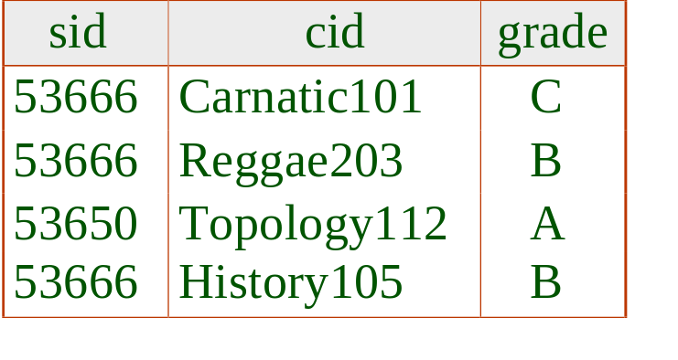
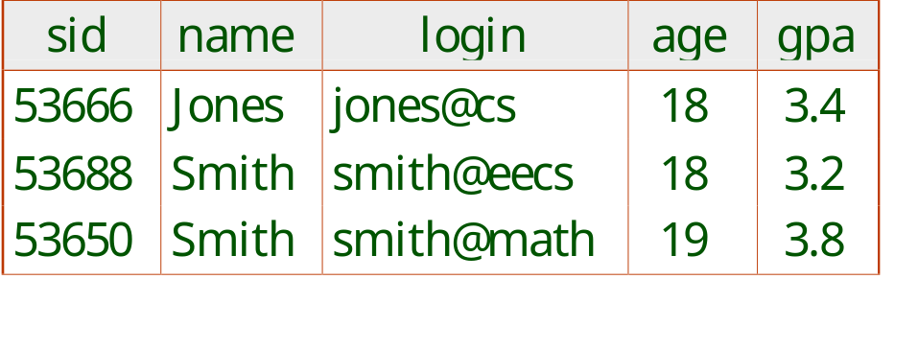
Foreign Keys in SQL
Only students listed in the Students relation should be allowed to enroll for courses.
CREATE TABLE Enrolled
(sid CHAR(20), cid CHAR(20), grade CHAR(2),
PRIMARY KEY (sid,cid),
FOREIGN KEY (sid) REFERENCES Students )
Enrolled
Students
Notes:
7

Slide 15
Enforcing Referential Integrity
Consider Students and Enrolled; sid in Enrolled is a foreign key that references Students.
What should be done if an Enrolled tuple with a non-existent student id is inserted? (Reject it!)
What should be done if a Students tuple is deleted?
  Also delete all Enrolled tuples that refer to it.
  Disallow deletion of a Students tuple that is referred to.
  Set sid in Enrolled tuples that refer to it to a default sid.
  (In SQL, also: Set sid in Enrolled tuples that refer to it to a special value null, denoting `unknown’ or `inapplicable’.)
Similar if primary key of Students tuple is updated.
Notes:
13

Slide 16
Referential Integrity in SQL
SQL/92 and SQL:1999 support all 4 options on deletes and updates.
  Default is NO ACTION (delete/update is rejected)
  CASCADE (also delete all tuples that refer to deleted tuple)
  SET NULL / SET DEFAULT (sets foreign key value of referencing tuple)
CREATE TABLE Enrolled
(sid CHAR(20) DEFAULT 100,
cid CHAR(20),
grade CHAR(2),
PRIMARY KEY (sid,cid),
FOREIGN KEY (sid)
REFERENCES Students
ON DELETE CASCADE
ON UPDATE SET DEFAULT )
Notes:
14

Slide 17
Where do ICs Come From?
ICs are based upon the semantics of the real-world enterprise that is being described in the database relations.
We can check a database instance to see if an IC is violated, but we can NEVER infer that an IC is true by looking at an instance.
  An IC is a statement about all possible instances!
  From example, we know name is not a key, but the assertion that sid is a key is given to us.
Key and foreign key ICs are the most common; more general ICs supported too.

Slide 18
Logical DB Design: ER to Relational
Entity sets to tables:
CREATE TABLE Employees
(ssn CHAR(11),
name CHAR(20),
lot INTEGER,
PRIMARY KEY (ssn))
name
ssn
lot
Employees
Notes:
3
The slides for this text are organized into several modules. Each lecture contains about enough material for a 1.25 hour class period. (The time estimate is very approximate--it will vary with the instructor, and lectures also differ in length; so use this as a rough guideline.) This covers Lectures 1 and 2 (of 6) in Module (5).
Module (1): Introduction (DBMS, Relational Model)
Module (2): Storage and File Organizations (Disks, Buffering, Indexes)
Module (3): Database Concepts (Relational Queries, DDL/ICs, Views and Security)
Module (4): Relational Implementation (Query Evaluation, Optimization)
Module (5): Database Design (ER Model, Normalization, Physical Design, Tuning)
Module (6): Transaction Processing (Concurrency Control, Recovery)
Module (7): Advanced Topics

Slide 19
Relationship Sets to Tables
In translating a relationship set to a relation, attributes of the relation must include:
  Keys for each participating entity set (as foreign keys).
    This set of attributes forms a superkey for the relation.
  All descriptive attributes.
CREATE TABLE Works_In(
ssn CHAR(1),
did INTEGER,
since DATE,
PRIMARY KEY (ssn, did),
FOREIGN KEY (ssn)
REFERENCES Employees,
FOREIGN KEY (did)
REFERENCES Departments)
Notes:
5

Slide 20
Review: Key Constraints
since
Each dept has at most one manager, according to the key constraint on Manages.
name
dname
ssn
lot
did
budget
Employees
Manages
Departments
Translation to
relational model?
1-to-1
1-to Many
Many-to-1
Many-to-Many
Notes:
6

Slide 21
Translating ER Diagrams with Key Constraints
CREATE TABLE Manages(
ssn CHAR(11),
did INTEGER,
since DATE,
PRIMARY KEY (did),
FOREIGN KEY (ssn) REFERENCES Employees,
FOREIGN KEY (did) REFERENCES Departments)
Map relationship to a table:
  Note that did is the key now!
  Separate tables for Employees and Departments.
Since each department has a unique manager, we could instead combine Manages and Departments.
CREATE TABLE Dept_Mgr(
did INTEGER,
dname CHAR(20),
budget REAL,
ssn CHAR(11),
since DATE,
PRIMARY KEY (did),
FOREIGN KEY (ssn) REFERENCES Employees)
Notes:
7

Slide 22
Review: Participation Constraints
Does every department have a manager?
  If so, this is a participation constraint: the participation of Departments in Manages is said to be total (vs. partial).
    Every did value in Departments table must appear in a row of the Manages table (with a non-null ssn value!)
since
since
name
name
dname
dname
ssn
did
did
budget
lot
budget
Employees
Manages
Departments
Works_In
since
Notes:
8

Slide 23
Participation Constraints in SQL
We can capture participation constraints involving one entity set in a binary relationship, but little else (without resorting to CHECK constraints).
CREATE TABLE Dept_Mgr(
did INTEGER,
dname CHAR(20),
budget REAL,
ssn CHAR(11) NOT NULL,
since DATE,
PRIMARY KEY (did),
FOREIGN KEY (ssn) REFERENCES Employees,
ON DELETE NO ACTION)
Notes:
9

Slide 24
Review: Weak Entities
A weak entity can be identified uniquely only by considering the primary key of another (owner) entity.
  Owner entity set and weak entity set must participate in a one-to-many relationship set (1 owner, many weak entities).
  Weak entity set must have total participation in this identifying relationship set.
name
ssn
lot
cost
pname
age
Employees
Policy
Dependents
Notes:
10

Slide 25
Translating Weak Entity Sets
Weak entity set and identifying relationship set are translated into a single table.
  When the owner entity is deleted, all owned weak entities must also be deleted.
CREATE TABLE Dep_Policy (
pname CHAR(20),
age INTEGER,
cost REAL,
ssn CHAR(11) NOT NULL,
PRIMARY KEY (pname, ssn),
FOREIGN KEY (ssn) REFERENCES Employees,
ON DELETE CASCADE)
Notes:
11

Slide 26
Review: ISA Hierarchies
name
ssn
lot
Employees
hourly_wages
hours_worked
As in C++, or other PLs, attributes are inherited.
If we declare A ISA B, every A entity is also considered to be a B entity.
ISA
contractid
Hourly_Emps
Contract_Emps
Overlap constraints: Can Joe be an Hourly_Emps as well as a Contract_Emps entity? (Allowed/disallowed)
Covering constraints: Does every Employees entity also have to be an Hourly_Emps or a Contract_Emps entity? (Yes/no)
Notes:
12

Slide 27
Translating ISA Hierarchies to Relations
General approach:
  3 relations: Employees, Hourly_Emps and Contract_Emps.
    Hourly_Emps: Every employee is recorded in Employees. For hourly emps, extra info recorded in Hourly_Emps (hourly_wages, hours_worked, ssn); must delete Hourly_Emps tuple if referenced Employees tuple is deleted).
    Queries involving all employees easy, those involving just Hourly_Emps require a join to get some attributes.
Alternative: Just Hourly_Emps and Contract_Emps.
  Hourly_Emps: ssn, name, lot, hourly_wages, hours_worked.
  Each employee must be in one of these two subclasses.
Notes:
13

Slide 28
Review: Binary vs. Ternary Relationships
name
ssn
lot
pname
age
Employees
Covers
Dependents
What are the additional constraints in the 2nd diagram?
Bad design
Policies
policyid
cost
name
pname
age
ssn
lot
Dependents
Employees
Purchaser
Beneficiary
Better design
Policies
policyid
cost
Notes:
7

Slide 29
Binary vs. Ternary Relationships (Contd.)
CREATE TABLE Policies (
policyid INTEGER,
cost REAL,
ssn CHAR(11) NOT NULL,
PRIMARY KEY (policyid).
FOREIGN KEY (ssn) REFERENCES Employees,
ON DELETE CASCADE)
The key constraints allow us to combine Purchaser with Policies and Beneficiary with Dependents.
Participation constraints lead to NOT NULL constraints.
What if Policies is a weak entity set?
CREATE TABLE Dependents (
pname CHAR(20),
age INTEGER,
policyid INTEGER,
PRIMARY KEY (pname, policyid).
FOREIGN KEY (policyid) REFERENCES Policies,
ON DELETE CASCADE)
Notes:
8

Slide 30
Views
A view is just a relation, but we store a definition, rather than a set of tuples.
CREATE VIEW YoungActiveStudents (name, grade)
AS SELECT S.name, E.grade
FROM Students S, Enrolled E
WHERE S.sid = E.sid and S.age<21
Views can be dropped using the DROP VIEW command.
  How to handle DROP TABLE if there’s a view on the table?
    DROP TABLE command has options to let the user specify this.
Notes:
18

Slide 31
Views and Security
Views can be used to present necessary information (or a summary), while hiding details in underlying relation(s).
  Given YoungStudents, but not Students or Enrolled, we can find students s who have are enrolled, but not the cid’s of the courses they are enrolled in.
Notes:
22

Slide 32
Relational Model: Summary
A tabular representation of data.
Simple and intuitive, currently the most widely used.
Integrity constraints can be specified by the DBA, based on application semantics. DBMS checks for violations.
  Two important ICs: primary and foreign keys
  In addition, we always have domain constraints.
Powerful and natural query languages exist.
Rules to translate ER to relational model
Notes:
15

