Slide 1
Relational Calculus
Chapter 4, Part B
Notes:
The slides for this text are organized into chapters. This lecture covers relational calculus from Chapter 4. The relational algebra part can be found in Chapter 4, Part A.
Chapter 1: Introduction to Database Systems
Chapter 2: The Entity-Relationship Model
Chapter 3: The Relational Model
Chapter 4 (Part A): Relational Algebra
Chapter 4 (Part B): Relational Calculus
Chapter 5: SQL: Queries, Programming, Triggers
Chapter 6: Query-by-Example (QBE)
Chapter 7: Storing Data: Disks and Files
Chapter 8: File Organizations and Indexing
Chapter 9: Tree-Structured Indexing
Chapter 10: Hash-Based Indexing
Chapter 11: External Sorting
Chapter 12 (Part A): Evaluation of Relational Operators
Chapter 12 (Part B): Evaluation of Relational Operators: Other Techniques
Chapter 13: Introduction to Query Optimization
Chapter 14: A Typical Relational Optimizer
Chapter 15: Schema Refinement and Normal Forms
Chapter 16 (Part A): Physical Database Design
Chapter 16 (Part B): Database Tuning
Chapter 17: Security
Chapter 18: Transaction Management Overview
Chapter 19: Concurrency Control
Chapter 20: Crash Recovery
Chapter 21: Parallel and Distributed Databases
Chapter 22: Internet Databases
Chapter 23: Decision Support
Chapter 24: Data Mining
Chapter 25: Object-Database Systems
Chapter 26: Spatial Data Management
Chapter 27: Deductive Databases
Chapter 28: Additional Topics

Slide 2
Relational Calculus
Comes in two flavors: Tuple relational calculus (TRC) and Domain relational calculus (DRC).
Calculus has variables, constants, comparison ops, logical connectives and quantifiers.
  TRC: Variables range over (i.e., get bound to) tuples.
  DRC: Variables range over domain elements (= field values).
  Both TRC and DRC are simple subsets of first-order logic.
Expressions in the calculus are called formulas. An answer tuple is essentially an assignment of constants to variables that make the formula evaluate to true.

Slide 3
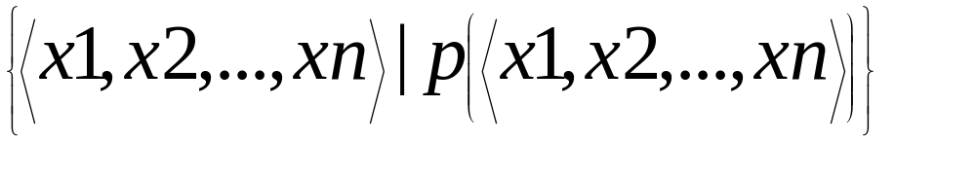
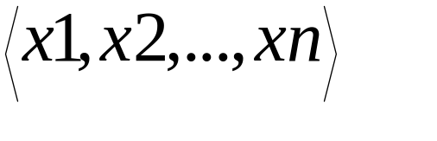
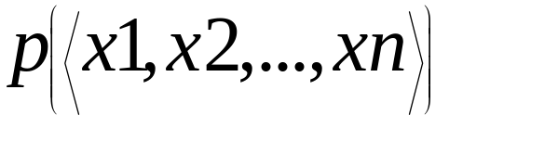
Domain Relational Calculus
Query has the form:
Answer includes all tuples that
make the formula be true.
Formula is recursively defined, starting with
simple atomic formulas (getting tuples from
relations or making comparisons of values),
and building bigger and better formulas using
the logical connectives.

Slide 4
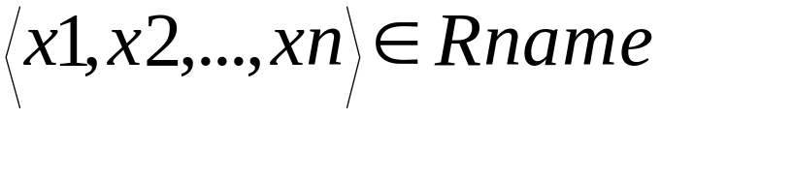

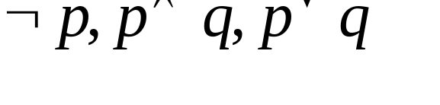
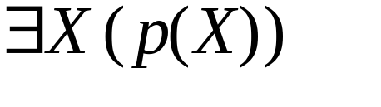
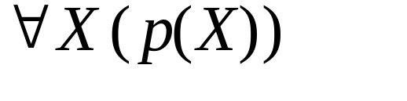

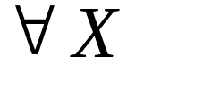
DRC Formulas
Atomic formula:
  , or X op Y, or X op constant
  op is one of
Formula:
  an atomic formula, or
  , where p and q are formulas, or
  , where variable X is free in p(X), or
  , where variable X is free in p(X)
The use of quantifiers and is said to bind X.
  A variable that is not bound is free.

Slide 5
Free and Bound Variables
The use of quantifiers and in a formula is said to bind X.
  A variable that is not bound is free.
Let us revisit the definition of a query:
There is an important restriction: the variables x1, ..., xn that appear to the left of `|’ must be the only free variables in the formula p(...).

Slide 6
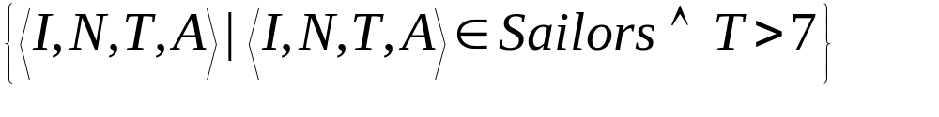
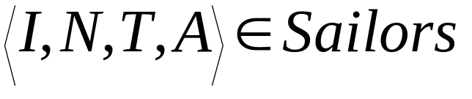
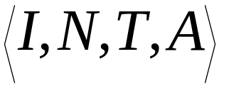
Find all sailors with a rating above 7
The condition ensures that the domain variables I, N, T and A are bound to fields of the same Sailors tuple.
The term to the left of `|’ (which should be read as such that) says that every tuple that satisfies T>7 is in the answer.
Modify this query to answer:
  Find sailors who are older than 18 or have a rating under 9, and are called ‘Joe’.

Slide 7
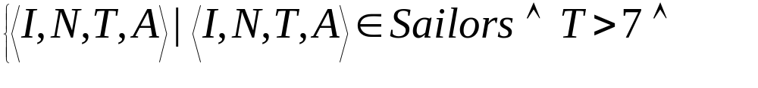
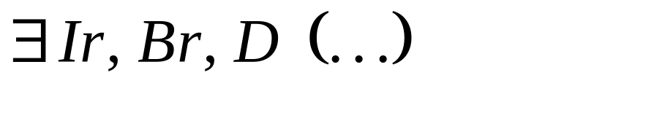
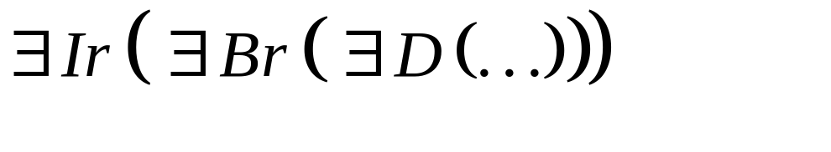

Find sailors rated > 7 who’ve reserved boat #103
We have used as a shorthand for
Note the use of to find a tuple in Reserves that `joins with’ the Sailors tuple under consideration.

Slide 8
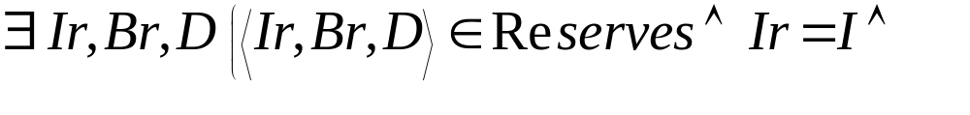
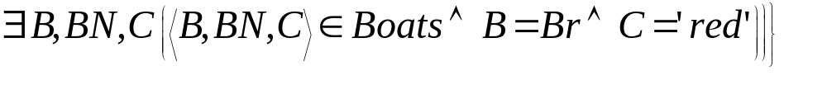
Find sailors rated > 7 who’ve reserved a red boat
Observe how the parentheses control the scope of each quantifier’s binding.
This may look cumbersome, but with a good user interface, it is very intuitive. (MS Access, QBE)

Slide 9
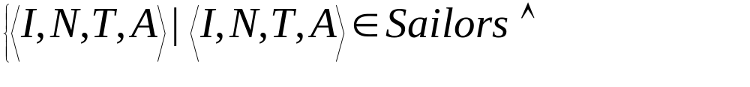
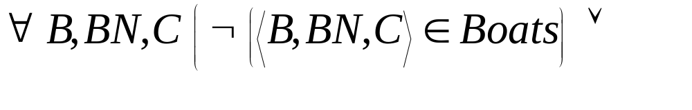
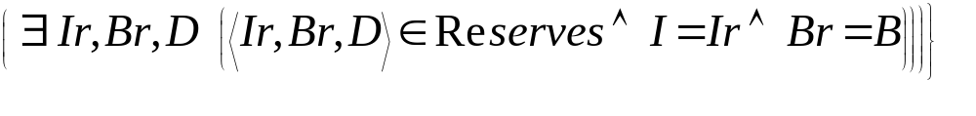
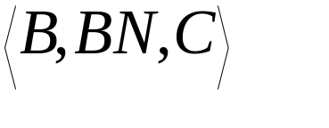
Find sailors who’ve reserved all boats
Find all sailors I such that for each 3-tuple either it is not a tuple in Boats or there is a tuple in Reserves showing that sailor I has reserved it.

Slide 10
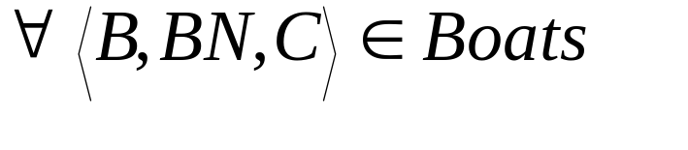
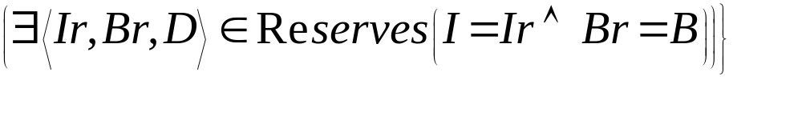
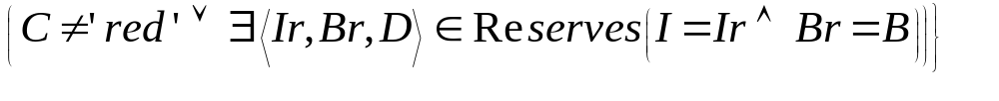
Find sailors who’ve reserved all boats (again!)
Simpler notation, same query. (Much clearer!)
To find sailors who’ve reserved all red boats:
.....

Slide 11
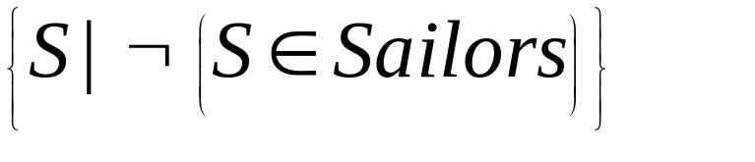
Unsafe Queries, Expressive Power
It is possible to write syntactically correct calculus queries that have an infinite number of answers! Such queries are called unsafe.
  e.g.,
It is known that every query that can be expressed in relational algebra can be expressed as a safe query in DRC / TRC; the converse is also true.
Relational Completeness: Query language (e.g., SQL) can express every query that is expressible in relational algebra/calculus.

Slide 12
Summary
Relational calculus is non-operational, and users define queries in terms of what they want, not in terms of how to compute it. (Declarativeness.)
Algebra and safe calculus have same expressive power, leading to the notion of relational completeness.

