Slide 1
SQL: Queries, Programming, Triggers
Chapter 5
Notes:
The slides for this text are organized into chapters. This lecture covers Chapter 5.
Chapter 1: Introduction to Database Systems
Chapter 2: The Entity-Relationship Model
Chapter 3: The Relational Model
Chapter 4 (Part A): Relational Algebra
Chapter 4 (Part B): Relational Calculus
Chapter 5: SQL: Queries, Programming, Triggers
Chapter 6: Query-by-Example (QBE)
Chapter 7: Storing Data: Disks and Files
Chapter 8: File Organizations and Indexing
Chapter 9: Tree-Structured Indexing
Chapter 10: Hash-Based Indexing
Chapter 11: External Sorting
Chapter 12 (Part A): Evaluation of Relational Operators
Chapter 12 (Part B): Evaluation of Relational Operators: Other Techniques
Chapter 13: Introduction to Query Optimization
Chapter 14: A Typical Relational Optimizer
Chapter 15: Schema Refinement and Normal Forms
Chapter 16 (Part A): Physical Database Design
Chapter 16 (Part B): Database Tuning
Chapter 17: Security
Chapter 18: Transaction Management Overview
Chapter 19: Concurrency Control
Chapter 20: Crash Recovery
Chapter 21: Parallel and Distributed Databases
Chapter 22: Internet Databases
Chapter 23: Decision Support
Chapter 24: Data Mining
Chapter 25: Object-Database Systems
Chapter 26: Spatial Data Management
Chapter 27: Deductive Databases
Chapter 28: Additional Topics

Slide 2
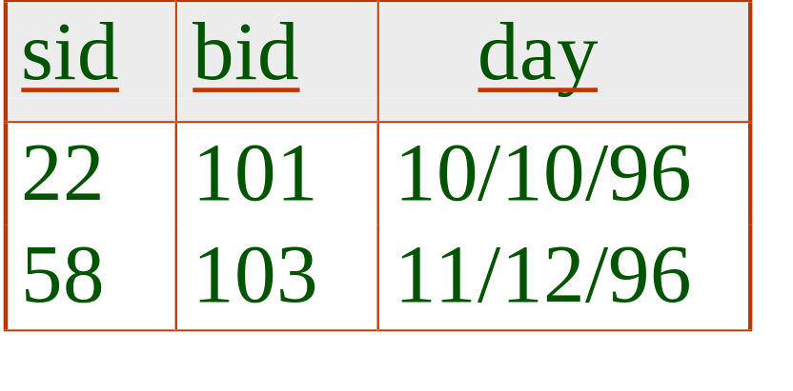
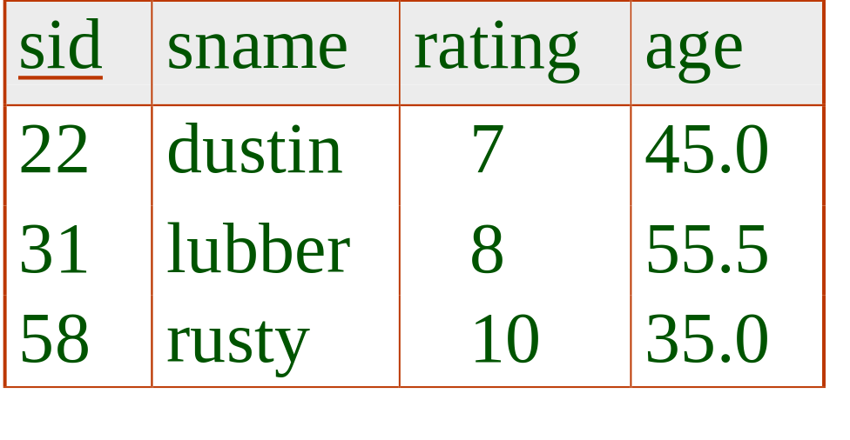
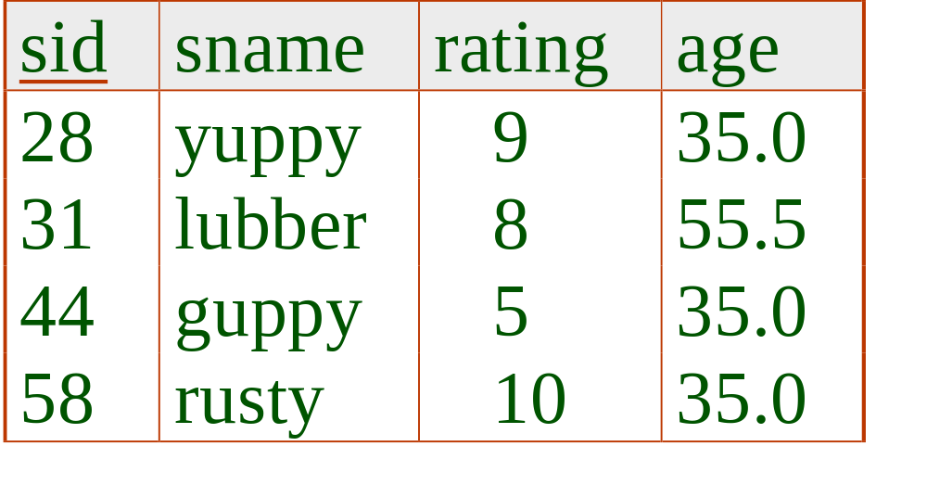
Example Instances
R1
We will use these instances of the Sailors and Reserves relations in our examples.
If the key for the Reserves relation contained only the attributes sid and bid, how would the semantics differ?
S1
S2

Slide 3

Basic SQL Query
SELECT [DISTINCT] target-list
FROM relation-list
WHERE qualification
relation-list A list of relation names (possibly with a range-variable after each name).
target-list A list of attributes of relations in relation-list
qualification Comparisons (Attr op const or Attr1 op Attr2, where op is one of ) combined using AND, OR and NOT.
DISTINCT is an optional keyword indicating that the answer should not contain duplicates. Default is that duplicates are not eliminated!

Slide 4
Conceptual Evaluation Strategy
Semantics of an SQL query defined in terms of the following conceptual evaluation strategy:
  Compute the cross-product of relation-list.
  Discard resulting tuples if they fail qualifications.
  Delete attributes that are not in target-list.
  If DISTINCT is specified, eliminate duplicate rows.
This strategy is probably the least efficient way to compute a query! An optimizer will find more efficient strategies to compute the same answers.

Slide 5
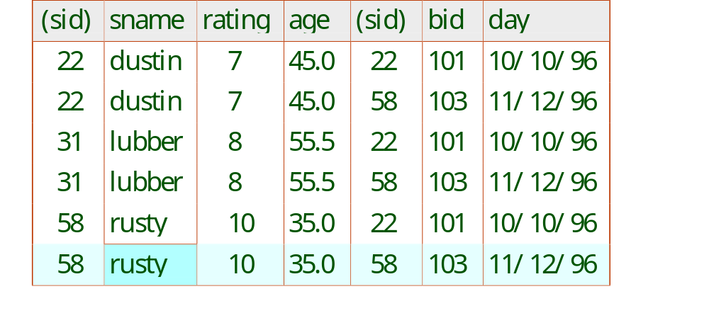
Example of Conceptual Evaluation
SELECT S.sname
FROM Sailors S, Reserves R
WHERE S.sid=R.sid AND R.bid=103

Slide 6
A Note on Range Variables
Really needed only if the same relation appears twice in the FROM clause. The previous query can also be written as:
SELECT S.sname
FROM Sailors S, Reserves R
WHERE S.sid=R.sid AND bid=103
It is good style,
however, to use
range variables
always!
OR
SELECT sname
FROM Sailors, Reserves
WHERE Sailors.sid=Reserves.sid
AND bid=103

Slide 7
Find sailors who’ve reserved at least one boat
SELECT [distinct???] S.sid
FROM Sailors S, Reserves R
WHERE S.sid=R.sid
Would adding DISTINCT to this query make a difference?
What is the effect of replacing S.sid by S.sname in the SELECT clause? Would adding DISTINCT to this variant of the query make a difference?

Slide 8
Expressions and Strings
SELECT S.age, age1=S.age-5, 2*S.age AS age2
FROM Sailors S
WHERE S.sname LIKE ‘B_%B’
Illustrates use of arithmetic expressions and string pattern matching: Find triples (of ages of sailors and two fields defined by expressions) for sailors whose names begin and end with B and contain at least three characters.
AS and = are two ways to name fields in result.
LIKE is used for string matching. `_’ stands for any one character and `%’ stands for 0 or more arbitrary characters.

Slide 9
Find sid’s of sailors who’ve reserved a red or a green boat
UNION: Can be used to compute the union of any two union-compatible sets of tuples (which are themselves the result of SQL queries).
If we replace OR by AND in the first version, what do we get?
Also available: EXCEPT [ALL] (What do we get if we replace UNION by EXCEPT?)
SELECT S.sid
FROM Sailors S, Boats B, Reserves R
WHERE S.sid=R.sid AND R.bid=B.bid
AND (B.color=‘red’ OR B.color=‘green’)
SELECT S.sid
FROM Sailors S, Boats B, Reserves R
WHERE S.sid=R.sid AND R.bid=B.bid
AND B.color=‘red’
UNION [ALL]
SELECT S.sid
FROM Sailors S, Boats B, Reserves R
WHERE S.sid=R.sid AND R.bid=B.bid
AND B.color=‘green’

Slide 10
Find sid’s of sailors who’ve reserved a red and a green boat
SELECT S.sid
FROM Sailors S, Boats B1, Reserves R1,
Boats B2, Reserves R2
WHERE S.sid=R1.sid AND R1.bid=B1.bid
AND S.sid=R2.sid AND R2.bid=B2.bid
AND (B1.color=‘red’ AND B2.color=‘green’)
INTERSECT: Can be used to compute the intersection of any two union-compatible sets of tuples.
Included in the SQL/92 standard, but some systems don’t support it.
Contrast symmetry of the UNION and INTERSECT queries with how much the other versions differ.
Key field!
SELECT S.sid
FROM Sailors S, Boats B, Reserves R
WHERE S.sid=R.sid AND R.bid=B.bid
AND B.color=‘red’
INTERSECT [ALL]
SELECT S.sid
FROM Sailors S, Boats B, Reserves R
WHERE S.sid=R.sid AND R.bid=B.bid
AND B.color=‘green’

Slide 11
Nested Queries
Find names of sailors who’ve reserved boat #103:
SELECT S.sname
FROM Sailors S
WHERE S.sid IN (SELECT R.sid
FROM Reserves R
WHERE R.bid=103)
Subquery:
Scalar
Can be full select
A very powerful feature of SQL: a WHERE clause can itself contain an SQL query! (Actually, so can FROM and HAVING clauses.)
To find sailors who’ve not reserved #103, use NOT IN.
To understand semantics of nested queries, think of a nested loops evaluation: For each Sailors tuple, check the qualification by computing the subquery.

Slide 12
Nested Queries with Correlation
Find names of sailors who’ve reserved boat #103:
SELECT S.sname
FROM Sailors S
WHERE EXISTS (SELECT *
FROM Reserves R
WHERE R.bid=103 AND S.sid=R.sid)
[UNIQUE]:
1. No dup
2. True if empty
EXISTS is another set comparison operator, like IN.
If UNIQUE is used, and * is replaced by R.bid, finds sailors with at most one reservation for boat #103. (UNIQUE checks for duplicate tuples; * denotes all attributes. Why do we have to replace * by R.bid?)
Illustrates why, in general, subquery must be re-computed for each Sailors tuple.

Slide 13
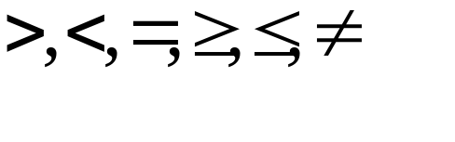
More on Set-Comparison Operators
We’ve already seen IN, EXISTS and UNIQUE. Can also use NOT IN, NOT EXISTS and NOT UNIQUE.
Also available: op ANY, op ALL, op IN
Find sailors whose rating is greater than that of some sailor called Horatio:
SELECT *
FROM Sailors S
WHERE S.rating > ANY [or SOME] (SELECT S2.rating
FROM Sailors S2
WHERE S2.sname=‘Horatio’)

Slide 14
Rewriting INTERSECT Queries Using IN
Find sid’s of sailors who’ve reserved both a red and a green boat:
SELECT S.sid
FROM Sailors S, Boats B, Reserves R
WHERE S.sid=R.sid AND R.bid=B.bid AND B.color=‘red’
AND S.sid IN (SELECT S2.sid
FROM Sailors S2, Boats B2, Reserves R2
WHERE S2.sid=R2.sid AND R2.bid=B2.bid
AND B2.color=‘green’)
Similarly, EXCEPT queries re-written using NOT IN.
To find names (not sid’s) of Sailors who’ve reserved both red and green boats, just replace S.sid by S.sname in SELECT clause. (What about INTERSECT query?)

Slide 15
Division in SQL
(1)
SELECT S.sname
FROM Sailors S
WHERE NOT EXISTS
((SELECT B.bid
FROM Boats B)
EXCEPT
(SELECT R.bid
FROM Reserves R
WHERE R.sid=S.sid))
Find sailors who’ve reserved all boats.
Let’s do it the hard way, without EXCEPT:
(2)
SELECT S.sname
FROM Sailors S
WHERE NOT EXISTS (SELECT B.bid
FROM Boats B
WHERE NOT EXISTS (SELECT R.bid
FROM Reserves R
WHERE R.bid=B.bid
AND R.sid=S.sid))
Sailors S such that ...
there is no boat B without ...
a Reserves tuple showing S reserved B

Slide 16
Aggregate Operators
COUNT (*)
COUNT ( [DISTINCT] A)
SUM ( [DISTINCT] A)
AVG ( [DISTINCT] A)
MAX (A)
MIN (A)
Significant extension of relational algebra.
single column
SELECT COUNT (*)
FROM Sailors S
SELECT S.sname
FROM Sailors S
WHERE S.rating= (SELECT MAX(S2.rating)
FROM Sailors S2)
SELECT AVG (S.age)
FROM Sailors S
WHERE S.rating=10
SELECT COUNT (DISTINCT S.rating)
FROM Sailors S
WHERE S.sname=‘Bob’
SELECT AVG ( DISTINCT S.age)
FROM Sailors S
WHERE S.rating=10

Slide 17
Find name and age of the oldest sailor(s)
SELECT S.sname, MAX (S.age)
FROM Sailors S
The first query is illegal! (We’ll look into the reason a bit later, when we discuss GROUP BY.)
The third query is equivalent to the second query, and is allowed in the SQL/92 standard, but is not supported in some systems.
SELECT S.sname, S.age
FROM Sailors S
WHERE S.age =
(SELECT MAX (S2.age)
FROM Sailors S2)
SELECT S.sname, S.age
FROM Sailors S
WHERE (SELECT MAX (S2.age)
FROM Sailors S2)
= S.age

Slide 18
GROUP BY and HAVING
So far, we’ve applied aggregate operators to all (qualifying) tuples. Sometimes, we want to apply them to each of several groups of tuples.
Consider: Find the age of the youngest sailor for each rating level.
  In general, we don’t know how many rating levels exist, and what the rating values for these levels are!
  Suppose we know that rating values go from 1 to 10; we can write 10 queries that look like this (!):
SELECT MIN (S.age)
FROM Sailors S
WHERE S.rating = i
For i = 1, 2, ... , 10:

Slide 19
Queries With GROUP BY and HAVING
SELECT [DISTINCT] target-list
FROM relation-list
WHERE qualification
GROUP BY grouping-list
HAVING group-qualification
The target-list contains (i) attribute names (ii) terms with aggregate operations (e.g., MIN (S.age)).
  The attribute list (i) must be a subset of grouping-list (Aggregate on other attributes). Intuitively, each answer tuple corresponds to a group, and these attributes must have a single value per group. (A group is a set of tuples that have the same value for all attributes in grouping-list.)

Slide 20
Conceptual Evaluation
The cross-product of relation-list is computed, tuples that fail qualification are discarded, `unnecessary’ fields are deleted, and the remaining tuples are partitioned into groups by the value of attributes in grouping-list.
The group-qualification is then applied to eliminate some groups. Expressions in group-qualification must have a single value per group!
  In effect, an attribute in group-qualification that is not an argument of an aggregate op also appears in grouping-list. (SQL does not exploit primary key semantics here!)
One answer tuple is generated per qualifying group.

Slide 21

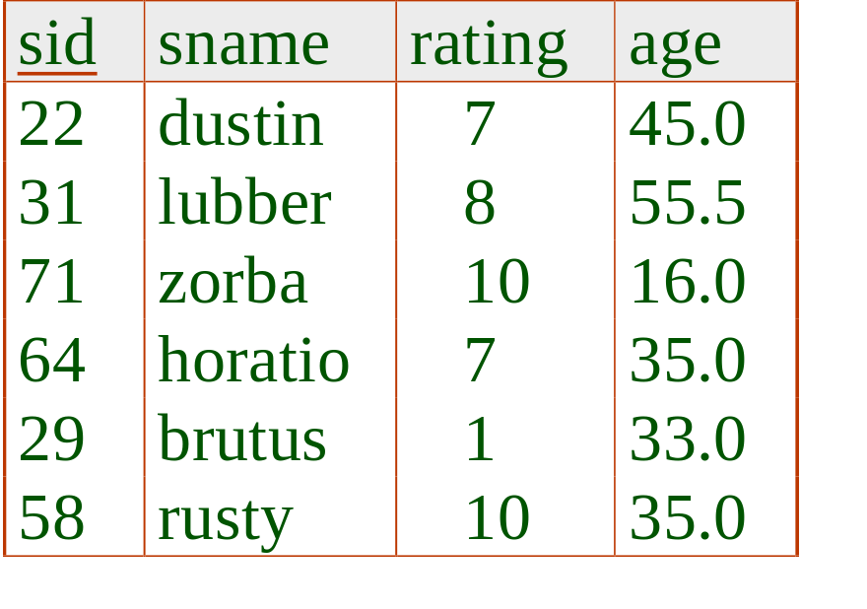
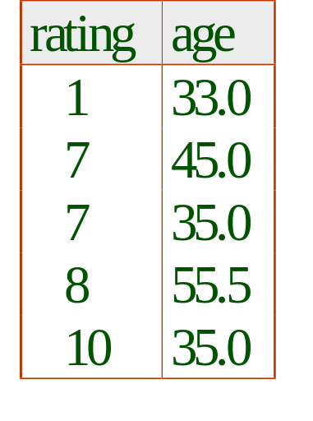
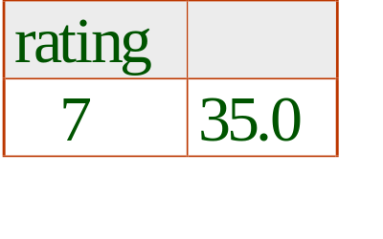
Find the age of the youngest sailor with age 18, for each rating with at least 2 such sailors
SELECT S.rating, MIN (S.age)
FROM Sailors S
WHERE S.age >= 18
GROUP BY S.rating
HAVING COUNT (*) > 1
Only S.rating and S.age are mentioned in the SELECT, GROUP BY or HAVING clauses; other attributes `unnecessary’.
2nd column of result is unnamed. (Use AS to name it.)
Answer relation

Slide 22
For each red boat, find the number of reservations for this boat
SELECT B.bid, COUNT (*) AS scount
FROM Sailors S, Boats B, Reserves R
WHERE S.sid=R.sid AND R.bid=B.bid AND B.color=‘red’
GROUP BY B.bid
Grouping over a join of three relations.
What do we get if we remove B.color=‘red’ from the WHERE clause and add a HAVING clause with this condition?
What if we drop Sailors and the condition involving S.sid?

Slide 23
Find the age of the youngest sailor with age > 18, for each rating with at least 2 sailors (of any age)
SELECT S.rating, MIN (S.age)
FROM Sailors S
WHERE S.age > 18
GROUP BY S.rating
HAVING 1 < (SELECT COUNT (*)
FROM Sailors S2
WHERE S.rating=S2.rating)
Shows HAVING clause can also contain a subquery.
Compare this with the query where we considered only ratings with 2 sailors over 18!
What if HAVING clause is replaced by:
  HAVING COUNT(*) >1

Slide 24
Find those ratings for which the average age is the minimum over all ratings
Aggregate operations cannot be nested! WRONG:
SELECT S.rating
FROM Sailors S
WHERE S.age = (SELECT MIN (AVG (S2.age)) FROM Sailors S2)
Correct solution (in SQL/92):
SELECT Temp.rating, Temp.avgage
FROM (SELECT S.rating, AVG (S.age) AS avgage
FROM Sailors S
GROUP BY S.rating) AS Temp
WHERE Temp.avgage = (SELECT MIN (Temp.avgage)
FROM Temp)

Slide 25
Null Values
Field values in a tuple are sometimes unknown (e.g., a rating has not been assigned) or inapplicable (e.g., no spouse’s name).
  SQL provides a special value null for such situations.
The presence of null complicates many issues. E.g.:
  Special operators needed to check if value is/is not null.
  Is rating>8 true or false when rating is equal to null? What about AND, OR and NOT connectives?
  We need a 3-valued logic (true, false and unknown).
  Meaning of constructs must be defined carefully. (e.g., WHERE clause eliminates rows that don’t evaluate to true.)
  New operators (in particular, outer joins) possible/needed.

Slide 26
Integrity Constraints (Review)
An IC describes conditions that every legal instance of a relation must satisfy.
  Inserts/deletes/updates that violate IC’s are disallowed.
  Can be used to ensure application semantics (e.g., sid is a key), or prevent inconsistencies (e.g., sname has to be a string, age must be < 200)
Types of IC’s: Domain constraints, primary key constraints, foreign key constraints, general constraints.
  Domain constraints: Field values must be of right type. Always enforced.
Notes:
5

Slide 27
General Constraints
CREATE TABLE Sailors
( sid INTEGER,
sname CHAR(10),
rating INTEGER,
age REAL,
PRIMARY KEY (sid),
CHECK ( rating >= 1
AND rating <= 10 )
Useful when more general ICs than keys are involved.
Can use queries to express constraint.
Constraints can be named.
CREATE TABLE Reserves
( sname CHAR(10),
bid INTEGER,
day DATE,
PRIMARY KEY (bid,day),
CONSTRAINT noInterlakeRes
CHECK (`Interlake’ <>
( SELECT B.bname
FROM Boats B
WHERE B.bid=bid)))
Notes:
8

Slide 28
Constraints Over Multiple Relations
CREATE TABLE Sailors
( sid INTEGER,
sname CHAR(10),
rating INTEGER,
age REAL,
PRIMARY KEY (sid),
CHECK
( (SELECT COUNT (S.sid) FROM Sailors S)
+ (SELECT COUNT (B.bid) FROM Boats B) < 100 )
Number of boats
plus number of
sailors is < 100
Awkward and wrong!
If Sailors is empty, the number of Boats tuples can be anything!
ASSERTION is the right solution; not associated with either table.
CREATE ASSERTION smallClub
CHECK
( (SELECT COUNT (S.sid) FROM Sailors S)
+ (SELECT COUNT (B.bid) FROM Boats B) < 100 )
Notes:
9

Slide 29
Triggers
Trigger: procedure that starts automatically if specified changes occur to the DBMS
Three parts:
  Event (activates the trigger)
  Condition (tests whether the triggers should run)
  Action (what happens if the trigger runs)

Slide 30
Triggers: Example (SQL:1999)
CREATE TRIGGER youngSailorUpdate
AFTER INSERT ON SAILORS
REFERENCING NEW TABLE NewSailors
FOR EACH STATEMENT
INSERT
INTO YoungSailors(sid, name, age, rating)
SELECT sid, name, age, rating
FROM NewSailors N
WHERE N.age <= 18

Slide 31
Summary
SQL was an important factor in the early acceptance of the relational model; more natural than earlier, procedural query languages.
Relationally complete; in fact, significantly more expressive power than relational algebra.
Even queries that can be expressed in RA can often be expressed more naturally in SQL.
Many alternative ways to write a query; optimizer should look for most efficient evaluation plan.
  In practice, users need to be aware of how queries are optimized and evaluated for best results.

Slide 32
Summary (Contd.)
NULL for unknown field values brings many complications
SQL allows specification of rich integrity constraints
Triggers respond to changes in the database

