Slide 1
Query-by-Example (QBE)
Online Chapter
Example is the school of mankind,
and they will learn at no other.
-- Edmund Burke (1729-1797)
Notes:
1
The slides for this text are organized into chapters. This lecture covers Chapter 6.
Chapter 1: Introduction to Database Systems
Chapter 2: The Entity-Relationship Model
Chapter 3: The Relational Model
Chapter 4 (Part A): Relational Algebra
Chapter 4 (Part B): Relational Calculus
Chapter 5: SQL: Queries, Programming, Triggers
Chapter 6: Query-by-Example (QBE)
Chapter 7: Storing Data: Disks and Files
Chapter 8: File Organizations and Indexing
Chapter 9: Tree-Structured Indexing
Chapter 10: Hash-Based Indexing
Chapter 11: External Sorting
Chapter 12 (Part A): Evaluation of Relational Operators
Chapter 12 (Part B): Evaluation of Relational Operators: Other Techniques
Chapter 13: Introduction to Query Optimization
Chapter 14: A Typical Relational Optimizer
Chapter 15: Schema Refinement and Normal Forms
Chapter 16 (Part A): Physical Database Design
Chapter 16 (Part B): Database Tuning
Chapter 17: Security
Chapter 18: Transaction Management Overview
Chapter 19: Concurrency Control
Chapter 20: Crash Recovery
Chapter 21: Parallel and Distributed Databases
Chapter 22: Internet Databases
Chapter 23: Decision Support
Chapter 24: Data Mining
Chapter 25: Object-Database Systems
Chapter 26: Spatial Data Management
Chapter 27: Deductive Databases
Chapter 28: Additional Topics

Slide 2
QBE: Intro
A “GUI” for expressing queries.
  Based on the DRC!
  Actually invented before GUIs.
  Very convenient for simple queries.
  Awkward for complex queries.
QBE an IBM trademark.
  But has influenced many projects
  Especially PC Databases: Paradox, Access, etc.

Slide 3



`Example Tables’ in QBE
Users specify a query by filling in example tables, or skeletons; we will use these skeletons in our examples.
Notes:
3

Slide 4


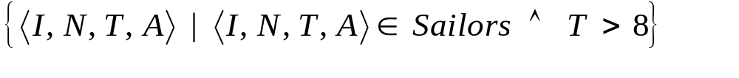
Basics
To print names and ages of all sailors:
Print all fields for sailors with rating > 8, in ascending order by (rating, age):
QBE puts unique new variables in blank columns. Above query in DRC (no ordering):
Notes:
4

Slide 5
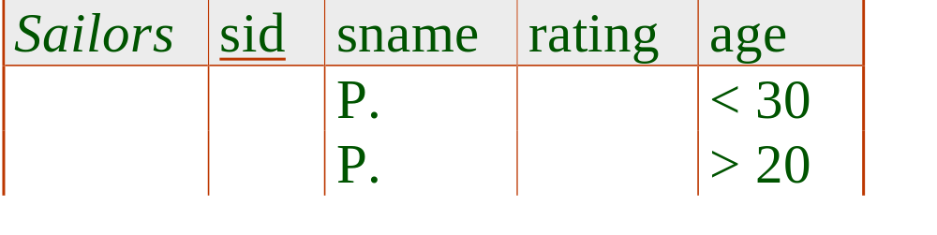
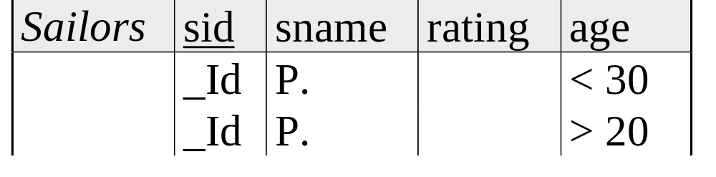

And/Or Queries
Note: MiniQBE
uses a slightly
different syntax!
Names of sailors younger than 30 or older than 20:
Names of sailors younger than 30 and older than 20:
Names of sailors younger than 30 and rating > 4:
Notes:
5

Slide 6

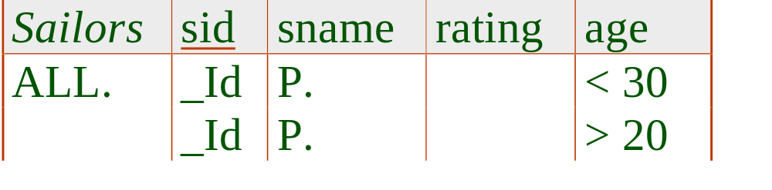
Duplicates
Single row with P: Duplicates not eliminated by default; can force elimination by using UNQ.
Multiple rows with P: Duplicates eliminated by default! Can avoid elimination by using ALL.
Notes:
6

Slide 7


Join Queries
Names of sailors who’ve reserved a boat for 8/24/96 and are older than 25 (note that dates and strings with blanks/special chars are quoted):
Note: MiniQBE uses double quotes
Joins accomplished by repeating variables.
Notes:
7

Slide 8


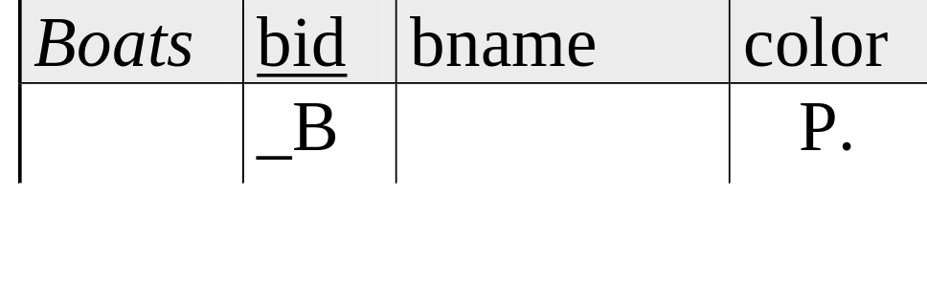
Join Queries (Contd.)
Colors of boats reserved by sailors who’ve reserved a boat for 8/24/96 and are older than 25 :
Notes:
8

Slide 9


Join Queries (Contd.)
Names and ages of sailors who’ve reserved some boat that is also reserved by the sailor with sid = 22:
Notes:
9

Slide 10


Unnamed Columns
MiniQBE allows
P. in multiple tables
Useful if we want to print the result of an expression, or print fields from 2 or more relations.
  QBE allows P. to appear in at most one table!
Notes:
10

Slide 11



“Negative Tables”
Can place a negation marker in the relation column:
Note:
MiniQBE
uses NOT
or ~.
Variables appearing in a negated table must also appear in a positive table!

Slide 12

Aggregates
QBE supports AVG, COUNT, MIN, MAX, SUM
  None of these eliminate duplicates, except COUNT
  Also have AVG.UNQ. etc. to force duplicate elimination
The columns with G. are the group-by fields; all tuples in a group have the same values in these fields.
  The (optional) use of .AO orders the answers.
  Every column with P. must include G. or an aggregate operator.
Notes:
13

Slide 13



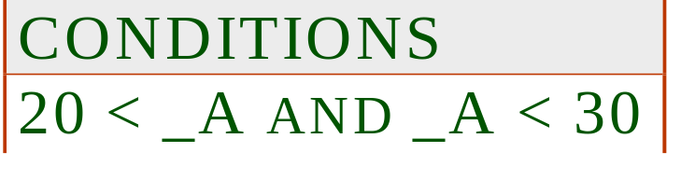
Conditions Box
Used to express conditions involving 2 or more columns, e.g., _R/_A > 0.2.
Can express a condition that involves a group, similar to the HAVING clause in SQL:
Express conditions involving AND and OR:
Notes:
14

Slide 14


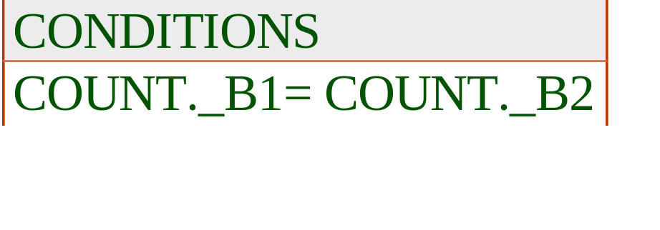

Find sailors who’ve reserved all boats
A division query; need aggregates (or update operations, as we will see later) to do this in QBE.
How can we modify this query to print the names of sailors who’ve reserved all boats?
Notes:
15

Slide 15


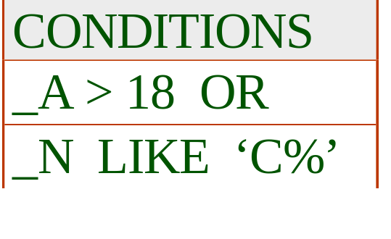

Inserting Tuples
Single-tuple insertion:
Inserting multiple tuples (rating is null in tuples inserted below):
Notes:
16

Slide 16



Delete and Update
Delete all reservations for sailors with rating < 4
Increment the age of the sailor with sid = 74
Notes:
17

Slide 17
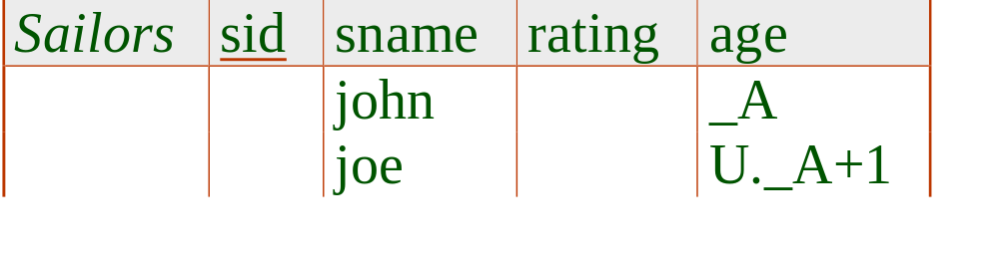
Restrictions on Update Commands
Cannot mix I., D. and U. in a single example table, or combine them with P. or G.
Cannot insert, update or modify tuples using values from fields of other tuples in the same table. Example of an update that violates this rule:
Should we update every Joe’s age?
Which John’s age should we use?
Notes:
18

Slide 18


Find sailors who’ve reserved all boats (Again!)
We want to find sailors _Id such that there is no boat _B that is not reserved by _Id:
Illegal query! Variable _B does not appear in a positive row. In what order should the two negative rows be considered? (Meaning changes!)
Notes:
19

Slide 19



A Solution Using Views
Find sailors who’ve not reserved some boat _B:
Next, find sailors not in this `bad’ set:
Notes:
20

Slide 20
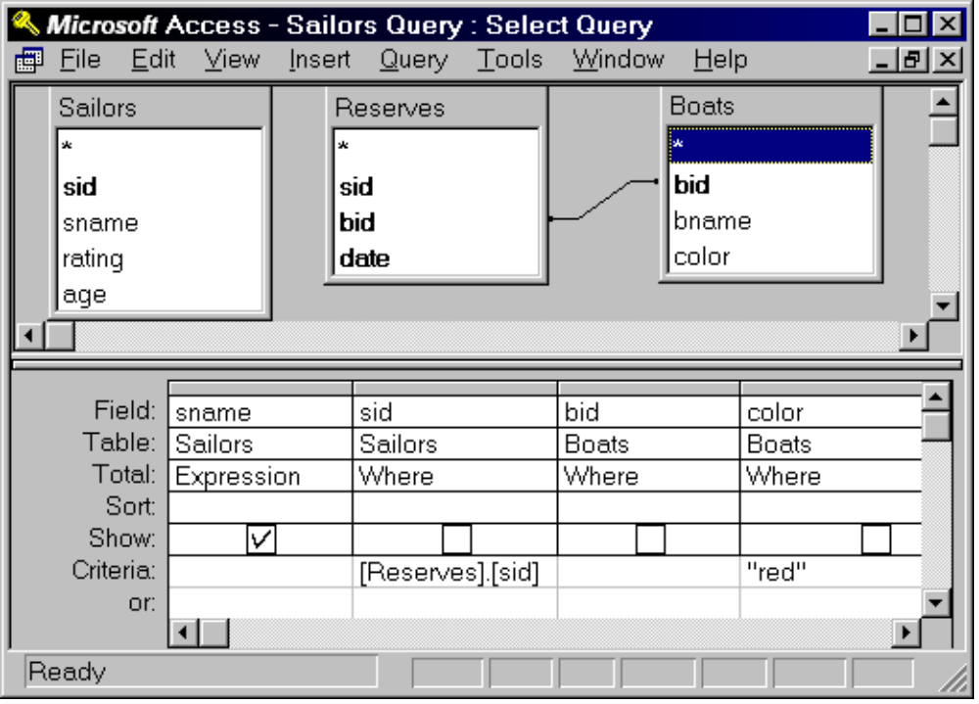
A Peek at MS Access

Slide 21
Summary
QBE is an elegant, user-friendly query language based on DRC.
It is quite expressive (relationally complete, if the update features are taken into account).
Simple queries are especially easy to write in QBE, and there is a minimum of syntax to learn.
Has influenced the graphical query facilities offered in many products, including Borland’s Paradox, Microsoft’s Access, Lotus Approach.
Notes:
22

