Slide 1
Noninvasive Glucometer
General Updates
Nov 2024
https://github.com/knowthebird/NoninvasiveGlucometer

Slide 2
Contest Updates
There were no contest entries ☹
Prizes will be saved/used as fund for noninvasive glucometer projects
If you have an idea for a design and want to chat about it, or request some support, or if you are interested in refining the designs in the git repo, reach out to noninvasiveglucometer@gmail.com
There were people who reached out with interest in how things were designed and suggestions for improvements in the future ☺
Just because there were not entries in the contest does not mean there is not interest in the problem
Many are going to look to protect their intellectual property, and not quickly share it for collaboration

Slide 3
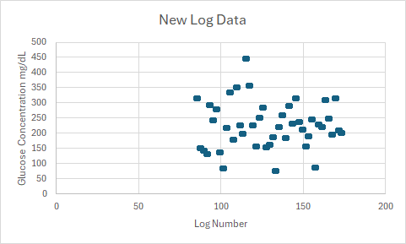
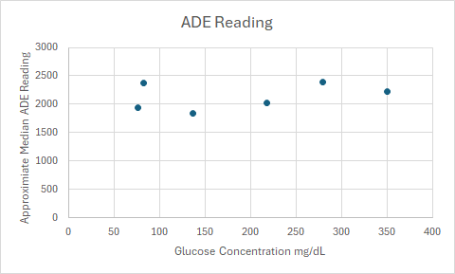
New Log Data
Lots of new samples,
89, two logs per session, separate fingers
A very wide range of concentration, 76 – 447 mg/dL
Thank you Dave!
Expected results are:
As blood glucose concentration increases more light is absorbed by the glucose and both reflectance and transmittance sensors report less light
For this design, sensors report higher voltage when more light is absorbed
12-bit resolution, 3V ~= 4096, 0V = 0
When looking at results, higher number should mean higher concentration
This was not observed.
Even when looking at the same finger and same sensor, the general voltage does not follow the glucose concentration.

Slide 4
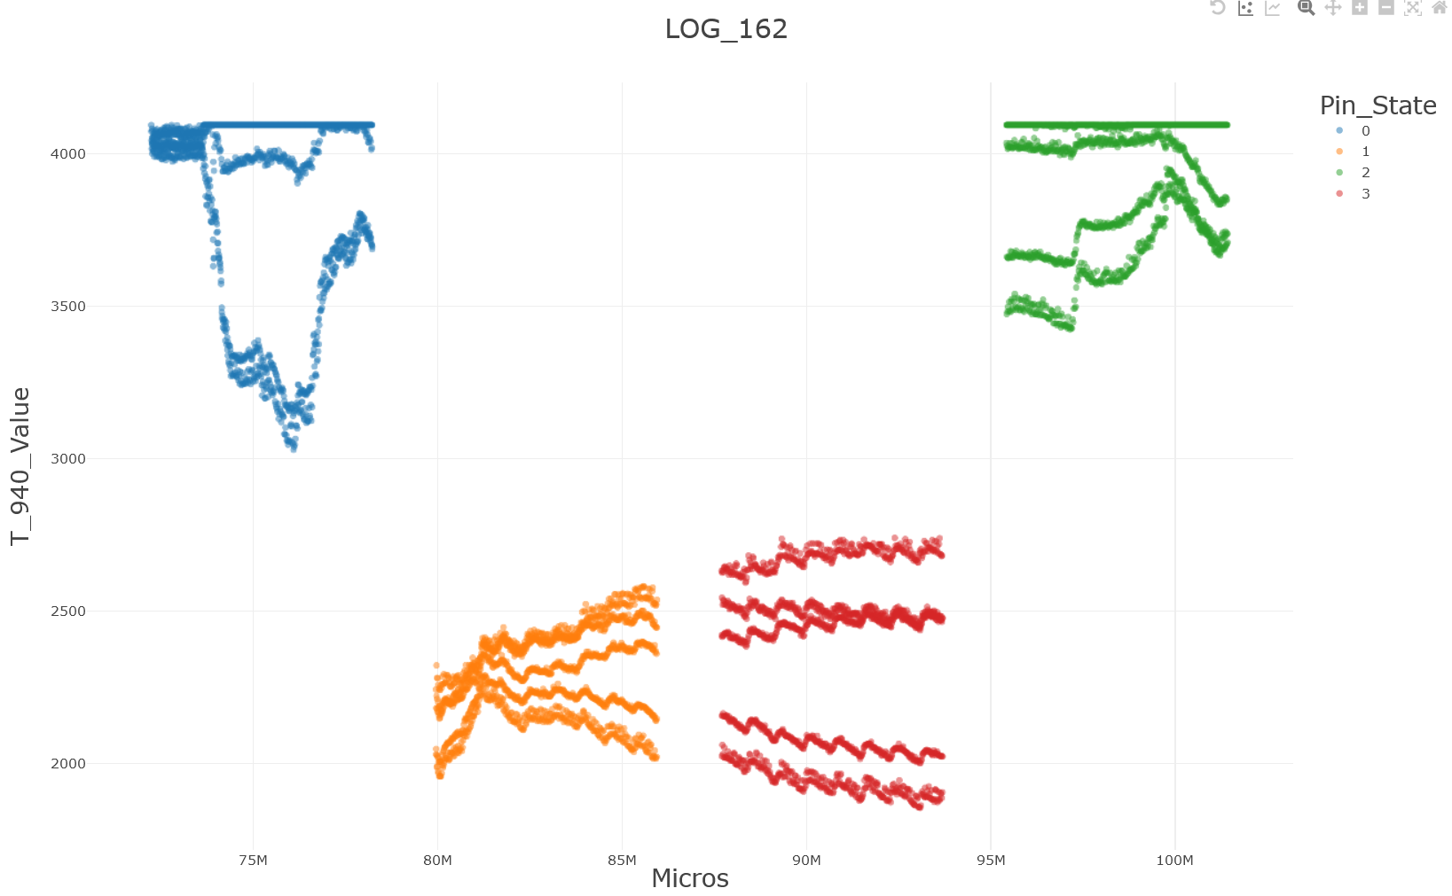
Glucosan 1- Hardware Failure
PPG Waveform appears to be
Duplicated in readings.

Slide 5
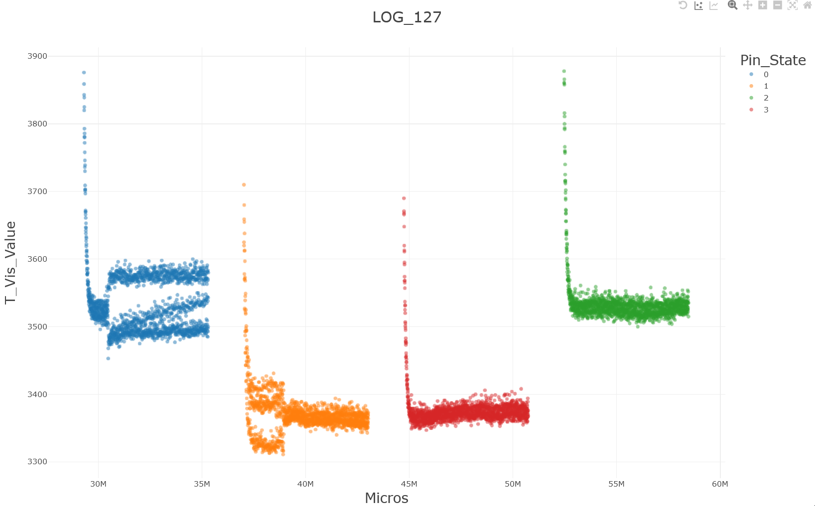
Glucosan 1- Hardware Failure
Duplication appears to be present in
almost every log for 85-174. In some log
files it appeared to “toggle” off and on.
Note, there are not new software calls that
should be made during this “toggle”.
Signal appears to become duplicated .
Occurs in state where LEDs or all off.
Duplication appears to stop.
Occurs in state where one LEDs is on.

Slide 6
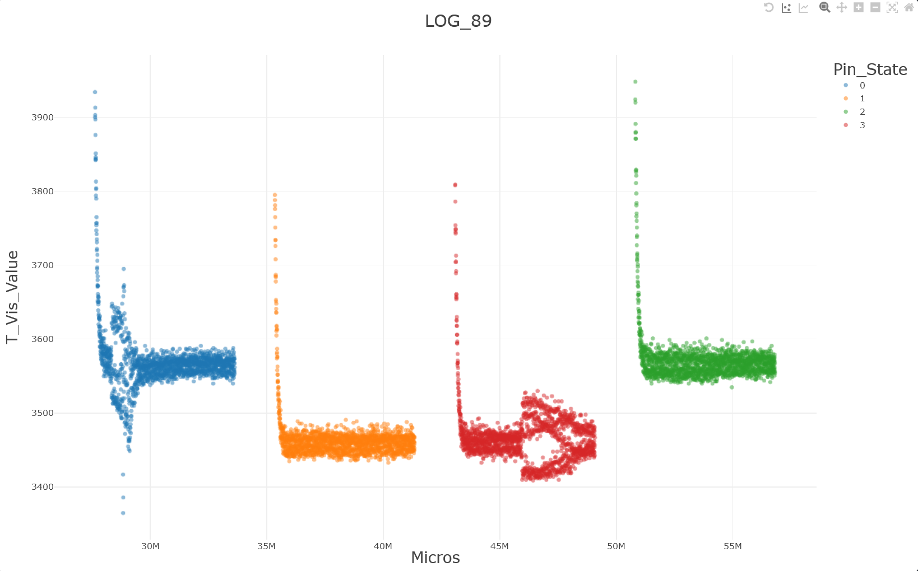
Glucosan 1- Hardware Failure
Even when less separated, there does appear
to be duplication or shifting occurring here.
Duplication becomes less seperated.
Occurs in state where LEDs or all off.
Duplication appears to widen again.
Occurs in state where two LEDs are on.

Slide 7
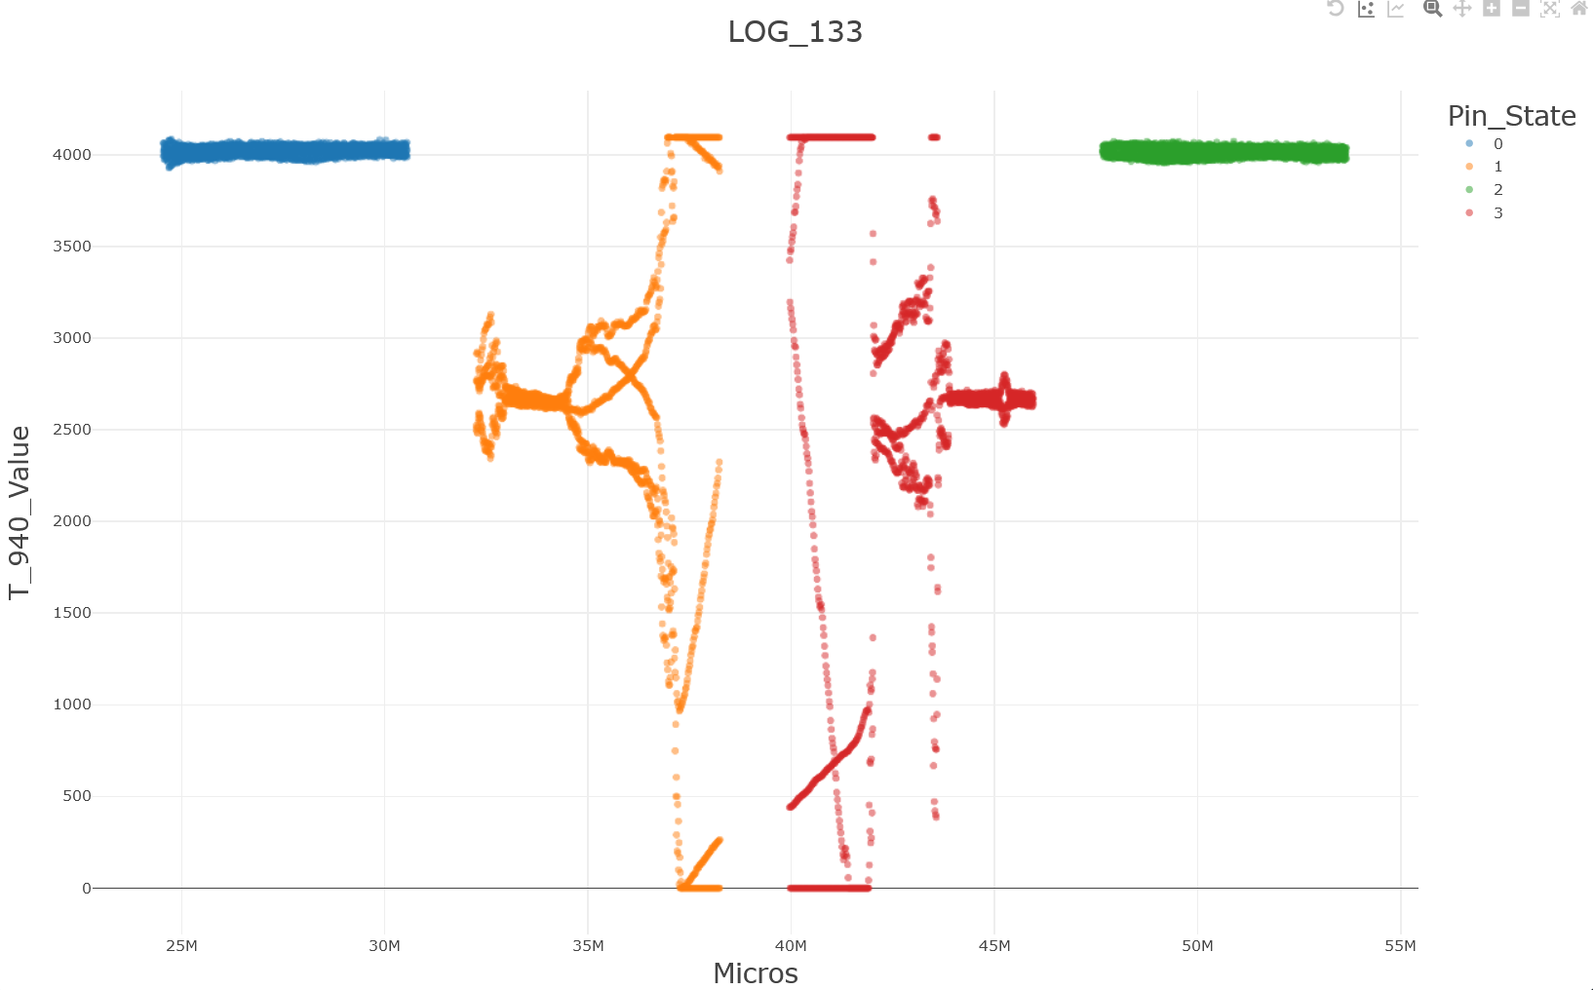
Glucosan 1- Hardware Failure
In some cases, the sensors appear to be completely failing.

Slide 8
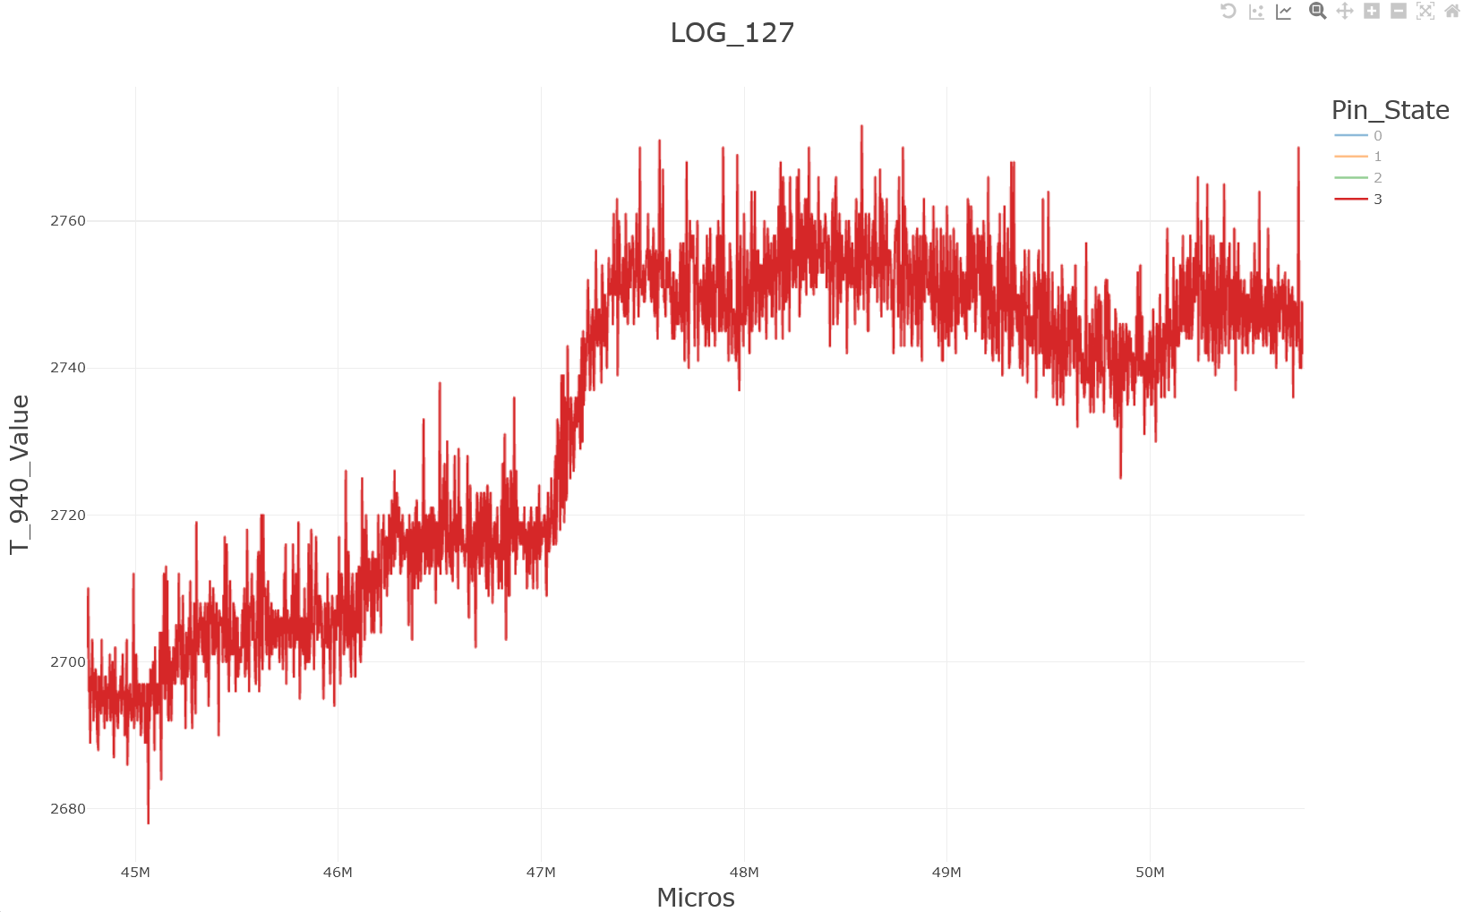
Movement Artifacts
Easy to see visually looking at logs but will require post processing algorithms to filter out.
Currently no IMU to monitor for movement for post processing or to alert.

Slide 9
In Hindsight – Lesson Learned
Getting a variety of samples is not trivial
Glucose concentrations typically stays in a set range, and extremes are a health risk.
Hardware needs to be more reliable before sending out in the world
A way of sharing results remotely (ex: over wifi), could make it easier to remotely identify issues faster

Slide 10
Short Term Next Steps – Simplify the Problem
Measure Controlled Samples In A Controlled Environment
Cuvette containing solution of dextrose monohydrate in distilled water
Fixed position of emitters and sensors
Can 3D print a jig
PC Oscilloscope for Sampling Sensor
Built in Logging
No concerns of microcontroller wiring or logging corrupting sampling
High Sampling Rates
Will be more helpful when ready to monitor PPG waveforms
Test with probes and consider coverings to reduce noise in readings.

Slide 11
Longer Term – Improvements For A Portable Device
Fixed position for Sensor and Emitter
Makes problem less complex when not accounting for their movement
IMUs on device and/or finger/ear
Need to be able to say what are artifacts of movement and be able to notify user of bad samples
Maybe Cover the sensor and emitter
Maybe you a bag, glove, or cover of some kind to prevent noise on sensors
May be more important with a fixed sensor/emitter introducing air gaps
Very long term, consider ability to share data through wifi or cell phone application
Could allow quicker results, and possibly a method for pushing updates back to the device
Adds complexity and data security risks too

Slide 12
The Research and Development Is Active
Companies
Abbott Laboratories
Apollon
Ascensia Diabetes Care Holdings AG
Biolinq Inc.
DexCom, Inc.
DiaMonTech AG
Glucosense Diagnostics
HagarTech
Integrity Applications, Inc.
Know Labs
LifePlusAI
LifeScan, Inc.
Medtronic plc
Movano, Inc.
Nemaura Medical
Profusa, Inc.
Roche Diagnostics
Scanbo
Senseonics Holdings, Inc.
RSP Systems
PK Vitality
Cnoga
Universities
Cardiff University
Kennesaw State University
Massachusetts Institute of Technology (MIT)
Monash University
National Taiwan Ocean University
RMIT University
Singapore National Population Health Survey
University of Chinese Academy of Sciences
University of Leeds
University of Missouri
Ulsan National Institute of Science and Technology (UNIST)
Lists provided by Amer Khaqan

