Slide 1

Computer Organization And Architecture
CPEN6260010 (2 Credits)
Quiz
Dr. Endra, S.Kom., M.T.
D2395

Slide 2
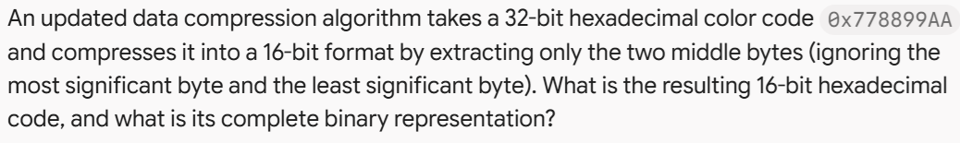
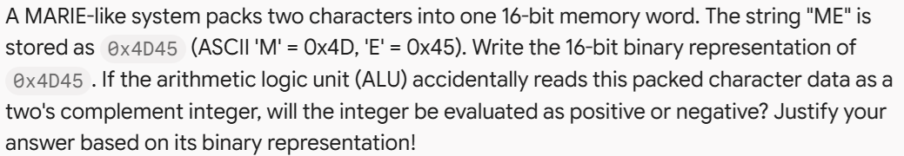
quiz
1.
2.

Slide 3
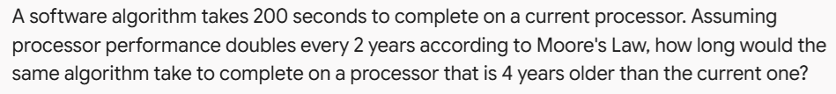
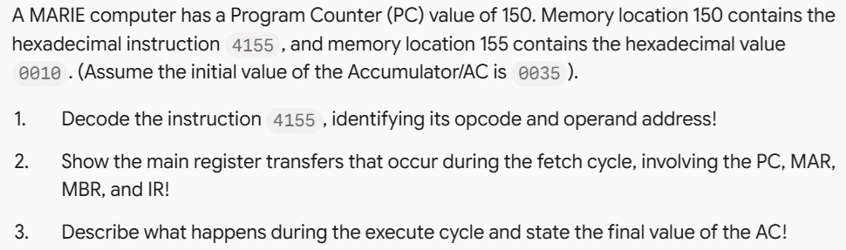
quiz
3.
4.

Slide 4

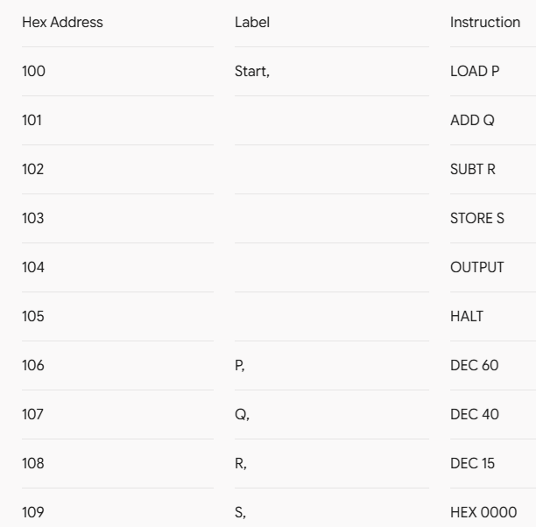
quiz
5.

Slide 5
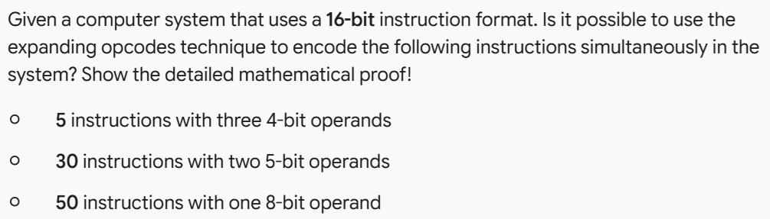
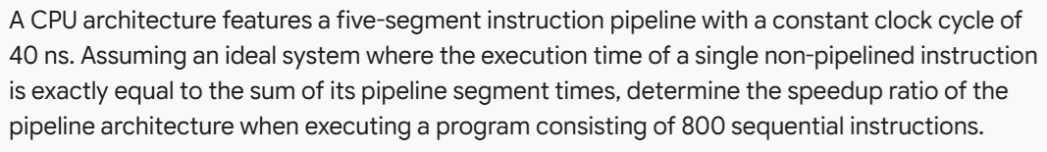
quiz
6.
7.

Slide 6
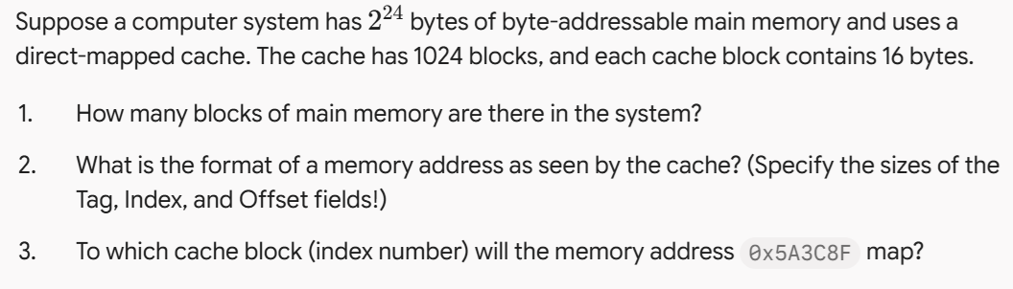
quiz
8.

