Slide 1

Computer Organization And Architecture
CPEN6260010 (2 Credits)
Quiz
Dr. Endra, S.Kom., M.T.
D2395

Slide 2


quiz
1.
2.

Slide 3



quiz
3.
4.

Slide 4
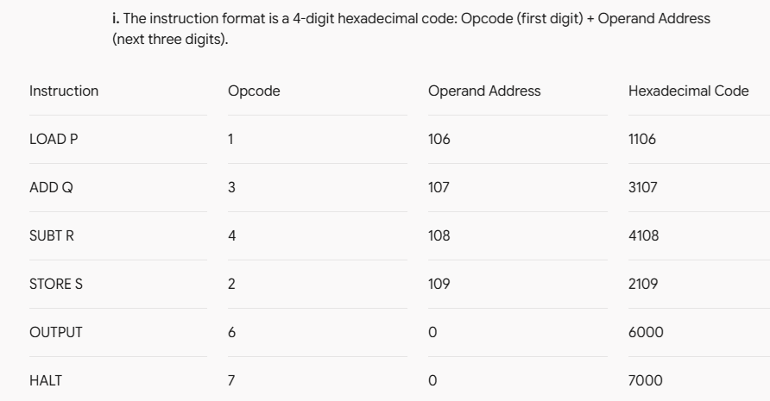
quiz
5.

Slide 5
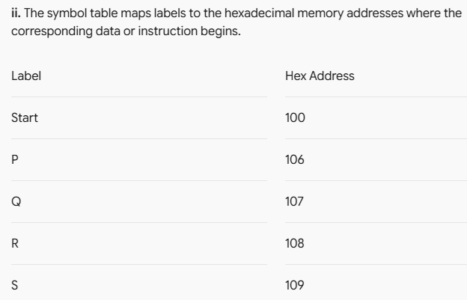
quiz
5.

Slide 6
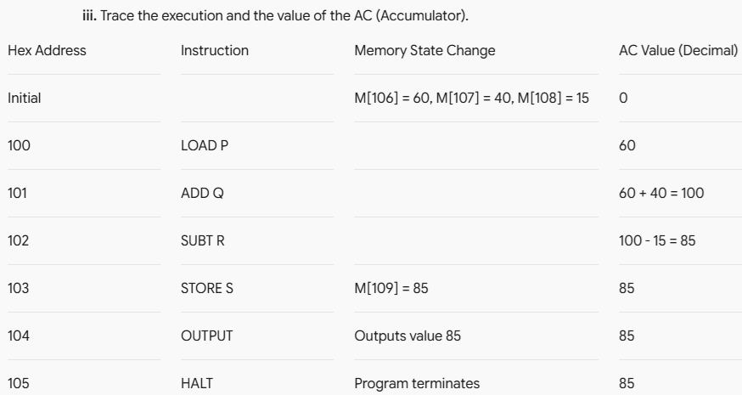
quiz
5.

Slide 7
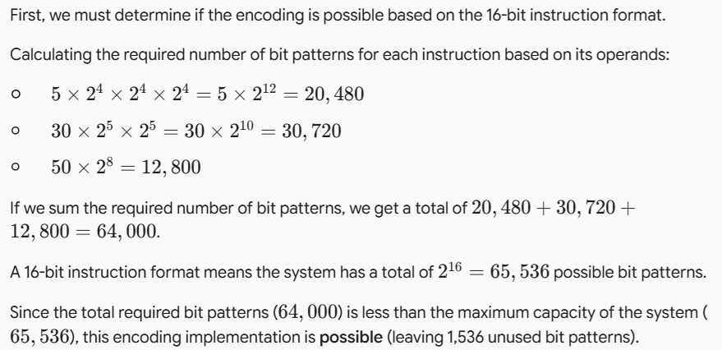
quiz
6.

Slide 8
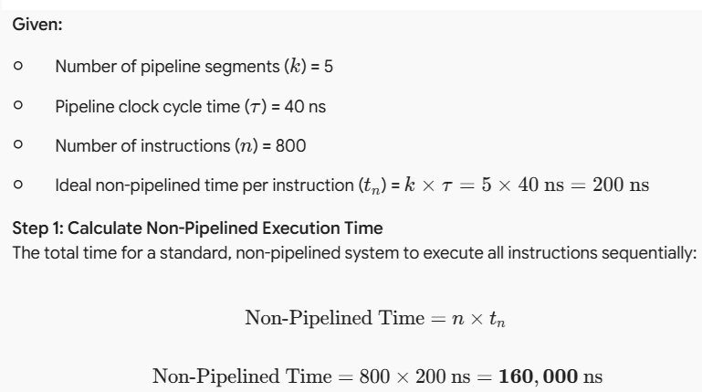
quiz
7.

Slide 9
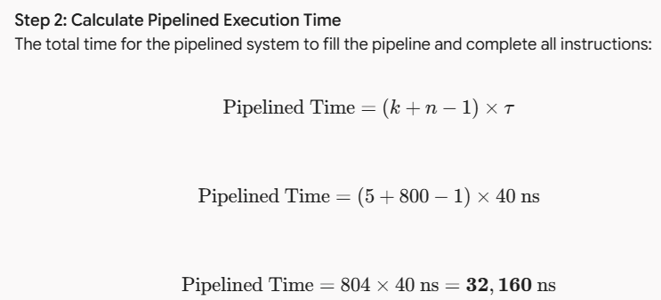
quiz
7.

Slide 10
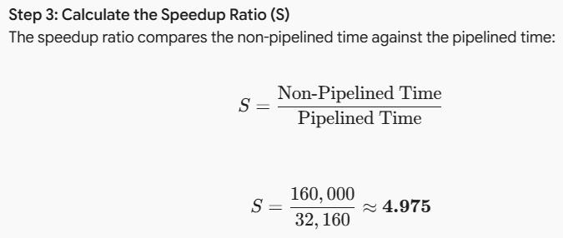
quiz
7.

Slide 11
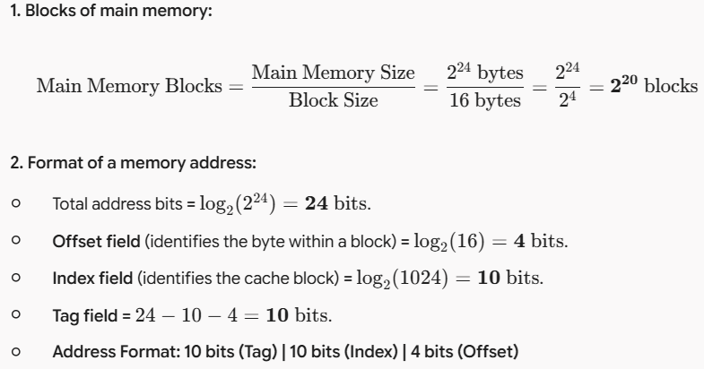
quiz
8.

Slide 12
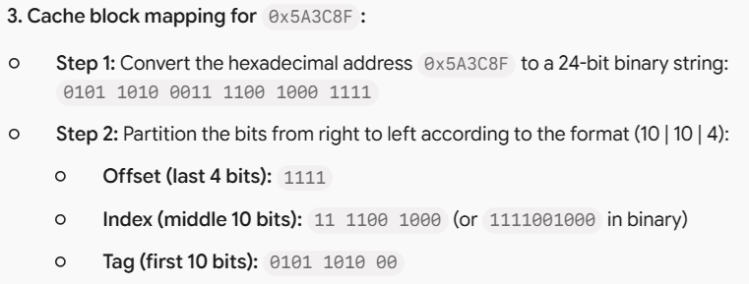




quiz
8.

