Slide 1





Slide 2
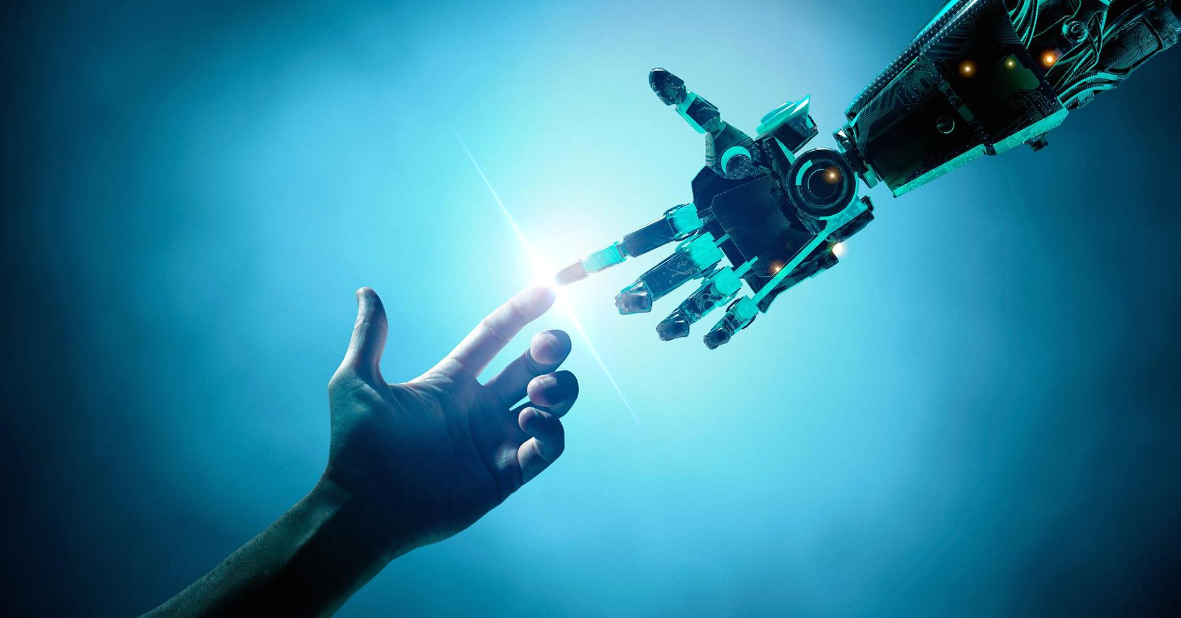
Technological revolution has begun in the field of Artificial Intelligence (AI).
Research is going on to develop intelligent, compact systems and implement them in most of the real-world applications.

Slide 3
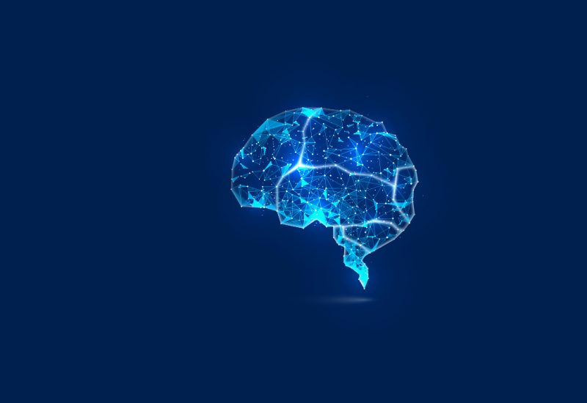
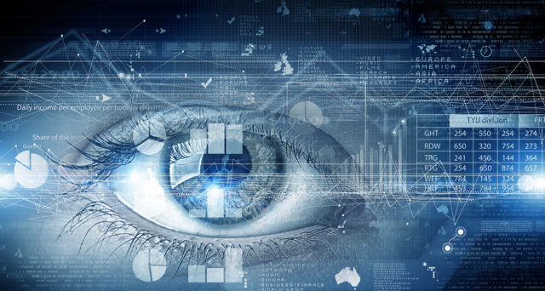
Computer Vision is one of the most widely used branches of AI.
It deals with imparting the machines with the ability to analyze the visual data.

Slide 4
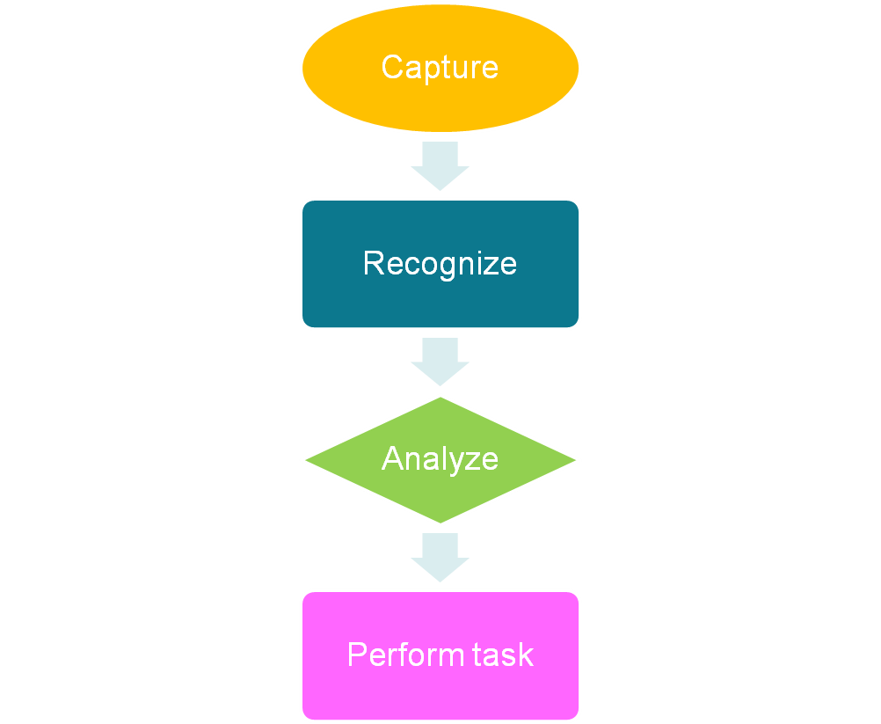
How it works?

Slide 5

Face Detection
Libraries – OpenCV
Hardware Required - Webcam/Camera

Slide 6
Install the OpenCV package
Import them in Jupyter notebook
conda install –c conda-forge opencv
import cv2

Slide 7
OpenCV has a pre-defined classifier 'haarcascade_frontalface_default.xml' for face detection
Load the classifier
detector = cv2.CascadeClassifier('haarcascade_frontalface_default.xml')

Slide 8
Capture the image and read
Display the image using imshow()
Set time delay for imshow() to work properly
cap=cv2.VideoCapture(0)
ret,img= cap.read()
cv2.imshow('webcam',img)
cv2.waitKey(0)
A new window will be displayed with the captured image

Slide 9
Convert the image to gray scale
detectMultiscale() is a special face detector function
gray = cv2.cvtColor(img, cv2.COLOR_BGR2GRAY)
faces = detector.detectMultiScale(gray, 1.3, 5)

Slide 10
Draw a rectangle for the face dimensions
x , y are the face coordinates followed by width and height of the rectangle
Colors range from 0-255 (blue,green,red)
for (x,y,w,h) in faces:
cv2.rectangle(img,(x,y),(x+w,y+h),(255,0,0),2)

Slide 11

Display a new window frame with the face detected
cv2.imshow('frame',img)
cv2.waitKey(0)

Slide 12
Release the captured image
Close all the windows
cap.release()
cv2.destroyAllWindows()

Slide 13
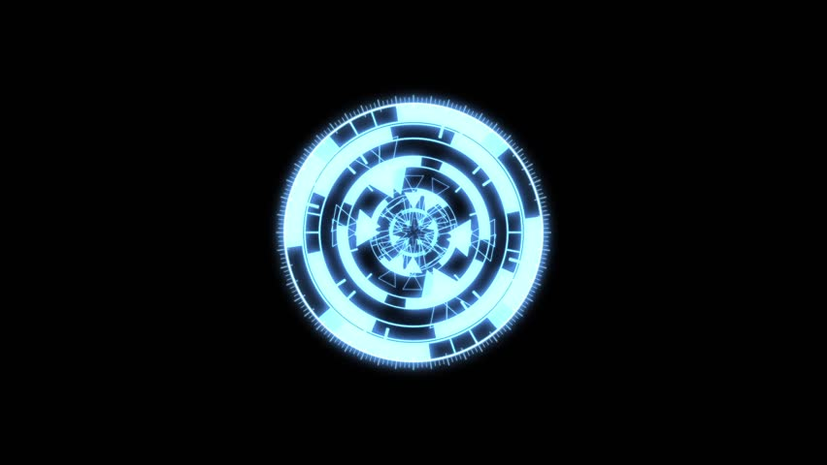
Using this image capture mechanism, we can detect not only faces, but also detect any object in an image
They can be processed and analyzed to get whatever output we want

Slide 14

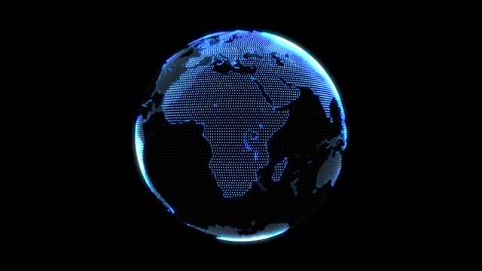
Face Recognition
Facial expression recognition
Gender classification
Digital cosmetics
Biometric systems
Vehicles
Tracking
Signals
Facial feature extraction
And many more….

Slide 15



