Slide 2
Design Architecture
Invisible
Features
Visible
Bugs
Visible
Vulnerabilities, Code smells, Violations
Invisible
Positive value
Negative Value
Positive Value
Negative Value

Slide 3

Continous Testing
Readability & Understandability
Reusability & Maintainability
Testability

Slide 4
SQL
Javascript
C#/Java
Naming
Naming
Naming
Readability
Readability
Readability
Reusability
Reusability
Reusability
Maintainability
Maintainability
Maintainability
SRP
SRP
SRP
OCP
OCP
OCP
LSP
LSP
LSP
ISP
ISP
ISP
DIP
DIP
DIP
Testability
Design Patterns
Design & Architectural Patterns
Testability
Testability

Slide 5


DO THIS
DO THAT
ANDD
DO THAT
AND THIS

Slide 6
• Bugs are discovered and have to be fixed (this is called corrective maintenance).
• The system has to be adapted to changes in the environment in which it
operates—for example, upgrades of the operating system or technologies (this is
called adaptive maintenance).
• Users of the system (and/or other stakeholders) have new or changed requirements
(this is called perfective maintenance).
• Ways are identified to increase quality or prevent future bugs from occurring
(this is called preventive maintenance).

Slide 8
What Is Maintainability?
Imagine two different software systems that have exactly the same functionality.
Given the same input, both compute exactly the same output. One of these two
systems is fast and user-friendly, and its source code is easy to modify. The other system
is slow and difficult to use, and its source code is nearly impossible to understand,
let alone modify. Even though both systems have the same functionality, their
quality clearly differs.
Maintainability (how easily a system can be modified) is one characteristic of software
quality. Performance (how slow or fast a system produces its output) is another.
The international standard ISO/IEC 25010:2011 (which we simply call ISO 25010 in
this book1) breaks down software quality into eight characteristics: maintainability,
functional suitability, performance efficiency, compatibility, usability, reliability, security,
and portability. This book focuses exclusively on maintainability.

Slide 9
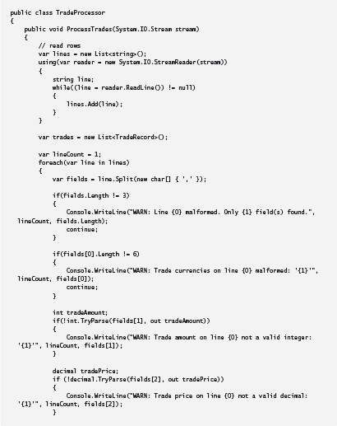
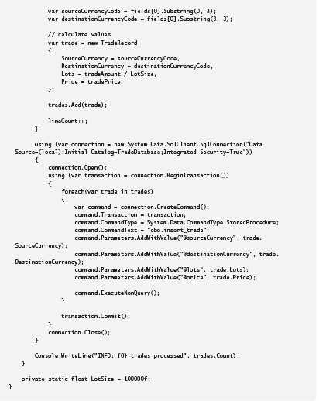

Slide 10
public void ProcessTrades(System.IO.Stream stream)
{
var lines = ReadTradeData(stream);
var trades = ParseTrades(lines);
StoreTrades(trades);
}

Slide 11
private IEnumerable<string> ReadTradeData(System.IO.Stream stream)
{
var tradeData = new List<string>();
using (var reader = new System.IO.StreamReader(stream))
{
string line;
while ((line = reader.ReadLine()) != null)
{
tradeData.Add(line);
}
}
return tradeData;
}

Slide 12
private IEnumerable<TradeRecord> ParseTrades(IEnumerable<string> tradeData)
{
var trades = new List<TradeRecord>();
var lineCount = 1;
foreach (var line in tradeData)
{
var fields = line.Split(new char[] { ',' });
if(!ValidateTradeData(fields, lineCount))
{
continue;
}
var trade = MapTradeDataToTradeRecord(fields);
trades.Add(trade);
lineCount++;
}
return trades;
}

Slide 13
private void StoreTrades(IEnumerable<TradeRecord> trades)
{
using (var connection = new System.Data.SqlClient.SqlConnection("Data
Source=(local);Initial Catalog=TradeDatabase;Integrated Security=True"))
{
connection.Open();
using (var transaction = connection.BeginTransaction())
{
foreach (var trade in trades)
{
var command = connection.CreateCommand();
command.Transaction = transaction;
command.CommandType = System.Data.CommandType.StoredProcedure;
command.CommandText = "dbo.insert_trade";
command.Parameters.AddWithValue("@sourceCurrency", trade.SourceCurrency);
command.Parameters.AddWithValue("@destinationCurrency",
trade.DestinationCurrency);
command.Parameters.AddWithValue("@lots", trade.Lots);
command.Parameters.AddWithValue("@price", trade.Price);
command.ExecuteNonQuery();
}
transaction.Commit();
}
connection.Close();
}
LogMessage("INFO: {0} trades processed", trades.Count());
}

