Slide 1
CDP GO

Slide 2
CDP GO
Is one of the most sufficient solution yet developed for coaching log form along with training memo in one mobile application.

Slide 3
CDP GO
1. Data Gathering
2. Brain Storming
3. Analyze
4. Design Patterns
5. Develop
6. Test
7. Debug

Slide 4
WHAT IT DOES?
1. You dont need to layout your template in coaching log form or type a word in training memo, Say good bye in excel and word.
2. Fill up through mobile app and ready to generate the reports in dashboard.
3. Evaluate and Request anywhere and where ever you are, submit it through online.
4. Store in database for long term storage and accessibility.
5. Less hassle for evaluating and training memo.

Slide 5
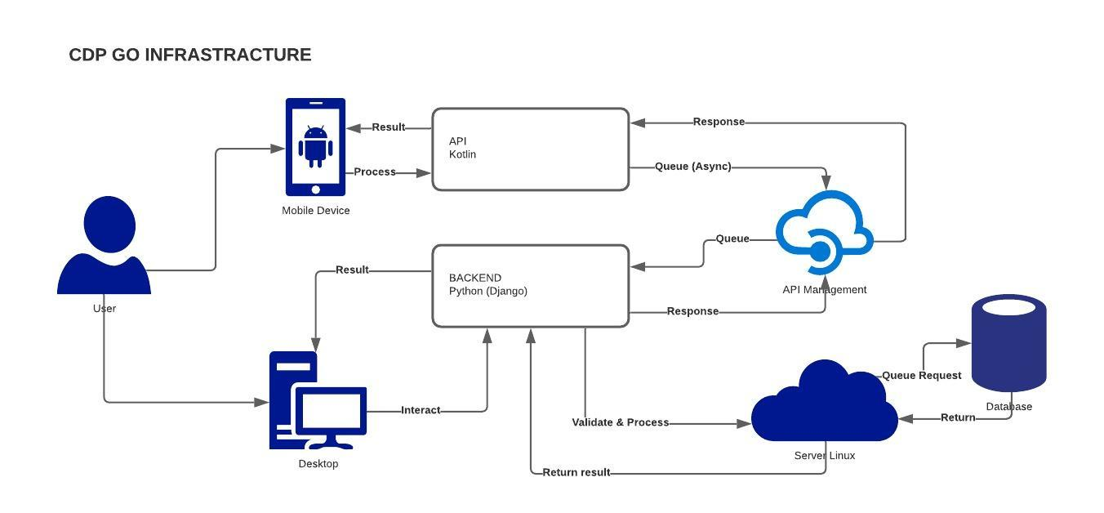
INFRASTRUCTURE

Slide 6
Images

Slide 7
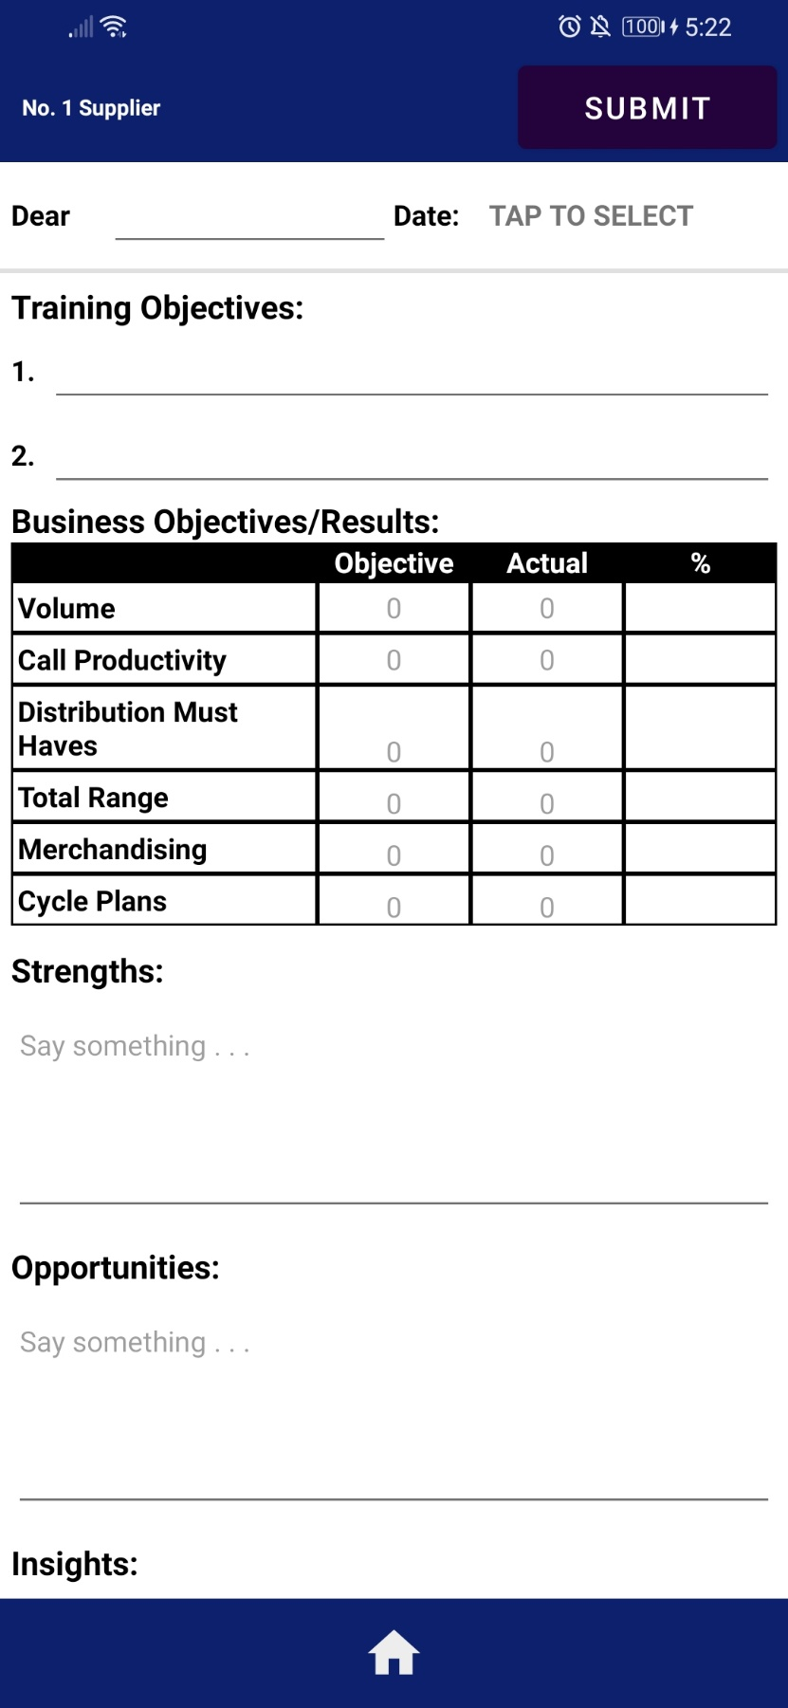
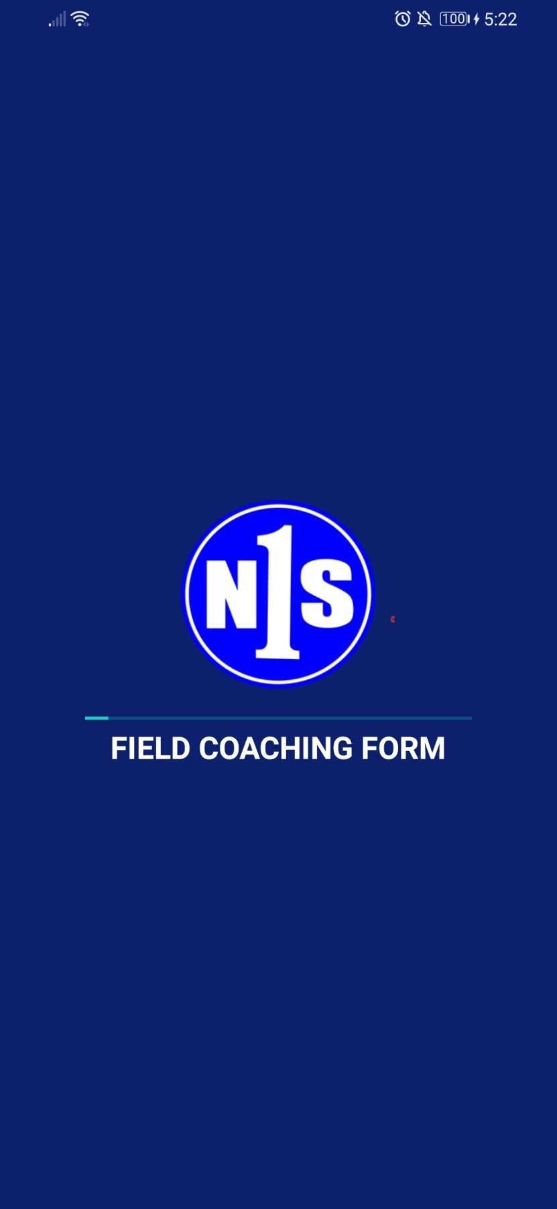
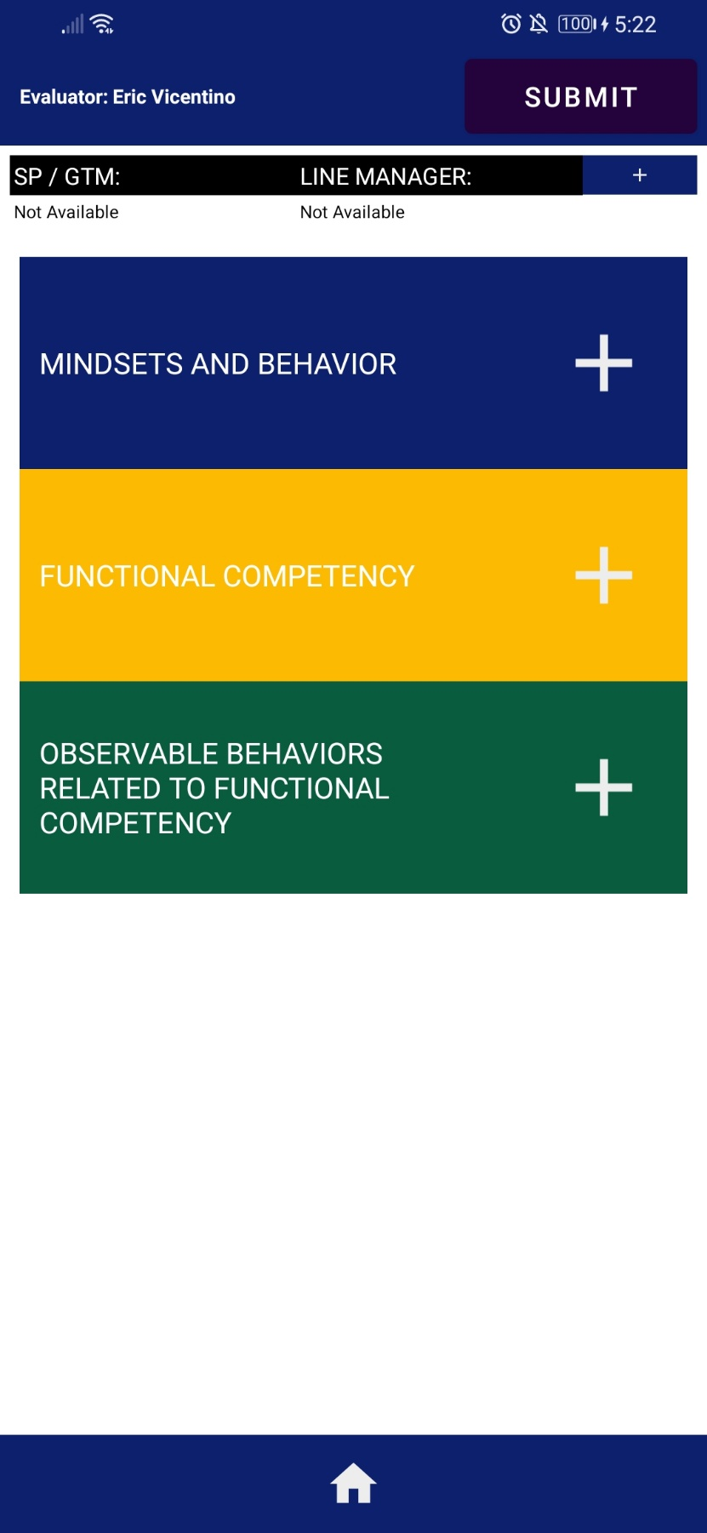

Slide 8
