Slide 1
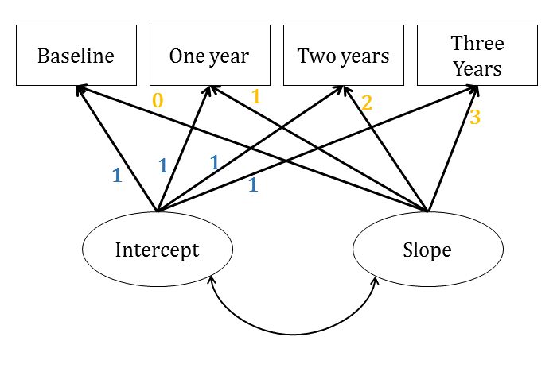
Structural Equation Model (SEM) key points:
SEM’s are comprised of two components. One, the Measurement model which links manifest (measured) variables to latent variables (or constructs). Two, the Structural model which specifies the associations between latent variables. Circles = latent variables and squares = manifest variables. Double headed arrows = correlations between variables and single headed arrows = directional paths between variables. Manifest variables have Measurement error (ℇ) = random and systematic error.
Latent Growth Curve Modelling (LGCM or (GCM)
Multivariate application of SEM, used to describe and analyse the change in observed attributes over time.
The model includes measures of a construct over time (e.g. single item social isolation sum scores).
Two latent variables of Intercept and Slope define individual trajectories or the growth of social isolation over time.
Focuses on within-individual changes over time.
Two stage (multilevel) process
1. describe the change over time for each individual – fit a regression line (growth curve) plotting the variable over time for each individual in the study
2. Individual regression equations are summarized to obtain an average intercept (mean of variable at first time point) and slope (rate of change). Each individual has variation from this intercept and slope.
The intercept is always set to 1 – as it is defined by the measurement of social isolation at the first time point.
Factor loadings for the slope reflect the time points measured. If time intervals are not consistent, the loadings should be proportionate to the time intervals.
If using this as a final model, first you need to check that there is significant variation in the slope (to make sure there is variation of change to be measured over time) by examining the covariance matrix.
With three time points, it’s possible to model a linear pattern. With four or more time points, you can model quadratic patterns.

