Slide 1
Integrating Conceptual and Logical Couplings for Change Impact Analysis in Software
Huzefa Kagdi, Malcom Gethers, Denys Poshyvanyk
Published in: Empirical Software Engineering (EMSE)
Volume 18, Issue 5, October 2013, pp. 933-969
Presented by: Jacqueline Wong

Slide 2
Agenda
Problem Summary
Background Information
Solution Details
Solution Evaluation
Conclusion
Comparison to Previous Work
Questions

Slide 3
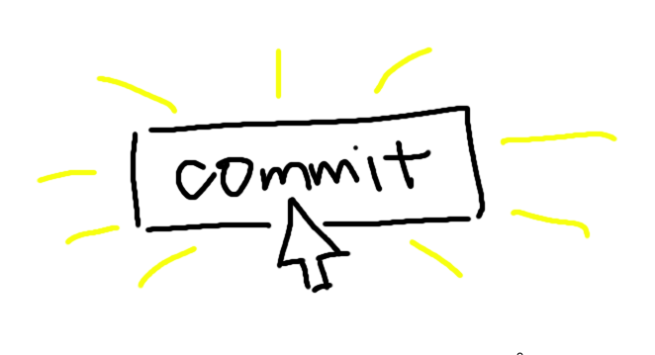

Problem Summary

Slide 4

Problem Summary

Slide 5
Background Information
What happened?
Side effects / Ripple effects caused by change
How can we avoid this?
Impact Analysis techniques

Slide 6
Solution Detail
Use both conceptual and logical (evolutionary) couplings for impact analysis
Conceptual Coupling – The extent domain concepts and software artifacts relate (Comments, identifiers, etc.)
Logical (Evolutionary) Coupling – The extent software artifacts were co-changed (Commits)
Philosophy: Present + Past of a software system = better impact analysis

Slide 7
Conceptual Coupling
Conceptual Similarity between software entities
Corpus Creation via text extraction
Index via Latent Semantic Indexing
Term-document matrix (Vector subspace)
Cosine Similarity
Value from 0 to 1

Slide 8


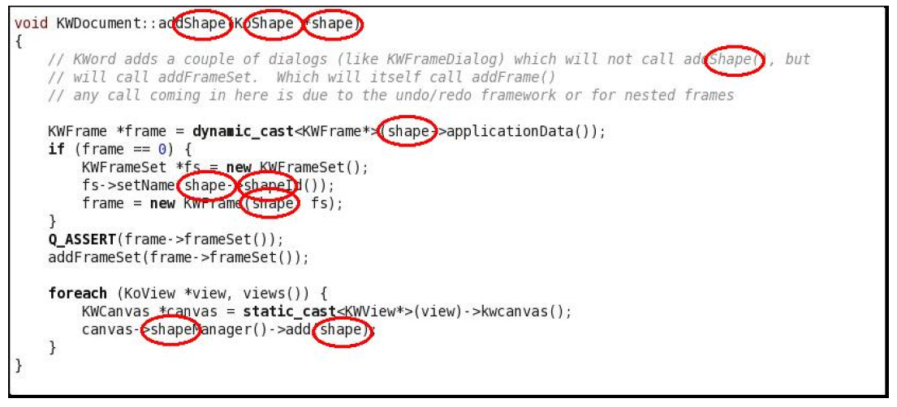
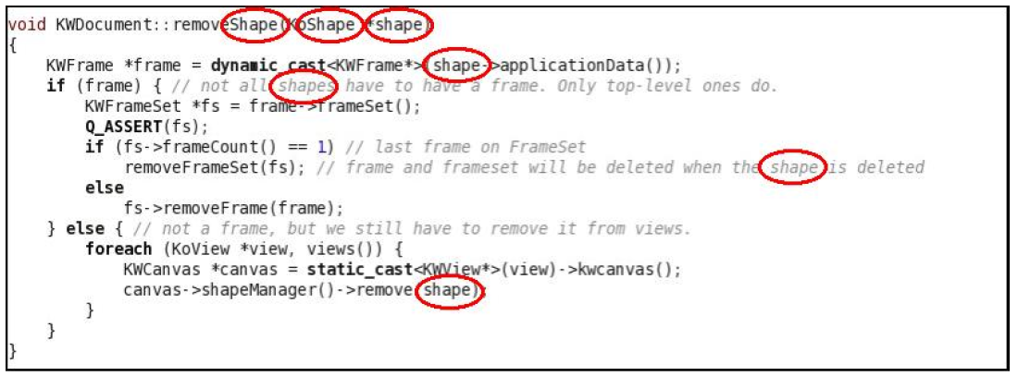
Conceptual Coupling Example

Slide 9
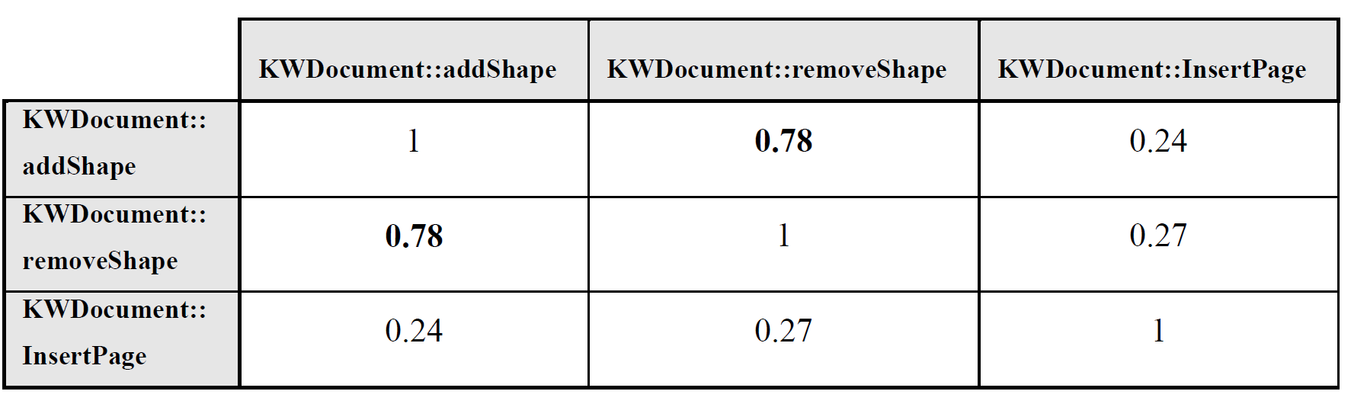
Conceptual Coupling Example

Slide 10
Evolutionary Coupling
How often software entities are co-changed
Extract change-sets (commits) from period of history
Convert to fine-grained change-sets
File-and-line level to syntactic level
Mine Evolutionary Couplings
Create association rules between entities (with confidence and support value)

Slide 11

Evolutionary Coupling Example
Commits | Methods Changed
13341 | {argouml/.../getType, argouml/.../isAStereotype}
12784 | {argouml/.../getType, argouml/.../isAStereotype}
12810 | {argouml/.../getType, argouml/.../isAStereotype}
Association Rule:
X Y
{argouml/.../getType} {argouml/.../isAStereotype}
Confidence Level: 1.0 (100%)
Support Level: 3

Slide 12
Combined Approach Steps
Select software entity to perform IA on.
Compute conceptual couplings via IR.
Set of conceptually related entities
Mine commits and compute evolutionary couplings.
Set of evolutionary coupled entities
Compute the estimated impact set.

Slide 13
Combined Approach Example
Apache Bug – Incorrect request body handling
3 Source Code Files Changed:
/modules/http/http_filters.c
/modules/http/http_protocol.c
/server/protocol.c

Slide 14
Combined Approach Example
Select software entity to perform IA on.
Using feature location, /modules/http/http_filters.c is selected as the software entity.
3 Source Code Files Changed:
/modules/http/http_filters.c
/modules/http/http_protocol.c
/server/protocol.c

Slide 15
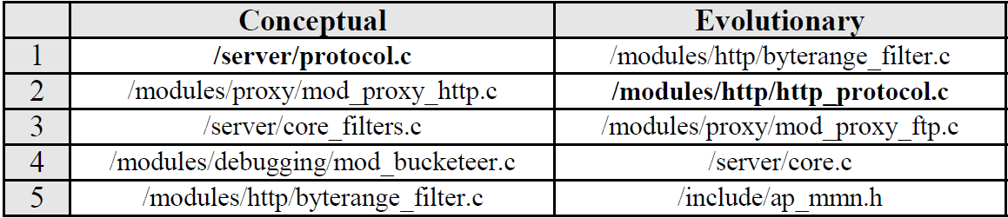
Combined Approach Example
Compute conceptual couplings via IR.
Mine commits and compute evolutionary couplings.

Slide 16
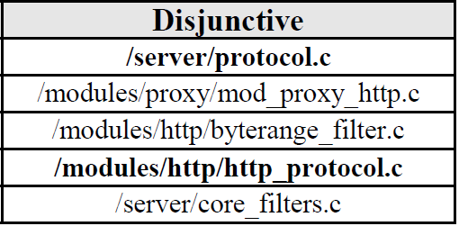
Combined Approach Example
Compute the estimated impact set.
Disjunctive (Union) vs. Conjunctive (Intersection)
User-selected result set size: μ = 5
Conjunctive
/modules/http/byterange_filter.c
/modules/proxy/mod_proxy_http.c

Slide 17
Solution Evaluation
Evaluated Systems:
Apache httpd, ArgoUML, iBatis, KOffice, jEdit
Accuracy Metrics:
Precision, Recall, F-Measure
Calculated for:
Conceptual Coupling, Evolutionary Coupling, Conceptual and Evolutionary Couplings (Disjunctive, Conjunctive)

Slide 18
Solution Evaluation
Corpus Variables
File Granularity vs. Method Granularity
Impact Set Variables
Disjunctive vs. Conjunctive
Result Set Size / Cut-off Points (10, 20, 30, 40, 50)
Amount of Historical Data
Larger release intervals

Slide 19
Solution Evaluation
Compute conceptual couplings on one particular subject system version.
Conceptual Training Set
Mine evolutionary couplings.
Evolutionary Training Set
Select a set of commits after the selected subject system version in #1.
Testing Set (For evaluation purposes)

Slide 20
Solution Evaluation
Derive disjunctive and conjunctive impact sets.
Compute accuracy metrics for standalone and combination techniques.
Compare standalone and combination accuracy results.
Repeat for all subject systems and versions.

Slide 21
Results – Research Questions
Does combining conceptual and evolutionary couplings improve accuracy of IA?
Does the choice of granularity (i.e., file vs. method) impact standalone techniques and their combinations?
Does the amount of training historical data impact the accuracy of the proposed combination?

Slide 22
Combining Conceptual and Evolutionary Coupling
Orthogonality of the Conceptual and Evolutionary Couplings
Are the coupling result sets individually contributing?
F-Measure Performance of the Standalone and Combined Approaches

Slide 23
Combining Conceptual and Evolutionary Coupling – Orthogonality
Verify that the individual result sets are not too similar.
Two not similar correct result sets can identify a larger correct result set when combined.
Scenarios where one coupling technique is stronger than the other.

Slide 24
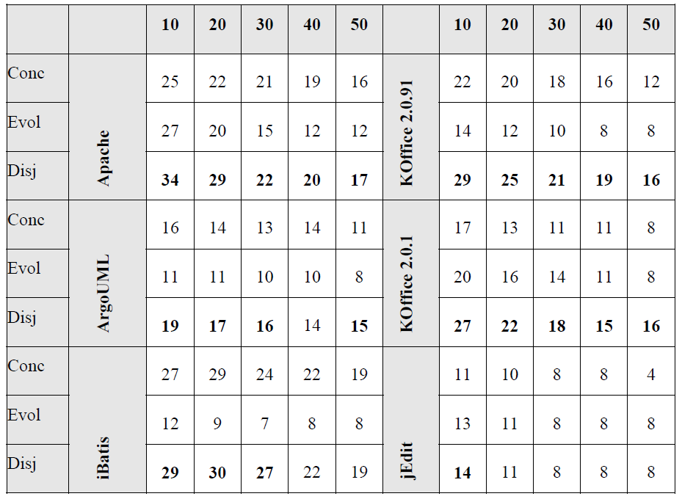
Combining Conceptual and Evolutionary Coupling – F-Measure Performance (File)
File-Level Granularity, F-Measure Percentage
Table

Slide 25
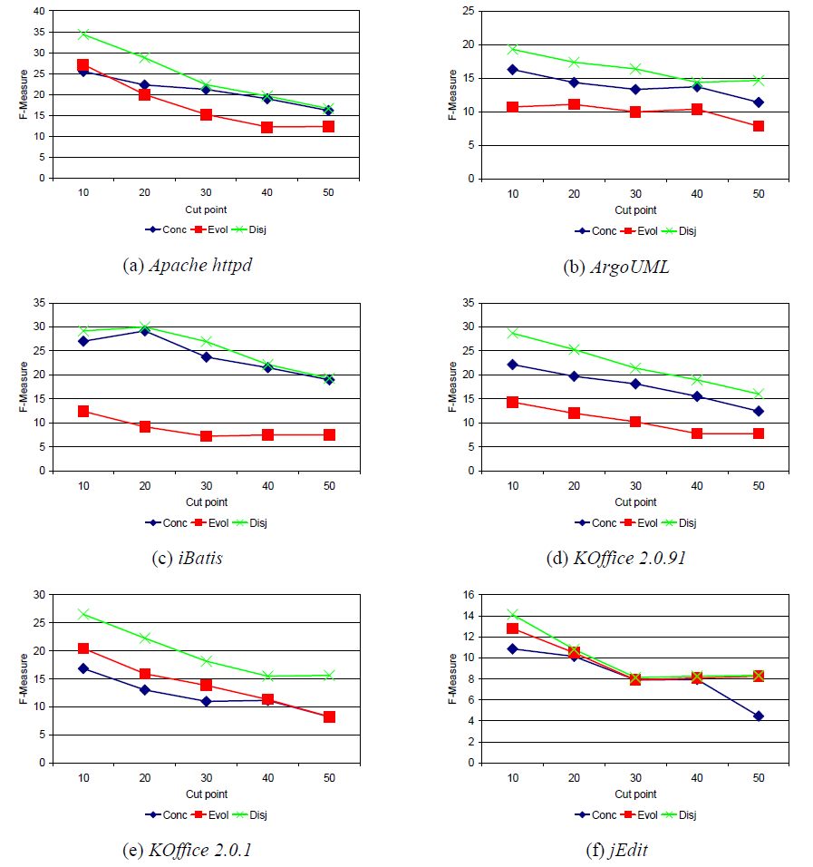
Combining Conceptual and Evolutionary Coupling – F-Measure Performance (File)
File-Level Granularity, F-Measure Percentage
Graph

Slide 26
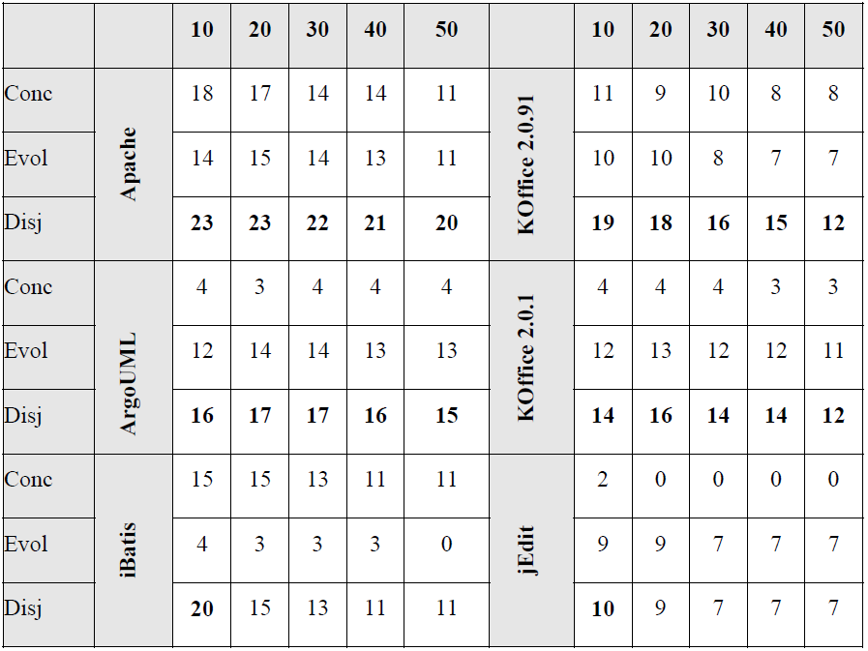
Combining Conceptual and Evolutionary Coupling – F-Measure Performance (Method)
Method-Level Granularity, F-Measure Percentage
Table

Slide 27
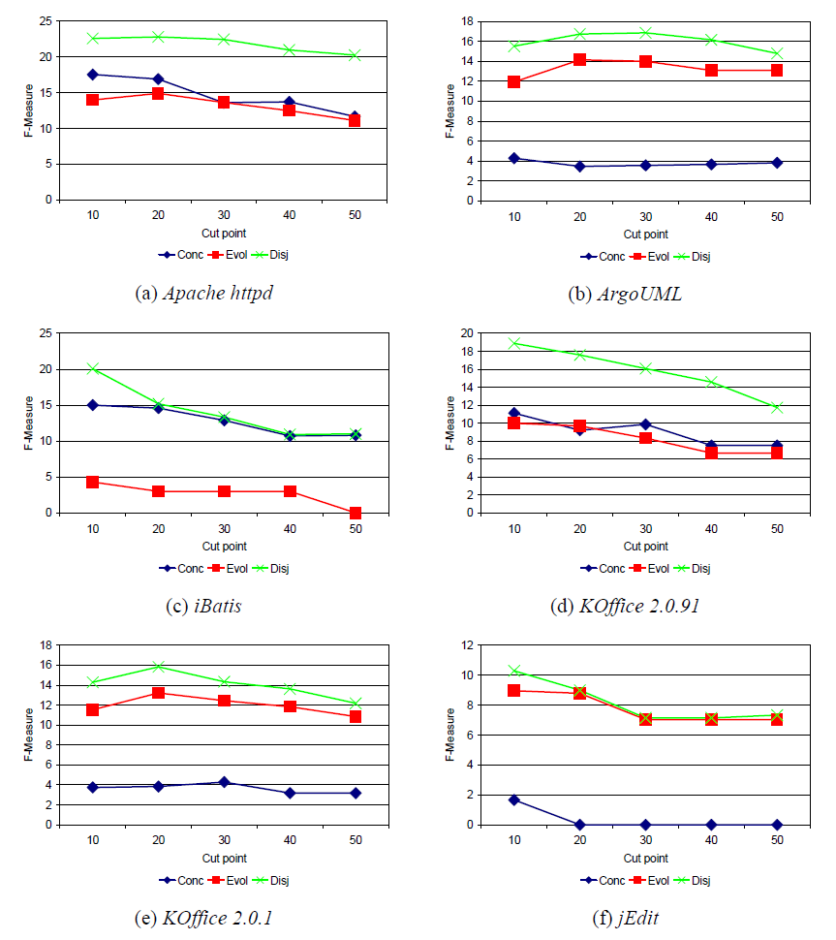
Combining Conceptual and Evolutionary Coupling – F-Measure Performance (Method)

Slide 28
Choice of Granularity (File)
File-Level Granularity, F-Measure Percentage
Table

Slide 29
Choice of Granularity (Method)
Method-Level Granularity, F-Measure Percentage
Table

Slide 30
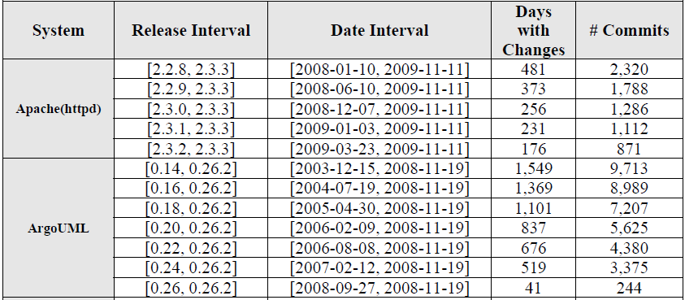
Amount of Training Historical Data

Slide 31
Amount of Training Historical Data
Increasing training history with development versions spanning several major releases (Especially larger systems) impacted F-measure value.
More noticeable effect on the method-level granularity.

Slide 32
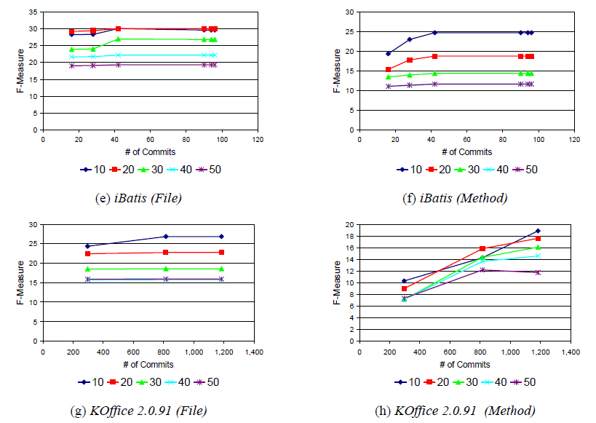
Amount of Training Historical Data
File Granularity
Method Granularity

Slide 33
Conclusion
Combining conceptual and logical (evolutionary) couplings improved F-measure values:
Up 3-17% vs. conceptual coupling
Up 9-20% vs. evolutionary coupling
Disjunctive performed better than conjunctive.
File-level granularity saw better results than method-level granularity.
Using larger history across major releases for the training set impacted F-measure values, more noticeably at the method-level granularity.

Slide 34
Comparison to Previous Work
Blending conceptual and evolutionary couplings to support change impact analysis in source code – Kagdi, 2010
Extension of previous work by:
Providing detailed analysis results for method level granularity
Added jEdit as a subject system
Extended statistical tests for both file and method granularity
Investigated if amount of training history affected results

Slide 35
Questions?
Thank you!

Slide 36
Questions
If you had to implement the impact analysis technique described in this paper today into your field of work, what would/would not work and how would you modify it?
What are some ways you could apply and/or expand the technique covered in this paper?
Discuss any of the future directions mentioned in the paper’s conclusion and how you think the extra factor would affect the overall results and why.

