Slide 1


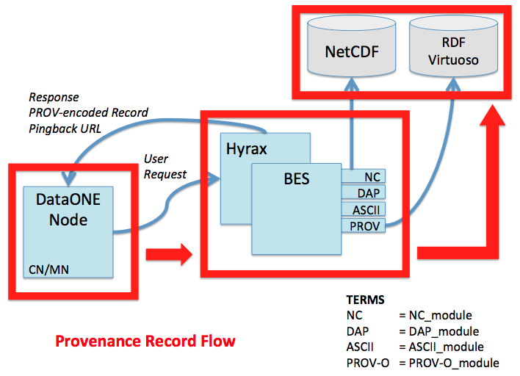
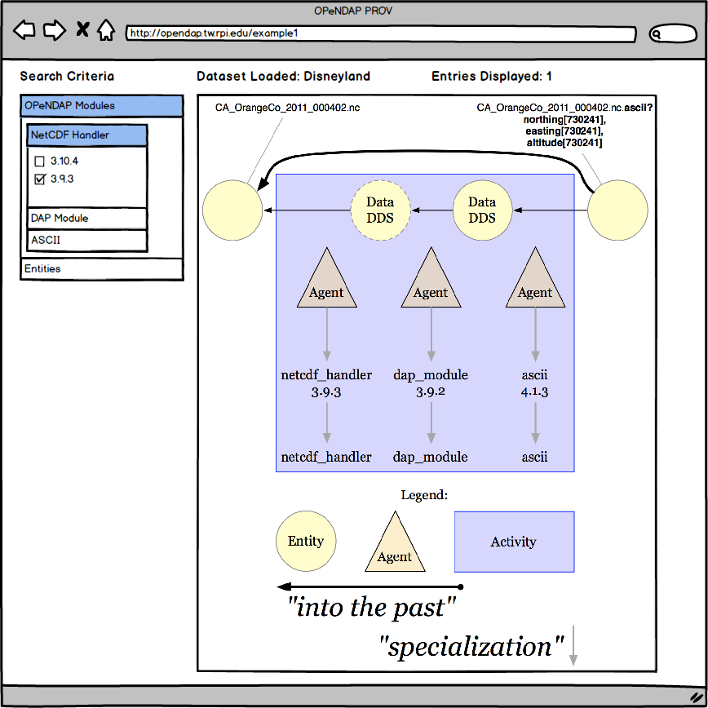
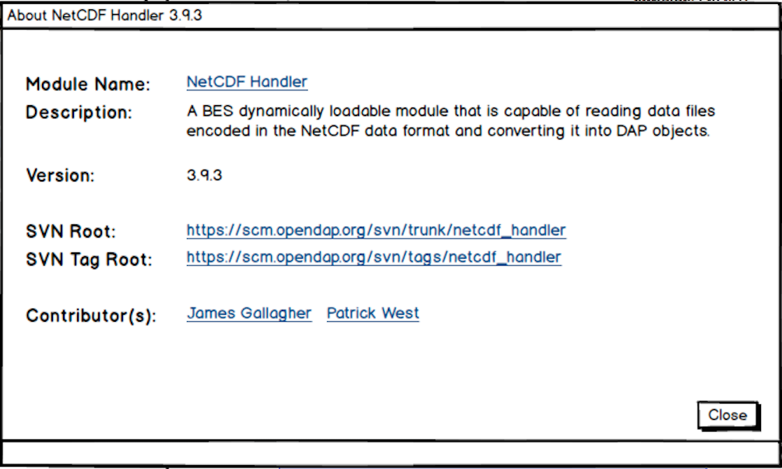
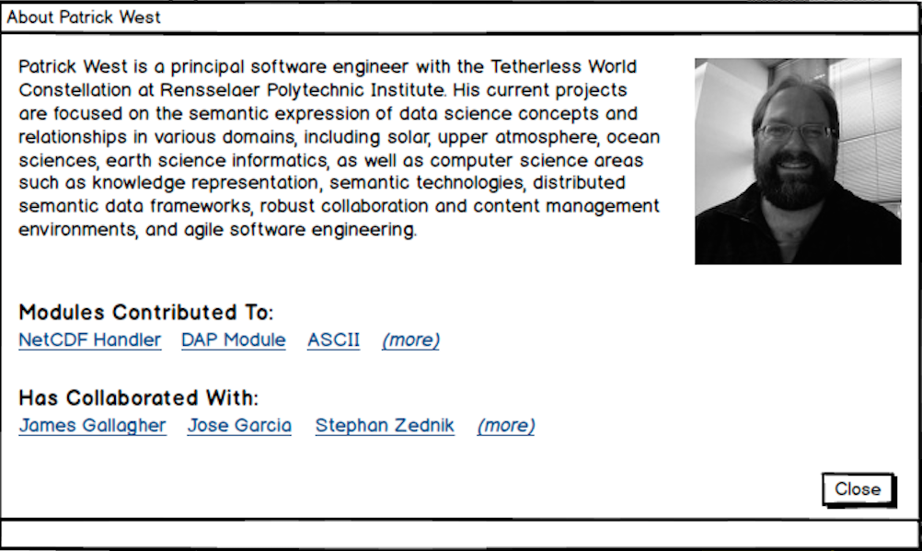
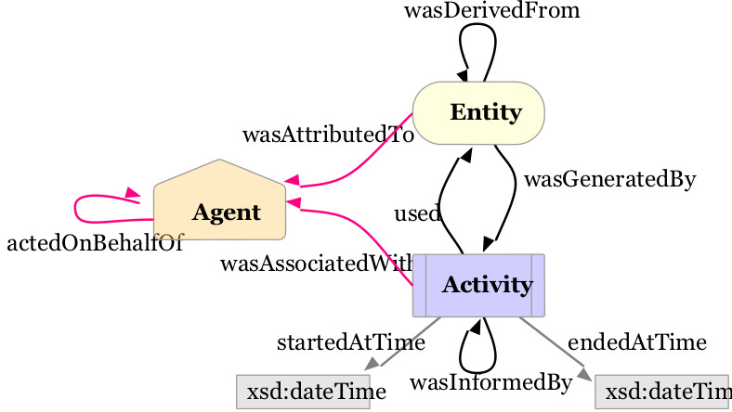

Provenance Record Design:
Based on the PROV-O ontology, as well as an ontology of OPeNDAP Modules and Activities presently in-development.
Expresses OPeNDAP activities as PROV Plans followed by back-end server.
Applying Provenance Extensions to the OPeNDAP Framework
James R. Michaelis, Patrick West, Deborah L. McGuinness
and Tim Lebo
{michaelis,dlm}@cs.rpi.edu {pwest,lebot}@rpi.edu
Rensselaer Polytechnic Institute, 110 8th Street, Troy, NY 12180
:CA_OrangeCo_2011_000402.nc.ascii
rdf:type prov:Entity;
prov:wasDerivedFrom :NC_File.
prov:wasGeneratedBy :BES_Process;
.
:BES_Process
rdf:type prov:Activity;
prov:qualifiedAssociation [
a prov:Association;
prov:agent :BES_Agent;
prov:hadPlan :BES_Plan;
rdfs:comment
"Execution of BES Server"@en
];
.
:BES_Agent
rdf:type prov:Agent;
foaf:name "BES Server"
.
:BES_Plan
rdf:type prov:Plan, prov:Collection;
prov:qualifiedInfluence [
a prov:Influence;
prov:entity opendap:NC_Module;
prov:hadRole opendap:Read;
opendap:order 1;
];
prov:qualifiedInfluence [
a prov:Influence;
prov:entity opendap:DAP_Module;
prov:hadRole opendap:Constrain;
opendap:order 2;
];
prov:qualifiedInfluence [
a prov:Influence;
prov:entity opendap:ASCII_Module;
prov:hadRole opendap:Transmit;
opendap:order 3;
];
.
Motivations and Challenges:
Proper data management hinges on recording and maintaining “steps” applied to create data.
Consumers require methods to assess whether available data is fit for their usage.
Was this dataset produced by a trustworthy source?
Producers are often expected to justify their efforts in generating new datasets.
Who is using our data?
What are they using it for? And why?
HOWEVER, most current-generation data analysis and manipulation tools fail to capture appropriate meta-information to address these needs.
Pingback:
Upstream providers can discover derivations of their own products.
Downstream providers can discover the lineage of their data products.
The OPeNDAP Hyrax Data Server Framework:
The Open Data Access Protocol (OPeNDAP) Hyrax is a web-based framework used by earth and space science communities for publishing and accessing datasets.
Can retrieve datasets using different formatting and aggregation strategies.
Consists of collections of data manipulation modules.
Logging Data Access Provenance:
Will involve extensions to select OPeNDAP modules to publish records of data access.
C: GET http://opendap.tw.rpi.edu/opendap/disney/CA_OrangeCo_2011_000402.nc.ascii?constraint
S: 200 OK
S: Link: <http://opendap.tw.rpi.edu/disney/provenance_record>
rel=“http://www.w3.org/ns/prov#has_provenance”
S: Link: <http://opendap.tw.rpi.edu/disney/pingback>
rel=“http://www.w3.org/ns/prov#pingback”
(CA_OrangeCo_2011_000402 ascii representation)
Host: opendap.tw.rpi.edu
Client: coyote.example.org
C: POST http://opendap.tw.rpi.edu/disney/pingback HTTP/1.1
C: Content-Type: text/uri-list
C: http://coyote.example.org/diagram_abc123/provenance
C: http://coyote.example.org/journal_article_def456/provenance
S: 204 No Content
Presenting Records:
Deployable in-parallel with OPeNDAP servers.
Graph-based visualization of provenance records.
Corresponding pages for OPeNDAP modules and contributors accessible from provenance pages.
World Wide Web Consortium (W3C) PROVenance language:
Provenance is information about entities, activities, and people involved in producing a piece of data or thing, which can be used to form assessments about its quality, reliability or trustworthiness.
PROV-O is the W3C recommended Ontology language
Next Steps:
Updates to select OPeNDAP modules to enable provenance logging during system executions.
Live updating of RDF Virtuoso Triplestore to add provenance records during OPeNDAP executions.
Term Expansion Guide:
BES: OPeNDAP Back-end Server
DAP: Data Access Protocol
DataONE: Data Observation Network for Earth
DDS: Data Definition Structure
NC / NetCDF: Network Common Data Form
OPeNDAP: Opensource Project for a Network Data Access Protocol
PROV-O: Provenance Ontology (from W3C)
RDF: Resource Description Format
SVN: (Apache) Subversion
W3C: World Wide Web Consortium
For more information:
Please visit our prov project Github at:
https://github.com/tetherless-world/opendap
or our lab’s project page at:
http://tw.rpi.edu/web/project/OPeNDAP
For questions about this work, please contact:
James Michaelis (michaelis@cs.rpi.edu)
Patrick West (westp@rpi.edu)
or Deborah L. McGuinness (dlm@cs.rpi.edu)
Sponsors:
NSF / DataONE
RPI Tetherless
World Constellation

