Slide 1

Applying Provenance Extensions to OPeNDAP Framework
Patrick West, James Michaelis, Tim Lebo, Deborah L. McGuinness
Rensselaer Polytechnic Institute
Tetherless World Constellation

Slide 2
Motivation and Challenges
Proper data management hinges on recording and maintaining “steps” applied to create data.
Consumers require methods to assess whether available data is fit for their usage.
Was this dataset produced by a trustworthy source?
Producers are often expected to justify their efforts in generating new datasets.
Who is using our data?
What are they using it for? And why?
HOWEVER, most current-generation data analysis and manipulation tools fail to capture appropriate meta-information to address these needs.

Slide 3
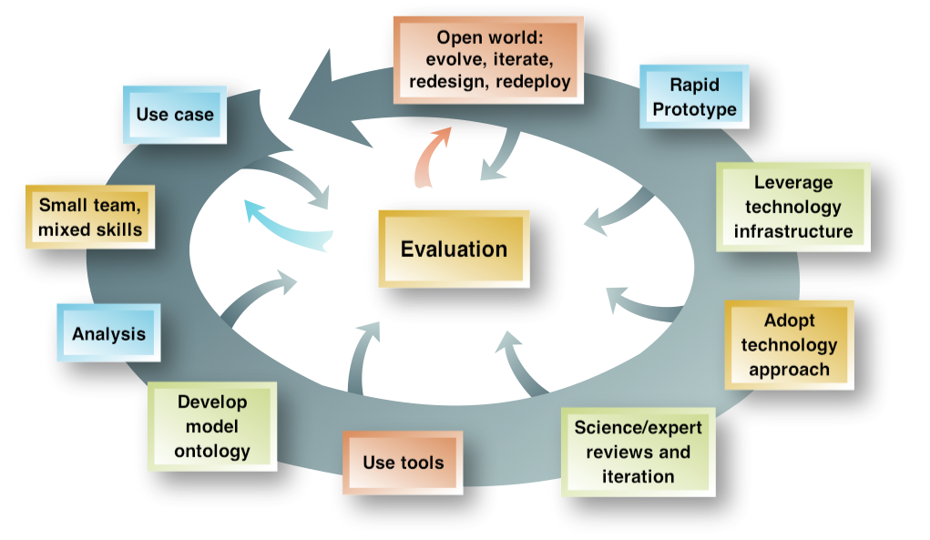
Semantic Web Iterative Development Methodology

Slide 4
Use Cases
a PROV pingback-enabled community collaborates to categorize the points in a LiDAR scan of Disneyland.
A client accesses a data point from a LiDAR scan of Disneyland
The client categorizes the point as “water”, which is a new derivation of that point
The client pings-back about this new derivation
A researcher generates a data product using OPeNDAP and wishes to access the provenance of the data product. What were the original data sources?
A scientist wishes to discover any derivations of their data sources

Slide 5
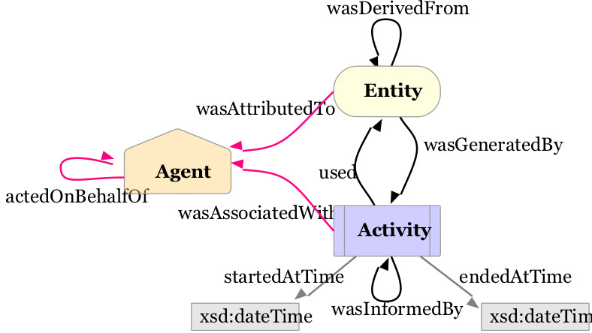
W3C PROV-O
Notes:
Provenance is information about entities, activities, and people involved in producing a piece of data or thing, which can be used to form assessments about its quality, reliability or trustworthiness.
This is a general provenance ontology model. For OPeNDAP we plan on using additional features such as prov:Plan.

Slide 6
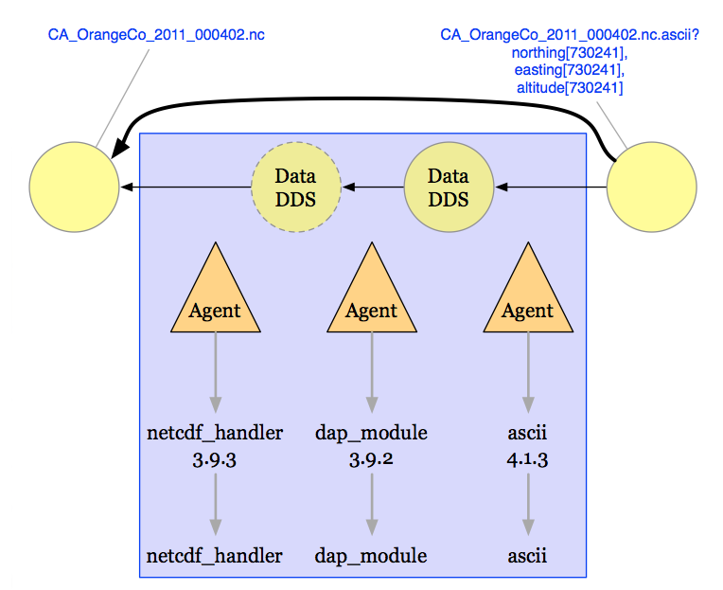
Provenance Trace
Running of the BES

Slide 7
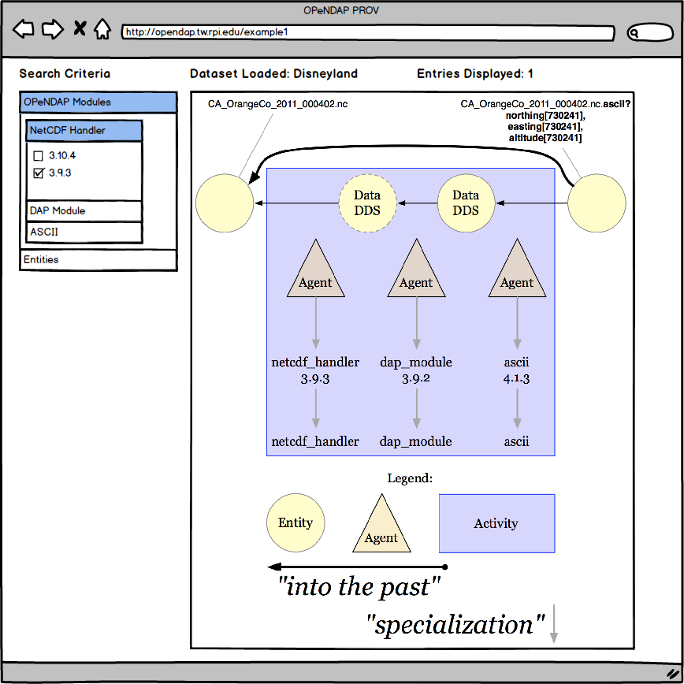
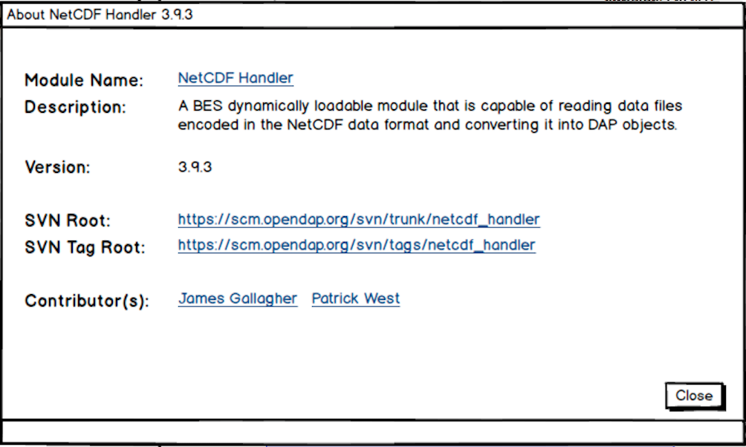
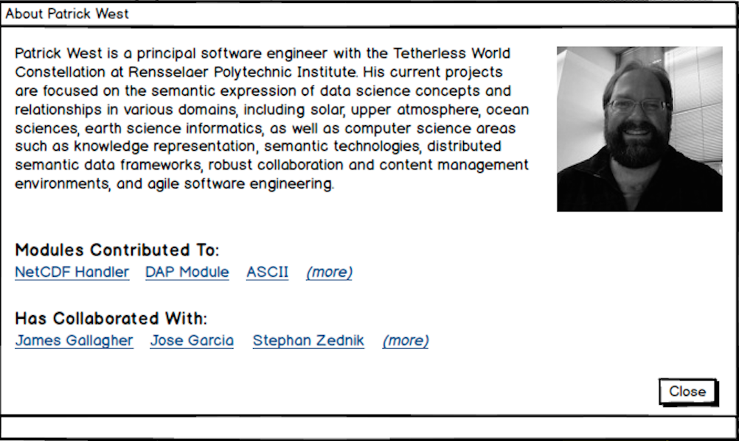
Visualization
Notes:
Being able to load up description pages for the various components and being able to load up corresponding descriptive pages for contributors and software.

Slide 8
RDF
:CA_OrangeCo_2011_000402.nc.ascii
rdf:type prov:Entity;
prov:wasDerivedFrom :NC_File.
prov:wasGeneratedBy :BES_Process;
.
:BES_Process
rdf:type prov:Activity;
prov:qualifiedAssociation [
a prov:Association;
prov:agent :BES_Agent;
prov:hadPlan :BES_Plan;
rdfs:comment
"Execution of BES Server"@en
];
.
:BES_Agent
rdf:type prov:Agent;
foaf:name "BES Server"
.
:BES_Plan
rdf:type prov:Plan, prov:Collection;
prov:qualifiedInfluence [
a prov:Influence;
prov:entity opendap:NC_Module;
prov:hadRole opendap:Read;
opendap:order 1;
];
prov:qualifiedInfluence [
a prov:Influence;
prov:entity opendap:DAP_Module;
prov:hadRole opendap:Constrain;
opendap:order 2;
];
prov:qualifiedInfluence [
a prov:Influence;
prov:entity opendap:ASCII_Module;
prov:hadRole opendap:Transmit;
opendap:order 3;
];
.
Notes:
Sample rdf of what the BES might generate during a run

Slide 9
Linked Data
Linked Data is about using the Web to connect related data that wasn't previously linked, or using the Web to lower the barriers to linking data currently linked using other methods. More specifically, Wikipedia defines Linked Data as "a term used to describe a recommended best practice for exposing, sharing, and connecting pieces of data, information, and knowledge on the Semantic Web using URIs and RDF."
The four rules of linked data are:
Use URIs as names for things (human readable)
Use HTTP URIs so that people can look up those names
When someone looks up a URI, provide useful information using standards (RDF*, SPARQL)
Includes links to other URIs, so they can discover more things.
Notes:
It’s on the web, machine readable, non-proprietary format, RDF standards, linked RDF

Slide 10
The Response
Host: opendap.tw.rpi.edu
Client: coyoto.example.com
C: GET http://opendap.tw.rpi.edu/opendap/CA_OrangeCo_2011_000402.nc.ascii?constraint
S: 200 OK
S: Link: <http://opendap.tw.rpi.edu/disney/provenance_record>
rel=“http://www.w3.org/ns/prov#has_provenance”
S: Link: <http://opendap.tw.rpi.edu/disney/pingback>
rel=“http://www.w3.org/ns/prov#pingback”
(CA_OrangeCo_2011_000402 ascii representation)

Slide 11
Pingback
Upstream providers can discover derivations of their own products
Downstream providers can discover the lineage of their data products

Slide 12
Pinging back
Host: opendap.tw.rpi.edu
Client: coyoto.example.com
C: POST http://opendap.tw.rpi.edu/disney/pingback HTTP/1.1
C: Content-Type: text/uri-list
C:
C: http://coyote.example.org/diagram_abc123/provenance
C: http://coyote.example.org/journal_article_def456/provenance
S: 204 No Content

Slide 13
Linking it Together
We don’t just want to link data product to data product
We need information about
Datasets (DCAT, new W3C working group on datasets)
People (FOAF)
Software and Software Versions (DOAP)
Organizations (FOAF)
Publications and Presentations (BIBO)
Visualizing data products (ToolMatch)

Slide 14
First attempt – after the fact
First approach, collect information from generating the response and build the provenance
Developed a Reporter, called after the response is transmitted, to generate the provenance and push to repository
After-the-fact … don’t have all the information, the ordering
Wrote out file to be ingested by the system, takes time, not available right away
Notes:
We had to do a lot of guess work

Slide 15
Including Provenance Capture in BES
In-Time provenance collection – built into the BES framework
Refactor parts of the BES to support the capture of provenance
In addition to adding information to response header, embed the provenance in the response object
Make the provenance available immediately

Slide 16
What’s Next?
Updates to select OPeNDAP modules to enable provenance logging during system executions.
Refactor the BES to incorporate provenance capture during execution
Live updating of RDF Virtuoso Triplestore to add provenance records during OPeNDAP executions.

Slide 17
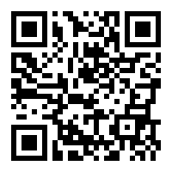
And we need your help!
We are trying to build the list of contributors to the OPeNDAP software
http://opendap.tw.rpi.edu/drupal/contributor_survey

Slide 18
Who’s Who?
Participants
James Michaelis, DataONE Summer Intern and RPI PhD Student, Developer
Patrick West, RPI Principal Software Engineer
Tim Lebo, RPI PhD Student, Developer
Acknowledgements
James Gallagher, OPeNDAP Lead Developer
Nathan Potter, OPeNDAP Developer
Peter Fox, RPI Professor
Deborah L. McGuinness, RPI Professor
Stephan Zednik, RPI Senior Software Engineer

Slide 19
More Information
Tetherless World GitHub Repository:
https://github.com/tetherless-world/opendap
Tetherless World OPeNDAP Projects
http://tw.rpi.edu/web/project/OPeNDAP
W3C Prov
http://www.w3.org/TR/2013/NOTE-prov-overview-20130430/
OPeNDAP
http://opendap.org and http://docs.opendap.org
In-Progress Development
http://opendap.tw.rpi.edu

Slide 20

Thanks!
Notes:
Comments? Questions?

Slide 21
Glossary
BIBO – Bibliographic Ontology
DCAT – Dataset Catalog Ontology
DOAP – Description of a Project Ontology
FOAF – Friend of a Friend Ontology
OPeNDAP – Opensource Project for a Network Data Access Protocol
PROV-O – The W3C Provenance Ontology
RPI/TWC – Rensselaer Polytechnic Institute / Tetherless World Constellation

