Slide 1

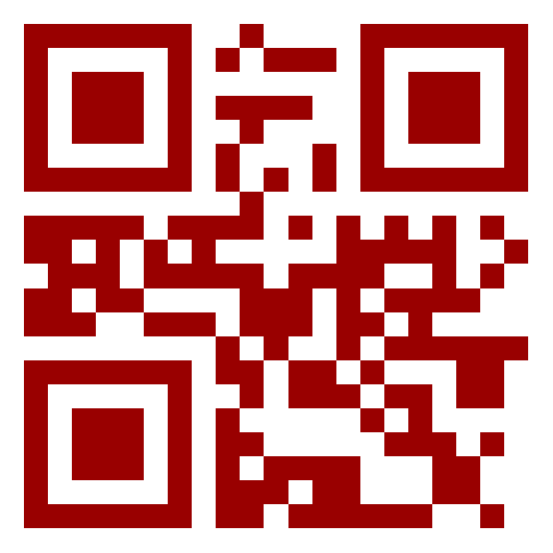
End-to-End IoT
IFTTT + MQTT; Internet-WiFi-BLE
Steven Knudsen, PhD, PEng
Mentor, The Pod
knud@ualberta.ca

Slide 2
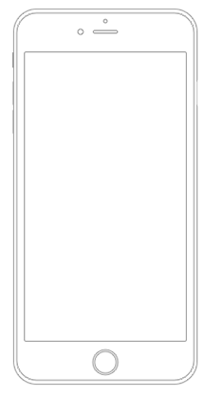



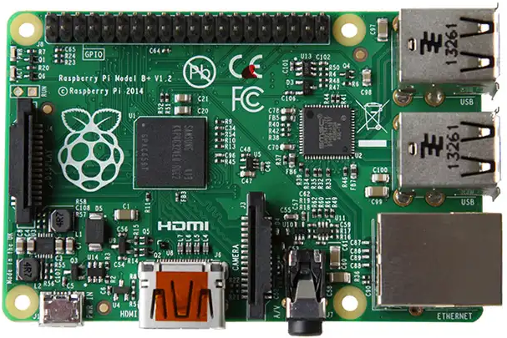
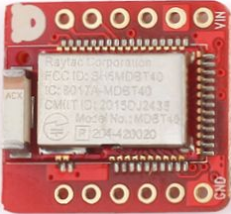

Objective: Control a BLE-enabled device from your phone

Slide 3
Overview of Main Steps
Set up MQTT (Adafruit IO)
Set up IFTTT
Confirm RPi can poll MQTT server, get command from IFTTT
Set up BLE connection with Raspberry Pi (RPi)
Control a PWM signal
Bridge MQTTT polling and BLE commands
Done!

Slide 4

Information and Caveats
Sources
github.com/knud
HackED2020Workshop
RB_Nano_v1 : WIP for Nordic nRF51822
Bluetooth Low Energy
Many options for platforms that are easy to work with
Adafruit and mbed are two good ones
Chose Nordic SDK only because using it a lot these days

Slide 5
Information and Cavets
github.com/IanHarvey/bluepy
Has issues with the nRF51822 when hosted on RPi
Solid on laptop and with nRF52xxx

Slide 6
MQTT — mqtt.org
An extremely lightweight publish/subscribe messaging transport to support machine-to-machine (M2M), Internet of Things (IoT) interactions.
Small; Windows executable is 1.4 MB

Slide 7
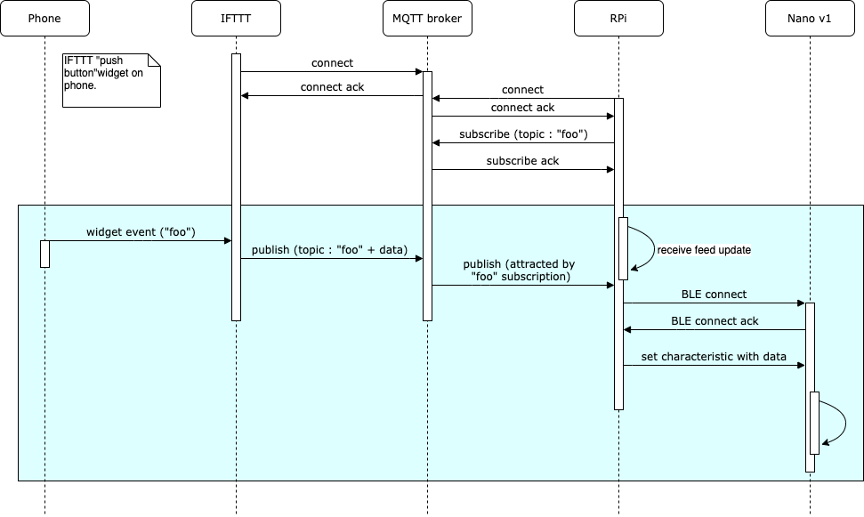

Slide 8
Set up MQTT
Sign up with io.adafruit.com (aka AIO)
Create new dashboard and open
Create a new feed and block
Set up / customize the block
Record AIO key
Needed for IFTTT and RPi client

Slide 9
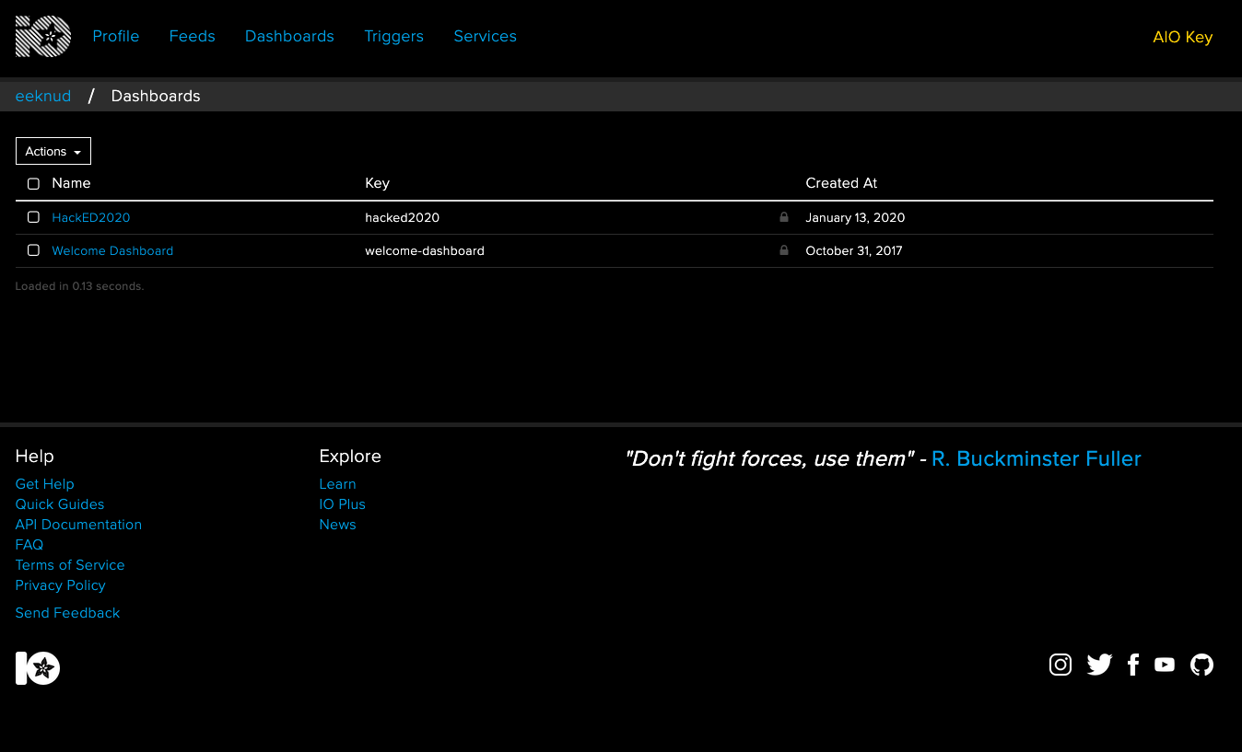

Slide 10
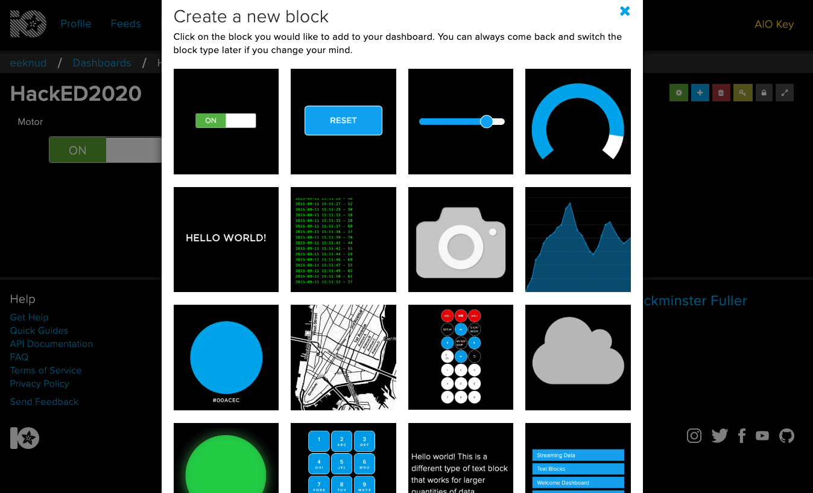

Slide 11
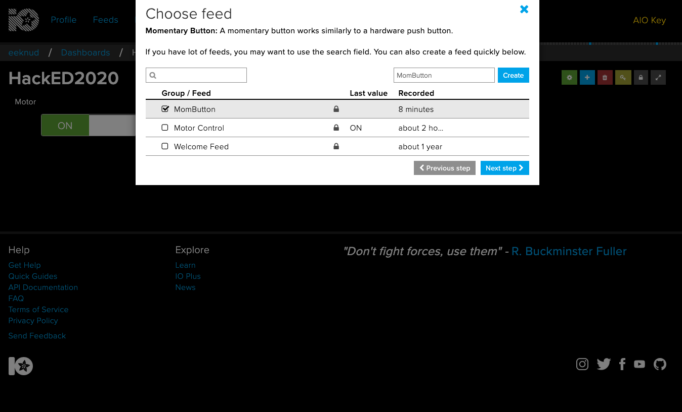

Slide 12
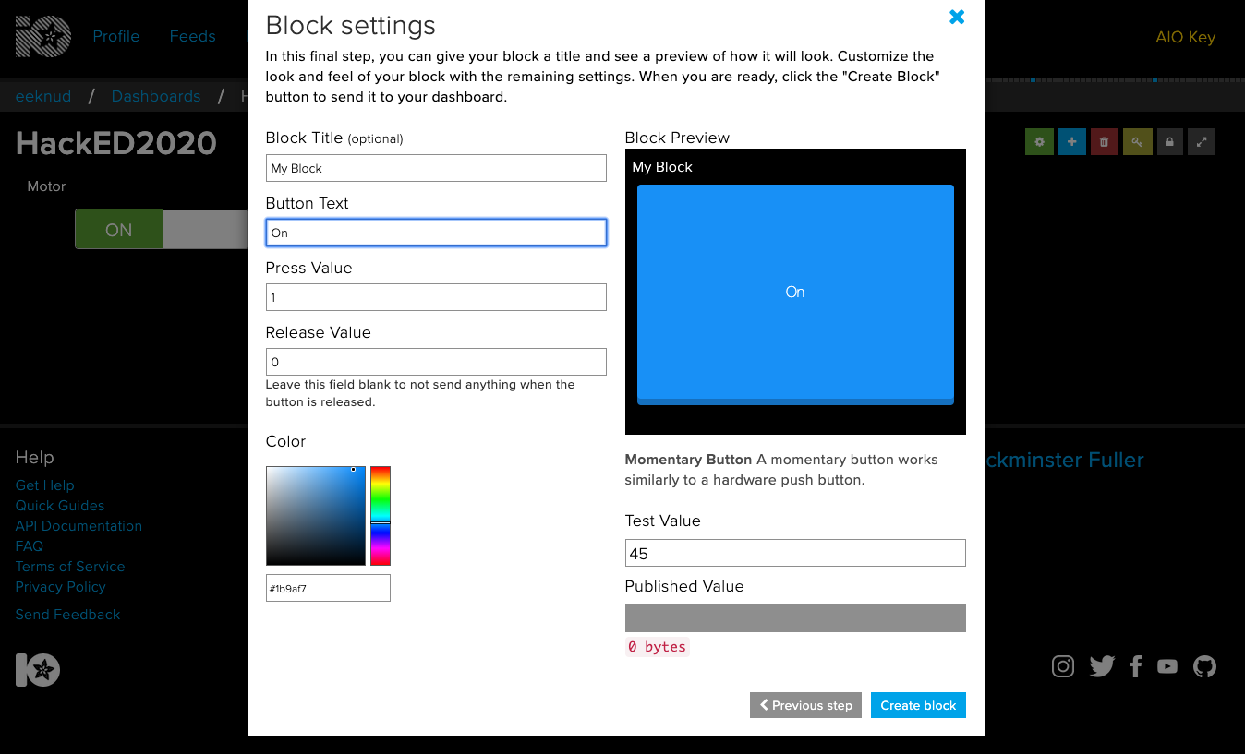

Slide 13
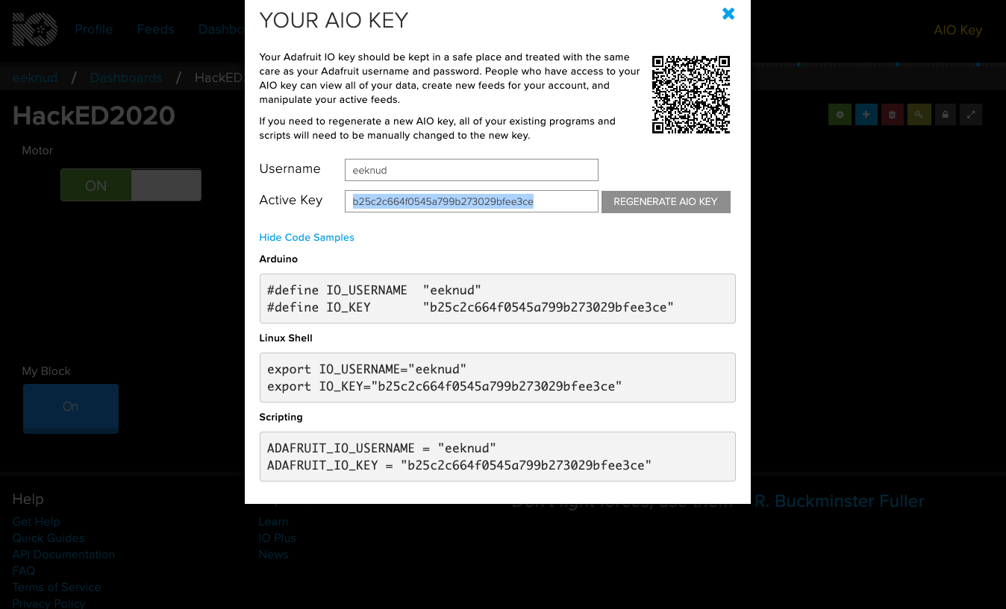

Slide 14
Set up IFTTT
Create a new widget
Select an action (“This”)
Button
Select a service (“That”)
Choose Adafruit service

Slide 15
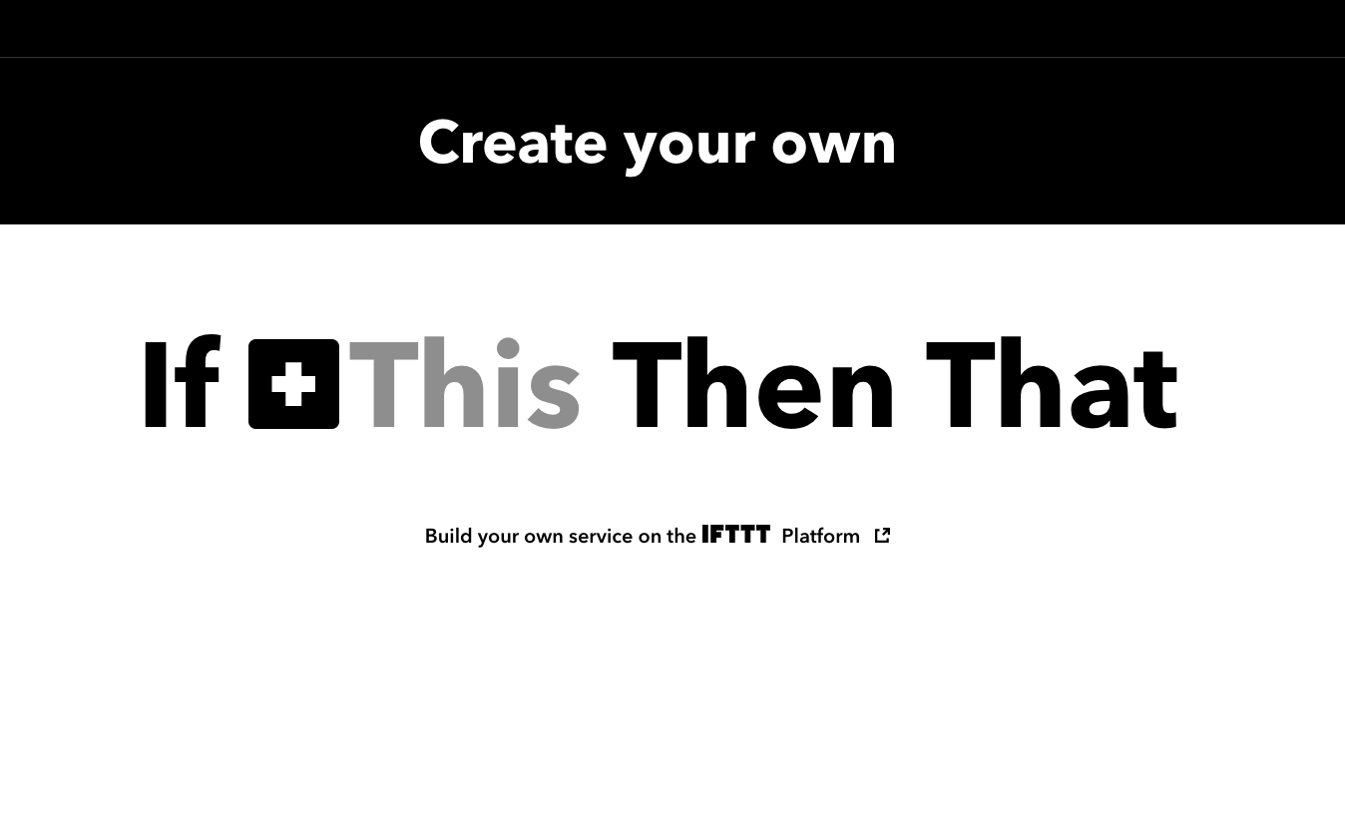

Slide 16
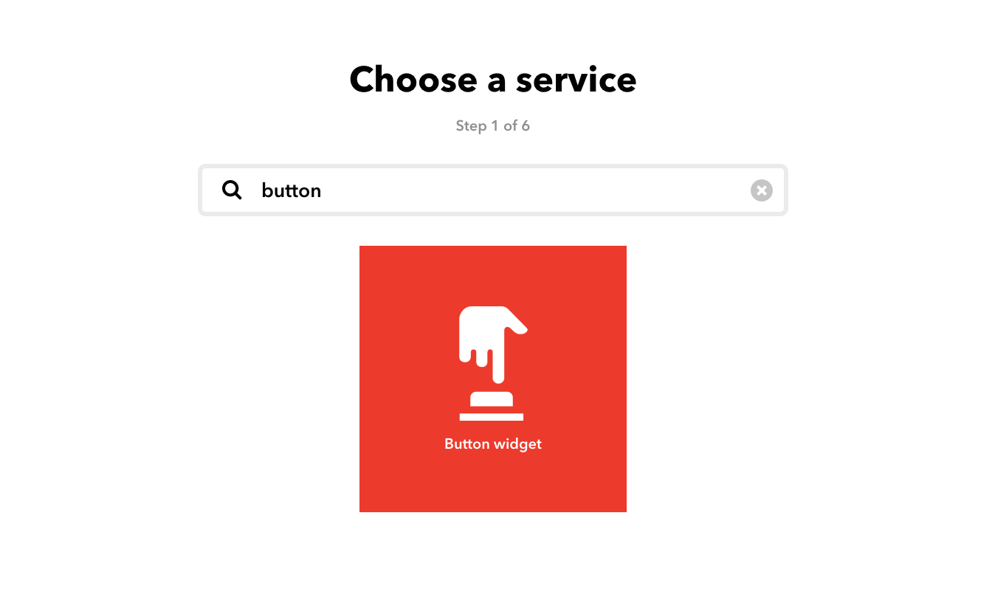

Slide 17
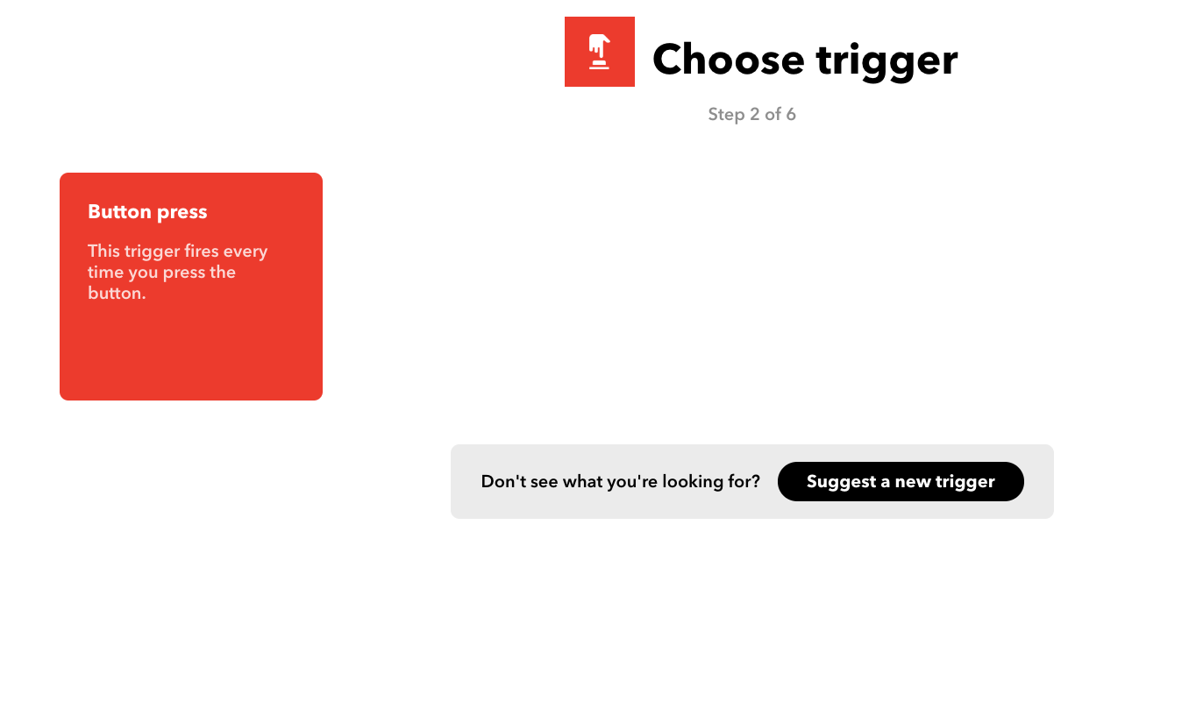

Slide 18
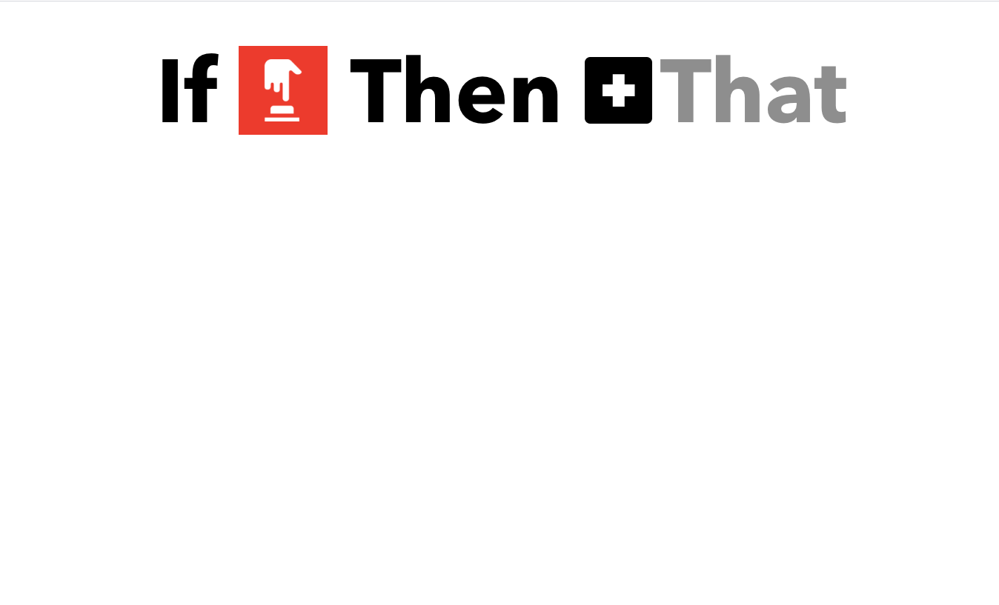

Slide 19
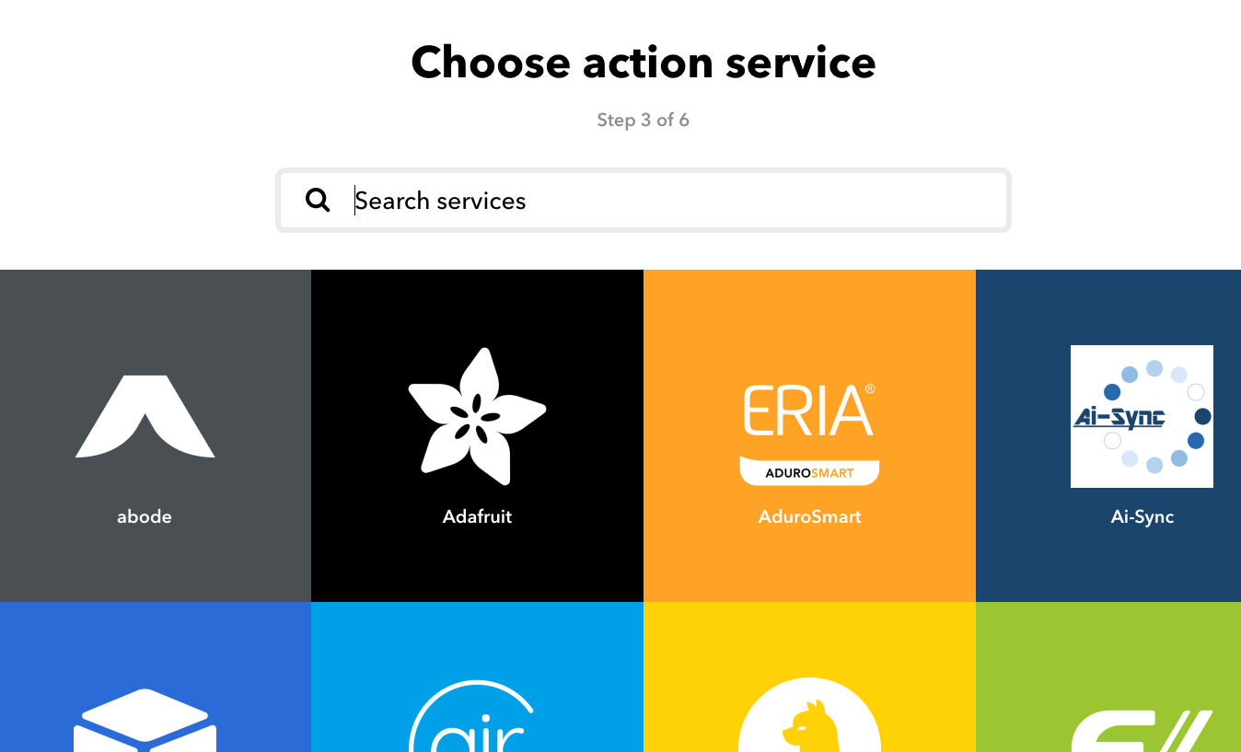

Slide 20
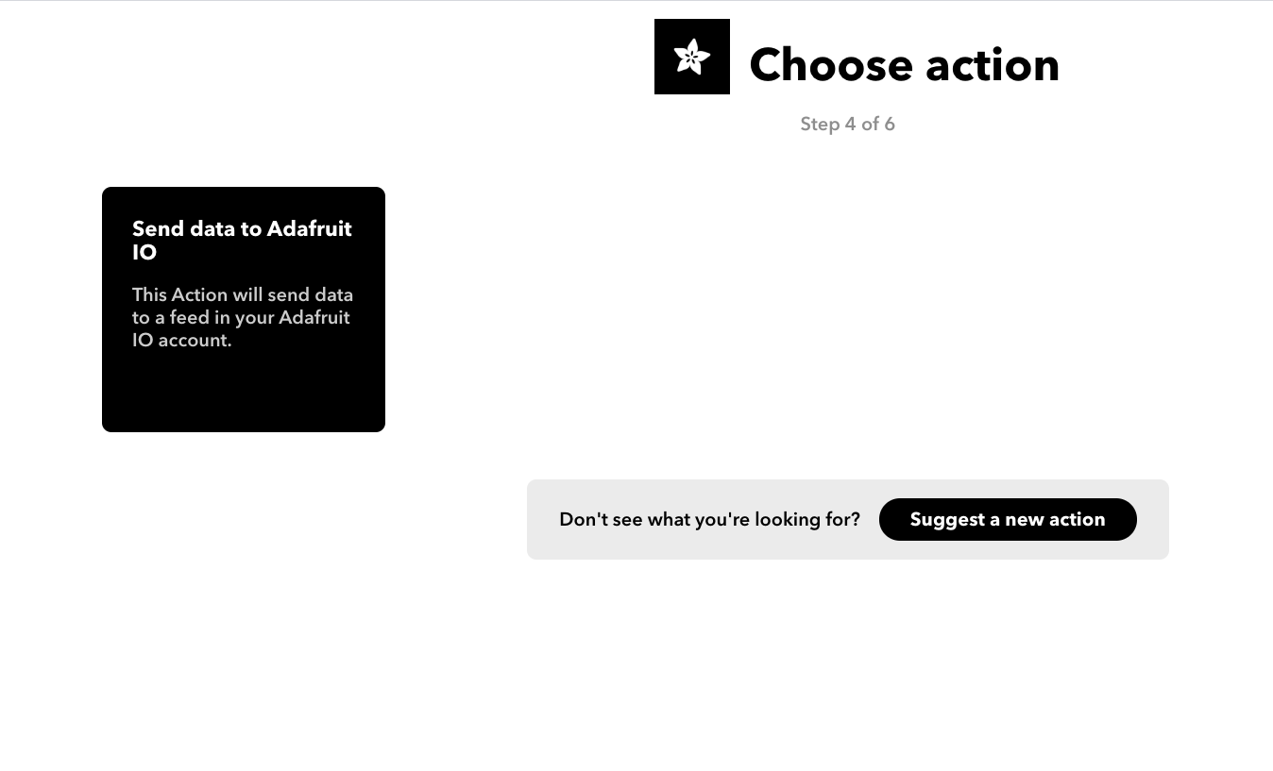

Slide 21
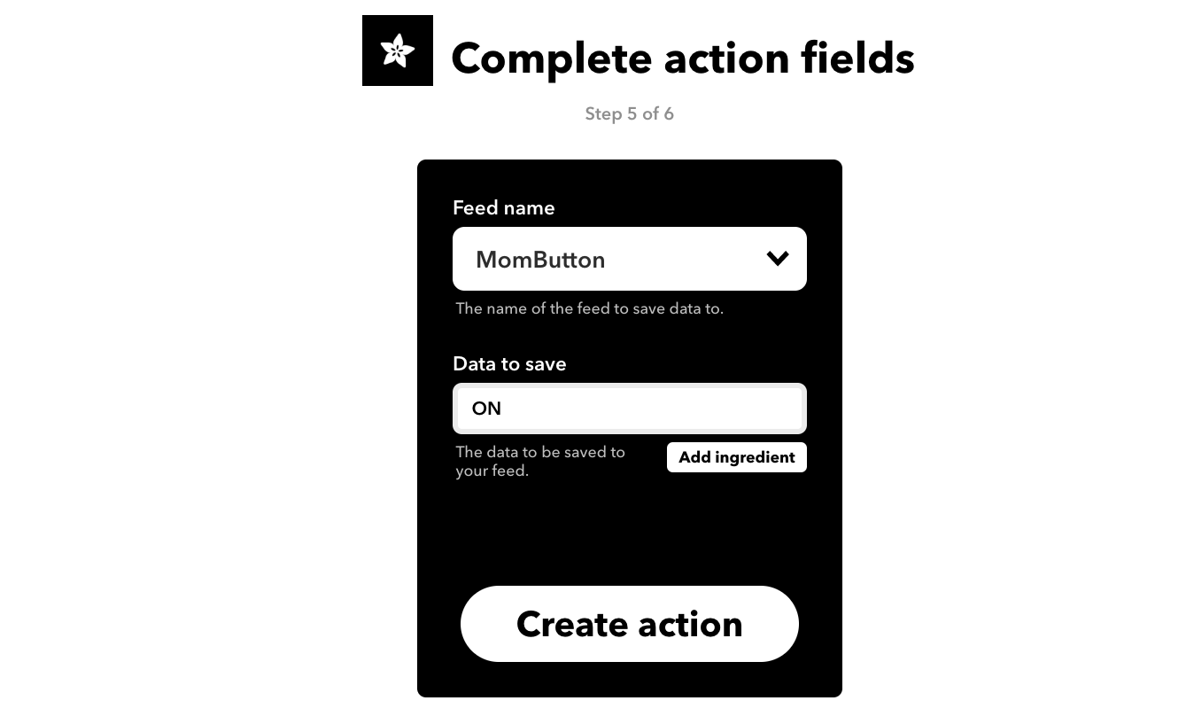

Slide 22
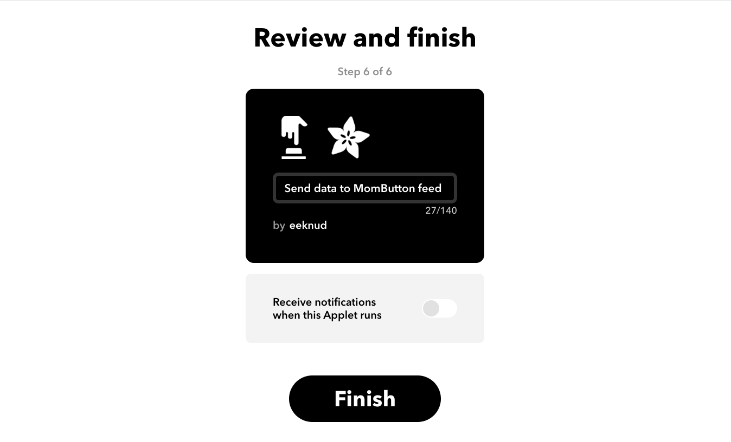

Slide 23
So far...
At this point the IFTTT widget should activate and be available on your phone
BTW, you need an IFTTT account and their app
Activating the widget sends the data you specified to the Adafruit feed
The Adafruit MQTT broker makes note of it for any subscribers
But we need a subscriber...

Slide 24
Raspberry Pi
Need to be sure that bluepy, requests, and adafruit-io are installed.
sudo pip3 install …
Need MQTTRelay.py from github.com/knud/HackED2020Workshop

Slide 25
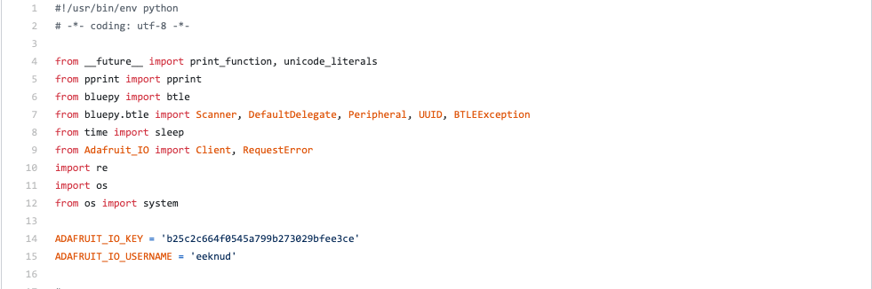

Slide 26
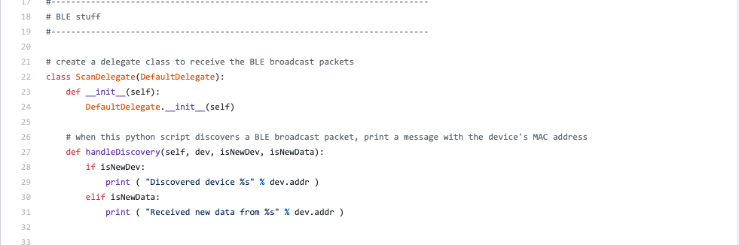

Slide 27
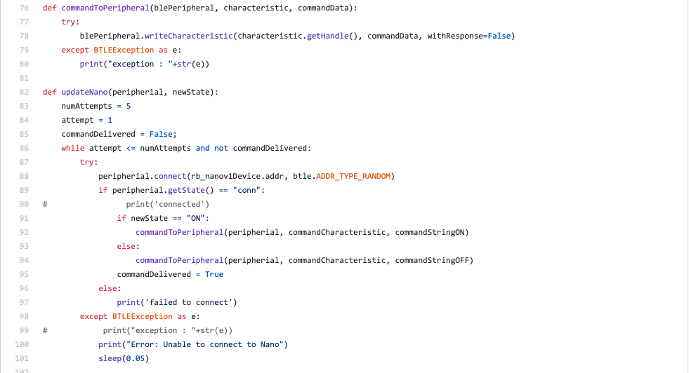

Slide 28
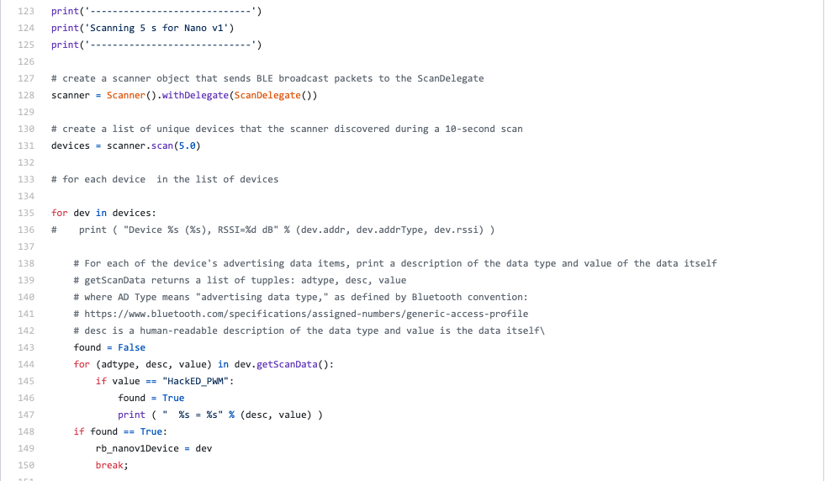

Slide 29
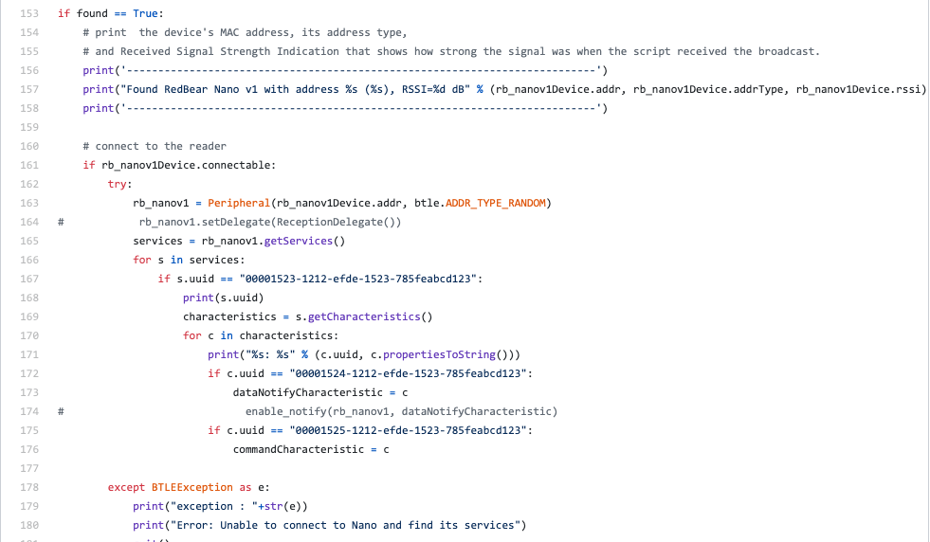

Slide 30
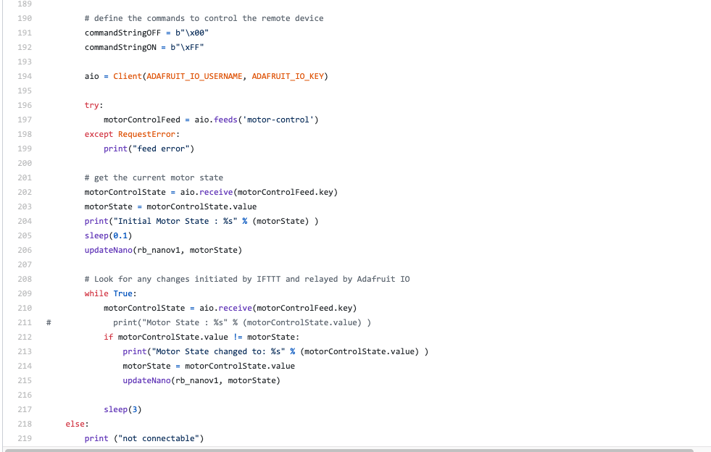

Slide 31
Objective: Control a BLE-enabled device from your phone

