Slide 1

KakaoMatch
Matthieu Bolliand – B201900109 Fredrik Julin – B201900048

Slide 2
The idea
Tinder is not popular in korea
The korean culture
Meeff
Kakao corp.

Slide 3
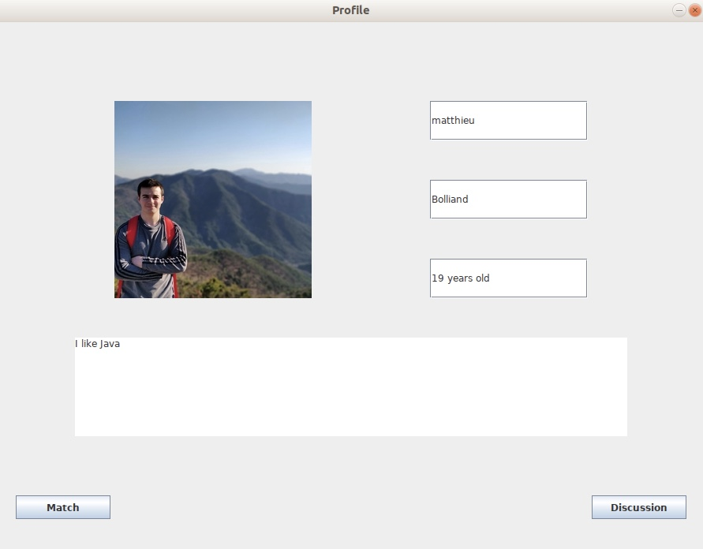
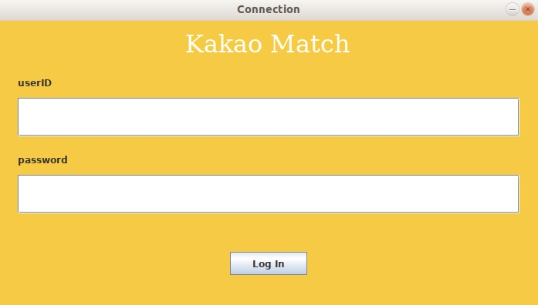
How it works

Slide 4
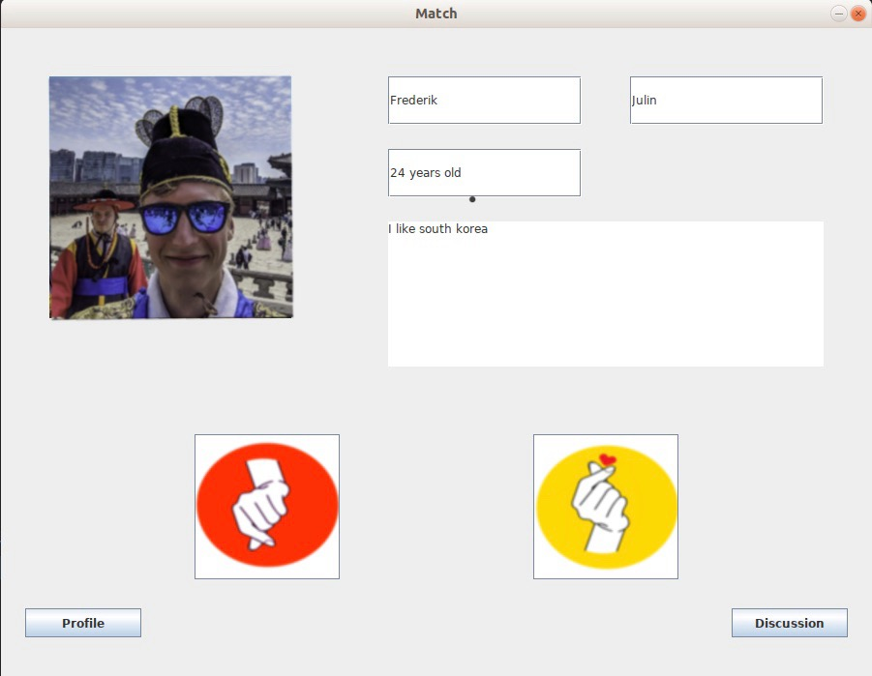
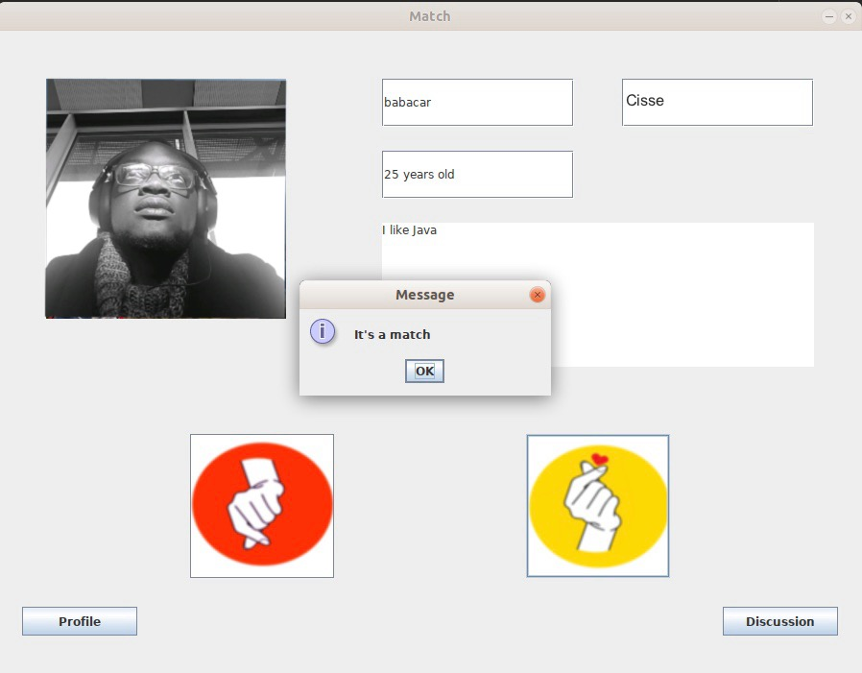

Slide 5
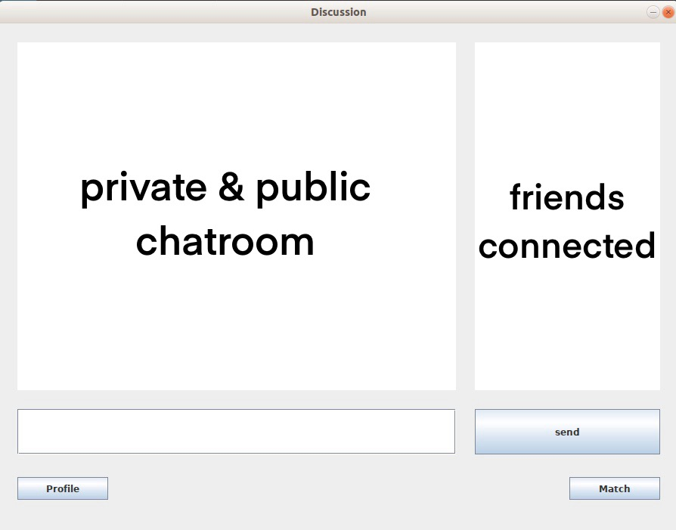

Slide 6
Challenges
Making a modulable interface
Setting up multiple connections on the server
Receive and send public and/or private message
Working together
Writing readable code so everyone can collaborate efficently

Slide 7
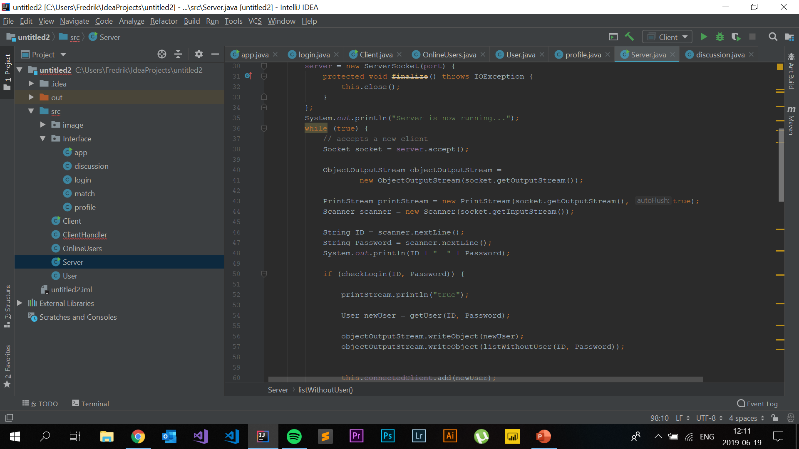
Main takeaways
OOP
Server / Clients
GUI
Organise a project with restrictions
Socket API
Multithreading
Place your screenshot here

Slide 8
Improvements and reflections on approach
Use version control (Git/Github) for easier collaboration
Use more extensive commentary when writing classes to make it easier for partners and yourself
Plan architecture and classes(initially) before starting to code
Make a timeplan!

Slide 9
Demonstration(insert video)
Or show on laptop

Slide 10
Possible extensions
Explore how to port from desktop applications to mobile devices
Integrate with a database so that users can be stored in other ways than just the current memory assigned to the program
Implement Geolocation so that people in your close proximity might be recommended for you
List can go on….

Slide 11
Thanks!
Any questions?
Image sources: https://www.kisspng.com/
Credits to Julieta Ulanovsky for the font montserrat used

