Slide 1
CartTruth
Pitch
8-minute pitch
Final-checkout price verification for Daraz and beyond.
Notes:
0:00-0:25
Good morning everyone. We are presenting CartTruth, a final-checkout price verification platform. Our core idea is simple: product pages make a promise, but checkout tells the truth. When a customer sees a product price online, that is not always the final amount they pay. Delivery charges, platform fees, taxes, vouchers, location, and account-specific conditions can all change the final total. CartTruth helps verify that final checkout price safely, without placing an order.

Slide 2
Checkout is where price trust breaks
Product pages show the promise. Checkout reveals the final payable total; that is where trust, disputes, and abandonment happen.
39%
$28T
1
abandon when extra shipping, tax, or fees are too high. Baymard.
business ecommerce sales across 45 economies in 2024. UNCTAD.
source of truth: the final payable checkout total.
Notes:
0:25-1:10
The problem we are addressing is checkout price uncertainty. For shoppers, it causes frustration. For sellers and support teams, it creates confusion when the product page shows one number but checkout reveals another. That final payable amount is the number customers remember. Baymard research identifies extra costs like shipping, taxes, and fees as a leading checkout abandonment reason. UNCTAD shows the scale of ecommerce itself: business ecommerce sales across 45 economies reached 28 trillion dollars in 2024.

Slide 3
Manual checks and product-page scrapers miss the real price
Manual
Scrapers
Network
Slow and inconsistent
People open the site, log in, add products, check totals, take screenshots, and repeat it across items.
Stops too early
Catalog scrapers see product-page prices, but not delivery, fees, vouchers, session state, or checkout rules.
Wrong viewpoint
Hosted server traffic can be blocked, incomplete, or different from what a real shopper sees locally.
Notes:
1:10-1:50
Today many teams solve this manually. Someone opens the marketplace, logs in, adds the item, checks the total, takes screenshots, and repeats the work. Basic scrapers also fail because they usually stop at the product page. The real price appears inside checkout after account session, delivery region, vouchers, and fees are applied. There is also a network issue: ecommerce systems may react differently to hosted traffic than to a normal shopper route.

Slide 4
CartTruth acts like a careful buyer, then stops
A user-directed checkout verifier for Daraz.lk: save a link, use an isolated session, run a Buy Now check, compare product-page price with checkout total, and keep evidence.
Save link
The user saves a Daraz product URL and CartTruth reads the observed product-page price.
Use session
An isolated browser profile lets checkout see the user's own Daraz account state.
Read checkout
Playwright opens checkout, extracts line price, delivery, fees, vouchers, and total.
Keep proof
Runs store screenshots, JSON results, status, and evidence artifact links.
Notes:
1:50-2:40
CartTruth solves this by acting like a careful buyer, but stopping before purchase. The user signs in with Google, saves a Daraz product link, and connects their own Daraz session using an isolated server-side browser. CartTruth then runs a Buy Now checkout check, reads the checkout breakdown, captures evidence, and stops before any order is placed. Our current MVP supports Daraz.lk, but the system is designed around adapters so the model can expand.

Slide 5
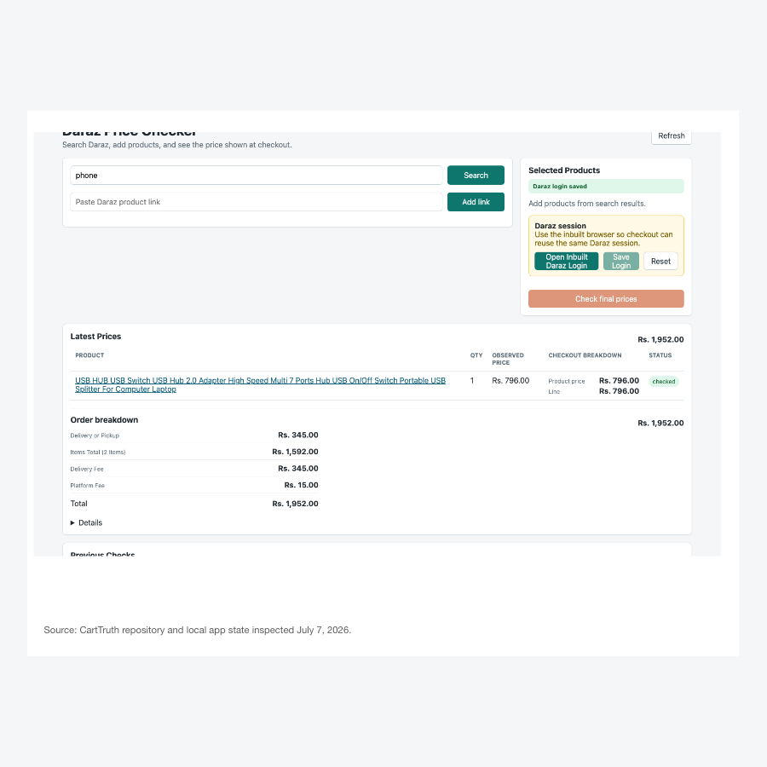
Demo: verify checkout safely
Show the live path
Dashboard -> saved product -> queued check -> checkout breakdown -> evidence artifact.
Backup if the live flow stalls
Open a recent completed run while the new checkout job continues in the background.
Notes:
2:40-4:40
Now I will show the working product. First, this is the CartTruth dashboard where we save Daraz product links. CartTruth reads the product-page price, but that is only the starting point. Next I will show a checkout check. The job opens the Daraz flow using the saved session and returns the run result. Here you can see product price, delivery or platform charges, vouchers if available, and the final total. CartTruth also stores evidence. If the live check takes too long or needs verification, I will open a recent completed run immediately.

Slide 6
Safety and evidence make the result usable
Never purchase
Network guards block order or payment finalization; unsafe purchase labels are refused.
Human verification
OTP, captcha, login, and verification become explicit needs_user_action states.
Evidence trail
Each run stores screenshots, structured JSON, result history, and artifact links.
Secret handling
API keys, cookies, passwords, proxy credentials, and session tokens are masked, hashed, or encrypted.
Notes:
4:40-5:30
What makes CartTruth different from a normal scraper is the safety and evidence layer. It has never-purchase guardrails that block order-finalization and payment-related requests. If Daraz asks for OTP, captcha, login, or manual verification, CartTruth does not bypass it. It marks the job as needing user action. Each run stores screenshots, structured JSON, result history, and redacted artifacts. The output is a verifiable record, not just a scraped number.

Slide 7
TorchProxies gives checkout checks a real-shopper route
Accuracy
MVP today
Roadmap
Why it matters
Checkout totals can vary by IP region, account session, delivery location, and promotion rules.
Supported now
CartTruth can use a configured TorchProxies ISP or residential profile, with masked credentials and telemetry.
Next controls
Country preference, sticky sessions, rotation, and fallback controls are preview settings until routing support lands.
Notes:
5:30-6:20
CartTruth also integrates TorchProxies for more realistic checkout verification. This matters because ecommerce pricing and availability can depend on the shopper's network location. CartTruth can route Daraz browser and checkout traffic through a configured TorchProxies ISP or residential profile, while masking proxy credentials. To be accurate about the MVP, advanced controls like requested country preference, sticky sessions, rotation, and fallback are preview settings and part of the routing roadmap.

Slide 8
REST and MCP turn CartTruth into infrastructure
One verifier, three surfaces
REST API
Save links, queue jobs, poll status, read runs, and fetch evidence artifacts with scoped ct_ API keys.
Dashboard for humans. REST for systems. MCP for AI agents that need safe checkout evidence without controlling payments or credentials.
MCP server
Agents can list links, queue checks, and read run evidence, but cannot save credentials or drive the browser.
Notes:
6:20-7:05
CartTruth is not only a dashboard. Users can create scoped API keys for REST, MCP, or both. Through the REST API, systems can add links, queue checks, list jobs, read completed runs, and retrieve evidence. Through MCP, AI tools can use CartTruth as a safe checkout verification tool. This matters because AI agents should not freely improvise checkout browser automation.

Slide 9
The roadmap turns the MVP into a pilotable platform
Now
Next
Pilot
Harden Daraz
Improve extraction coverage, product matching, blocked-state handling, and evidence review.
Deepen routing
Apply live country routing, sticky and rotation controls, and proxy health dashboards.
Expand by adapter
Recruit 2-3 sellers or commerce teams and add the next checkout adapter from pilot needs.
Notes:
7:05-7:40
We are starting with a focused beachhead: Daraz Sri Lanka checkout verification. The next milestones are clear: harden the Daraz workflow, complete advanced proxy routing, improve evidence reports, expand adapters, and run pilots with users who already check prices manually.

Slide 10
CartTruth
Pilot Ask
July 2026
Help us validate final-checkout verification with real Daraz users who check prices manually today.
Notes:
7:40-8:00
Our ask is simple: help us validate CartTruth with users who regularly need to prove final checkout prices. CartTruth gives them one reliable answer to a messy ecommerce question: what is the real price at checkout?

