Slide 1
shown price
CartTruth
fees
Checkout price verification for marketplaces, sellers, and commerce teams.
vouchers
checkout total
Project deck | July 2026
01

Slide 2
The checkout total is where ecommerce trust breaks
Product pages show the promise. Checkout reveals the real price.
Price drift
Operational risk
Automation gap
Delivery, platform fees, service fees, tax, vouchers, and quantity rules can change the final amount.
Support teams need evidence when shoppers, sellers, and marketplaces disagree about the total.
Existing systems often know catalog prices, but not what a real account sees at checkout.
40%
abandoned because extra checkout costs were too high
64%
top ecommerce checkouts performed mediocre or worse
1
source of truth: the final payable total customers remember
Sources: Baymard UX statistics and Checkout UX benchmark; CartTruth product analysis.
CartTruth project deck
02

Slide 3
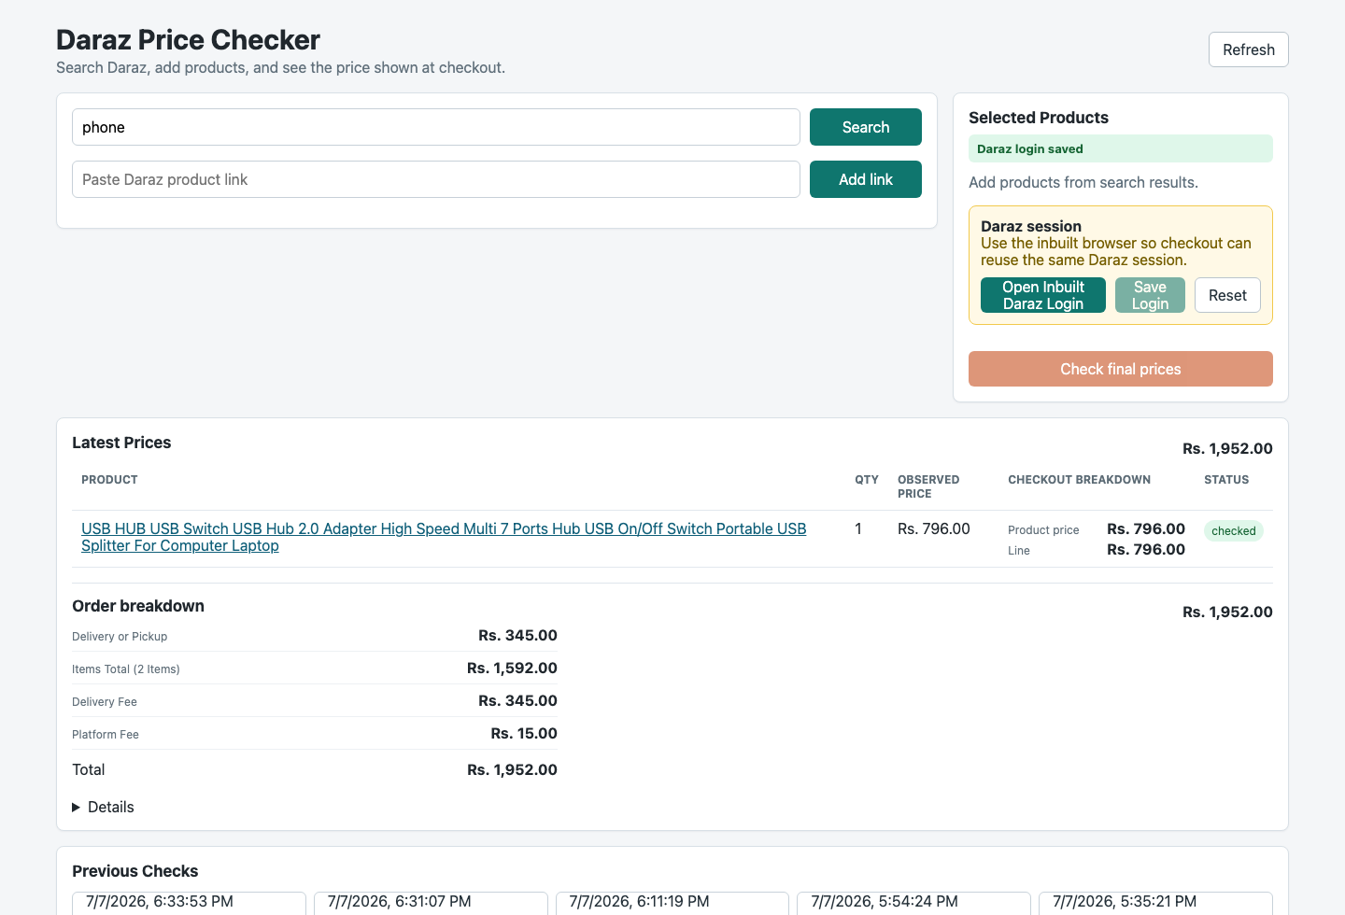
CartTruth already proves the Daraz workflow end to end
Current product surface, based on the local web app.
Search or paste
Find Daraz products through search or a direct product link.
Select quantities
Build a selected product list and recalculate product-page prices.
Save login
Use an inbuilt Daraz browser so checkout sees the same account session.
Read checkout
Capture product price, line price, delivery, platform fee, vouchers, and total.
Keep evidence
Store screenshots, JSON extraction data, run history, and artifact links.
Source: CartTruth repository and local app state inspected July 7, 2026.
CartTruth project deck
03

Slide 4
The product acts like a careful buyer, then stops before purchase
1
Input
2
Session
3
Product read
A user searches Daraz or pastes a product URL, then selects products and quantities.
The inbuilt browser captures and validates a saved Daraz login profile.
Playwright opens each product page and records the observed product-page price.
4
Cart isolation
5
Checkout extraction
6
Evidence
The app navigates to cart, selects only requested products, and adjusts quantities.
It loads checkout, parses line prices, fees, vouchers, delivery, and order total.
The result writes JSON and screenshots so humans or systems can review the finding.
Guardrail: CartTruth blocks order-finalization requests and never submits payment or purchase actions.
CartTruth project deck
04

Slide 5
Safety and evidence make the result usable, not just scraped
Never-purchase guard
Session status
Network routes abort order/payment/finalization requests. Unsafe purchase button labels are refused before click.
The app reports missing, saved, needs-login, needs-verification, unknown, and live browser states.
Blocker classification
Audit trail
CAPTCHA, blocked traffic, login requirements, unavailable products, and manual attention become explicit statuses.
Each run writes selected products, extraction data, screenshots, final result JSON, and redacted artifacts.
This is the difference between screen scraping and a verification workflow that a support, QA, or platform team can trust.
Source: CartTruth core safety, redaction, evidence, and Daraz service modules inspected July 7, 2026.
CartTruth project deck
05

Slide 6
The codebase is already shaped like a multi-retailer platform
Experience
Contracts
Execution
Adapters
Evidence
React web app
CLI runner
Local API server
Zod request/result schemas
Money and comparison helpers
Status and failure taxonomy
Playwright flows
Session capture
Proxy provider interface
Never-purchase safety
Daraz service for LK flow
Walmart adapter
Target and BestBuy scaffolds
Mock adapter for tests
Run directories
Screenshots
JSON reports
Artifact endpoints
Design implication: REST and MCP do not require a rewrite. They expose the same runner, schemas, adapters, and evidence model through new contracts.
CartTruth project deck
06

Slide 7
The market is large because checkout accuracy touches every online order
$28T
$3.88T
$3.0B
40%
business ecommerce sales across 45 economies in 2024
global consumer ecommerce revenue forecast for 2026
Sri Lanka ecommerce revenue projected by 2028
checkout abandonment tied to extra costs
UNCTAD
Statista
ECDB via The Morning
Baymard
CartTruth does not need to own checkout or payments. It can sit in the verification layer that protects price accuracy before money moves.
Wedge
Start where checkout totals are most opaque, then expand by retailer adapter and client integration.
Sources: UNCTAD Data Hub 2024 update; Statista eCommerce Worldwide Market Forecast; Baymard UX statistics; The Morning citing ECDB.
CartTruth project deck
07

Slide 8
Daraz is the beachhead; the platform expands by adapter and account
Beachhead: Daraz Sri Lanka
Expansion path
A focused marketplace flow gives CartTruth a concrete, local use case where delivery, vouchers, fees, and session state materially change the payable total.
Each new adapter adds a retailer-specific checkout reader while preserving the same input contract, safety layer, evidence trail, and status model.
Best early users
Higher-value clients
Deal hunters
Marketplace sellers
Support teams reproducing complaints
Retail QA teams
Ecommerce operations
Fintech and offer partners
AI automation teams
Sources: CartTruth current Daraz implementation; Daraz Sri Lanka market page for local ecommerce context.
CartTruth project deck
08

Slide 9
REST and MCP turn CartTruth into infrastructure
REST API
MCP server
For existing client systems
For AI agents and analyst workflows
POST /checks
GET /runs/:id
GET /runs/:id/artifacts
POST /sessions
Webhook on completed, blocked, needs_attention
Auth, quotas, adapter health, and evidence retention
Tools: check_cart_total, search_product, read_run
Resources: run JSON, screenshots, adapter status
Prompts: investigate price delta, summarize evidence
Transports: local stdio first, hosted HTTP later
Same engine, two surfaces: deterministic APIs for software, MCP primitives for models that need tools and context.
Sources: Model Context Protocol specification 2025-06-18; official TypeScript SDK docs; CartTruth local API endpoints.
CartTruth project deck
09

Slide 10
A practical go-to-market can start with paid verification workflows
Segment
Pain
CartTruth offer
Pricing hypothesis
Marketplace sellers
Final price and voucher outcome is hard to monitor.
Saved product lists, scheduled checks, evidence history.
Pro subscription plus check quota.
Ecommerce QA
Pricing releases can break totals across regions and accounts.
Scenario files, CI/API checks, adapter health reports.
Team plan or usage-based runs.
Support and compliance
Disputes need reproducible proof.
Read-only evidence bundles with redacted screenshots.
Seat-based review access.
AI / automation teams
Agents need a safe checkout tool, not browser improvisation.
MCP tools, resources, and prompts on top of REST contracts.
Platform plan with MCP/API limits.
The first commercial proof does not require a broad marketplace. It requires a few repeat users who already lose time validating checkout outcomes manually.
CartTruth project deck
10

Slide 11
Next milestones turn a working checker into a pilotable platform
01
Harden Daraz
Improve extraction coverage, product matching, privacy redaction, and blocked-state handling.
02
Formalize REST
Publish request/result contracts, API keys, webhooks, hosted evidence, and adapter health endpoints.
03
Ship MCP
Expose search, check, read-run, and evidence resources for agentic client workflows.
04
Add adapters
Package the adapter SDK and implement the next marketplace or retailer path.
05
Run pilots
Recruit 2-3 sellers or commerce teams and measure saved time, dispute quality, and repeat usage.
Ask: approve the API + MCP roadmap and start pilot discovery with real checkout-verification users.
CartTruth project deck
11

