Slide 1
Springleaf marketing response
seminar presentation (AML-R)
Marcus Cramer
Markus heuchert

Slide 2
Determine whether to send a direct mail piece to a customer
Kaggle challenge from August 2015
Binary classification problem
1.934 anonymized variables
150.000 labels records for training
Major challenges
binary classification problem
150.000
labeled training records
1.934
anonymized attributes

Slide 3







approach
Crisp-dm framework for data mining and predictive analytics
Business Understanding
Data Understanding
DATA
Data Cleaning
Deployment
Modeling
Evaluation

Slide 4
Agenda
Data Understanding
Data Cleaning
Modeling
Evaluation

Slide 5
Imputation
prettify
Done with mi package (15 iterations/attribute)
The algorithm iteratively draws imputed values from the conditional distribution for each variable given the observed and imputed values of the other variables in the data.
The imputation of one attribute is based on the top 5 highest spearman correlating attributes for performance reasons
Factors are not imputed

Slide 6
Imputation concept
Imputation by chained equations impractical on all attributes at once
Selection of helpful attributes for imputation of attribute a required and done through:
High value correlation
“Missingness” pattern correlation below threshold
High correlating attributes are good basis for imputation
(Pearson cor. on boolean-casted data)
We do not want helpuful attributes to be missing as well when a is missing
… but can be missing as well in the to-be-imputed record

Slide 7
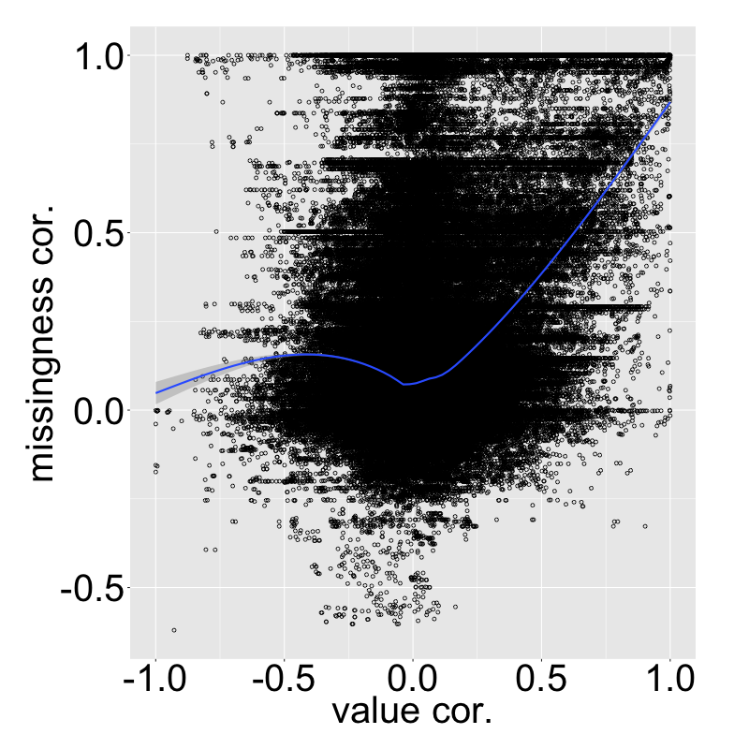
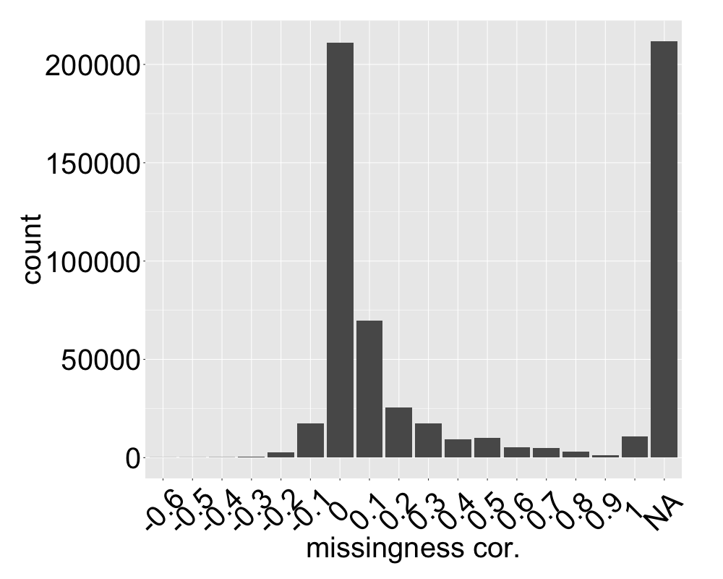

Slide 8
example: impute v1
Values
Missingness
V1 | V2 | V3
NA | 10 | NA
2.3 | 7 | 1.2
1.8 | 3 | 0.2
0.2 | 1 | 0
NA | NA | NA
V1 | V2 | V3
T | F | T
F | F | F
F | F | F
F | F | F
T | T | T
V1 and V3 have high value correlation, but also high missingness correlation → V3 is no imputation candidate
V1 and V2 show less missingness correlation and the values are correlated → V2 is imputation candidate

Slide 9
Options
prettify
Sample
Increase sample size
Imputation
Numerical
Change number of top correlating attributes used for imputation
Use random attributes instead of top correlating ones
Factors
Also impute factor NAs instead of treating them as a level

Slide 10

Modeling
What?
Why?
How?
SVM
42
ABCD
RF
XGB
dfd

Slide 11
Receiver operator characteristic
Area under curve (AUC) as the performance criterion
ROC curves visualize binary classification performance
The better a classifier, the closer its curve is to the top-left corner
The threshold of a classifier defines a point on the curve
AUC summarizes the performance and is between 0 and 1
P(TP)
P(FP)
random guess
classifiers
Notes:
P(TP)=probability of detection, sensitivity
AUC is equal to the probability that a classifier will rank a randomly chosen positive instance higher than a randomly chosen negative one (assuming 'positive' ranks higher than 'negative')

Slide 12
Boosting (Additive learning)
algorithms which convert weak learners into a strong learner
Boosting algorithms fit iteratively weak learners of the same type
Small decision trees for instance
Next iteration focuses on previously misclassified data
Adding up all learners with weights gives a powerful learner
Learner 1
Weighted Data
Learner 2
Weighted Data
…

Slide 13
eXtreme gradient Boosting (xgboost)
Popular boosting algorithm
Each new model gradually optimizes the objective, which is approximated through Taylor expansion
For binary classification, simple decision trees are fitted
Subsampling of predictors and data as in bagging is used
Plenty of customization possible
XGBoost has won many Kaggle competition, due to its
Power
Speed
Customization
http://datascience.stackexchange.com/questions/10943/why-is-xgboost-so-much-faster-than-sklearn-gradientboostingclassifier
Notes:
Simple = max depth

Slide 14
xgboost
Each model is an ensemble of weak classifiers (trees)
We make predictions by summing up predictions from each tree
Each step adds one tree
LogLoss loss function for binary classification
We can assign a score analytically with the best solution, because it is quadratic (for L)

Slide 15






Xgboost
From Voscorts presentation
gradient boosting framework
XGBoost is short for eXtreme Gradient Boosting
Scalable and flexible gradient boosting framework
Supports multiple languages
Many Kaggle competitions were won with XGBoost

Slide 16
What makes the difference
From Voscorts presentation
Difference between gbm and xgboost
Performance
Regularization
Prune on full binary trees
Speed
Parallel Processing with OpenMp
Customization
Custom optimization objectives
Parameter tuning

