Slide 1
Springleaf marketing response
seminar presentation (AML-R)
Marcus Cramer
Markus heuchert

Slide 2
Agenda
Approach
Data Understanding & Cleaning
Modeling & Evaluation

Slide 3
Intro slide
Kaggle challenge
Binary outcome
150k records in train/test
Major challenges

Slide 4








crisp-dM
framework for data mining and predictive analytics
Business Understanding
Data Understanding
Learnings
Leading methodology for analytics, data mining, data science projects
six phases, each with subtasks
Multiple iterations possible
DATA
Data Cleaning
Deployment
Modeling
Evaluation

Slide 5
Different attribute types must be handled seperately
No of categoricals update
Number of attributes per attribute type

Slide 6
Beautify
Different NA encodings
Obvious NAs: -1 (all other values positive), [], blank
More sophisticated:
Find columns with negative mean of unique values and remove outliers -> results in positive mean of unique values -> outlier = -99999 -> NA encoding
Take mean of unique values and mean of unique values minus one extremum on both sides -> if first value is more than 10 times higher than second value, we probably have an illogically high maximum value -> this is the case for 1+e09, 9999, 99, 100
Sometimes, the second highest value also seems to be some sort of NA encoding (same approach as above but removed second maximum too) -> 9996, 9998, 98
For other columns, a couple of extreme outliers exist. The maximum of extreme outliers is 5 values, which are more than 10000 times higher than the rest in the same column -> 999999999, 999999998, 999999997, 999999996, 999999995, 999999994
Everything double checked for plausibility with random manual samples
Made sure that data is unlikely to be factors (then these encodings might stand for sensible values)

Slide 7
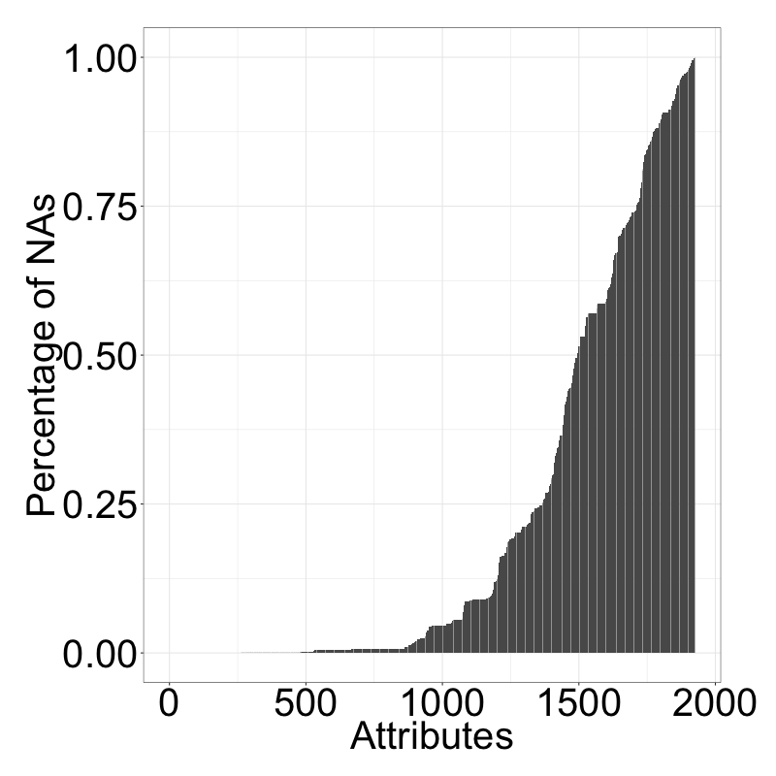
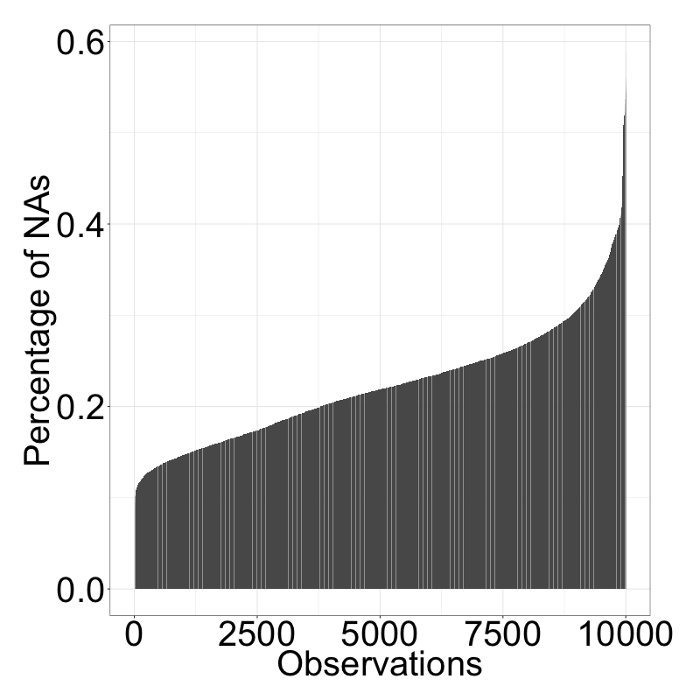
Number of Nas varies a lot per attribute and observation
X axis
NA values per attribute in %
NA values per sample in %

Slide 8
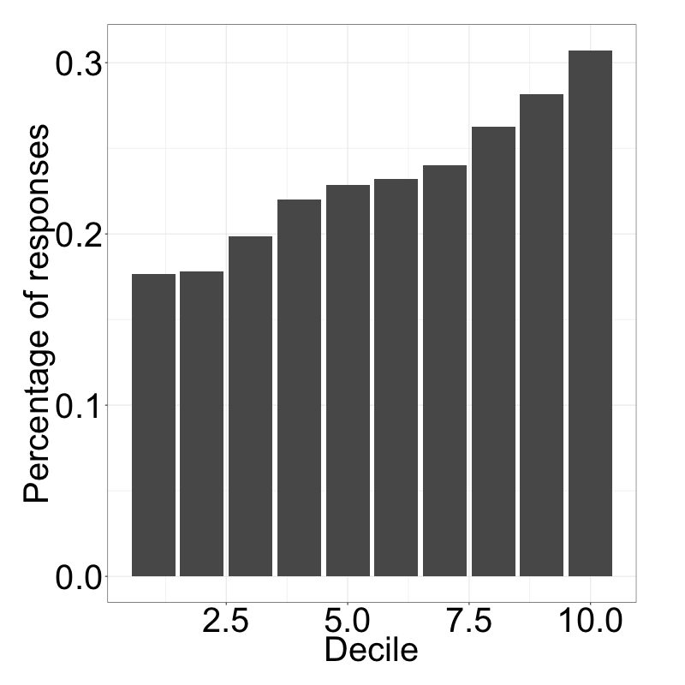
Completeness of observation highly impacts target variable
Incompleteness of sample

Slide 9
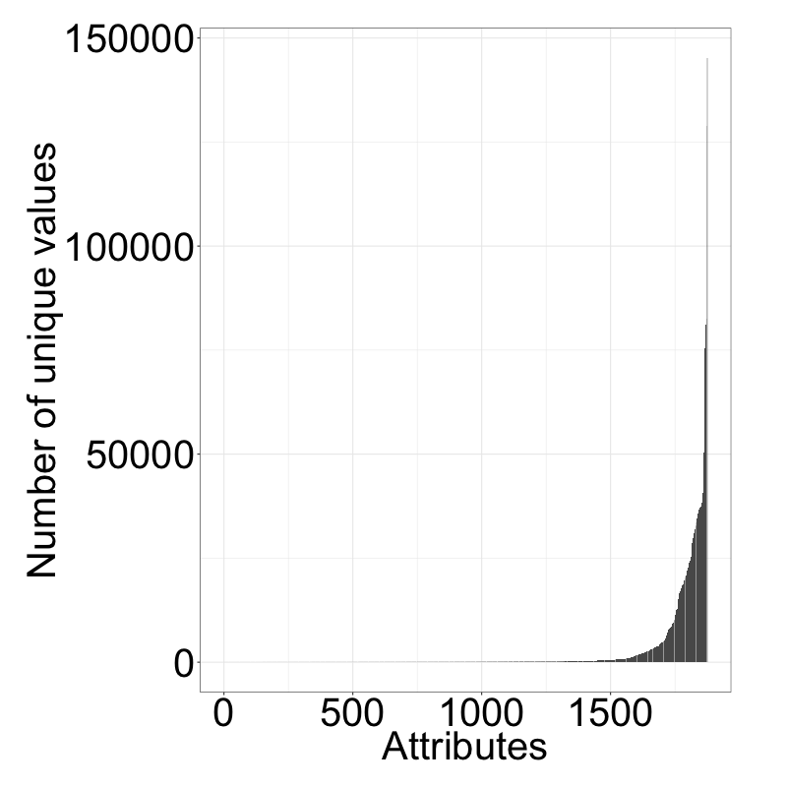
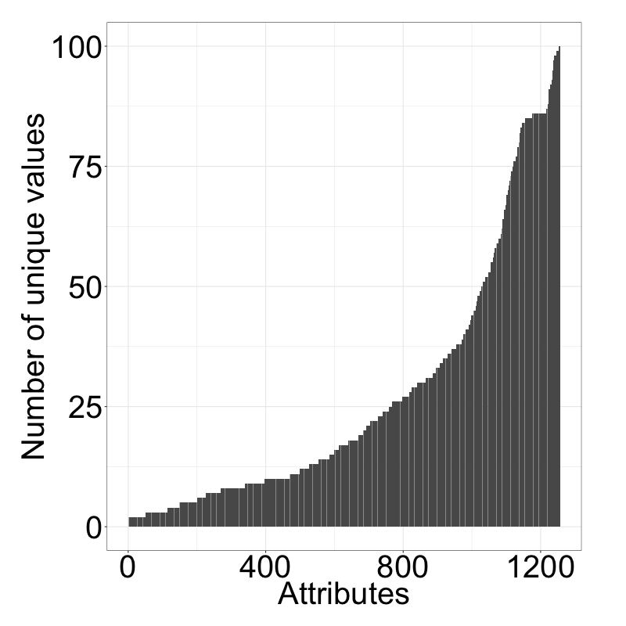
Numerical/categ. values hard to differentiate via “elbow-criterion”
Number of unique values per attribute
Number of unique values (<101)

Slide 10
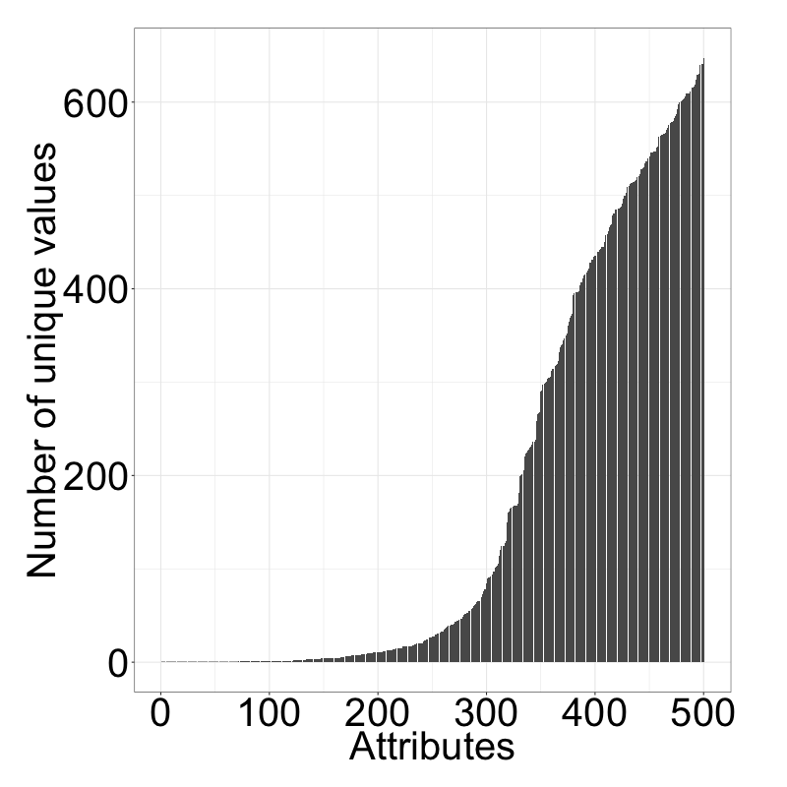
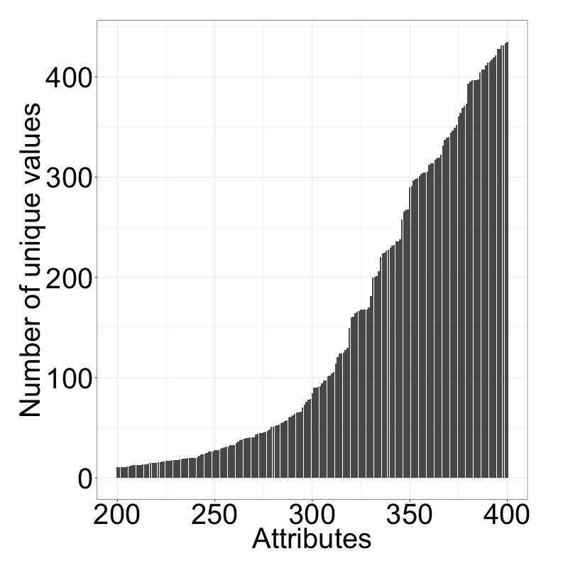

Elbow criterion applied to variances of unique values more insightful?
Var. between unique values (lowest 500)
Var. between unique values (200-400)
Elbows?
Elbow?
Highest difference between the 349. and the 350. attribute. We therefore assume, that the attributes 1-350 (sorted by variance) are candidates for categorical attributes.

Slide 11
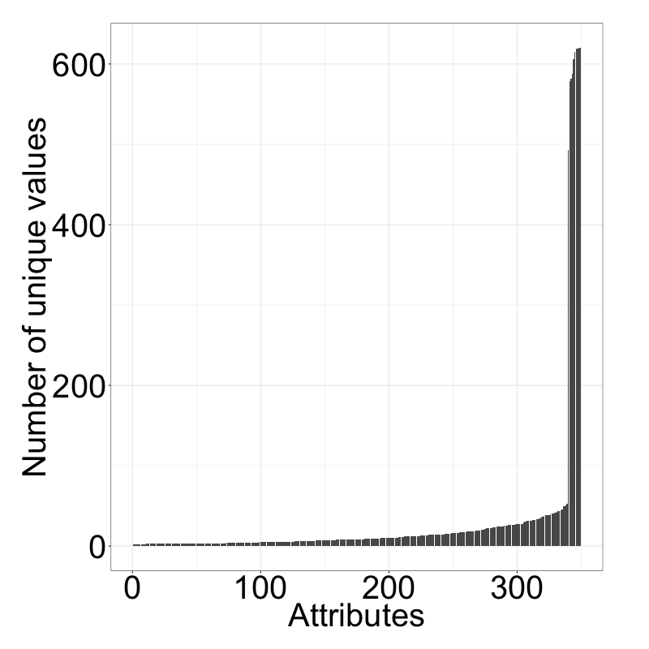
Reapplying this to the number of unique values reveals drastic elbow
Number of unique values per attribute
Highest gap between 339 and 340, it seems reasonable that out of the 339 attributes with the lowest variances, the attributes with the lowest number of unique values are categorical. All these attributes have less than 54 unique values.
Elbow
We identified 339 attributes, that are likely to be categorical. This is just a rough estimate, however, as the meaning of attributes is unknown.

Slide 12
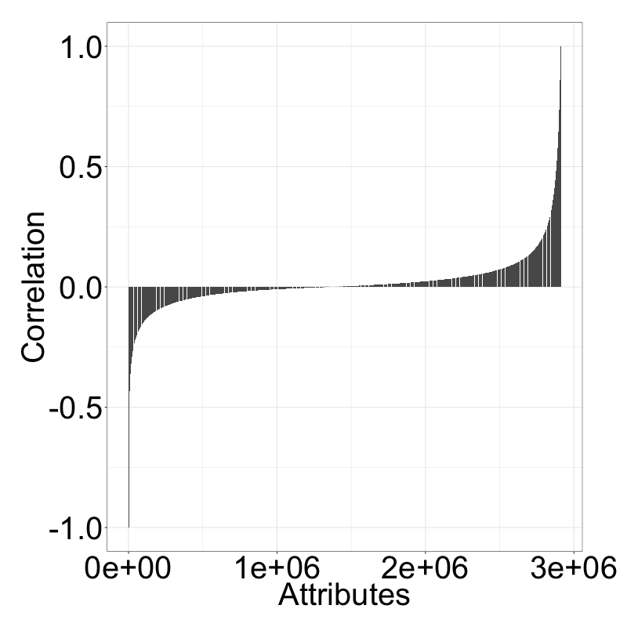
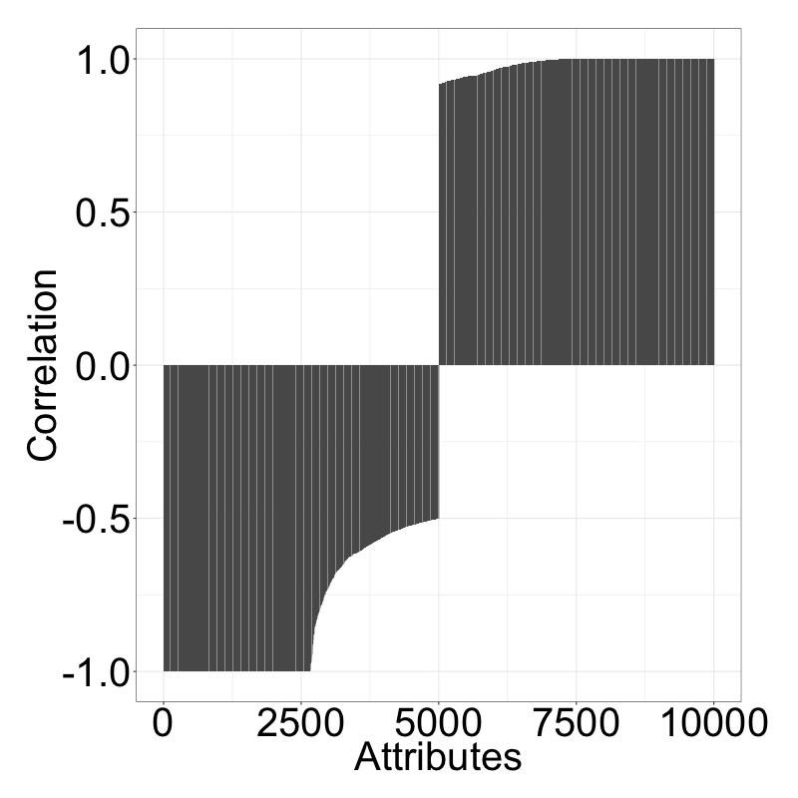
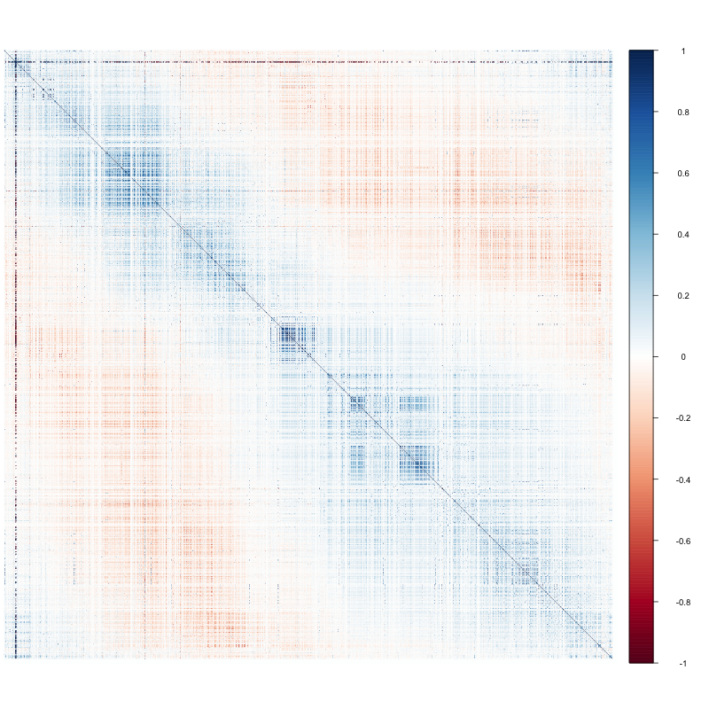
Attributes are fairly uncorrelated according to pearson coef.
Which plots?
Correlations between all attributes
5000 lowest and highest correlations

Slide 13
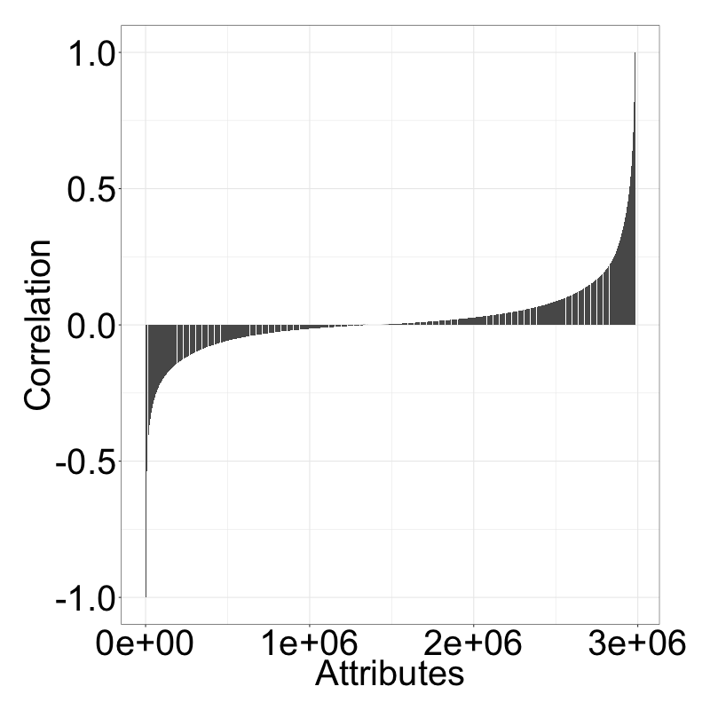
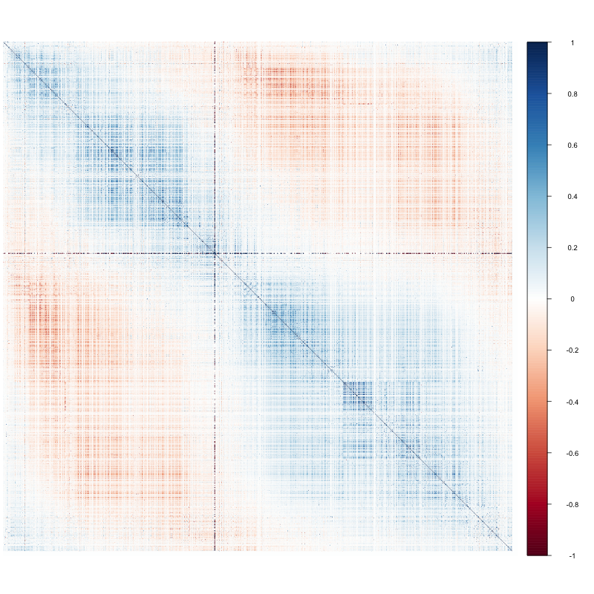
Spearman reveals higher correlation according to rank of att. values
Which plots?
Correlations between all attributes
5000 lowest and highest correlations
38 entries with a correlation of 1 and 10 entries with a correlation of -1 could be identified (out of these 40 unique attributes). We can therefore remove these 40 attributes.

Slide 14
Imputation
prettify
Done with mi package (15 iterations/attribute)
The algorithm iteratively draws imputed values from the conditional distribution for each variable given the observed and imputed values of the other variables in the data.
The imputation of one attribute is based on the top 5 highest spearman correlating attributes for performance reasons
Factors are not imputed

Slide 15
Options
prettify
Sample
Increase sample size
Imputation
Numerical
Change number of top correlating attributes used for imputation
Use random attributes instead of top correlating ones
Factors
Also impute factor NAs instead of treating them as a level

Slide 16
Modeling
What?
Why?
How?

Slide 17
Boosting
From Voscorts presentation
Learn from the failures of the previous Classifier
Multiple classifier of the same type
Mostly weak classifiers
Iteratively procedure
Future classifiers focus on misclassified data
Learner weighted according to accuracy
Many boosting algorithms
Adaboost, BrownBoost, xgboost, LogitBoost, …
Decision Tree 1
Decision Tree 2
Decision Tree 3
Decision Tree 1
Weighted Data
Decision Tree 2
…

Slide 18






Xgboost
From Voscorts presentation
gradient boosting framework
XGBoost is short for eXtreme Gradient Boosting
Scalable and flexible gradient boosting framework
Supports multiple languages
Many Kaggle competitions were won with XGBoost

Slide 19
What makes the difference
From Voscorts presentation
Difference between gbm and xgboost
Performance
Regularization
Prune on full binary trees
Speed
Parallel Processing with OpenMp
Customization
Custom optimization objectives
Parameter tuning

